Slide 1
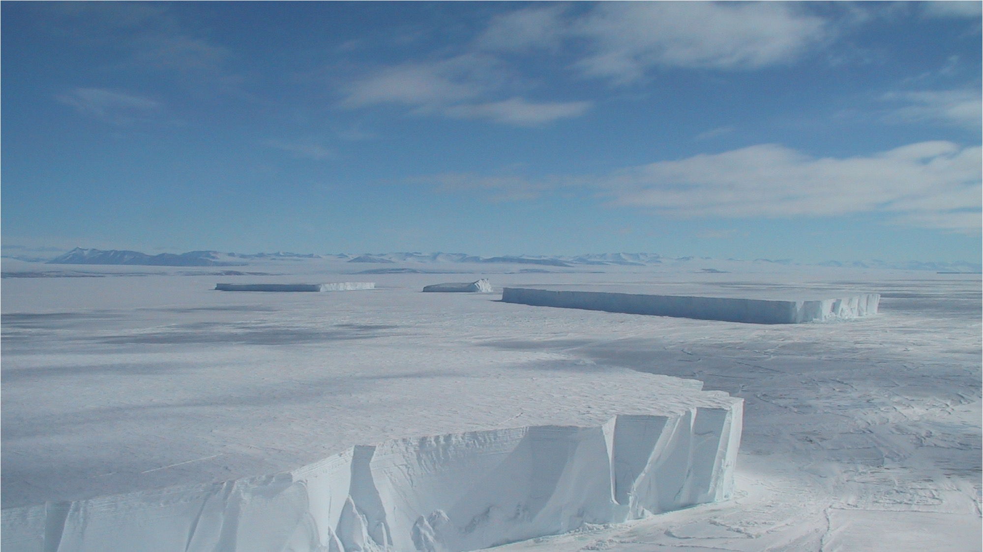


2022 Introduction to SCAR
US-SCAR is supported by
NSF Office of Polar Programs
Section of Antarctic Sciences

Slide 2
NSF Funding for US-SCAR
Travel support for US scientists to attend SCAR science
meetings, especially early career researchers
Travel support for delegates and representatives to
attend SCAR business meetings
US-SCAR website
US-SCAR mail list
US-SCAR intern and fellow
Facilitate wider interactions within the US Antarctic Community and increased participation of US scientists in SCAR

Slide 3

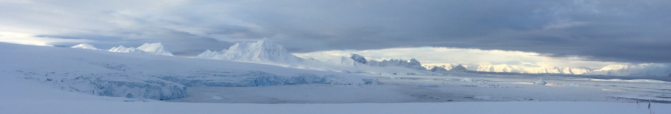
What is SCAR?
www.scar.org
An interdisciplinary scientific body of the International Science Council (ISC)
Established in 1958 to continue the international scientific cooperation that was a hallmark of the International Geophysical Year (IGY)
www.SCAR.org
Sign up for the SCAR Newsletter
34 member countries
9 ISC unions
11 associate member countries
Notes:
including US

Slide 4
www.scar.org
SCAR’s Mission for 60+ Years
Science Leadership: initiate, develop and coordinate high quality international scientific research in the Antarctic and Southern Ocean region
Scientific Advice: provide objective and independent scientific advice to the Antarctic Treaty System (ATS) and other bodies ⎯ e.g., the Intergovernmental Panel on Climate Change (IPCC), Intergovernmental Science-Policy Platform on Biodiversity and Ecosystem Services (IPBES)
Notes:
no funding

Slide 5
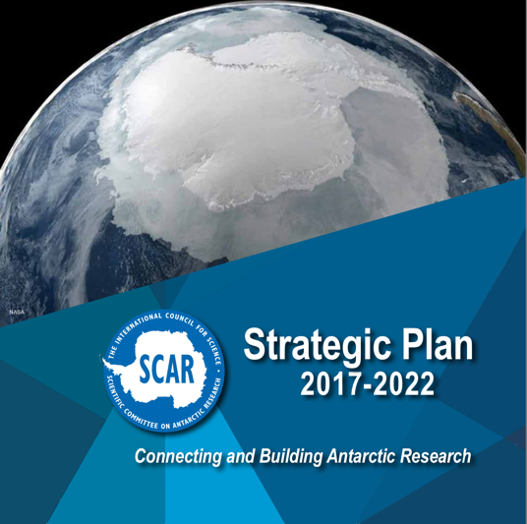
SCAR Strategic Plan
www.scar.org
Expand collaborative and visionary Antarctic research;
Offer scientific advice to the Antarctic Treaty System and other organizations;
Enhance research capacity in member countries;
Enhance public awareness and understanding of Antarctic issues; and
Facilitate unrestricted and free access to Antarctic research data.
New Strategic Plan in development for 2023-2028

Slide 6
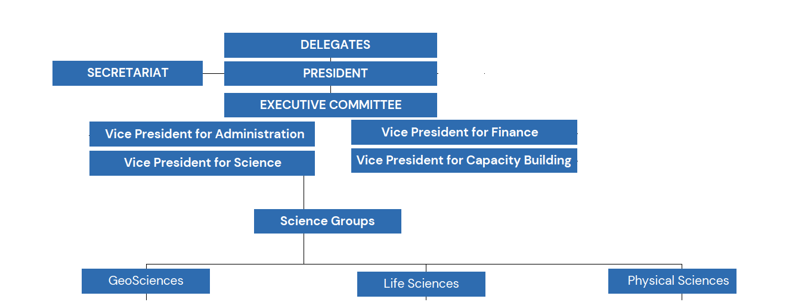
www.scar.org
SCAR Organization
SCAR Executive Committee
President: Yeadong Kim, Korea
Vice-Presidents:
Finance, Jefferson Simoes, Brazil
Science, Deneb Karentz, United States
Capacity, Muthalagu Ravichandran, India
Administration, open
SCAR Secretariat (Cambridge, UK)
Executive Director: Chandrika Nath
Executive Officer: Eoghan Griffin
Communications Officer: Johanna Grabow
Administrative Officer: Rosemary Nash
34 countries, 9 ISC unions,
plus 11 associate countries
Notes:
slide 6

Slide 7
www.scar.org
How Does SCAR Accomplish its Mission?
National Representation: Delegate and Alternate Delegate
Science Groups: National representatives (up to four)
US National Committee for SCAR = Polar Research Board, National Academies

Slide 8

US-SCAR Team
Delegate: Deneb Karentz
Alternate Delegate: Allan Weatherwax
Representatives to the Science Groups
Geosciences: Peter Doran, Samantha Hansen, Julia Wellnner
Life Sciences: Byron Adams, Chuck Amsler, George Watters
Physical Sciences: John Cassano, Lu Lu, Kirsty Tinto
PRB liasons: Laurie Geller, April Melvin
Webmaster: Joe Souney
US-SCAR fellow: Lynn Kaluzienski
US-SCAR intern: Kevin Galvin

Slide 9
www.scar.org
How Does SCAR Accomplish its Mission?
Delegates and Science Group business meetings every two years – 2022 India, 2024 Chile, 2026 Norway
SCAR Open Science Conference every two years –
2022 India, 2024 Chile, 2026 Norway
SCAR Biology Symposium (2023 New Zealand) and SCAR International Symposium on Antarctic Earth Sciences – each every four years
Participate in Antarctic Treaty Consultative Meeting every year
Capacity Building, Education and Training Program (CBET)
People like you
Notes:
fellowships
visiting scholars
medals

Slide 10
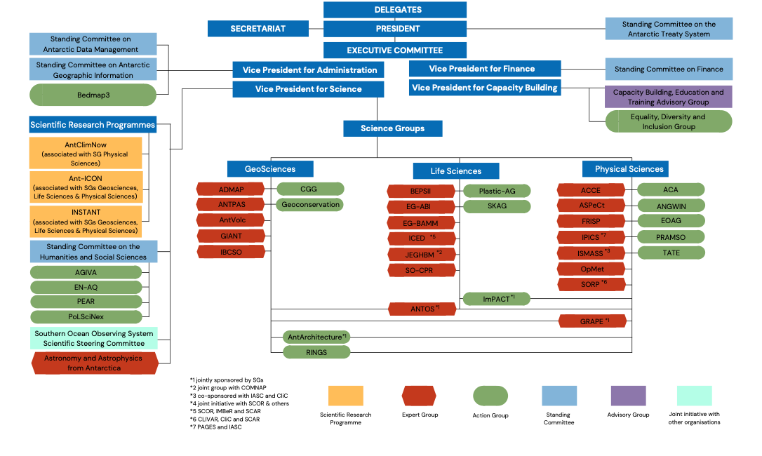
SCAR Organization
www.scar.org
Science Groups: GeoSciences, Life Sciences, Physical Sciences
Scientific Research Programs: focused initiatives (6 years)
Expert Groups: broad focus (6-8 years)
Action Groups: address a specific issue (2-4 years)
Standing Committees
Joint Initiatives
Notes:
slide 10

Slide 11
US representatives
John Cassano
Lu Lu
Kirsty Tinto
SCAR Physical Sciences Group
SCAR PSG Officers
Chief Officer: David Bromwich (term ending in 2022)
Deputy Chief Officer: Adriana María Gulisano
Secretary: Steve Colwell (term ending in 2022)

Slide 12
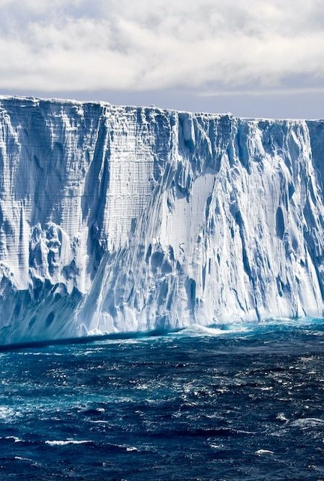
Overview of the Physical Sciences Group
Processes at the interfaces between ice, ocean, land and atmosphere
Describe and predict the response to climate change
Understanding of ice sheet dynamics
Extracting climate records from the ice sheet
Exploring processes and changes in sea-ice and ocean circulation
Improving understanding of atmospheric dynamics and chemistry and the role of the ozone hole in Antarctic climate
A distinct component of physical sciences research in Antarctica is based on the unique properties of the continent that favour its use as a platform for astronomical and solar-terrestrial observations.
PSG primarily acts through its subsidiary groups
Credit: SmartWater Magazine

Slide 13
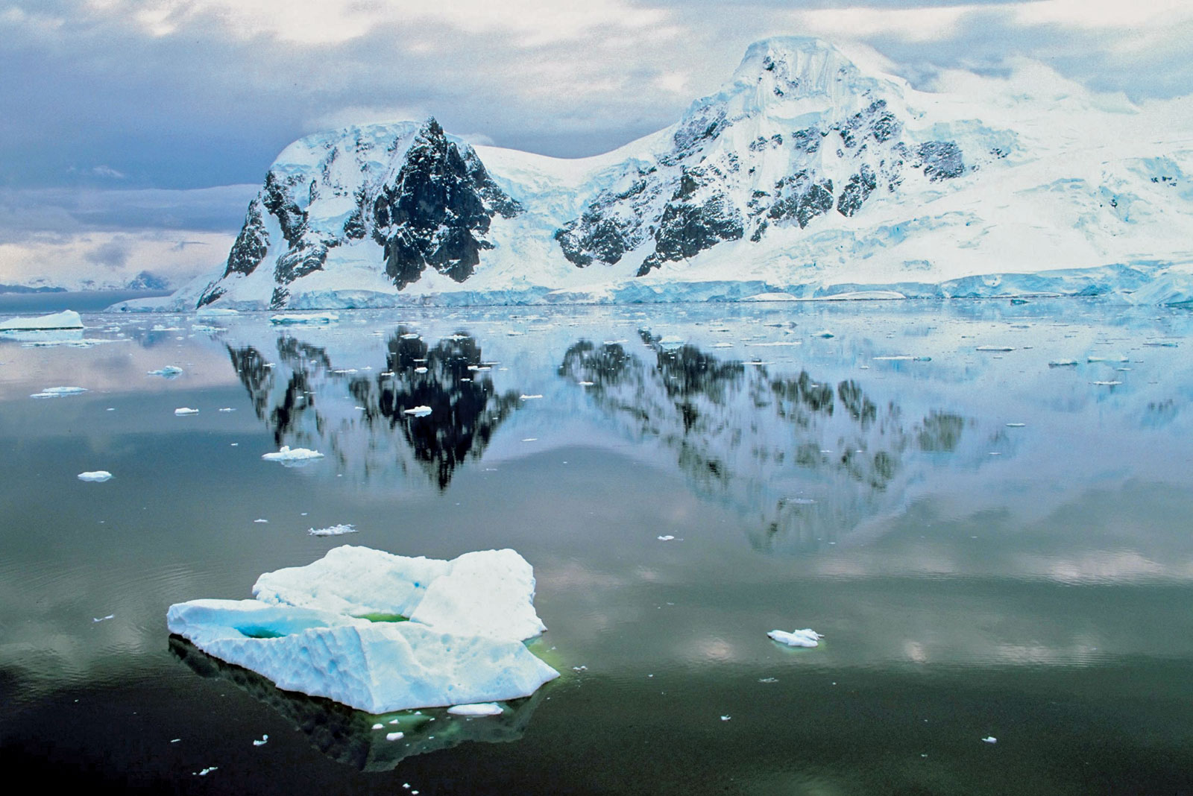
Scientific Research Programme:
AntClim^{now} aims to answer fundamental science questions (as identified by the SCAR Horizon Scan), relating to Antarctic Climate variability. The programme aims to take a regional approach to observing and modelling the Antarctic environment, but taking an integrated approach that will consider the Antarctic as a whole.
Contact: Tom Bracegirdle and Ilana Wainer.
Near-term variability and Prediction of the Antarctic Climate System (ANTCLIMNOW)
© Jupiterimages—Photos.com/Getty Images

Slide 14
Scientific Research Programme:
The Ant-ICON SRP will answer fundamental science questions (as identified by the SCAR Horizon Scan), relating to the conservation and management of Antarctica and the Southern Ocean and focus on research to drive and inform international decision-making and policy change.
Contact: Aleks Terauds and Mecha Santos
Integrated Science to Inform Antarctic and Southern Ocean Conservation (Ant-ICON)
© Jupiterimages—Photos.com/Getty Images

Slide 15
Scientific Research Programme:
The INSTANT SRP will address a first-order question about Antarctica’s contribution to sea level. It encompasses geoscience, physical sciences and biological sciences, of the way in which interactions between the ocean, atmosphere and cryosphere have influenced ice-sheets in the past, and what expectations will be in the future with a special focus on quantifying the contributions to global sea level change. They aim to quantify the Antarctic ice sheet's contribution to past and future global sea-level change.
Contact: Tim Naish and Florence Colleoni
INStabilities & Thresholds in ANTarctica (INSTANT)
© Jupiterimages—Photos.com/Getty Images

Slide 16
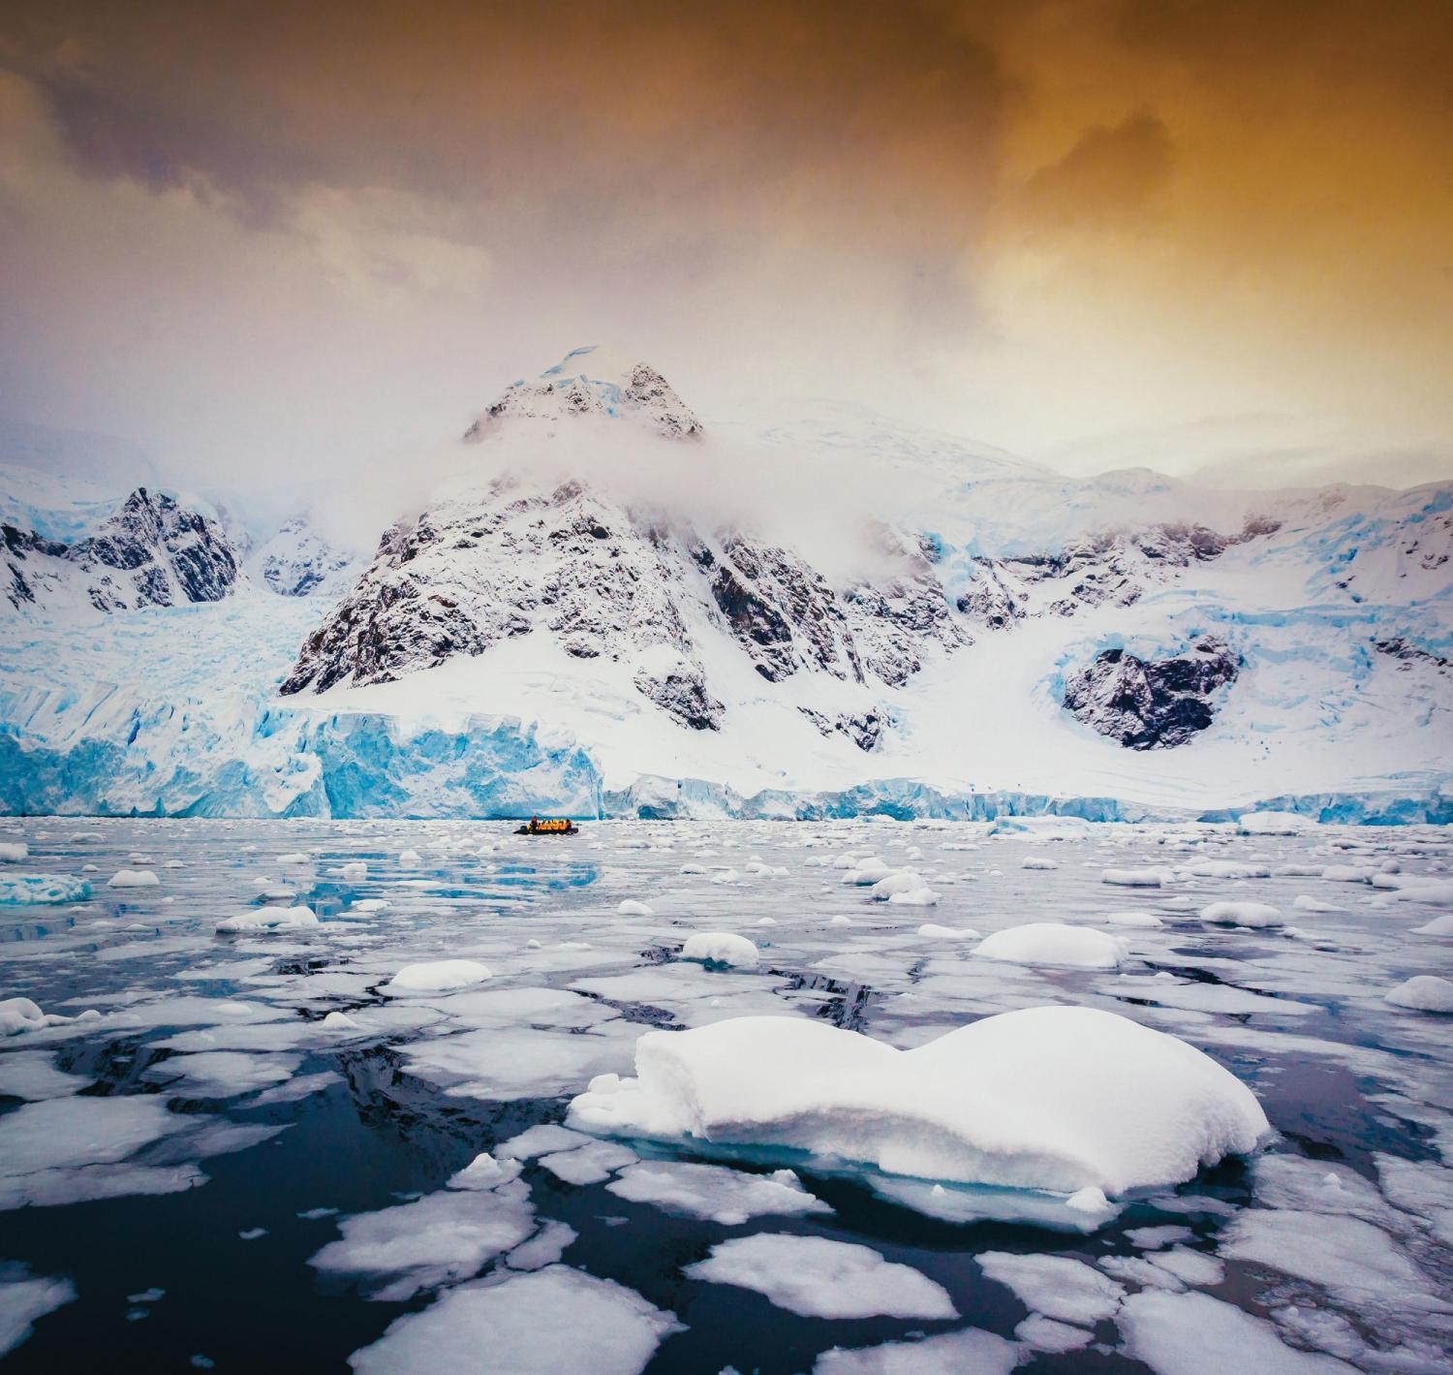
Antarctic Climate Change and the Environment – ACCE
The Expert Group on Antarctic Climate Change and the Environment acts as an umbrella for SCAR activities and produces the yearly update to the ACCE report. (Formerly under PSG now taken over by SCAR Executive)
Antarctic Near-shore and Terrestrial Observing System – ANTOS - Co-sponsored with Geosciences and Life Sciences
The SCAR ANTOS Expert Group aims to establish a biologically focussed, integrated and coordinated Antarctic-wide observation, to identify and track environmental variability and change at biologically relevant scales, and to use this information to inform biological, physical, and earth science studies.
Contacts: Craig Cary and Vonda Cummings.
Antarctic Sea-ice Processes and Climate – ASPeCt
The Expert Group on Antarctic Sea-ice Processes and Climate (ASPeCt) aims to improve our understanding of the Antarctic sea ice zone through focussed and ongoing field programmes, remote sensing and numerical modelling.
Contact: Marilyn Raphael.
Expert Groups
@Getty Images/ David Merron Photography

Slide 17
The Forum for Research into Ice Shelf Processes (FRISP) aims to coordinate the community engaged in research on the glaciological, oceanic and atmospheric processes governing the behaviour of ice shelves that are key to the ice sheet contribution to sea level change.
GNSS (Global Navigation Satellite System) Research and Application for Polar Environment – GRAPE – Co-sponsored with Geosciences
The GNSS (Global Navigation Satellite System) Research and Application for Polar Environment (GRAPE) aims to build and coordinate a robust network of international collaborations to address a variety of weather and space weather related needs at high latitudes and the polar regions (Arctic and Antarctica), through ad hoc data sharing and models development.
Contacts: Giorgiana De Franceschi and Nicolas Bergeot
Southern Ocean Region Panel – SORP
The Southern Ocean Region Panel Expert Group (SORP) aims to coordinate the discussion and communication of scientific advances in the understanding of climate variability and change in the Southern Ocean, and advise CLIVAR, CliC, and SCAR on progress, achievements, new opportunities and impediments in Southern Ocean research.
Contact: Adrian Jenkins.
Forum for Research into Ice Shelf Processes – FRISP
Contact: Torge Martin and Elisabeth Sikes.

Slide 18
International Partnership in Ice Core Sciences – IPICS
The Expert Group for International Partnership in Ice Core Sciences aims to coordinate international collaboration between ice core scientists, engineers, and drillers to aid in providing information about past climate and environmental conditions on timescales from decades to hundreds of millennia.
Operational Meteorology in the Antarctic – OpMet
The Expert Group on Operational Meteorology in the Antarctic (OpMet) aims to establish and nurture links between groups working in the area of operational meteorology in Antarctica, such as the Antarctic Weather and Climate Workshop group, and the WMO EC-PHORS (Panel of Experts on Polar and High Mountain Observations, Research and Services), helping to facilitate monitoring of the meteorological observations that come from Antarctica.
Contacts: Steve Colwell.
Ice Sheet Mass Balance and Sea Level – ISMASS
Contact: Tas van Ommen and Hubertus Fischer.
The Expert Group on Ice Sheet Mass Balance and Sea Level (ISMASS) aims to promote research on the estimation of the mass balance of ice sheets and its contribution to sea level, facilitate coordination among the different international efforts focused in this field; to propose directions for future research; to integrate the observations and modelling efforts, as well as the distribution and archiving of the corresponding data, and to contribute to the diffusion, to society and policy makers, of the current scientific knowledge and achievements in this field of science.
Contact: Heiko Goelzer (Chair); Frank Pattyn (SCAR liaison); Tolly Aðalgeirsdóttir (IASC liaison); and Edward Hanna (CliC liaison).

Slide 19
The SCAR Action Group on Antarctic Clouds and Aerosols (ACA) aims to organise an international large scale campaign to investigate clouds and aerosols in Antarctica through a series of special observing periods when intensive ground-based measurements would be made at the same time as in-situ measurements using instrumented aircraft.
ANtarctic Gravity Wave Instrument Network - ANGWIN
ANGWIN (in the Cornish English dialect ANGWIN means “the white”) is a “scientist driven” concept that is designed to develop a network of Antarctic gravity wave observatories, operated by different nations working together in a spirit of close scientific collaboration, in order to address scientific processes on a polar scale.
Contact: Tom Lachlan-Cope.
Antarctic Clouds and Aerosols – ACA
Contacts: Tracy Moffat-Griffin.
Action Groups
@Getty Images/ David Merron Photography

Slide 20
The RINGS Action Group will (1) clarify the current knowledge gaps at the ice-sheet margin and assess the impacts of new data filling these knowledge gaps, and (2) develop a set of protocols to systematically collect, analyze, and share comprehensive airborne geophysical data. The group will work for two years closely with relevant groups to generate novel synergies addressing highly societally-relevant sea-level questions.
Tropical Antarctic Teleconnections – TATE
The Action Group for Tropic Antarctic Teleconnections (TATE) aims to examine climate processes linking the Tropics to Antarctica.
Contact: Kenichi Matsuoka.
Ice Sheet Margin – RINGS – Co-sponsored with Geosciences
Contact: Sheeba Chenoli.
Earth Observation Action Group - EOAG
The SCAR Earth Observation Action Group (EOAG) aims to be a permanent advocate for the acquisition of all types of satellite data over the Antarctic and Southern Ocean region (up to 60° S) from multiple space agencies, recommending the type of satellite observations needed to measure Essential Climate Variables (ECV’s) relevant to the Polar regions, and recommending how best to preserve the long term continuity of satellite Earth Observation data records
Contact: Anna Hogg.

Slide 21
This Action Group aims to facilitate coordinated investigation of chemical input to the Antarctic region, monitoring the routes through which toxic, environmental contaminants reach the continent.
AntArchitecture Action Group
This Action Group aims to develop a continent‐wide, age‐depth model of Antarctica’s ice using the internal layers and surfaces imaged by radar‐sounding and use this to determine the stability of the Antarctic Ice Sheets over past glacial cycles.
Contact: Susan Bengston Nash and Pernilla Bohlin-Nizzett
Input Pathways of persistent organic pollutants to AntarCTica (IMPACT)
Contact: Robert Bingham

Slide 22
SCAR 2022
Business meetings 27-29 July
Open Science Conference 1-10 August
  Virtual meeting with free registration
Delegates meeting 5-7 September
scar2022.org

Slide 23
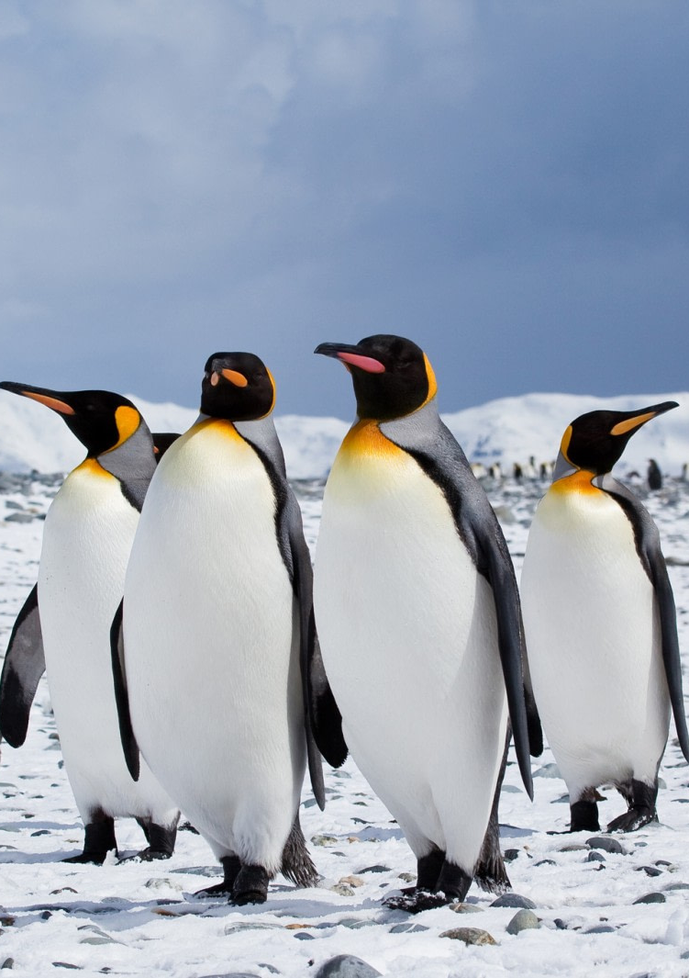
Physical Sciences Group Business Meeting @ SCAR2022
Election of new chief officer and secretary
Proposal for new Scientific Research Program Planning Group - Radio Sciences Research on Antarctic Atmosphere (RESOURCE)
Proposal for RINGS to become an expert group
Proposal for ANGWIN and TATE to extend for 4 more years
Credit: Oceanwide Expeditions

Slide 24
US-SCAR
Please visit our website at www.usscar.org
  Interview series with US Antarctic researchers
    usscar.org/us-antarctic-interview-series
  US Antarctic science directory
    usscar.org/directory
  Polar Science Early Career Community Office (PSECCO)
    usscar.org/news/psecco-opportunities-polar-early-career-scientists
  Subscribe to US-SCAR mailing list (bottom of US-SCAR home page)
Contact us at info@usscar.org
Thank you to NSF/OPP/Antarctic Sciences for providing funding for US-SCAR.

