Slide 1
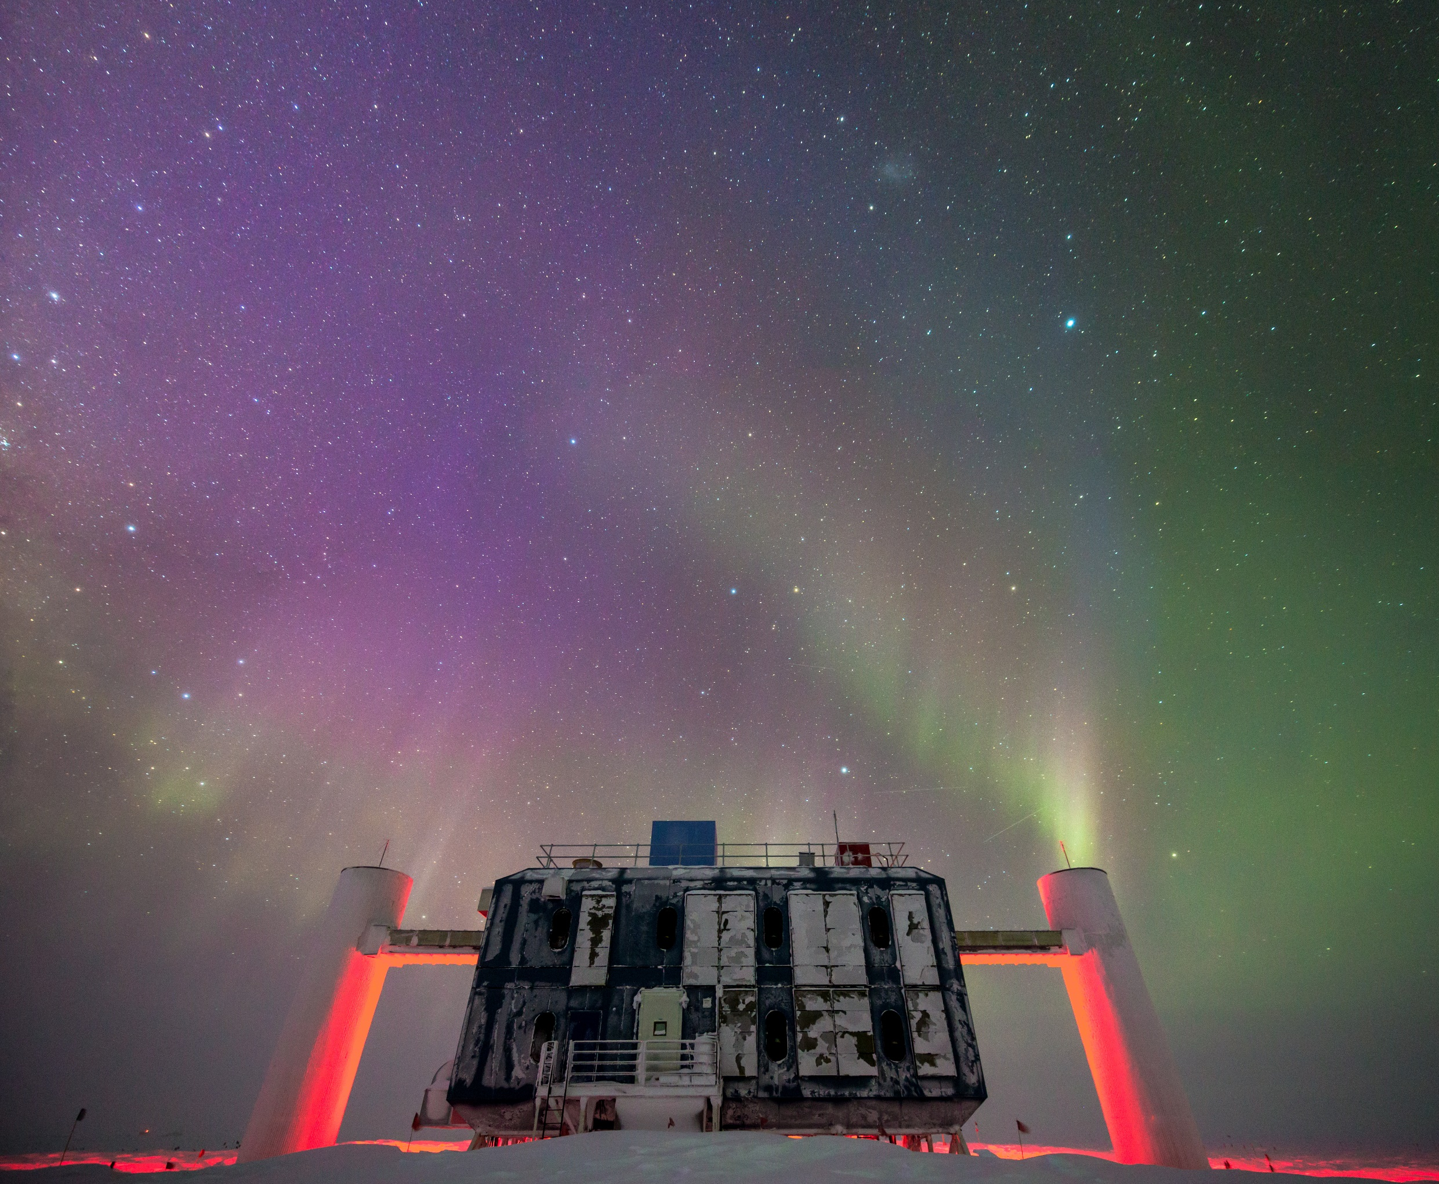
The IceCube Upgrade
Kael Hanson
Professor, University of Wisconsin Department of Physics
Director, Wisconsin IceCube Particle Astrophysics Center
SCAR Astronomy and Astrophysics from Antarctica
9 September 2021 | Madison, WI
Extending IceCube DeepCore’s reach into GeV physics and exploiting an opportunity to deploy precision calibration devices.

Slide 2
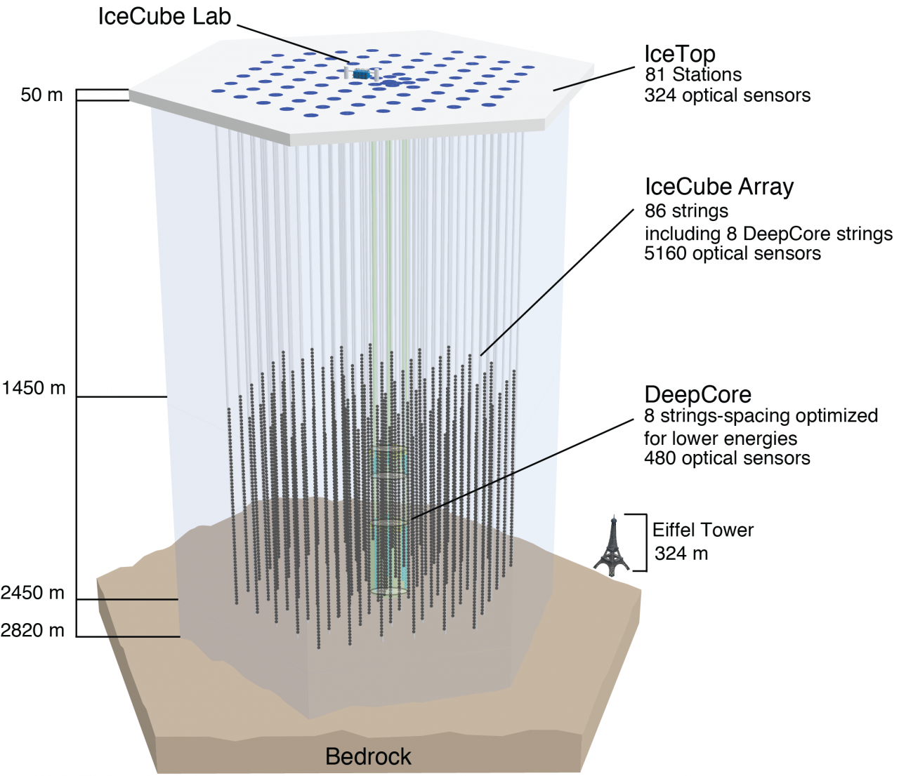
IceCube - DeepCore
Midway through IceCube construction it was realized that the massive volume of ice instrumented by IceCube could be used as a veto for penetrating cosmic ray muons surrounding a smaller 20 Mton volume in the deep, clear ice ideal for study of neutrino particle physics.
The atmospheric neutrinos which are background for IceCube astrophysics are a great beamline for neutrino physics:
Free
Wide range of L/E hard to access at accelerator facilities
Energetics favorable for tau neutrino production, again hard to access at accelerators.
Notes:
IceCube energies of interest are typically 1 TeV and above; DeepCore pushes energy threshold down to about 20 GeV, suitable for neutrino oscillation physics studies.

Slide 3
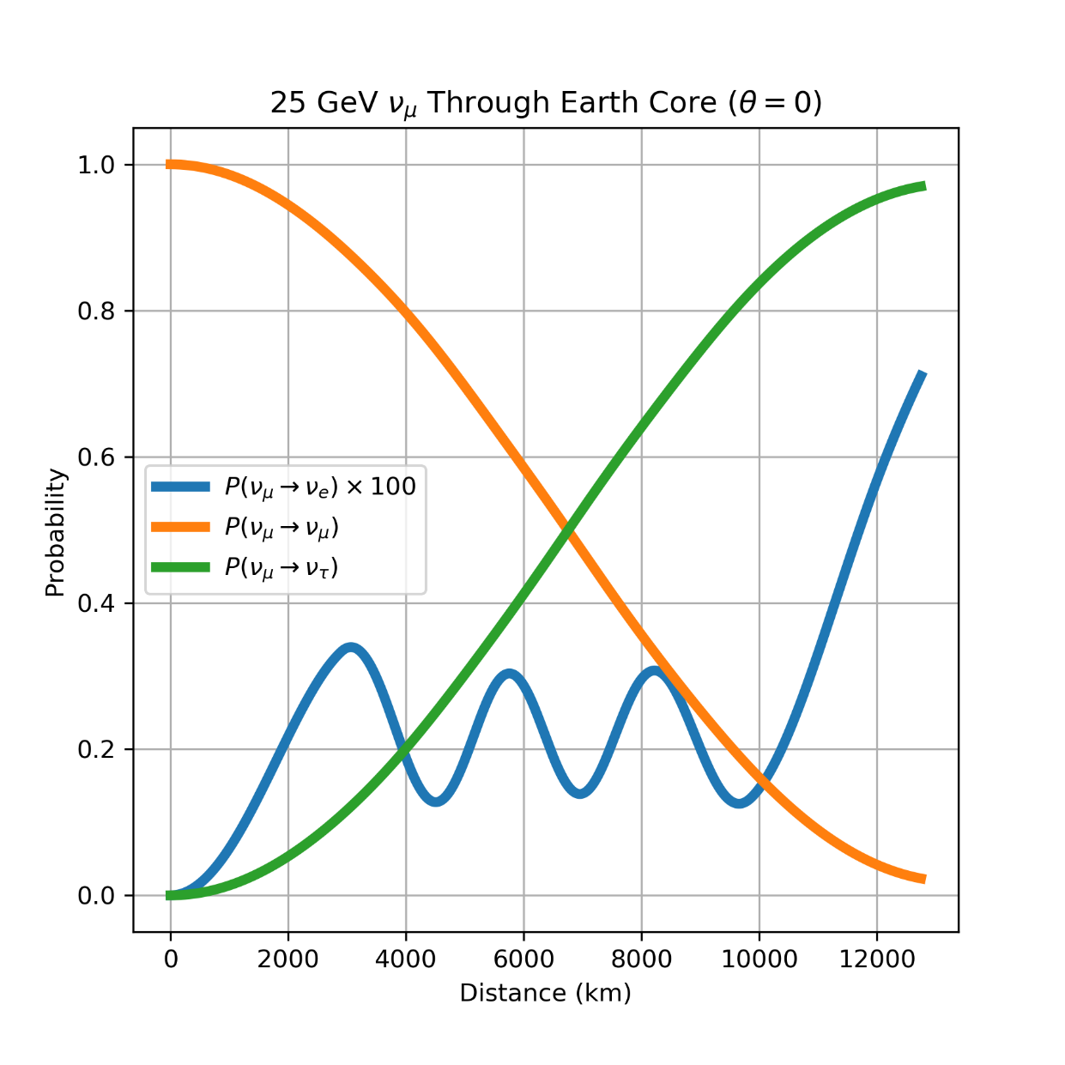
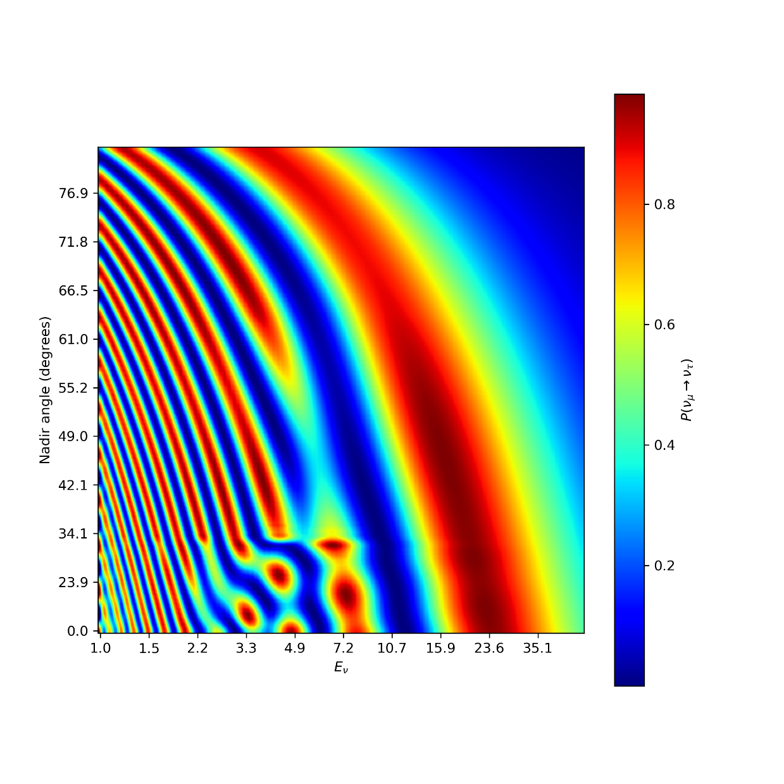
Neutrino Oscillations

Slide 4
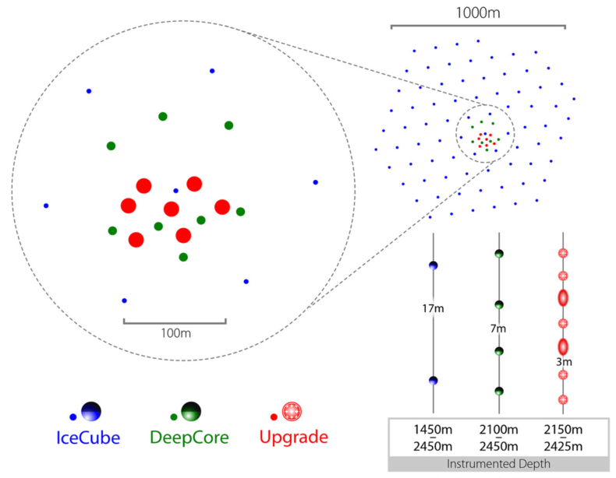
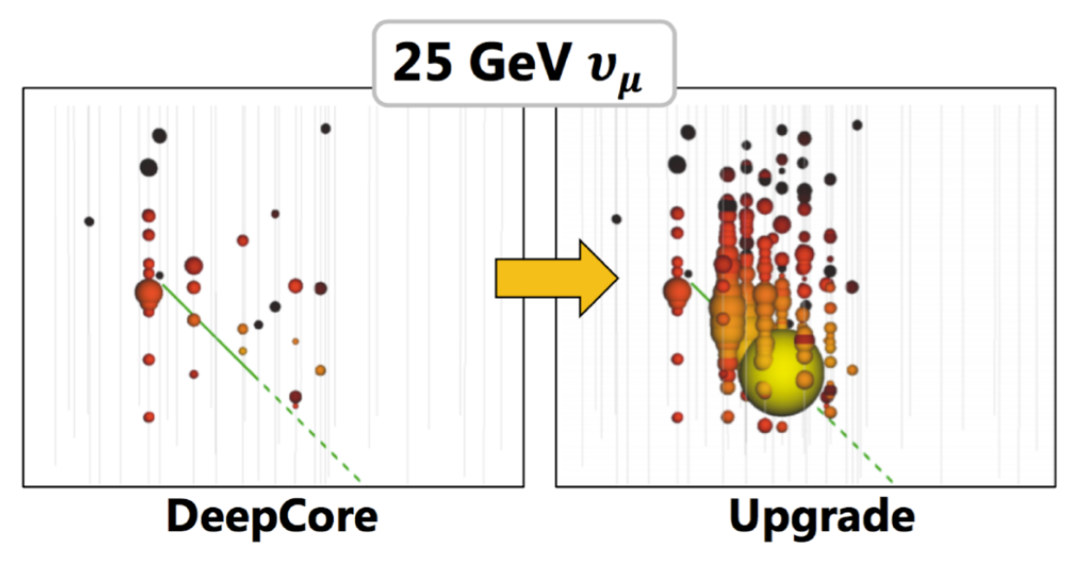
To GeV-Scale Physics: the IceCube Upgrade
Problem: Events in IceCube DeepCore start to become sparse and hard to reconstruct < 25 GeV where interesting signal lies. Energy and angular resolution at 25 GeV smears oscillograms.
Solution: deploy high photocathode area modules more densely. DeepCore string spacing of 75 m drops to 25 m in Upgrade; double density in z positions along string.

Slide 5
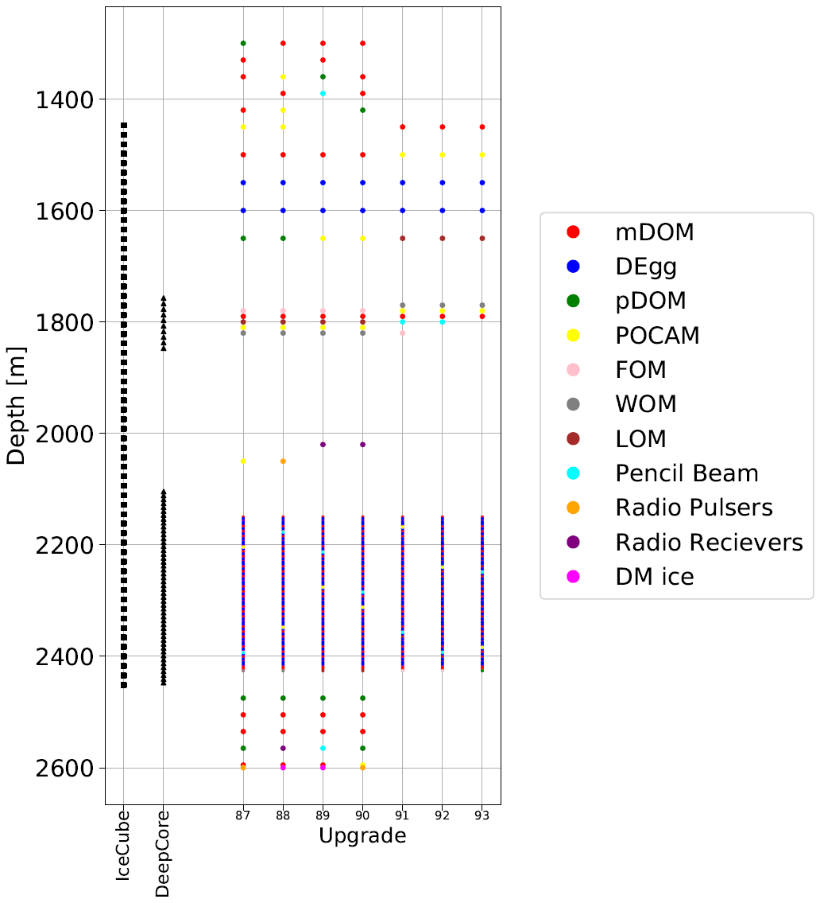
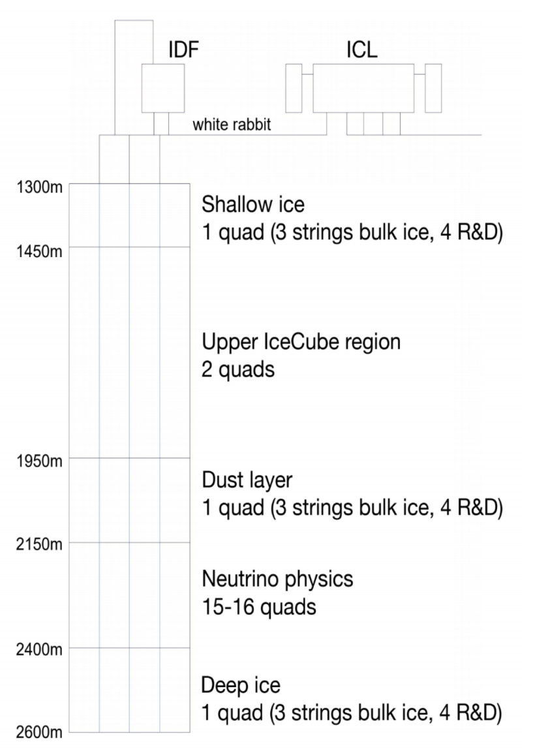
Array Configuration
Optical Sensors
430 mDOMs (DESY and MSU)
300 D-Eggs (Chiba U)
20 IceCube DOMs w new MB (UW)
Calibration Devices
2000 Small Imaging CMOS Camera
20 POCAM (Precision Optical Calib Module)
10 Pencil Beam modules
10 Acoustic geometry calibration modules
5 “Swedish” Camera modules

Slide 6
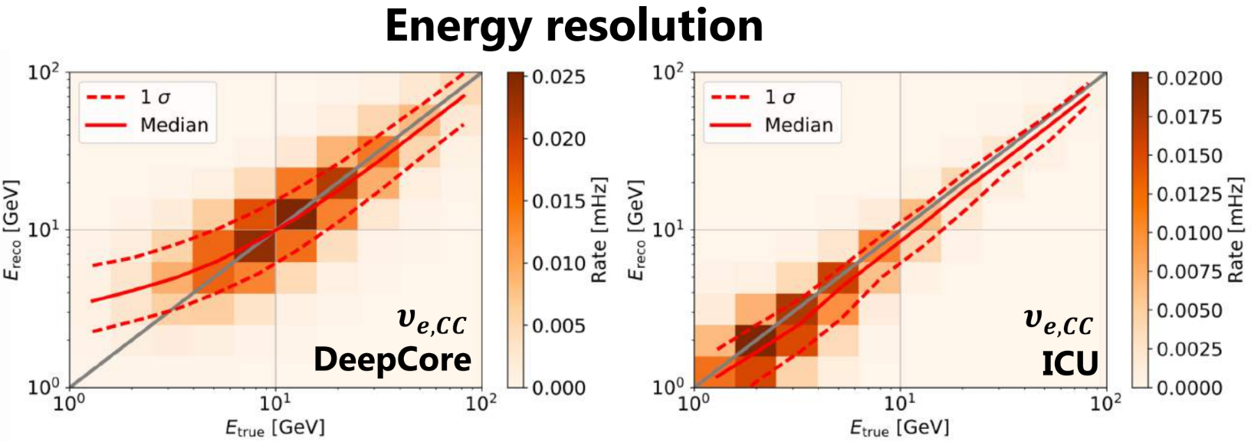
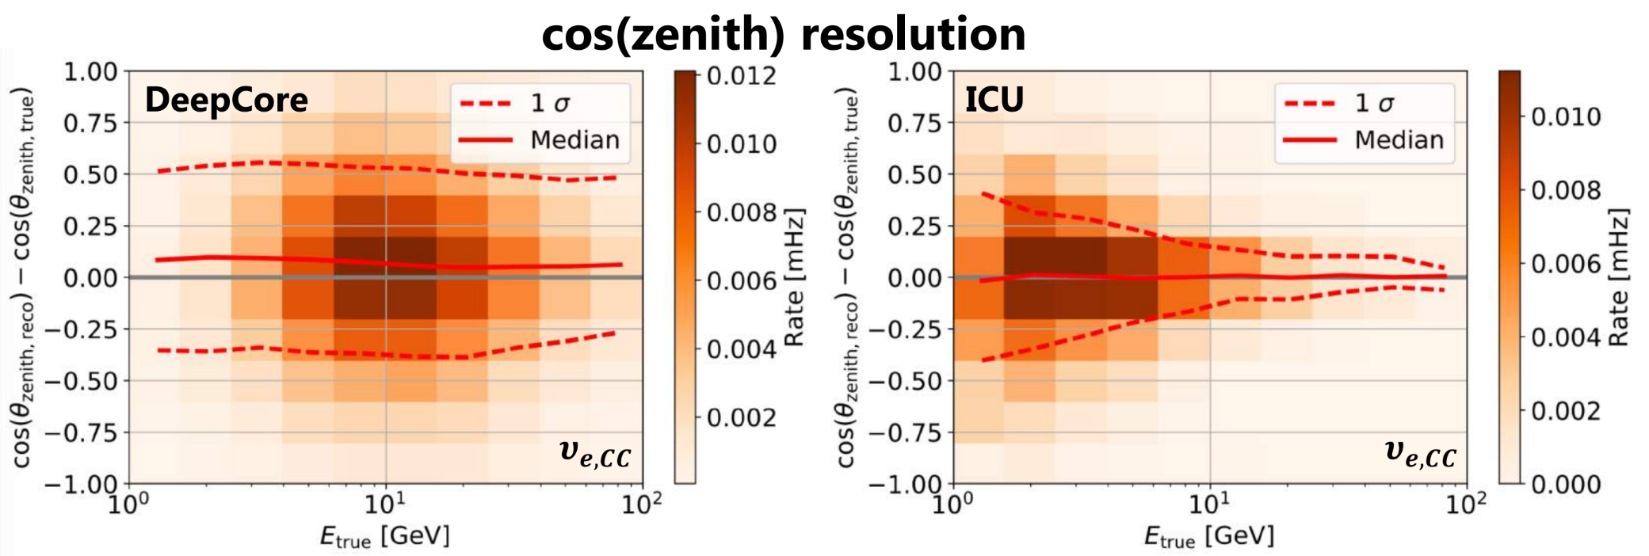
Low Energy Neutrino Events: DeepCore vs Upgrade

Slide 7
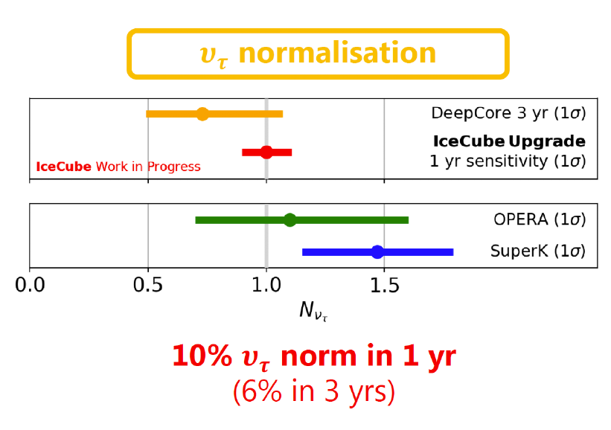
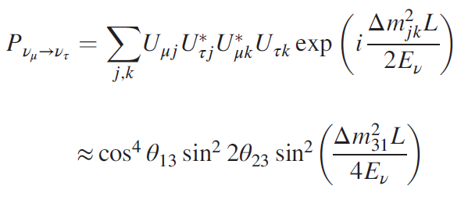
PMNS Unitarity Testing
Angle
Energy
if not then there is something else going on – exciting possibility to see new physics!!!
Upshot

Slide 8
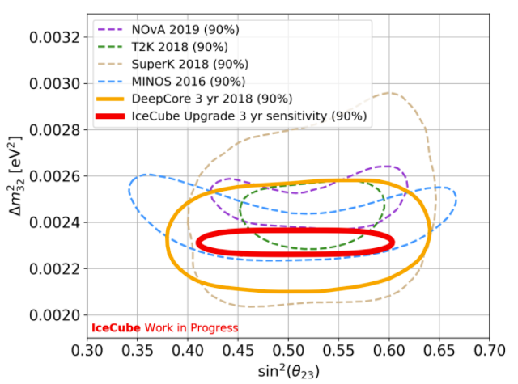
Atmospheric Neutrino Mixing Parameters
Standard Model of Elementary Particles does well to predict the behavior of the Universe on the smallest scales.
Still large number of ad hoc parameters that are “just there”
Neutrino sector is full of these – in fact SM doesn’t even include masses so something’s clearly wrong with the model.
Upgrade will be leading laboratory for next decade to measure these parameters with highest precision to date. Clues could be lurking in better measurements.
Example: atmospheric mixing angle ϑ₂₃ is curiously close to 45° which if exactly 45° probably belies some deeper symmetry

Slide 9
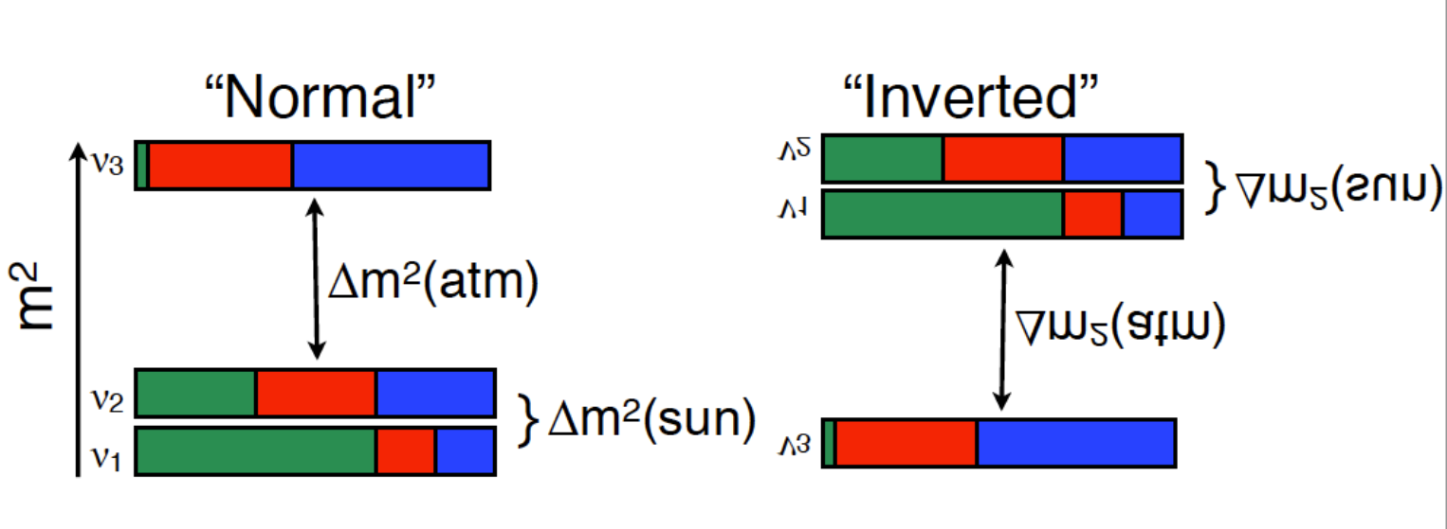
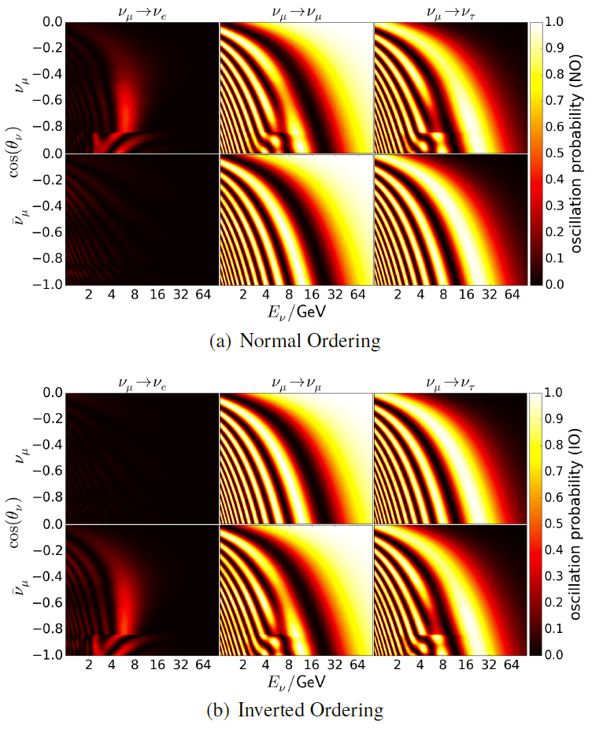
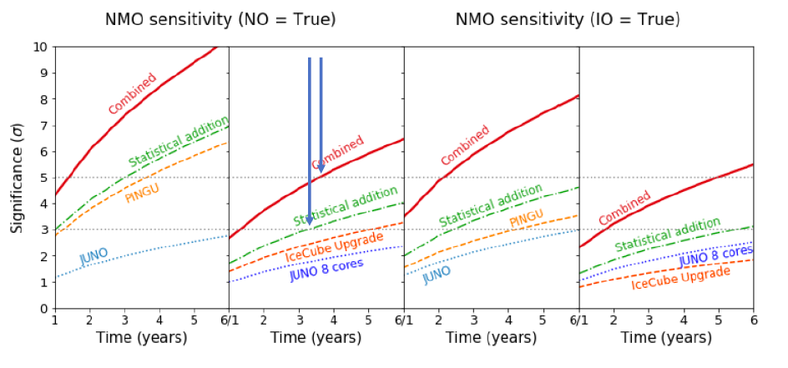
Neutrino Mass Ordering

Slide 10
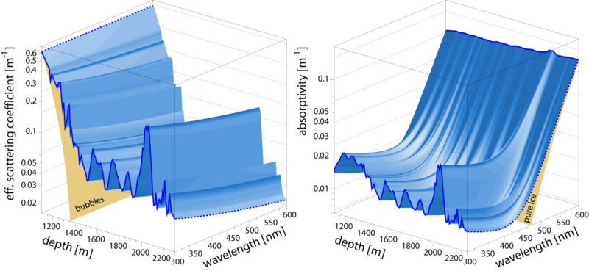
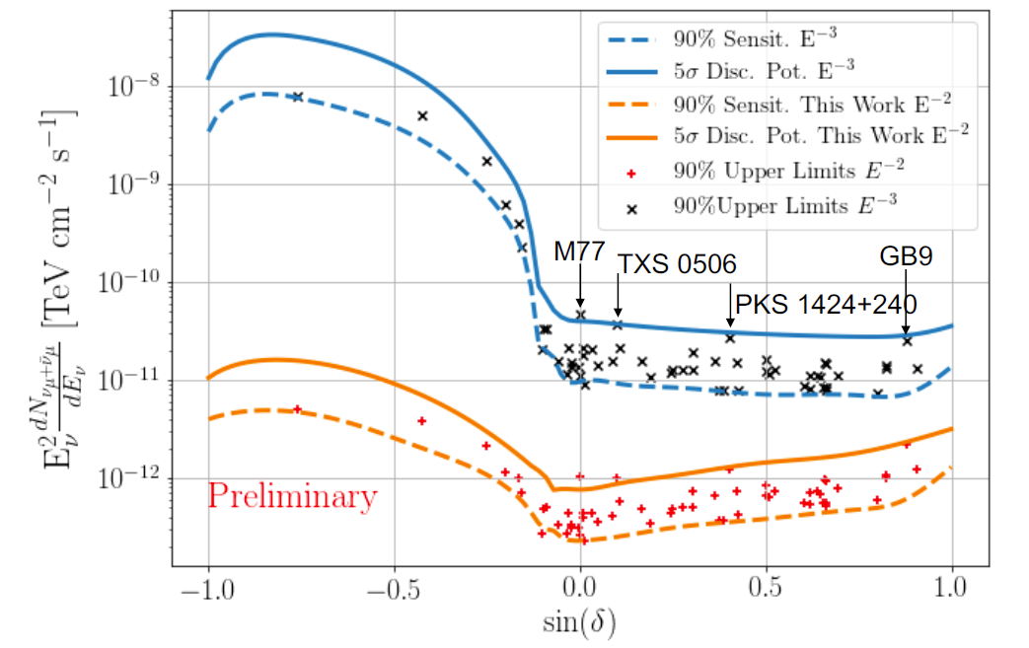
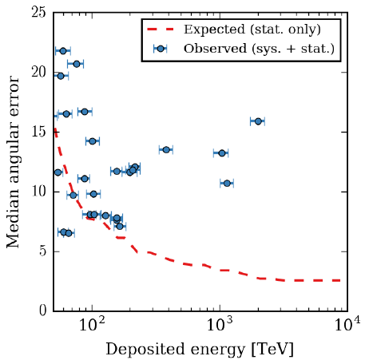
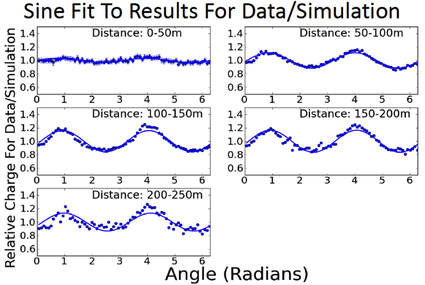
Precision Calibration of the Ice
Goal: improve knowledge of ice (absorption, scattering, scattering function, hole-ice) to re-analyze archival IceCube data and immediately resolve sources which are borderline with current IceCube.

Slide 11
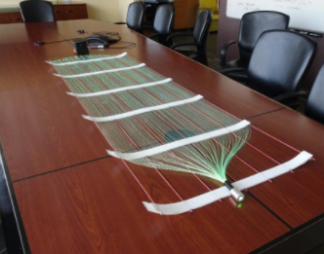
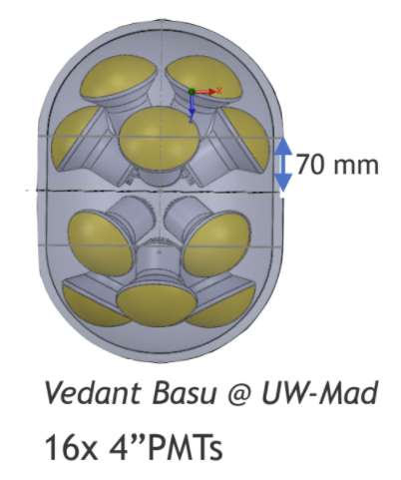
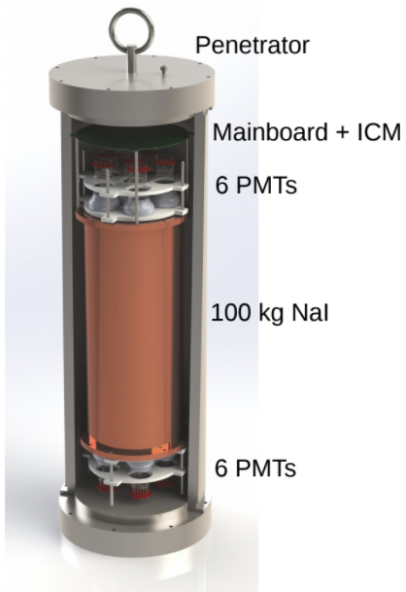
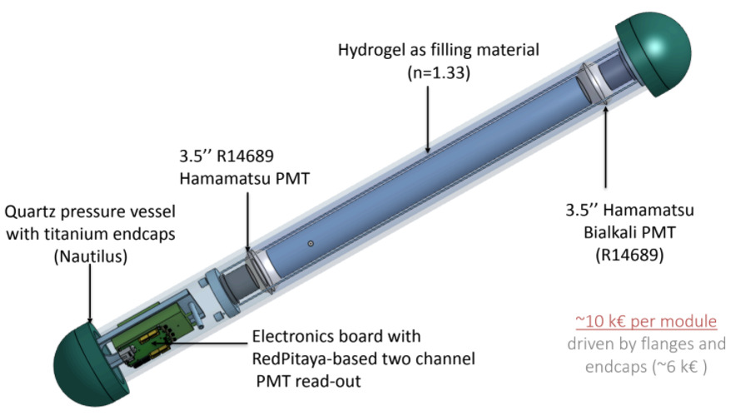
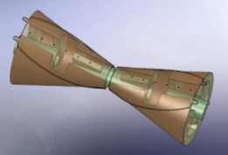
New Modules for Next-Gen Arrays

Slide 12
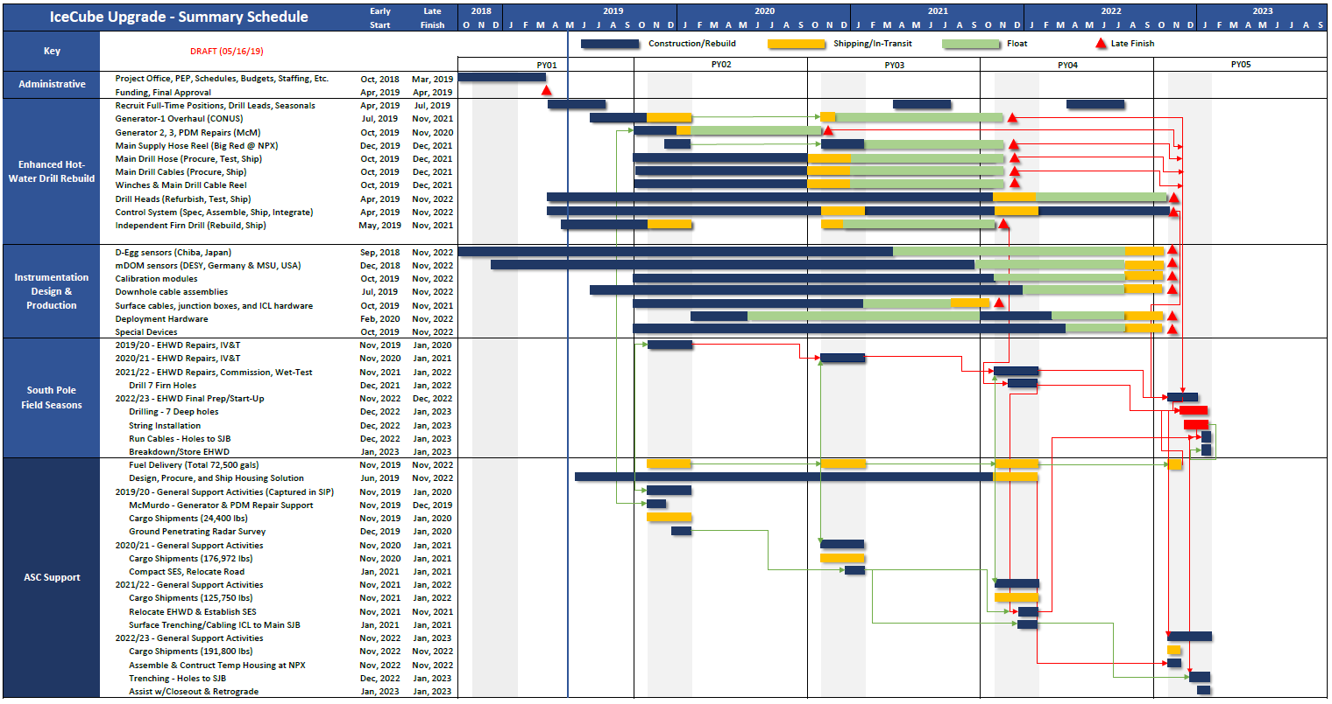
Project Timeline

Slide 13
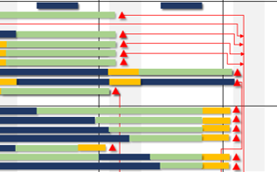
COVID Impacts Field Support
No Field
Seasons!
N
N+1
N+2

Slide 14
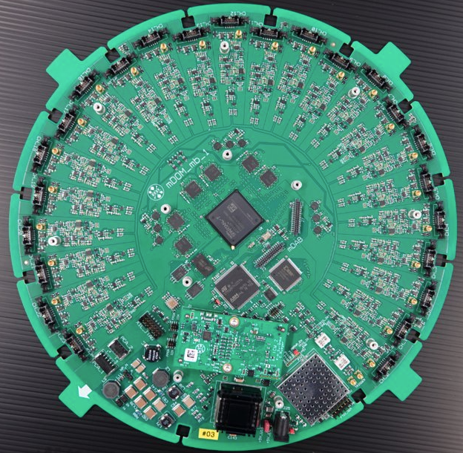
Conclusions / Outlook
The IceCube Upgrade is a modest enhancement to the IceCube facility that will deliver
world-leading neutrino physics measurements
precision calibration of the ice in and around existing IceCube instrumented volume that can be used in data reprocessing passes to provide an extended catalog of IceCube astrophysical sources;
an opportunity to deploy a handful of prototype future sensors for IceCube Gen2 and DM-Ice dark matter detectors.
Despite COVID impacts on field work, the project continues its efforts off-ice: a new generation of fully functional optical modules are lining up at the production and test facilities for deployment.

