Slide 1
ReSouRCE
Radio Sciences Research on AntarCtic AtmosphEre
The roadmap for a new SRP
Lucilla Alfonsi (INGV, Italy), Nicolas Bergeot (ROB, Belgium)
on behalf of the RESOURCE Planning Group Core Membership
MOTIVATION
RESOURCE (Radio Sciences Research on AntarctiC AtmospherE) aims to gather the communities that investigate the polar atmosphere, with particular reference to Antarctica, by means of radio probes into a common shared initiative.
The scope is:
improve the current understanding of the Antarctic atmosphere sharing the expertise and the experience achieved by several scientific teams in the world, thus facilitating the advancement in the field and avoiding any duplication of activities already in action;
take advantage of the experience of the Expert Group GRAPE (GNSS Research and Application for Polar Environment);
build upon the GRAPE legacy by enhancing interactions between the scientists who measure and utilise the entire radio spectrum, either as an auxiliary or principal observation, to study the atmosphere.
According to the SCAR rules a proposal for a Programme Planning Group was submitted on March 2020. Due to the pandemic the decision is still pending.
Sponsoring SSGs: GeoScience, Physical Science
Expected duration of the programme 8 years
20,000 $US / year = 160,000 $US

Slide 2
SPECIFIC OBJECTIVES
While the users of radio devices often consider the atmospheric contribution as a source of error that needs to be corrected, deleted, or mitigated, atmospheric scientists who rely on radio techniques have a common interest:
to isolate the atmospheric contribution and use it in the study of the near-earth space environment.
RESOURCE aspires to such common goal to pursue two main scientific objectives:
To monitor and to investigate the polar atmosphere
To support the radio sciences interested in removing or mitigating the atmospheric contribution.

Slide 3
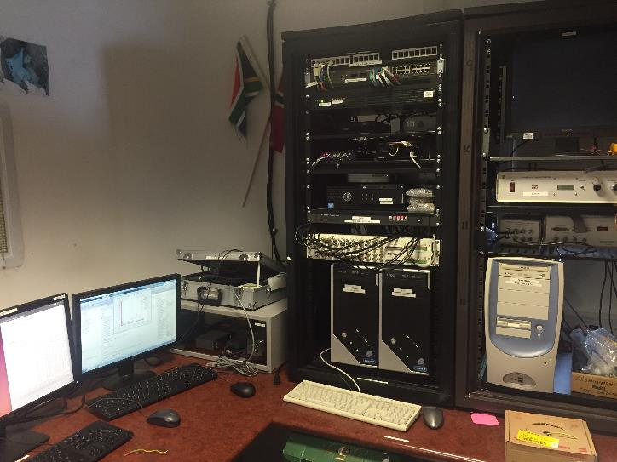
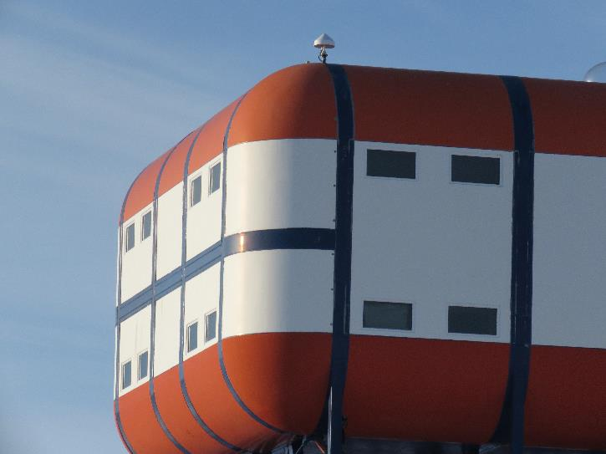
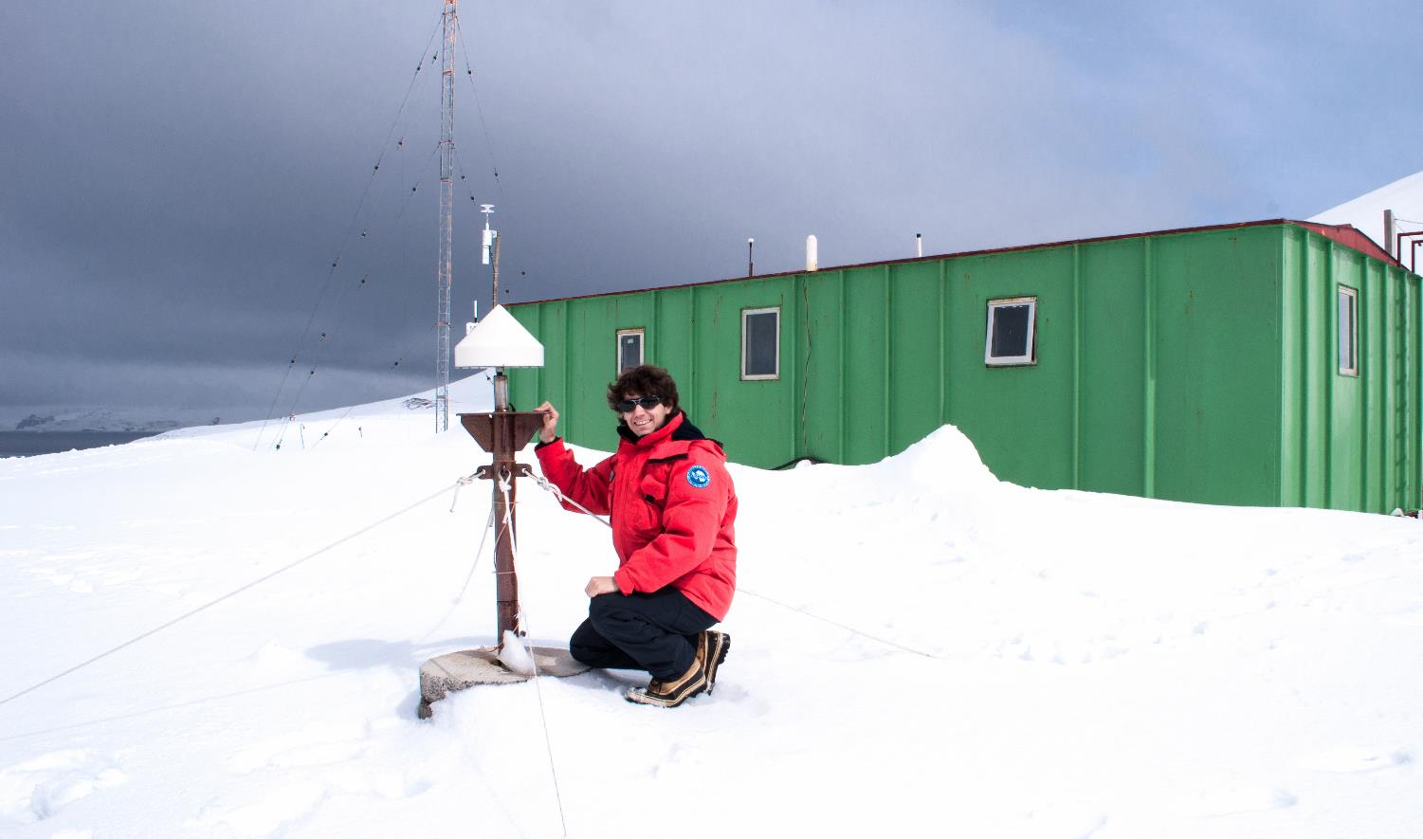
THE ReSouRCE OPPORTUNITY
INSTRUMENTS
Ionosondes: HF backscattering radars equipped with magnetic loop, rhombic or delta antennas to measure the ionospheric plasma frequency and virtual heights;
SuperDARN: A network of HF over-the-horizon radars that perform experiments individually and collaboratively to measure and monitor ionospheric convection through the observation of ionospheric irregularities.
Riometers: passive radio receivers operating on HF band to measure the ionospheric absorption;
GNSS receivers: L-band dual-frequency receivers;
GNSS TEC and scintillation monitors: L-band dual-frequency receivers equipped with ad hoc firmware for ionospheric monitoring;
VLF receivers: to monitor VLF waves as important drivers of the loss of energetic electrons from the radiation belts;
High-power large aperture (HPLA) radars for studying space-Earth interaction within the fields of aeronomy, meteors, and space debris;
EISCAT for disturbances detection in the ionosphere and magnetosphere;
All-sky view imagers for auroral studies;
Geomagnetic observatories to monitor the geomagnetic field variations due to external origin.

Slide 4
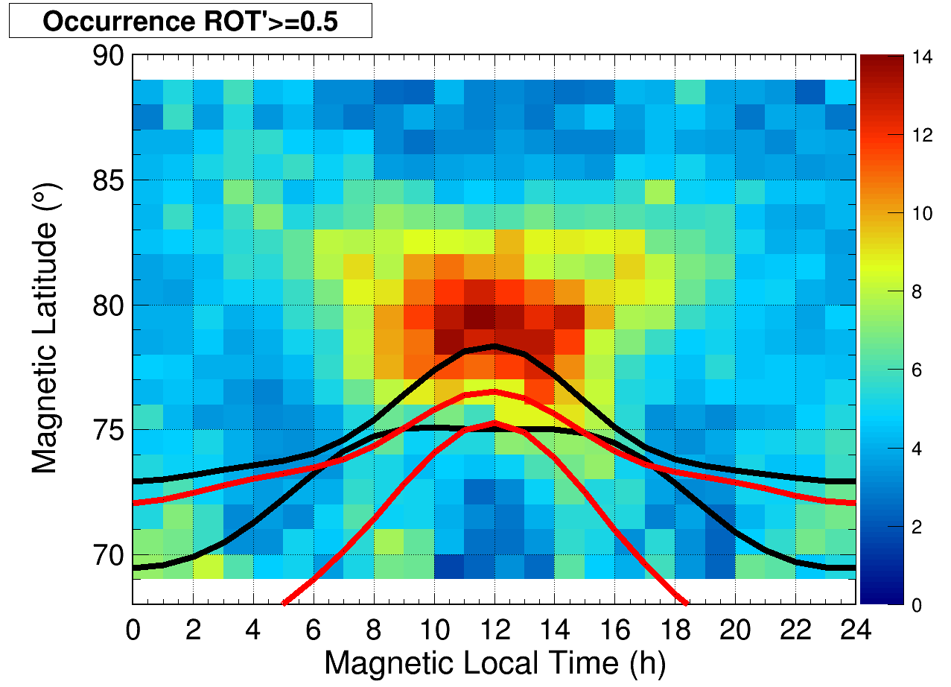
THE ReSouRCE OPPORTUNITY
SKILLS
Analysis of radio occultation data to derive atmospheric characteristics;
Analysis of space-based measurements to derive electron density, ion and electron temperatures measurements;
Analysis of P, L, X-bands SAR images to derive ionospheric information;
Calibration of Total Electron Content measured from different GNSS receivers;
Computation of the location and velocity (line-of-sight and convective motion) of ionospheric irregularities from SuperDARN
Derive the Precipitable Water Vapour from the GNSS stations
Provide a regional model to obtain Precipitable Water Vapour at remote sites where no meteorological data are available
Use of cloud computing to share data and software

Slide 5
THE ReSouRCE OPPORTUNITY
Open questions
Due to the nearly vertical geometry of the geomagnetic field lines at high latitudes, the reconnection between the Earth’s magnetic field and the IMF results in a prompt response of the auroral and polar ionosphere to fluctuations in the solar wind modifications. The question is, how prompt is that reaction?
The effects of solar perturbations on the upper atmosphere over the poles are often asymmetric. Do we fully understand the reason for such asymmetries?
What is the role of the coupling between the neutral and the ionized layers at the atmosphere at the poles?
Can we interpret plasmaspheric erosion as the signature of electric field penetration from high to low latitudes during geomagnetic storms?
Can we identify when ionospheric plasma structuring at high latitudes appears as fragmentation from large to smaller-scale structures or vice versa as clustering of small-scale irregularities into larger-scale configurations? What are the mechanisms for each of these forms of restructuring?
Can we understand the origins of the long-term behaviour of the polar ionosphere?
Can we improve the modelling of the coupling of the neutral atmosphere to the ionized atmosphere at high latitudes?
8. Is it possible to identify the contribution of the anthropogenic and natural sources in the assessment of climate change over the poles?

Slide 6
THE ReSouRCE OPPORTUNITY
Gap Analysis
• Strengthen the collaboration atmospheric scientists with solar physicists to learn more about solar wind forecasting (including CMEs propagation);
• Foster the collaboration among experts of different disciplines, such as astrophysics, planetology, neutral atmosphere physics and chemistry, to share the competencies necessary to understand the roles of the different drivers of atmospheric dynamics from above and below;
• Facilitate the sharing of data, algorithms and models to harmonize the exploitation of the information (adoption of standards, agreement on metrics, use of shared communication tools, use of interoperable tools, etc.);
• Keep and strengthen the collaboration between the research communities that manage and exploit ground-based and in-situ observations to optimize and maximize the efforts given an increasing number of multi-instruments sites on the ground and multi-sensors payloads in space.

Slide 7
RESOURCE Programme Planning Group submitted to SCAR on March 2020, Due to the pandemic the decision is still pending.
RESOURCE Community is finalizing a joint review paper to be submitted to Survey in Geophysics on early October 2021
The RESOURCE White Paper was published by SCAR on September 2020
https://scar.org/scar-library/search/science-4/physical-sciences/grape-2/5539-grape-white-paper-2020/
ReSouRCE Planning Group welcomes everybody interested TO JOIN!!!
Contact: lucilla.alfonsi@ingv.it

