Slide 1
Rare Transits Observed by ASTEP
Georgina Dransfield
L. Abe, A. Agabi, P. Bendjoya, N. Crouzet, T. Guillot, D. Mékarnia, F-X Schmider, O. Suarez, A. Triaud

Slide 2
Talk Structure
Introduction
TESS and the need for follow-up
ASTEP results
What’s next?

Slide 3
Exoplanets – where are we now?

Slide 4
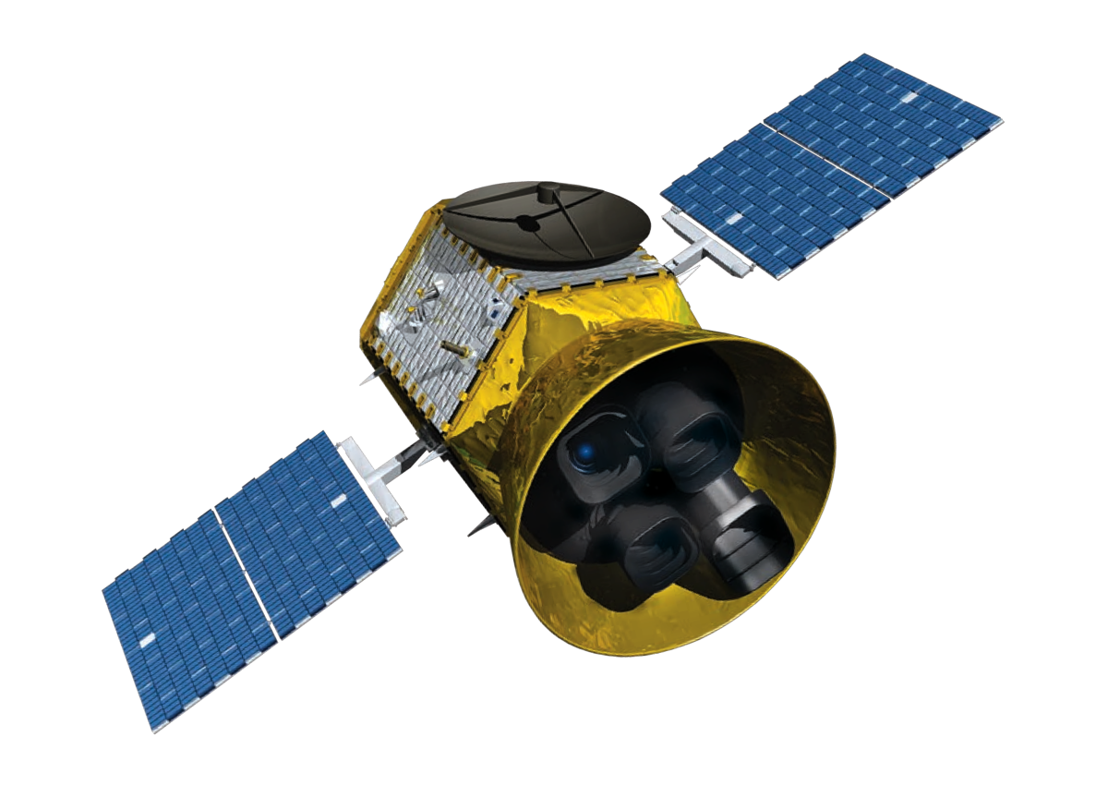
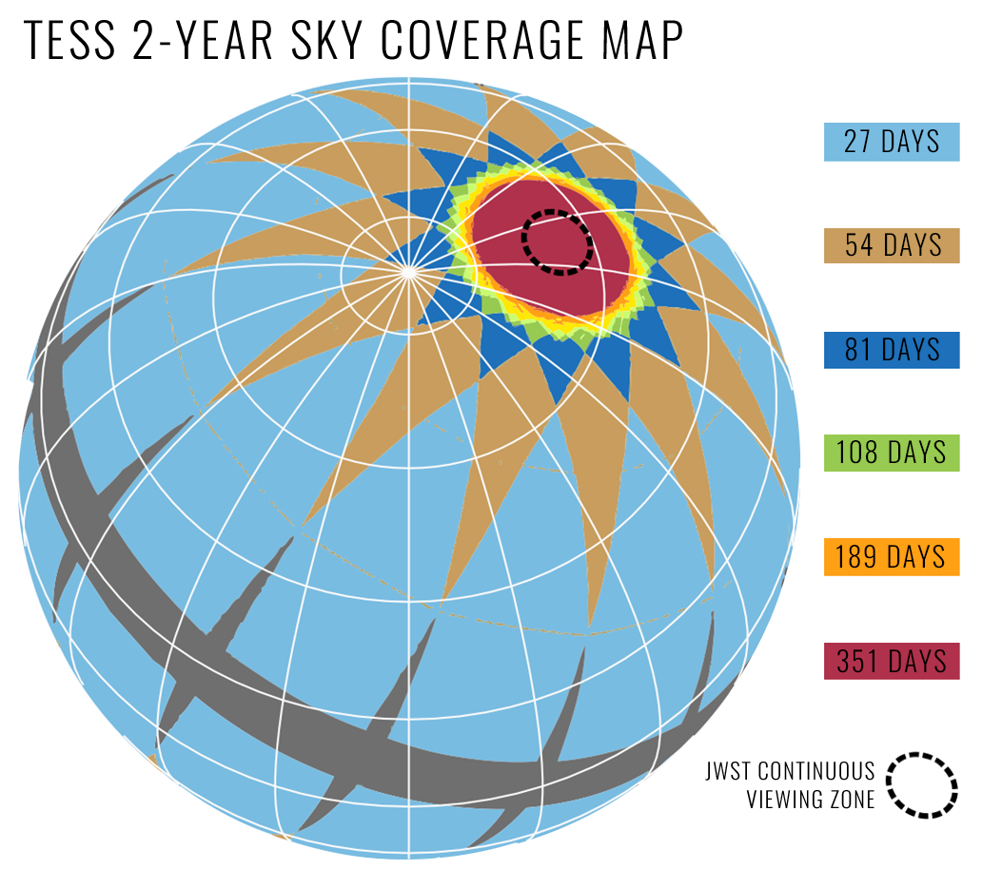
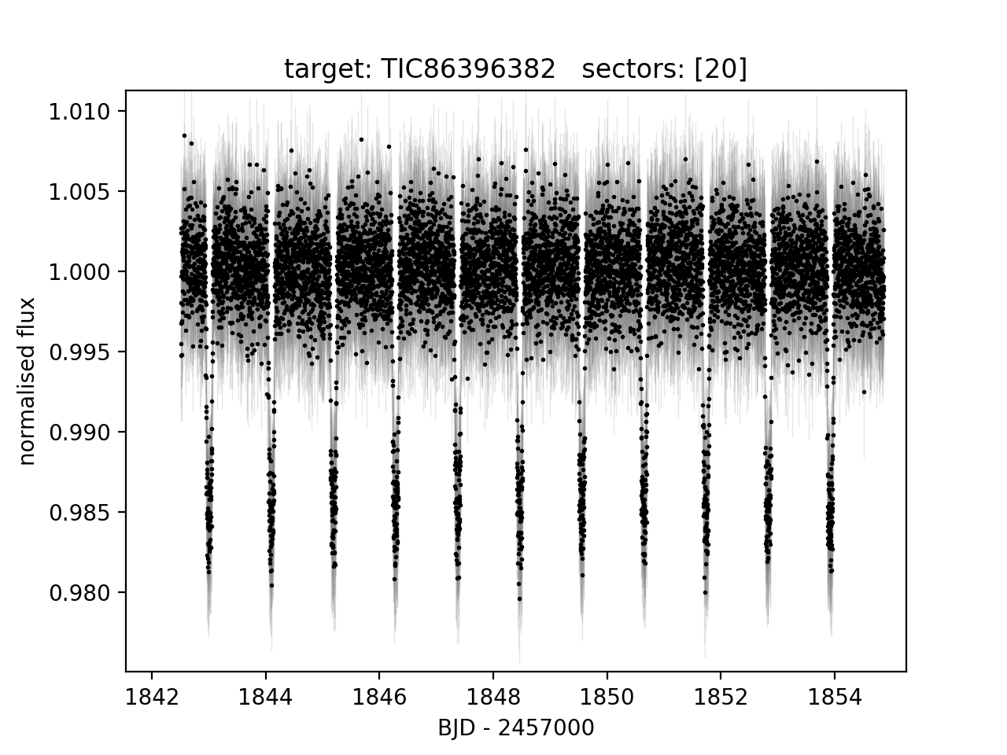
Exoplanets – Transit Photometry
Image credit: https://archive.stsci.edu/missions-and-data/tess

Slide 5
ExoFOP - SG1
Not in the TESS game?
ExoFOP: Exoplanet Follow-up Observing Program
SG1: Sub-group 1 – ground-based photometric follow-up
Aim: validate planet candidates, rule out false positives
Image credit: Lightkurve package
Notes:
FOr those of you not in the TESS game for Exoplanets, ExoFOP is ....
divided into several sub groups, sg 1 is ground based photometric follow up.
TESS pixels are 21"/px. The image to the right isn't even a very crowded field, but the light from several stars bleeds into pixels.
A big job for SG1 then is confirming that events detected by TESS occur on target using significantly smaller apertures and checking the field for eclipsing binaries.
EXOFOP is a global effort and there are many SG1 observatories, so to stand out, astep needs to offer something different.

Slide 6
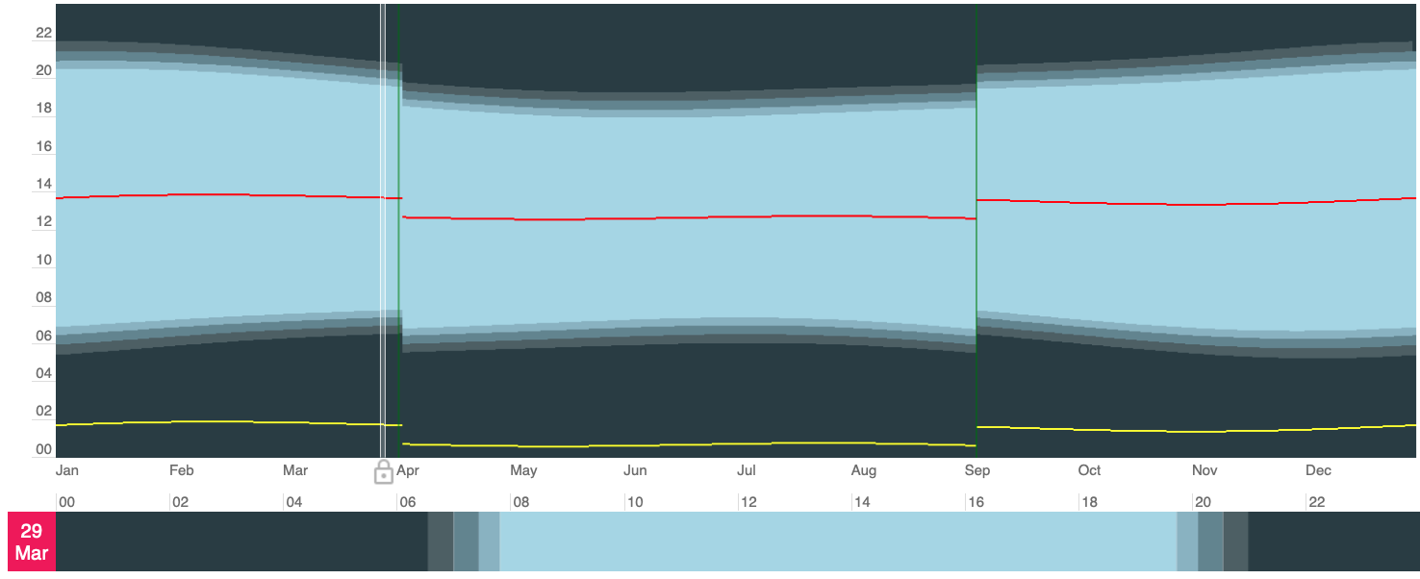
What is ASTEP’s niche?
Image credit: https://www.timeanddate.com
Notes:
This is what we can offer
On the vertical axis we have time of day, on the horizontal we have dates of year. This plot shows the durations of the night and timings of the various twilights.
Antarctic one is unfamiliar, lets look at paranal, another popular observing site.

Slide 7
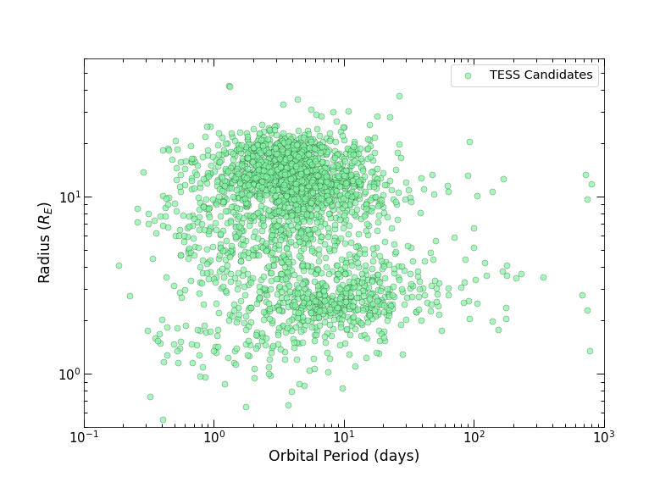
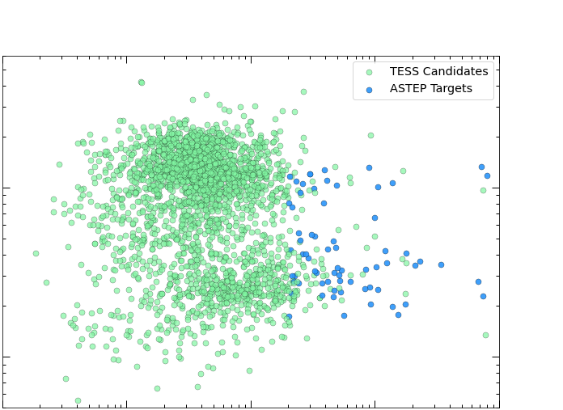
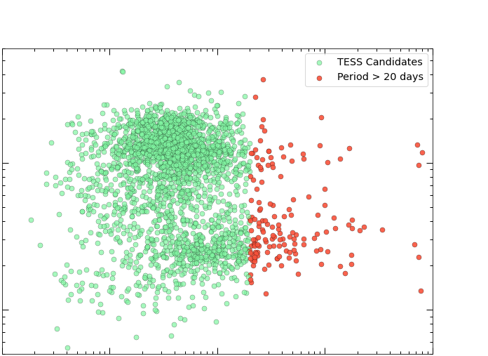
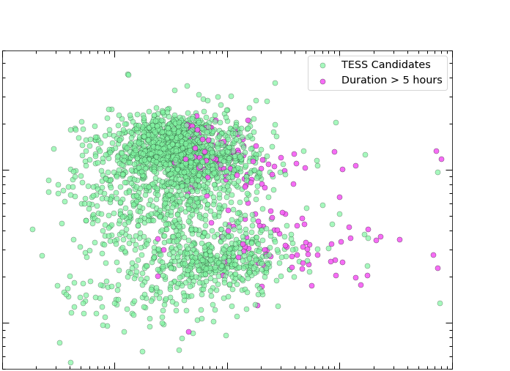
Long Periods 🤝 Long Transits
Notes:
LOOOOONG periods and long transits are our bread&butter. it's where we can excel.
If we look at everyone's favourite radius period diagram with TESS candidates. all TOIs that are not confirmed or FP
periods >20 days are not favoured by TESS due to observing strategy of 27 days per sector. But they do come up due to CVZ. Hard to follow-up on from the ground
Long transits are another toughie. To catch them in full with a bit of OOT you need the start to be in the right time in your night.
Where these meet is where we come in. They are the targets best left to us, as we have a better chance than anyone at catching them.

Slide 8
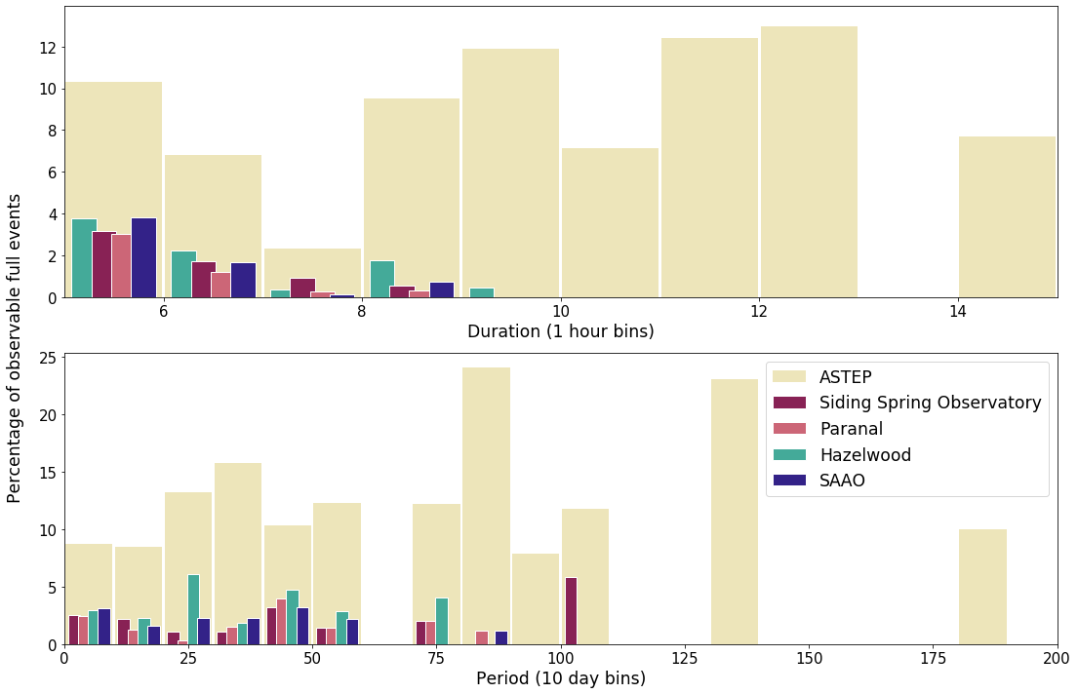
We observe what others can’t!
Notes:
Let's look at the top panel here first. From the current TOI list, i selected all southern candidates with transit durations longer than 5 hours. I then used the Pyton package ASTROPLAN to answer the question: how many full transits could we observe over the next five years, observing from ASTEP and 4 other SG1 observing sites.
The results are what we see in the top panel. events are in 1 hour duration bins and the vertical axis shows the percentage of events observable in full. The bottom panel contains the same events, but grouped by period instead. We can see that for long transits, especially intersecting with long periods, ASTEP outperforms all other observatories.

Slide 9
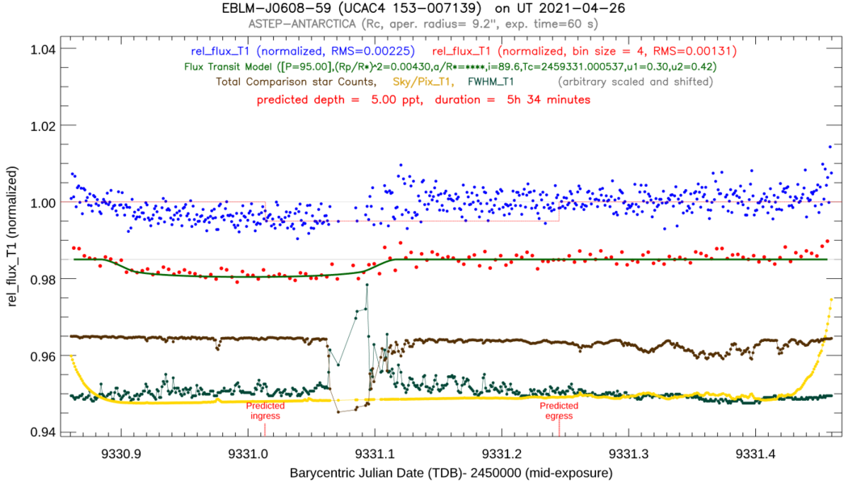
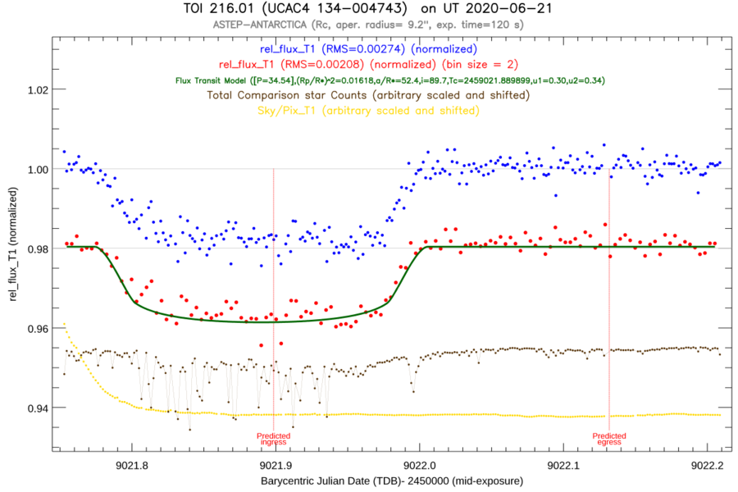
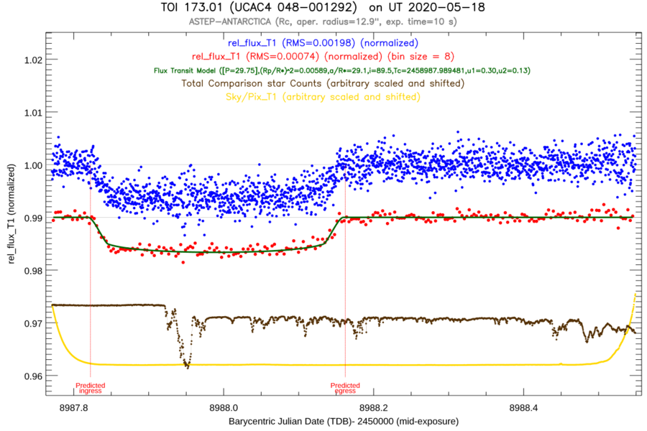
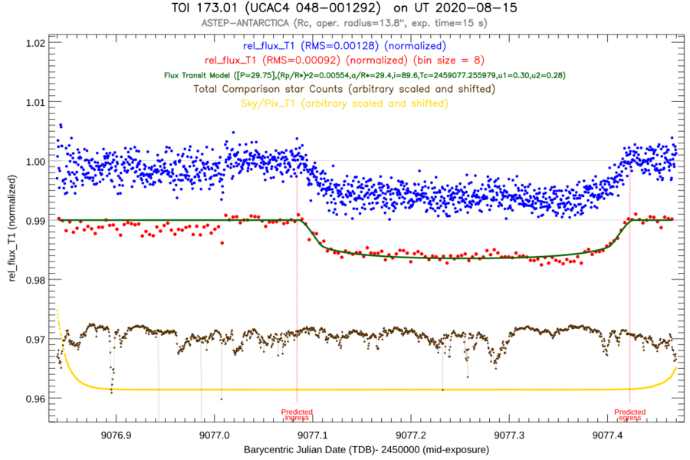
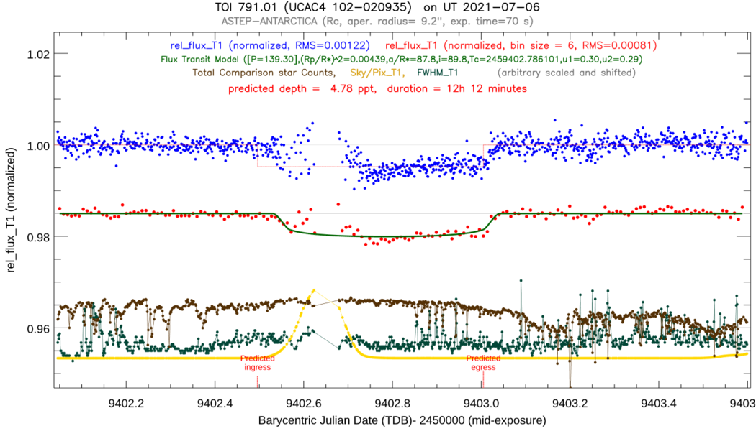
Results:
TOI 216.01
TOI 173.01
TOI 791.01
TOI 1338.01/EBLM J0608-59
FIRST EVER!
Warm Neptune
Period ≈ 95 days
Duration > 5 hours
Warm Jupiter
Period ≈ 35 days
Duration > 5 hours
Warm Jupiter
Period ≈ 30 days
Duration > 8 hours
Warm Jupiter
Period ≈ 139 days
Duration > 12 hours
Dawson, R et.al (2021)
Villanueva (in prep)
Notes:
Originally a single transit candidate, 30d period, over 8 hours long. Also has a Saturn analog in the system.
TOI 216c 35d period, over 5 hours long, part of a pair of planets close to mean-motion-resonance
We can follow TTVs of systems when others can’t because they are below the Horizon. Once again – ASTEP to the rescue!

Slide 10
Results: TOI 282.01
Warm Neptune
Period ≈ 56 days
Duration > 8 hours
2nd Warm Neptune in system
Period ≈ 84 days
Duration > 10 hours
Dransfield, G. (in prep)

Slide 11
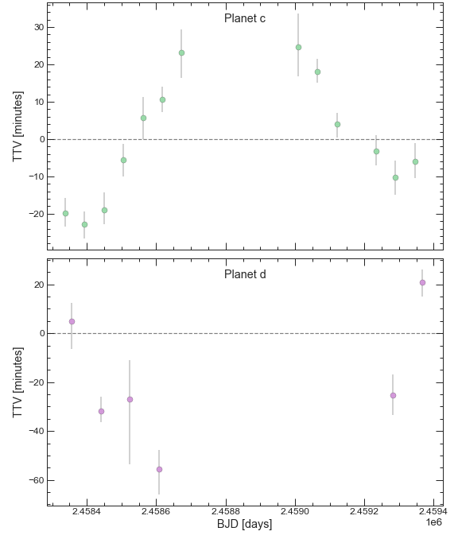
Results: TOI 282.01
Warm Neptune
Period ≈ 56 days
Duration > 8 hours
2nd Warm Neptune in system
Period ≈ 84 days
Duration > 10 hours
Dransfield, G. (in prep)

Slide 12
Results: TOI 282.01
Warm Neptune
Period ≈ 56 days
Duration > 8 hours
2nd Warm Neptune in system
Period ≈ 84 days
Duration > 10 hours
+ a Super Earth
Period ≈ 23 days
Duration > 5 hours
Dransfield, G. (in prep)

Slide 13
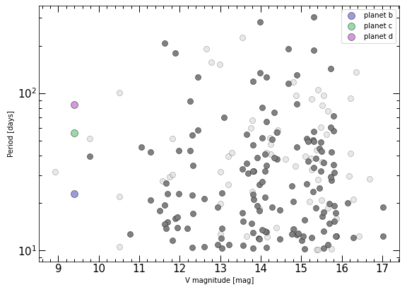
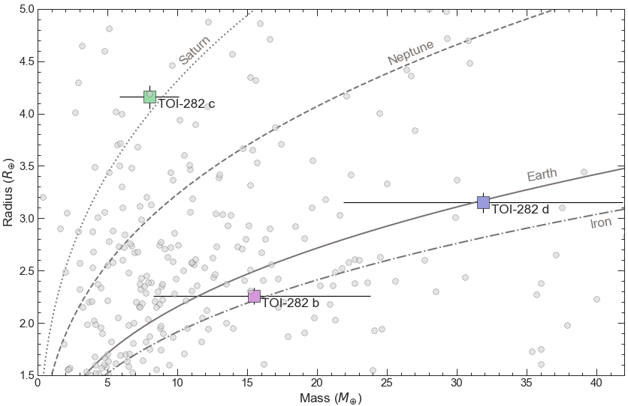
Results: TOI 282 b, c and d
Dransfield, G. (in prep)

Slide 14
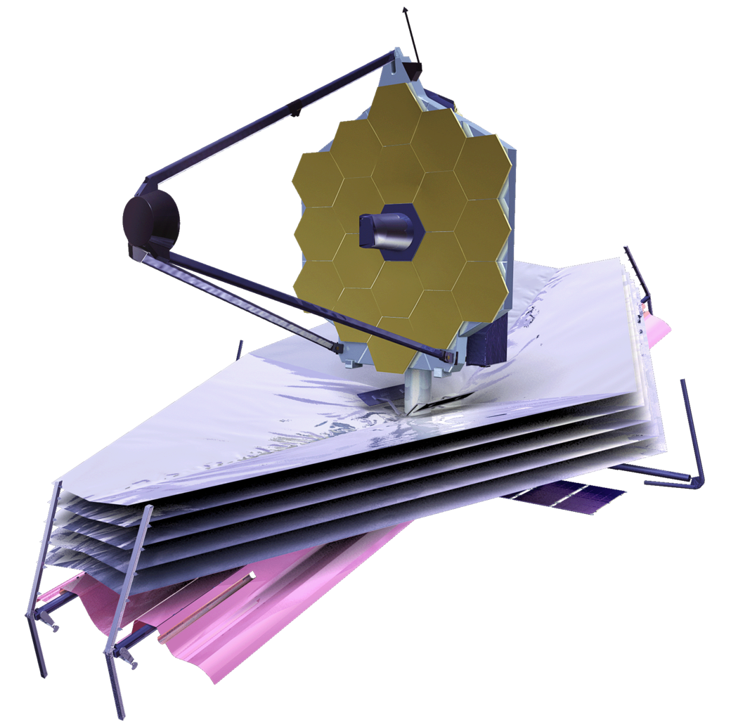
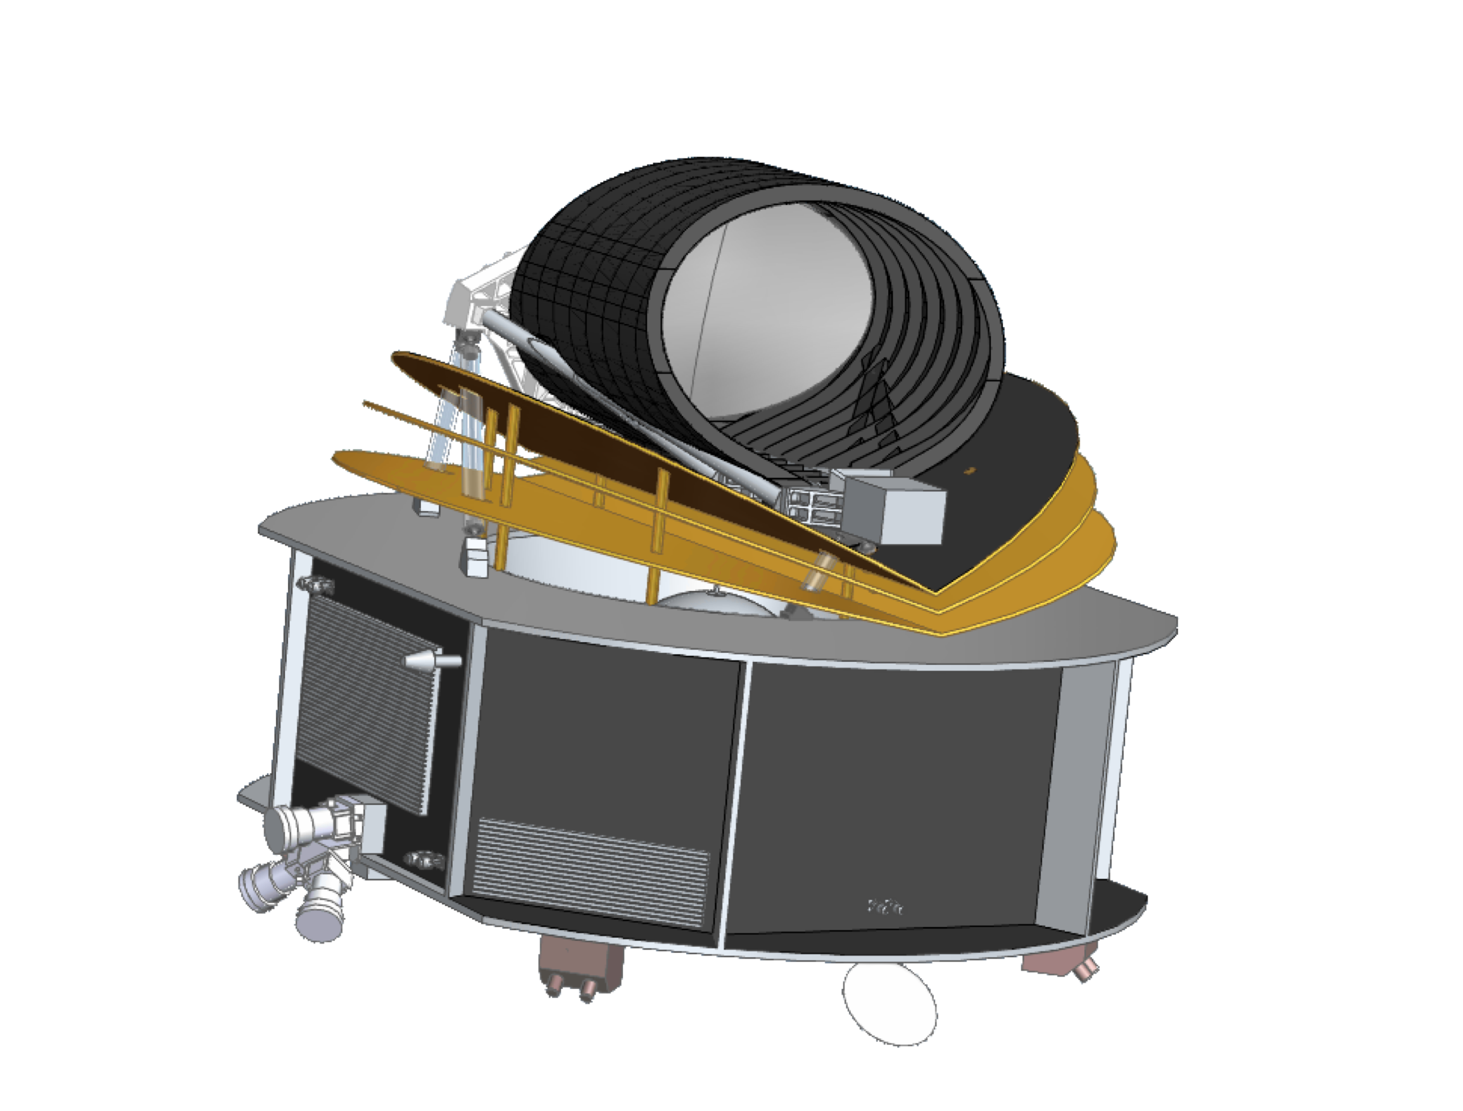
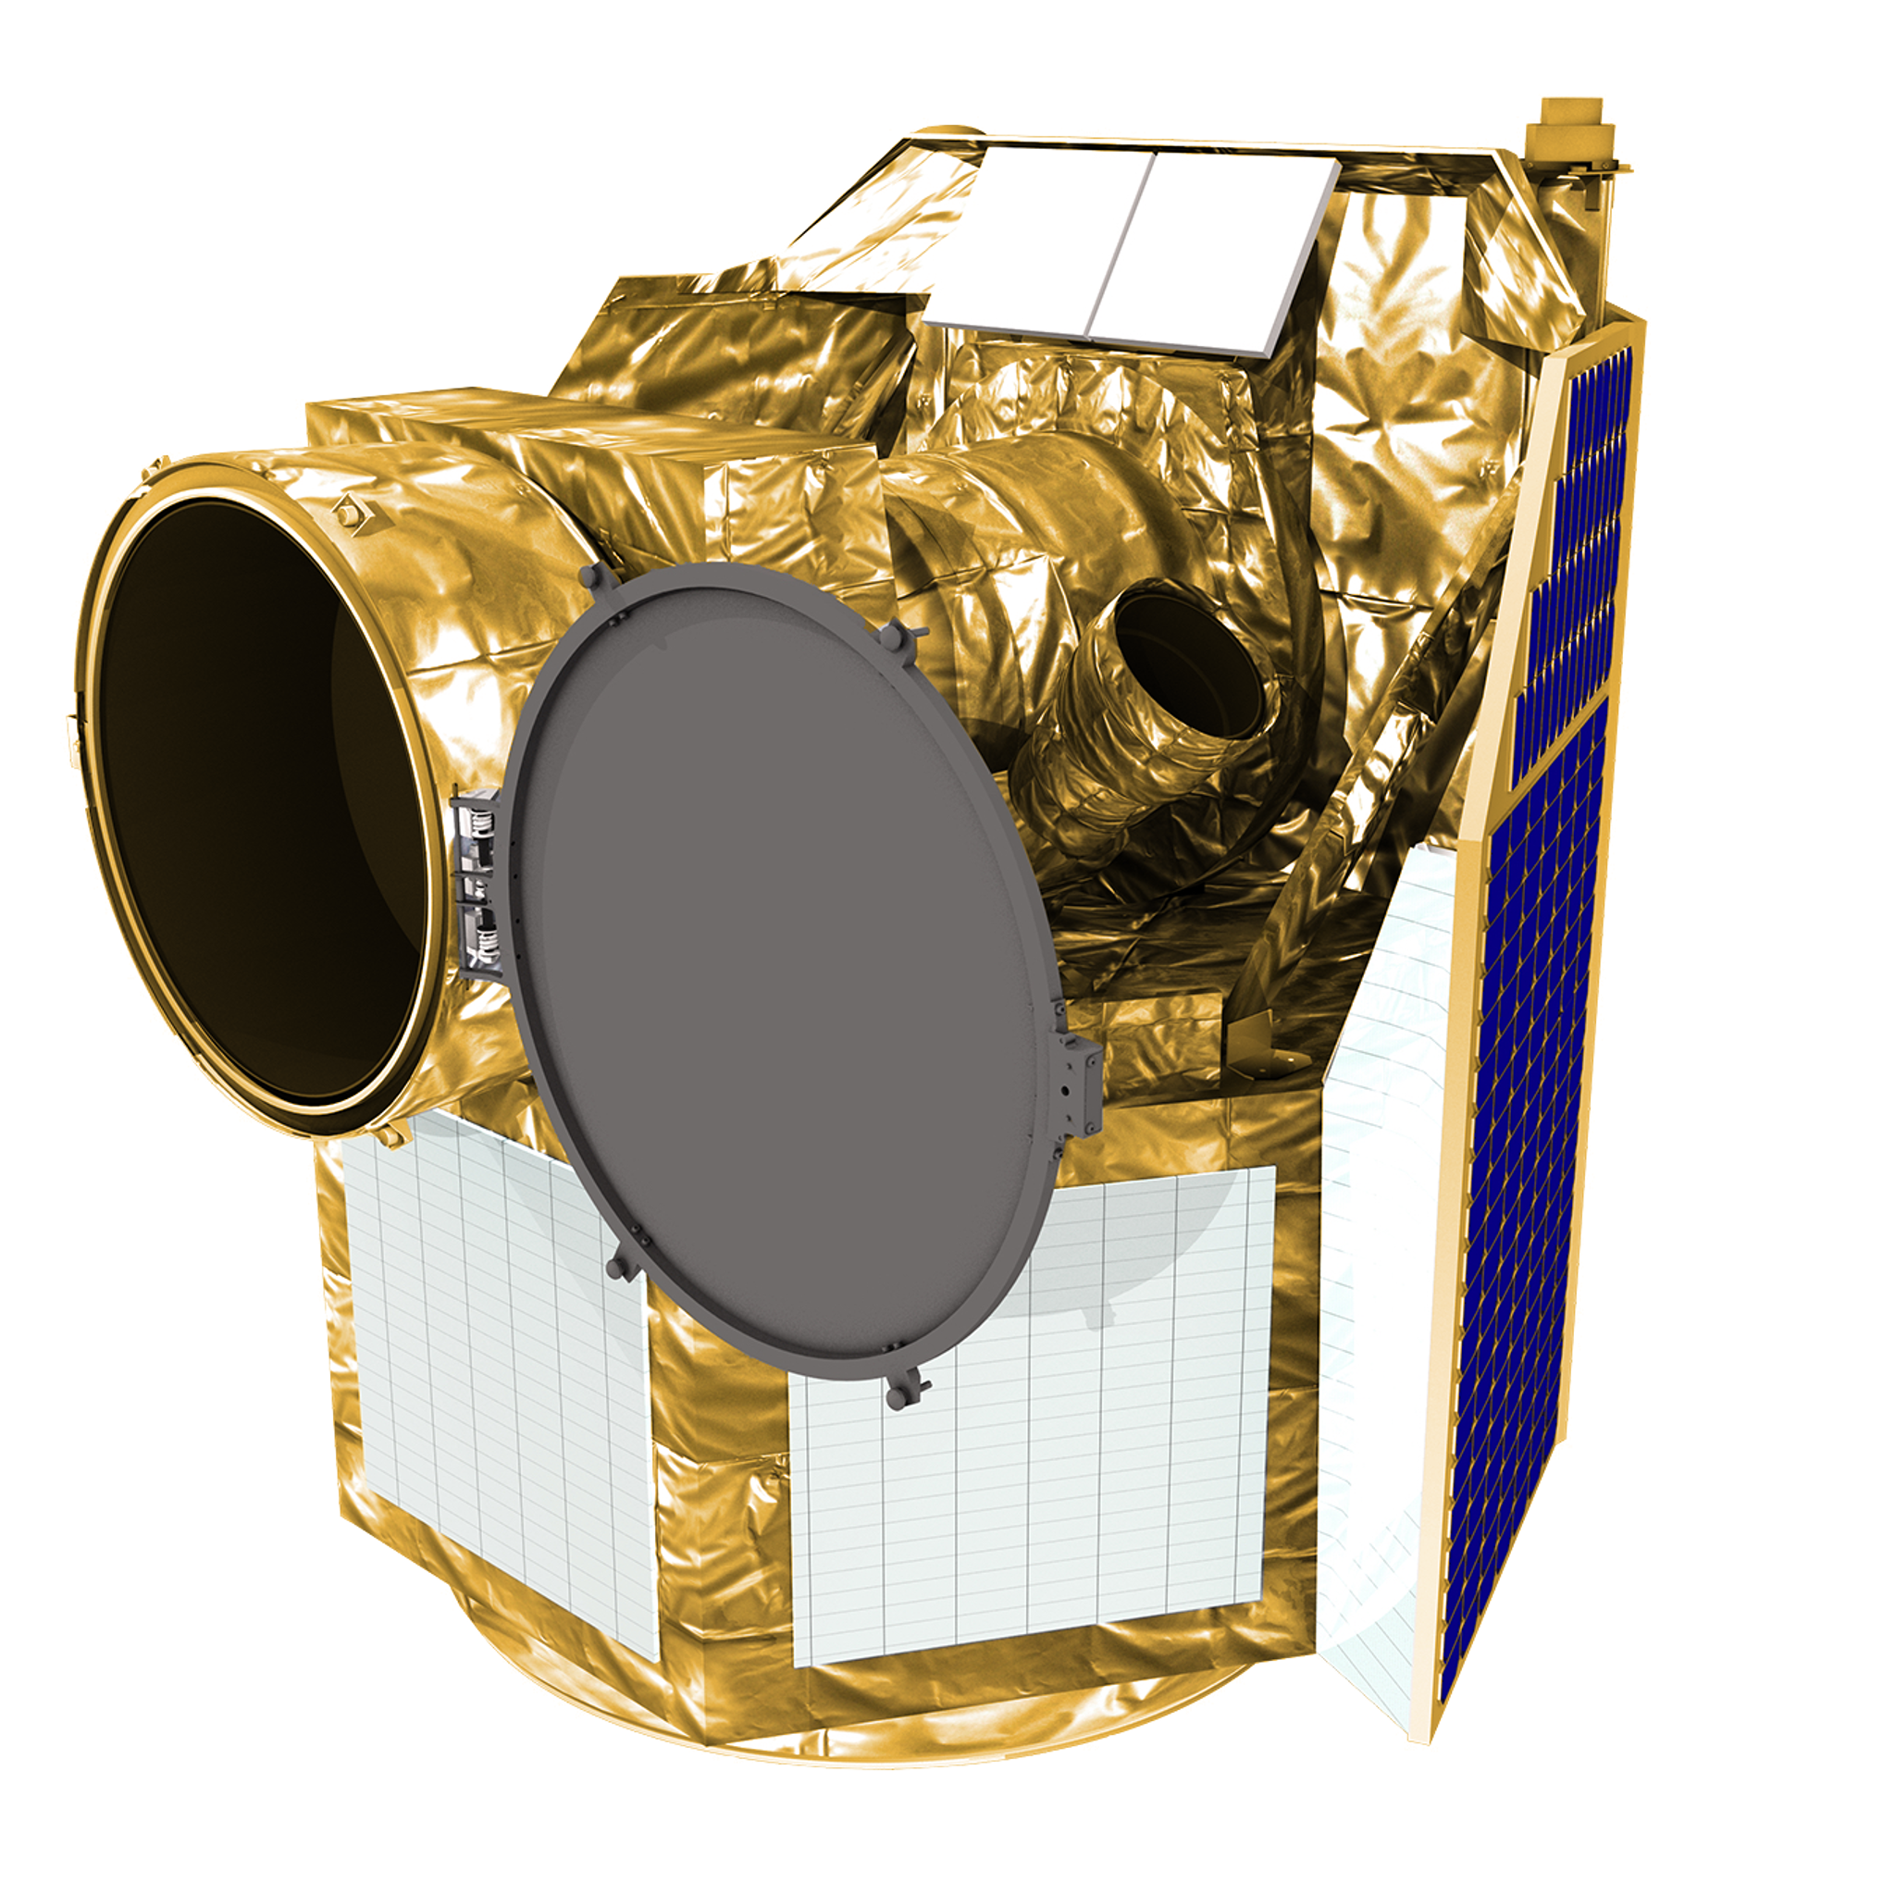
What’s next?
Continue with TESS Follow-up
Ephemeris refinement for JWST and Ariel
ASTEP is the ‘Anti-CHEOPS’
Email me at gxg831@bham.ac.uk

