Slide 1
The antenna system of COSMO
(COSmic Monopole Observer)
Elenia Manzan
Università degli Studi di Milano
SCAR AAA 2021
08/09/2021

Slide 2
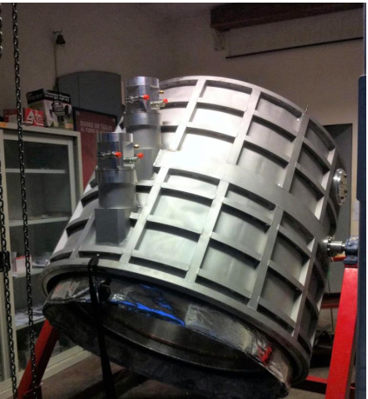
The COSMO experiment
Aims at measuring the isotropic y-distortion of the CMB spectrum
The current state-of-the-art is $\left|y\right|<1.5∙{10}^{−5}$, from COBE-FIRAS and TRIS
COSMO forecasted sensitivity: $\left|y\right|\sim {10}^{−6}$
Site: Concordia station, Antarctica
Image: COSMO collaboration
SCAR AAA 2021
08/09/2021

Slide 3
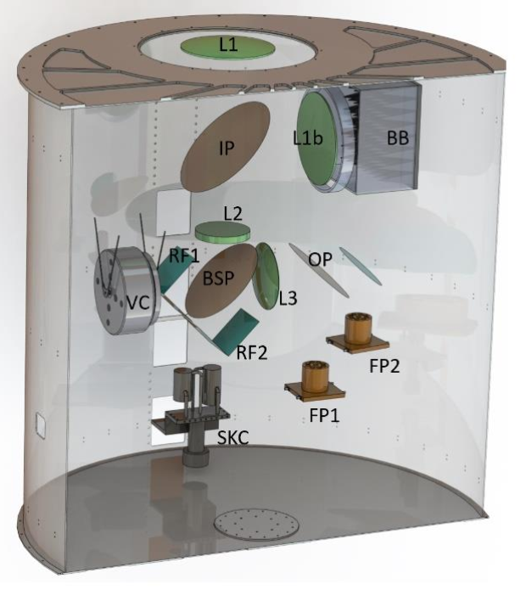
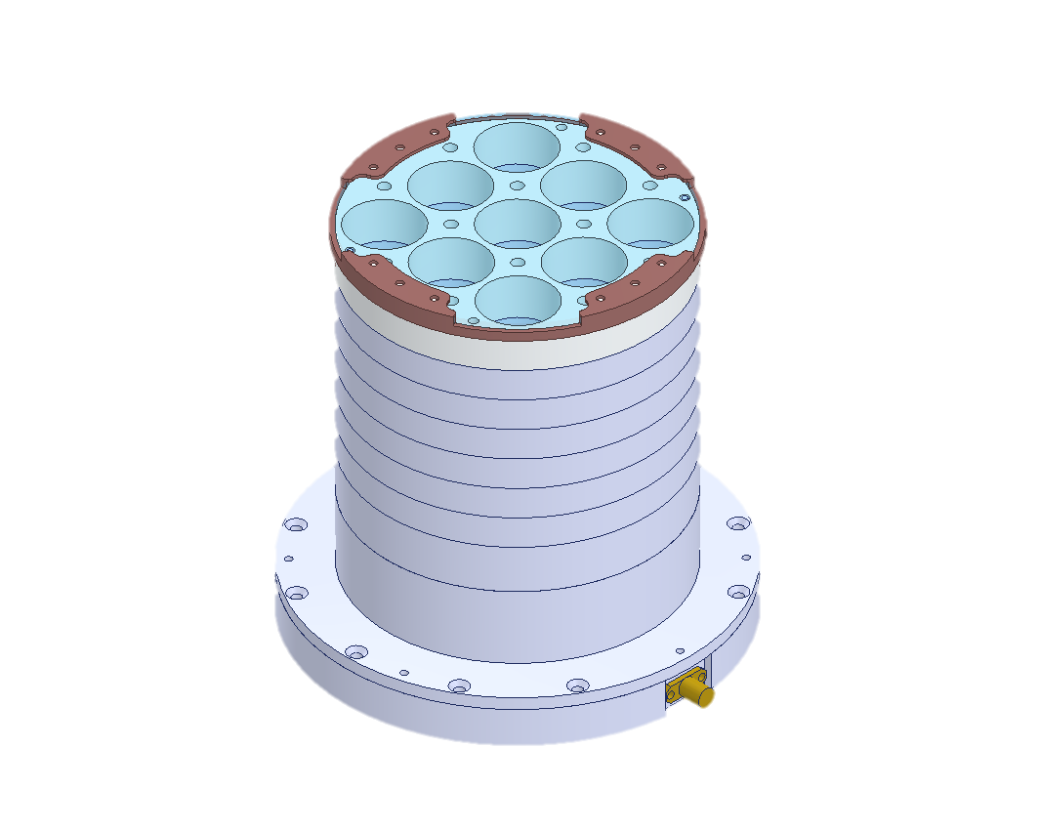
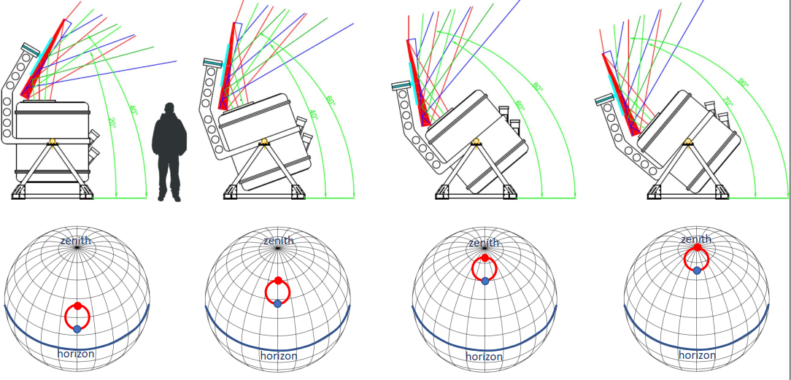
The COSMO experiment
Differential, cryogenic Martin-Pupplett Fourier Transform Spectrometer (FTS)
Reference Blackbody
2 Focal planes: 18 multimoded feed-horns + KID bolometers
Band: 120-300 GHz (limited by the atmospheric window)
Focal planes + band-pass filters
FTS
The cryostat can be tilted and a spinning wedge mirror performs fast sky scans
SCAR AAA 2021
08/09/2021

Slide 4
The antenna system
SCAR AAA 2021
08/09/2021

Slide 5
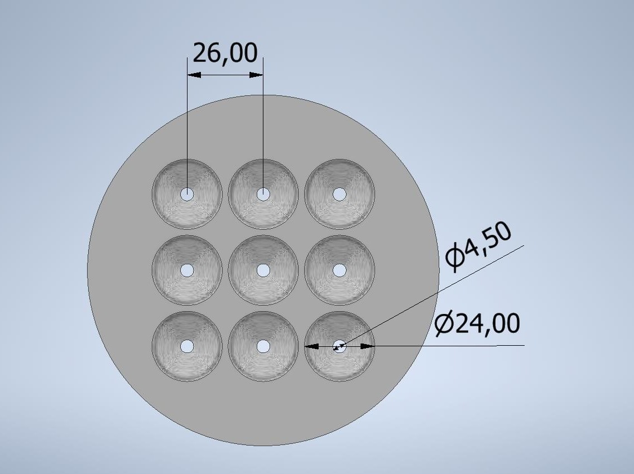
Overview of the antenna system
Array 1 band: 120-180 GHz
Array 2 band: 210-300 GHz
Antennas: smooth-walled feed-horns
Made in aluminum with CNC milling
3x3 feed-horn arrays
Multimoded feed-horns instead of traditional single-mode horns
[measures in mm]
SCAR AAA 2021
08/09/2021

Slide 6
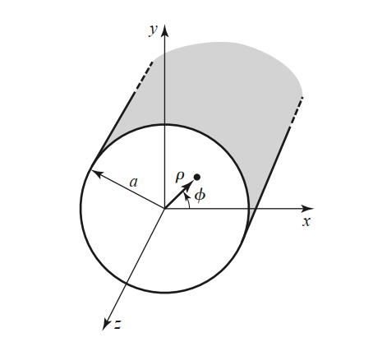
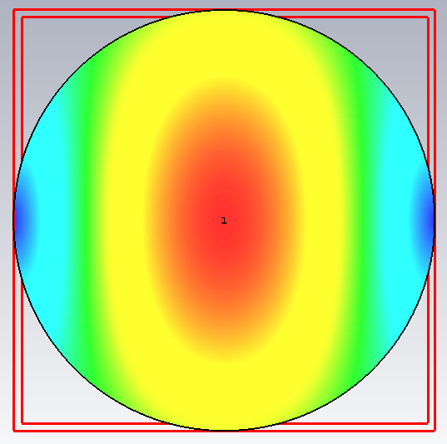
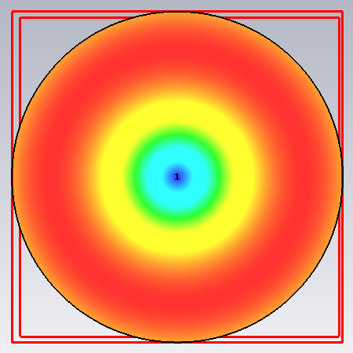
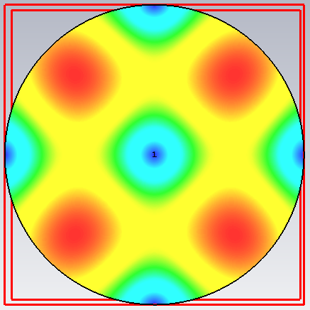
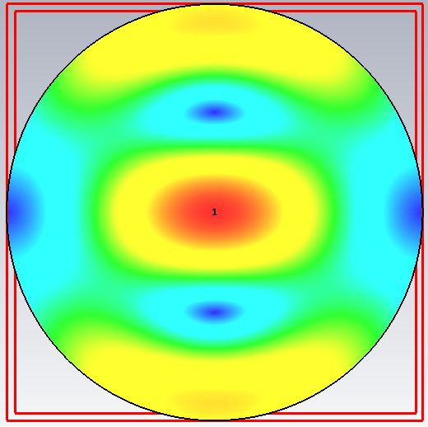
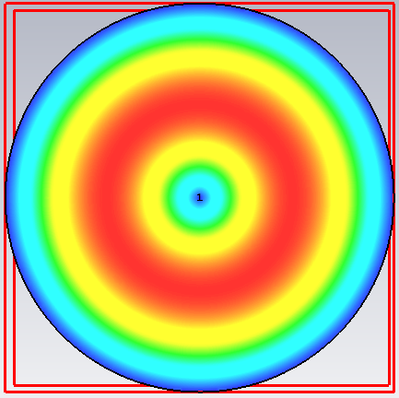
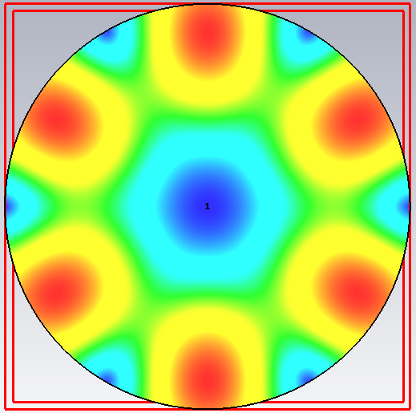
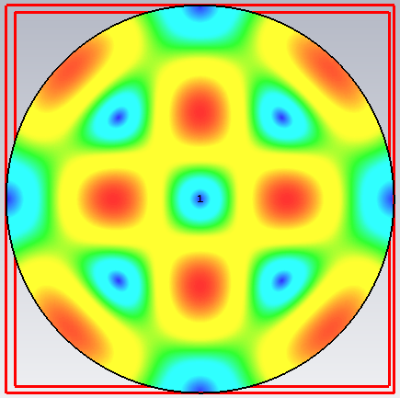
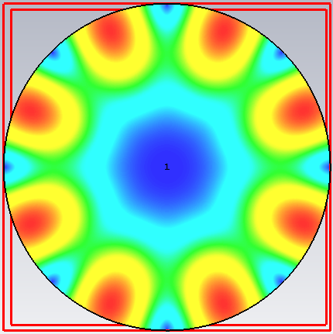
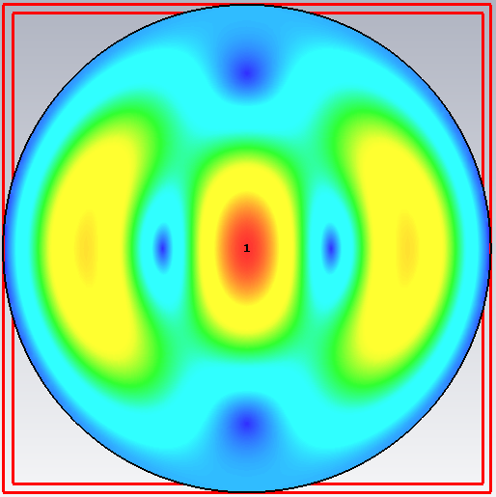
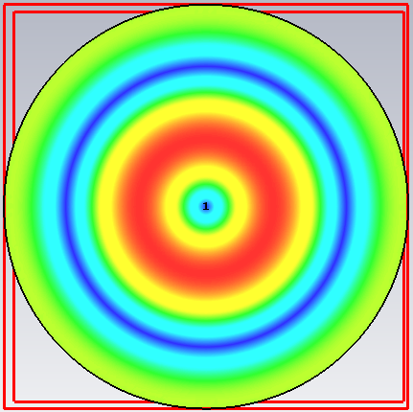
Multimode propagation principle
Single-mode antenna
Multi-mode antenna
Band | Waveguide diameter | # modes
120-180 GHz | 1.47 mm | 1
210-300 GHz | 1 mm | 1
Band | Waveguide diameter | # modes
120-180 GHz | 4.5 mm | From 10 to 19
210-300 GHz | 4 mm | From 23 to 42
A hollow circular waveguide supports TE and TM mode propagation.
TE11
TM01
TE21
TM11
TE01
Cut-off frequency $\sim 1/a$
TE31
TM21
TE41
TE12
TM02
SCAR AAA 2021
08/09/2021

Slide 7
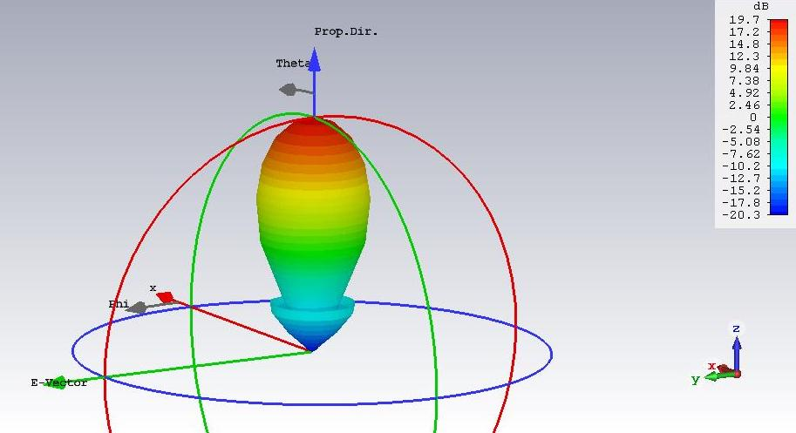
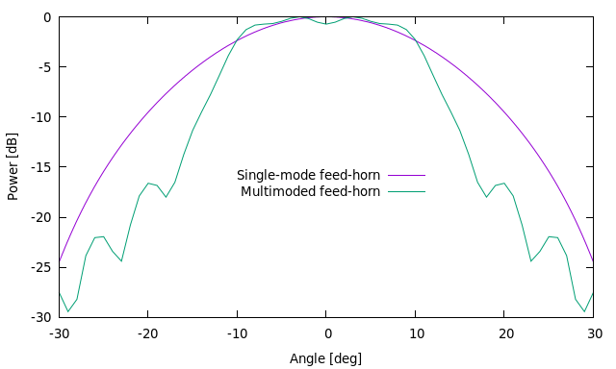
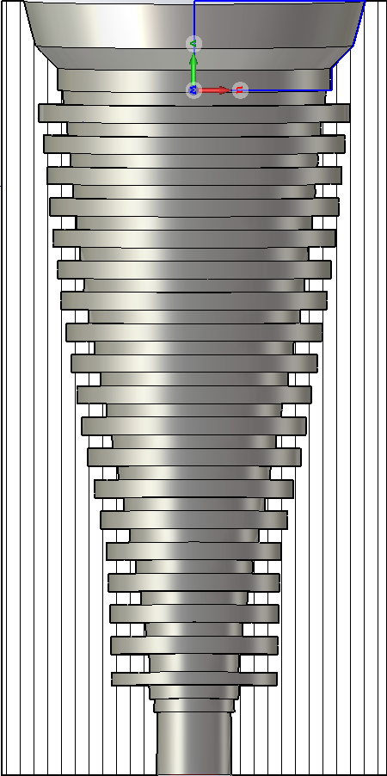
Multimode propagation advantages
Multimoded receivers (antenna+detector) have a higher signal-to-noise level: $\frac{S}{N}\sim \sqrt{N_{modes}}$
Multimoded antennas can illuminate the cryostat aperture (or telescope) more uniformly than single-mode ones.
The beam pattern $P(θ,φ)$ describes the antenna performance, i.e. the angular distribution of emitted/received power in farfield condition.
Multimoded beam pattern are flatter than single-mode ones along the antenna axis.
150 GHz
SCAR AAA 2021
08/09/2021

Slide 8
The antenna design in details
The antenna design is the best trade-off between
The multimode requirement on the circular waveguide: fixed waveguide diameter
The mechanical constraint on the antenna aperture: aperture $≤$ 24 mm
The optimization of the antenna directivity inside
the cryostat aperture window, seen under a $≈17°$ angle (f/# 3.3)
Aperture window
Band | Waveguide diameter
120-180 GHz | 4.5 mm
210-300 GHz | 4 mm
Focal planes + band-pass filters
SCAR AAA 2021
08/09/2021

Slide 9
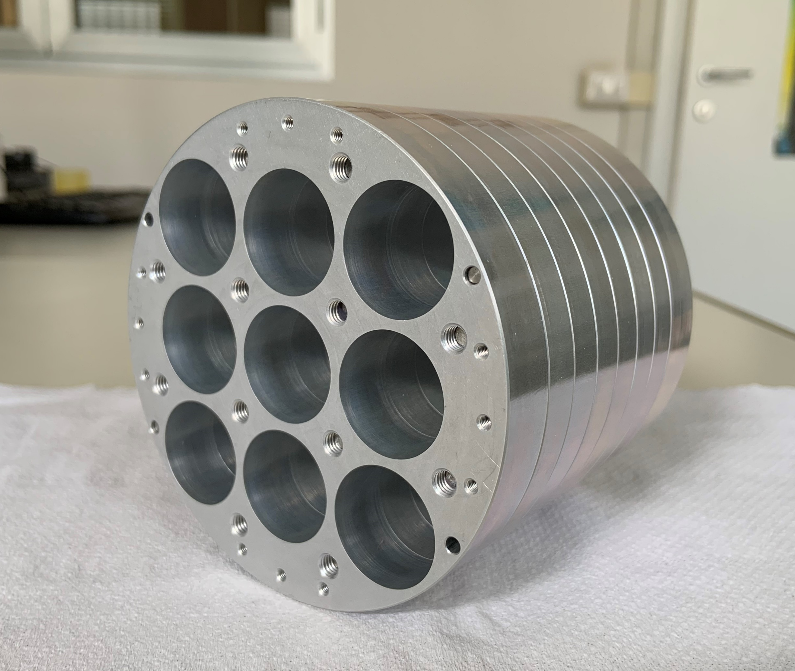
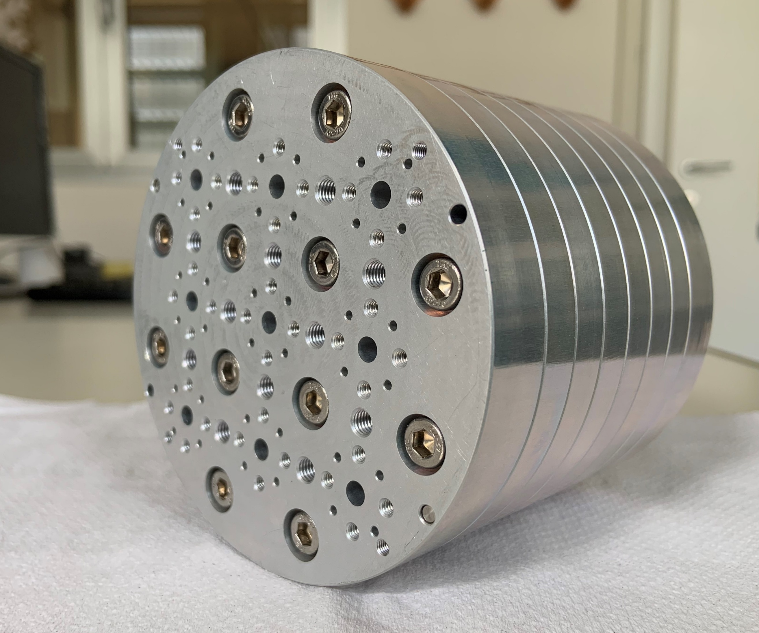
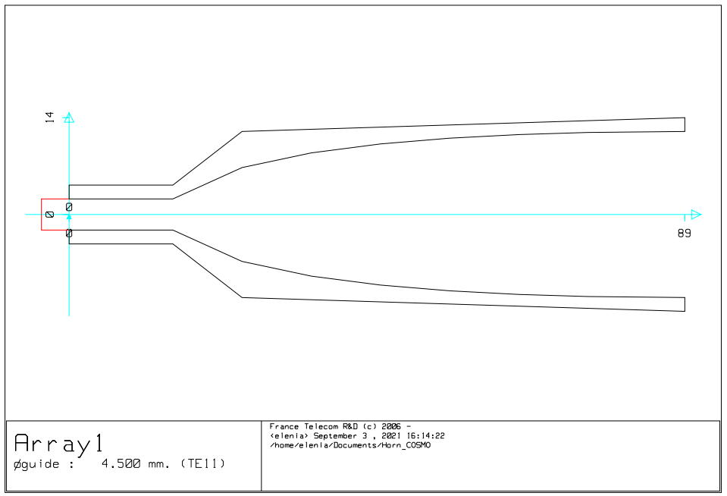
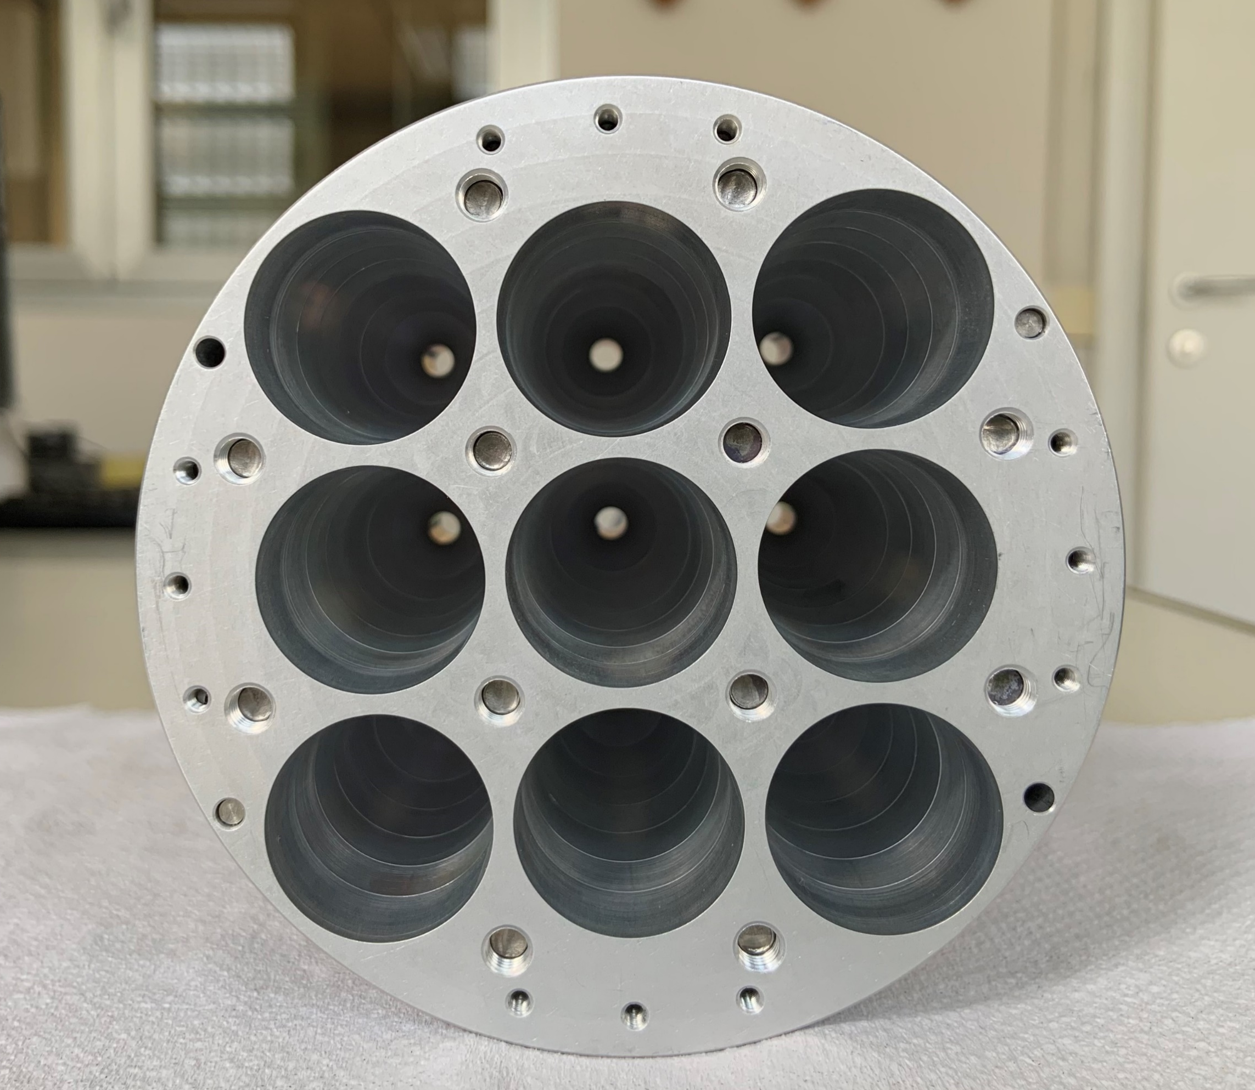
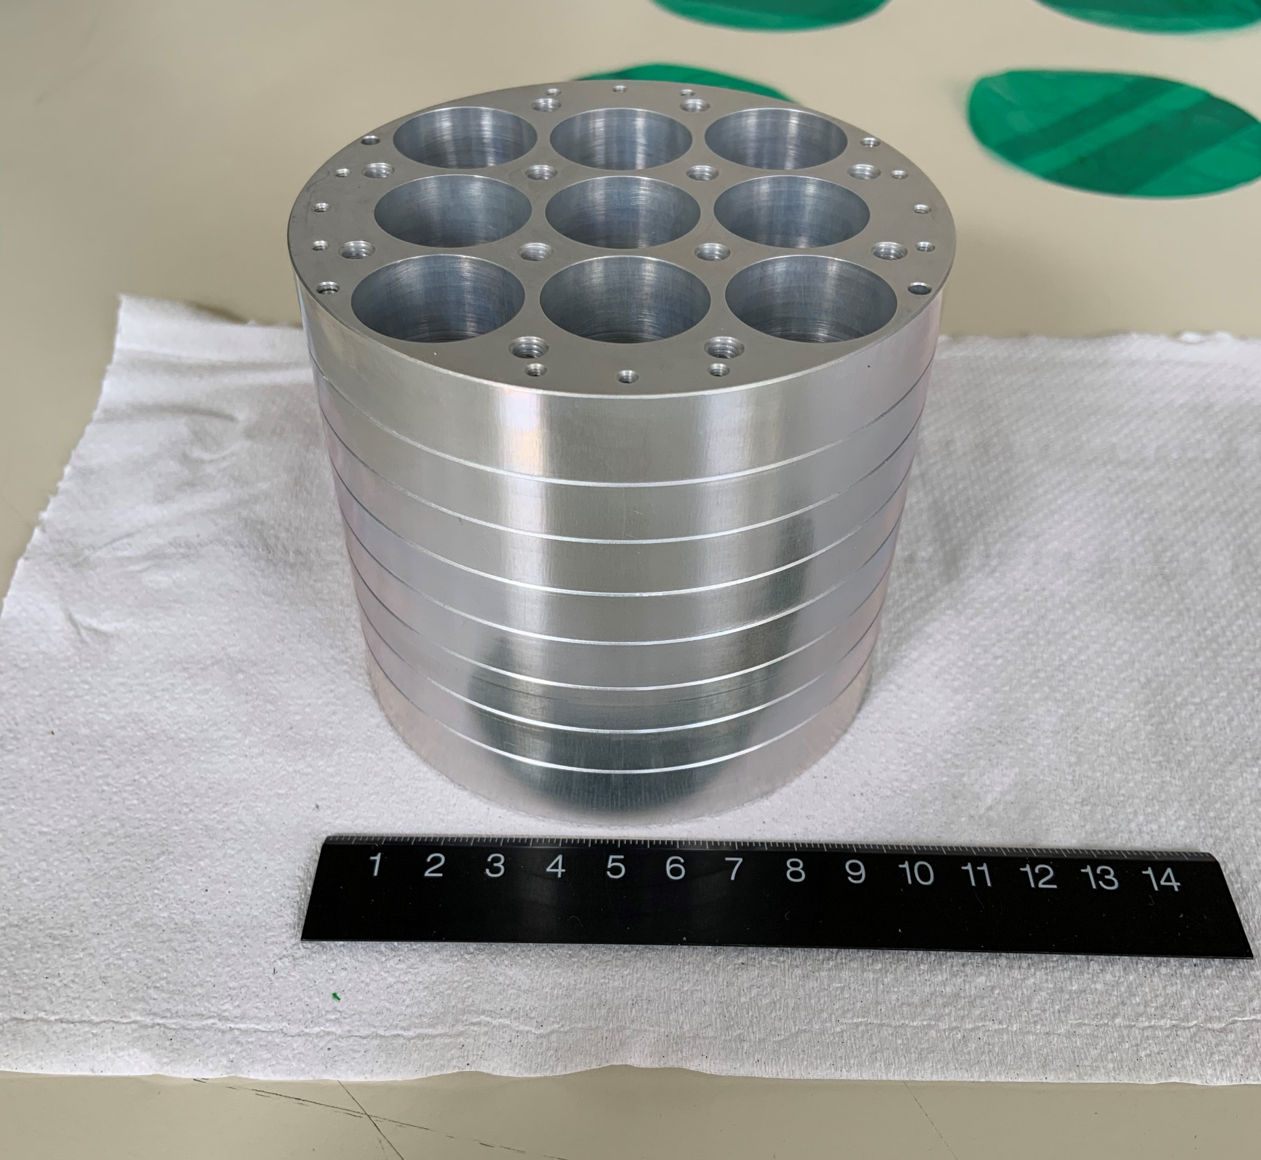
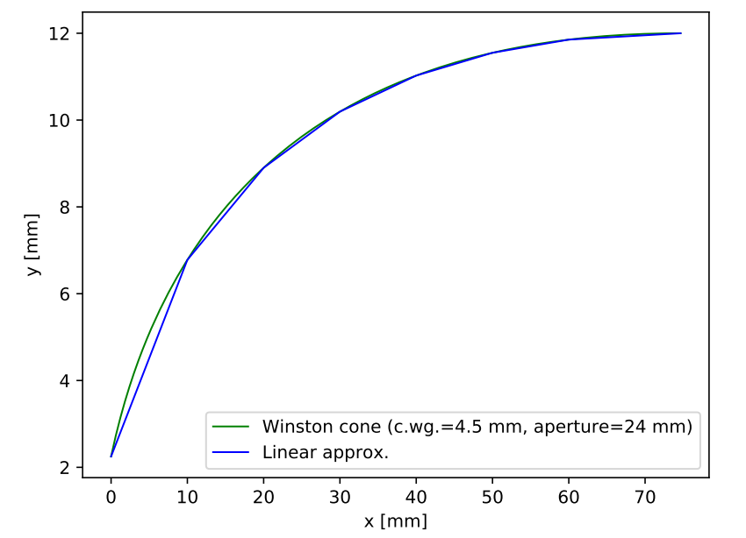
The low-frequency array
Profile: 4.5 mm circular waveguide + platelet Winston cone
[measures in mm]
SCAR AAA 2021
08/09/2021

Slide 10
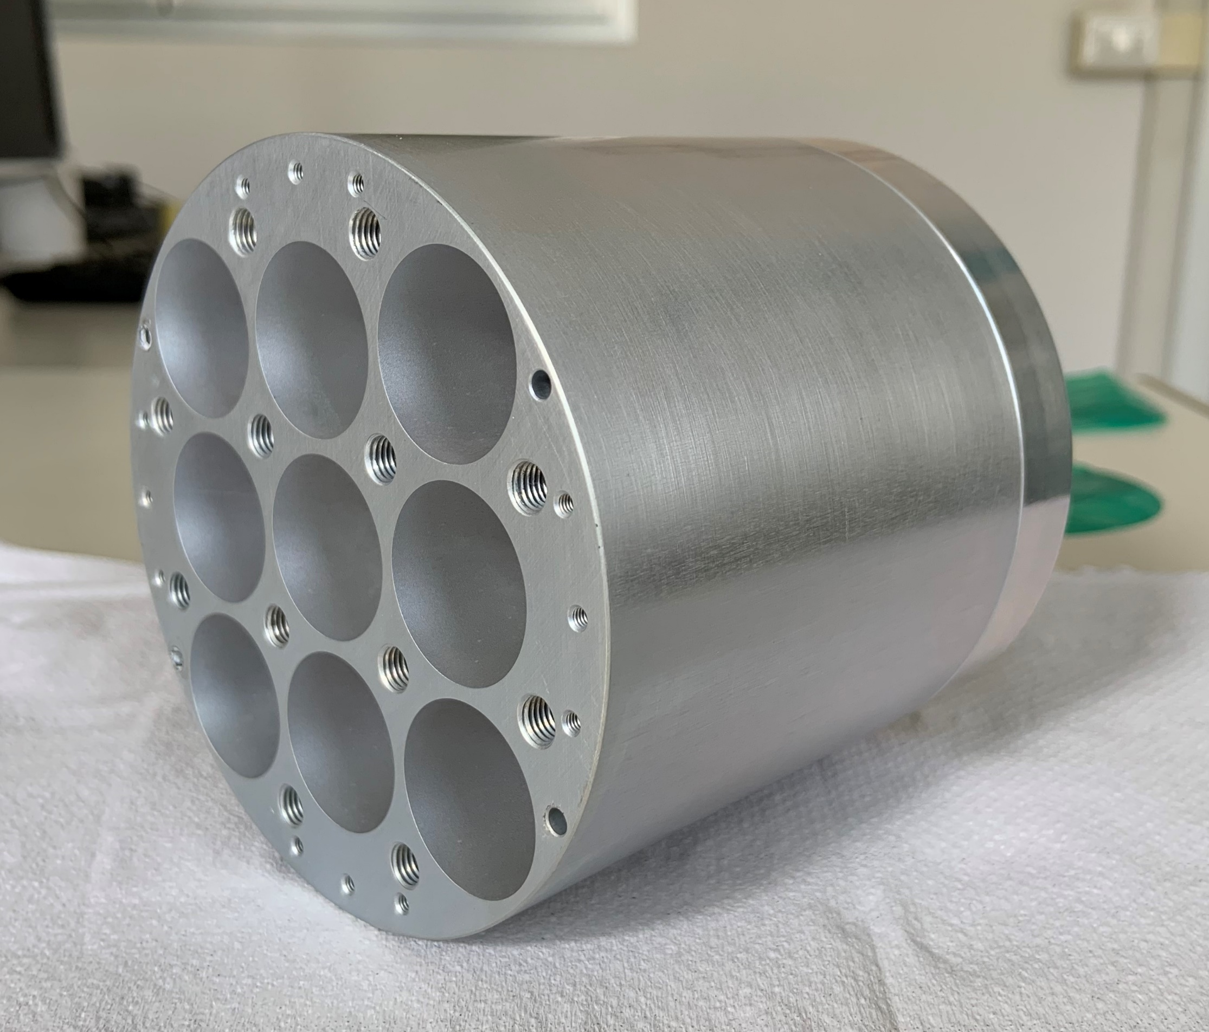
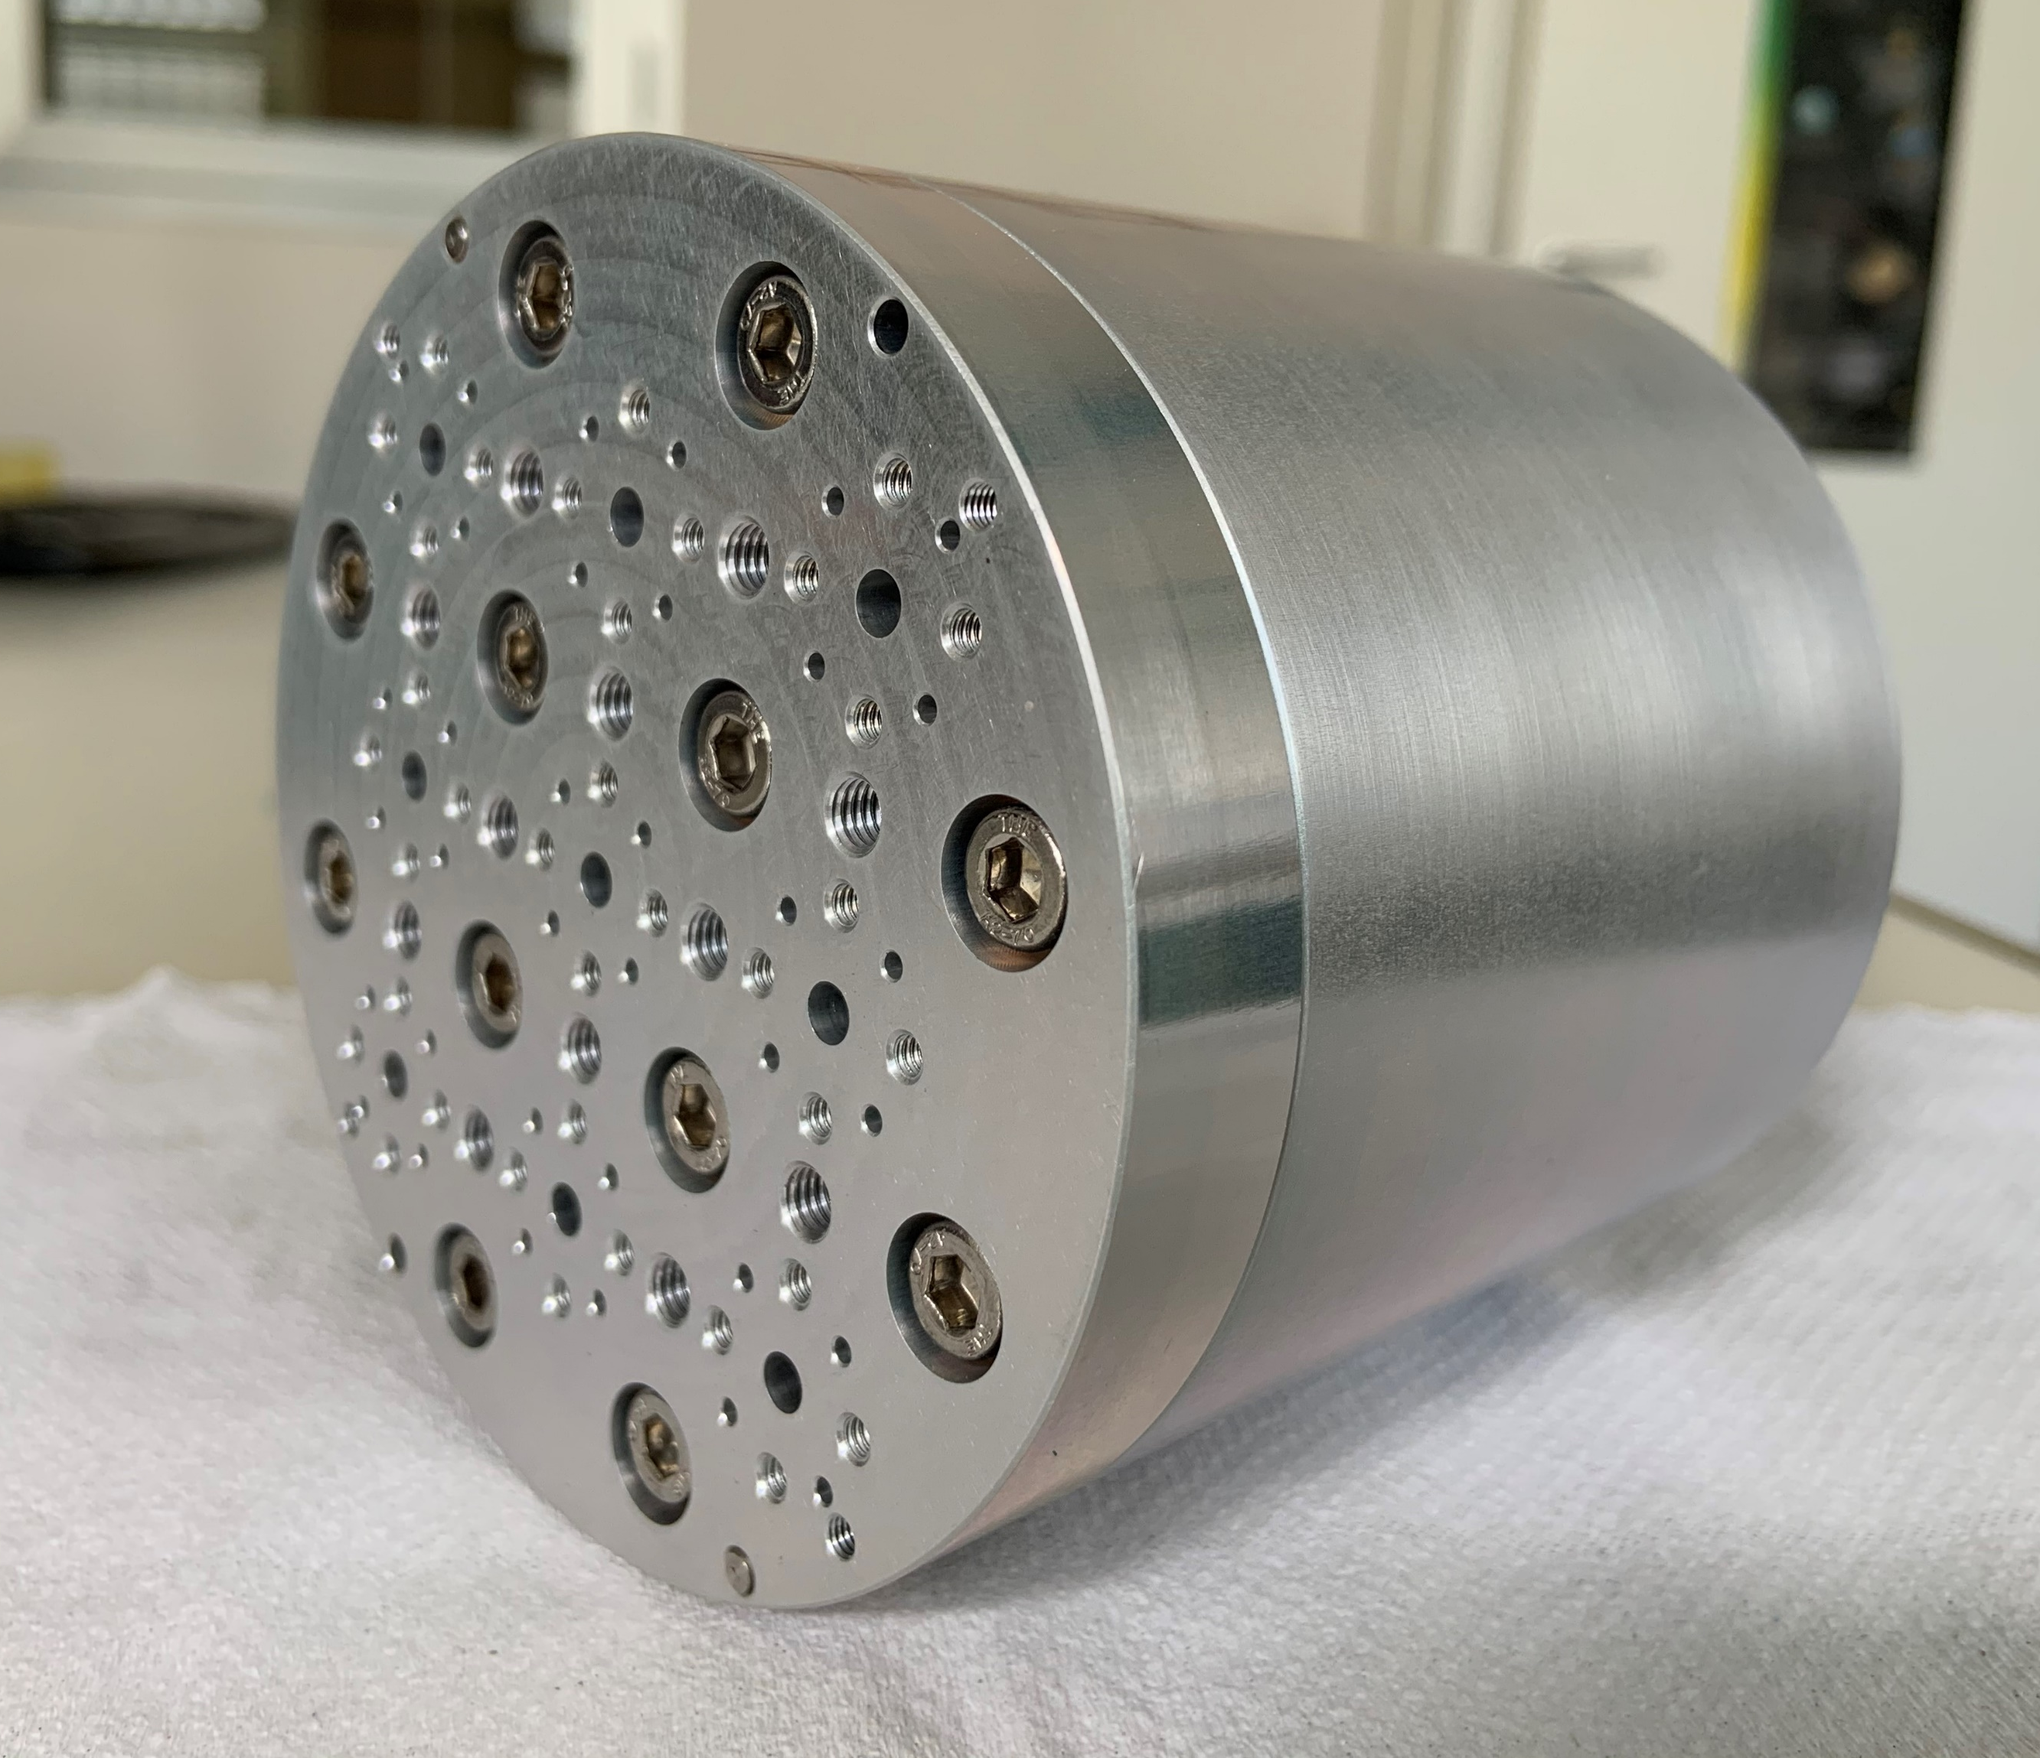
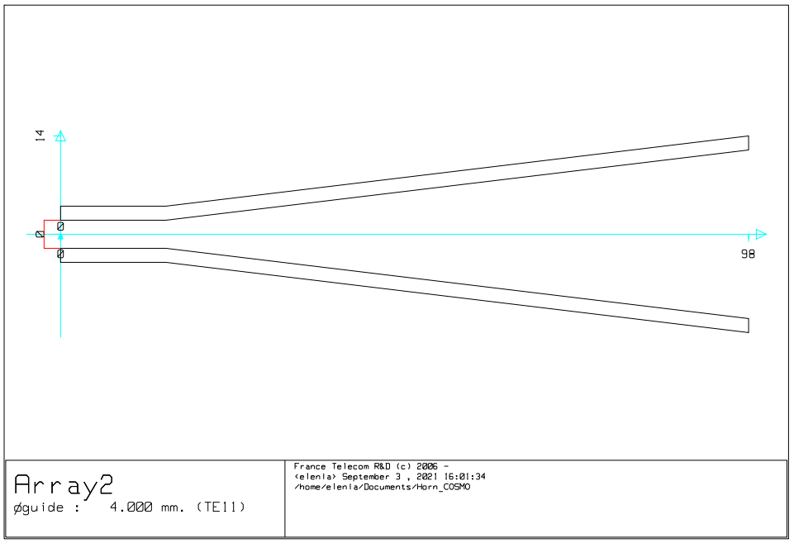
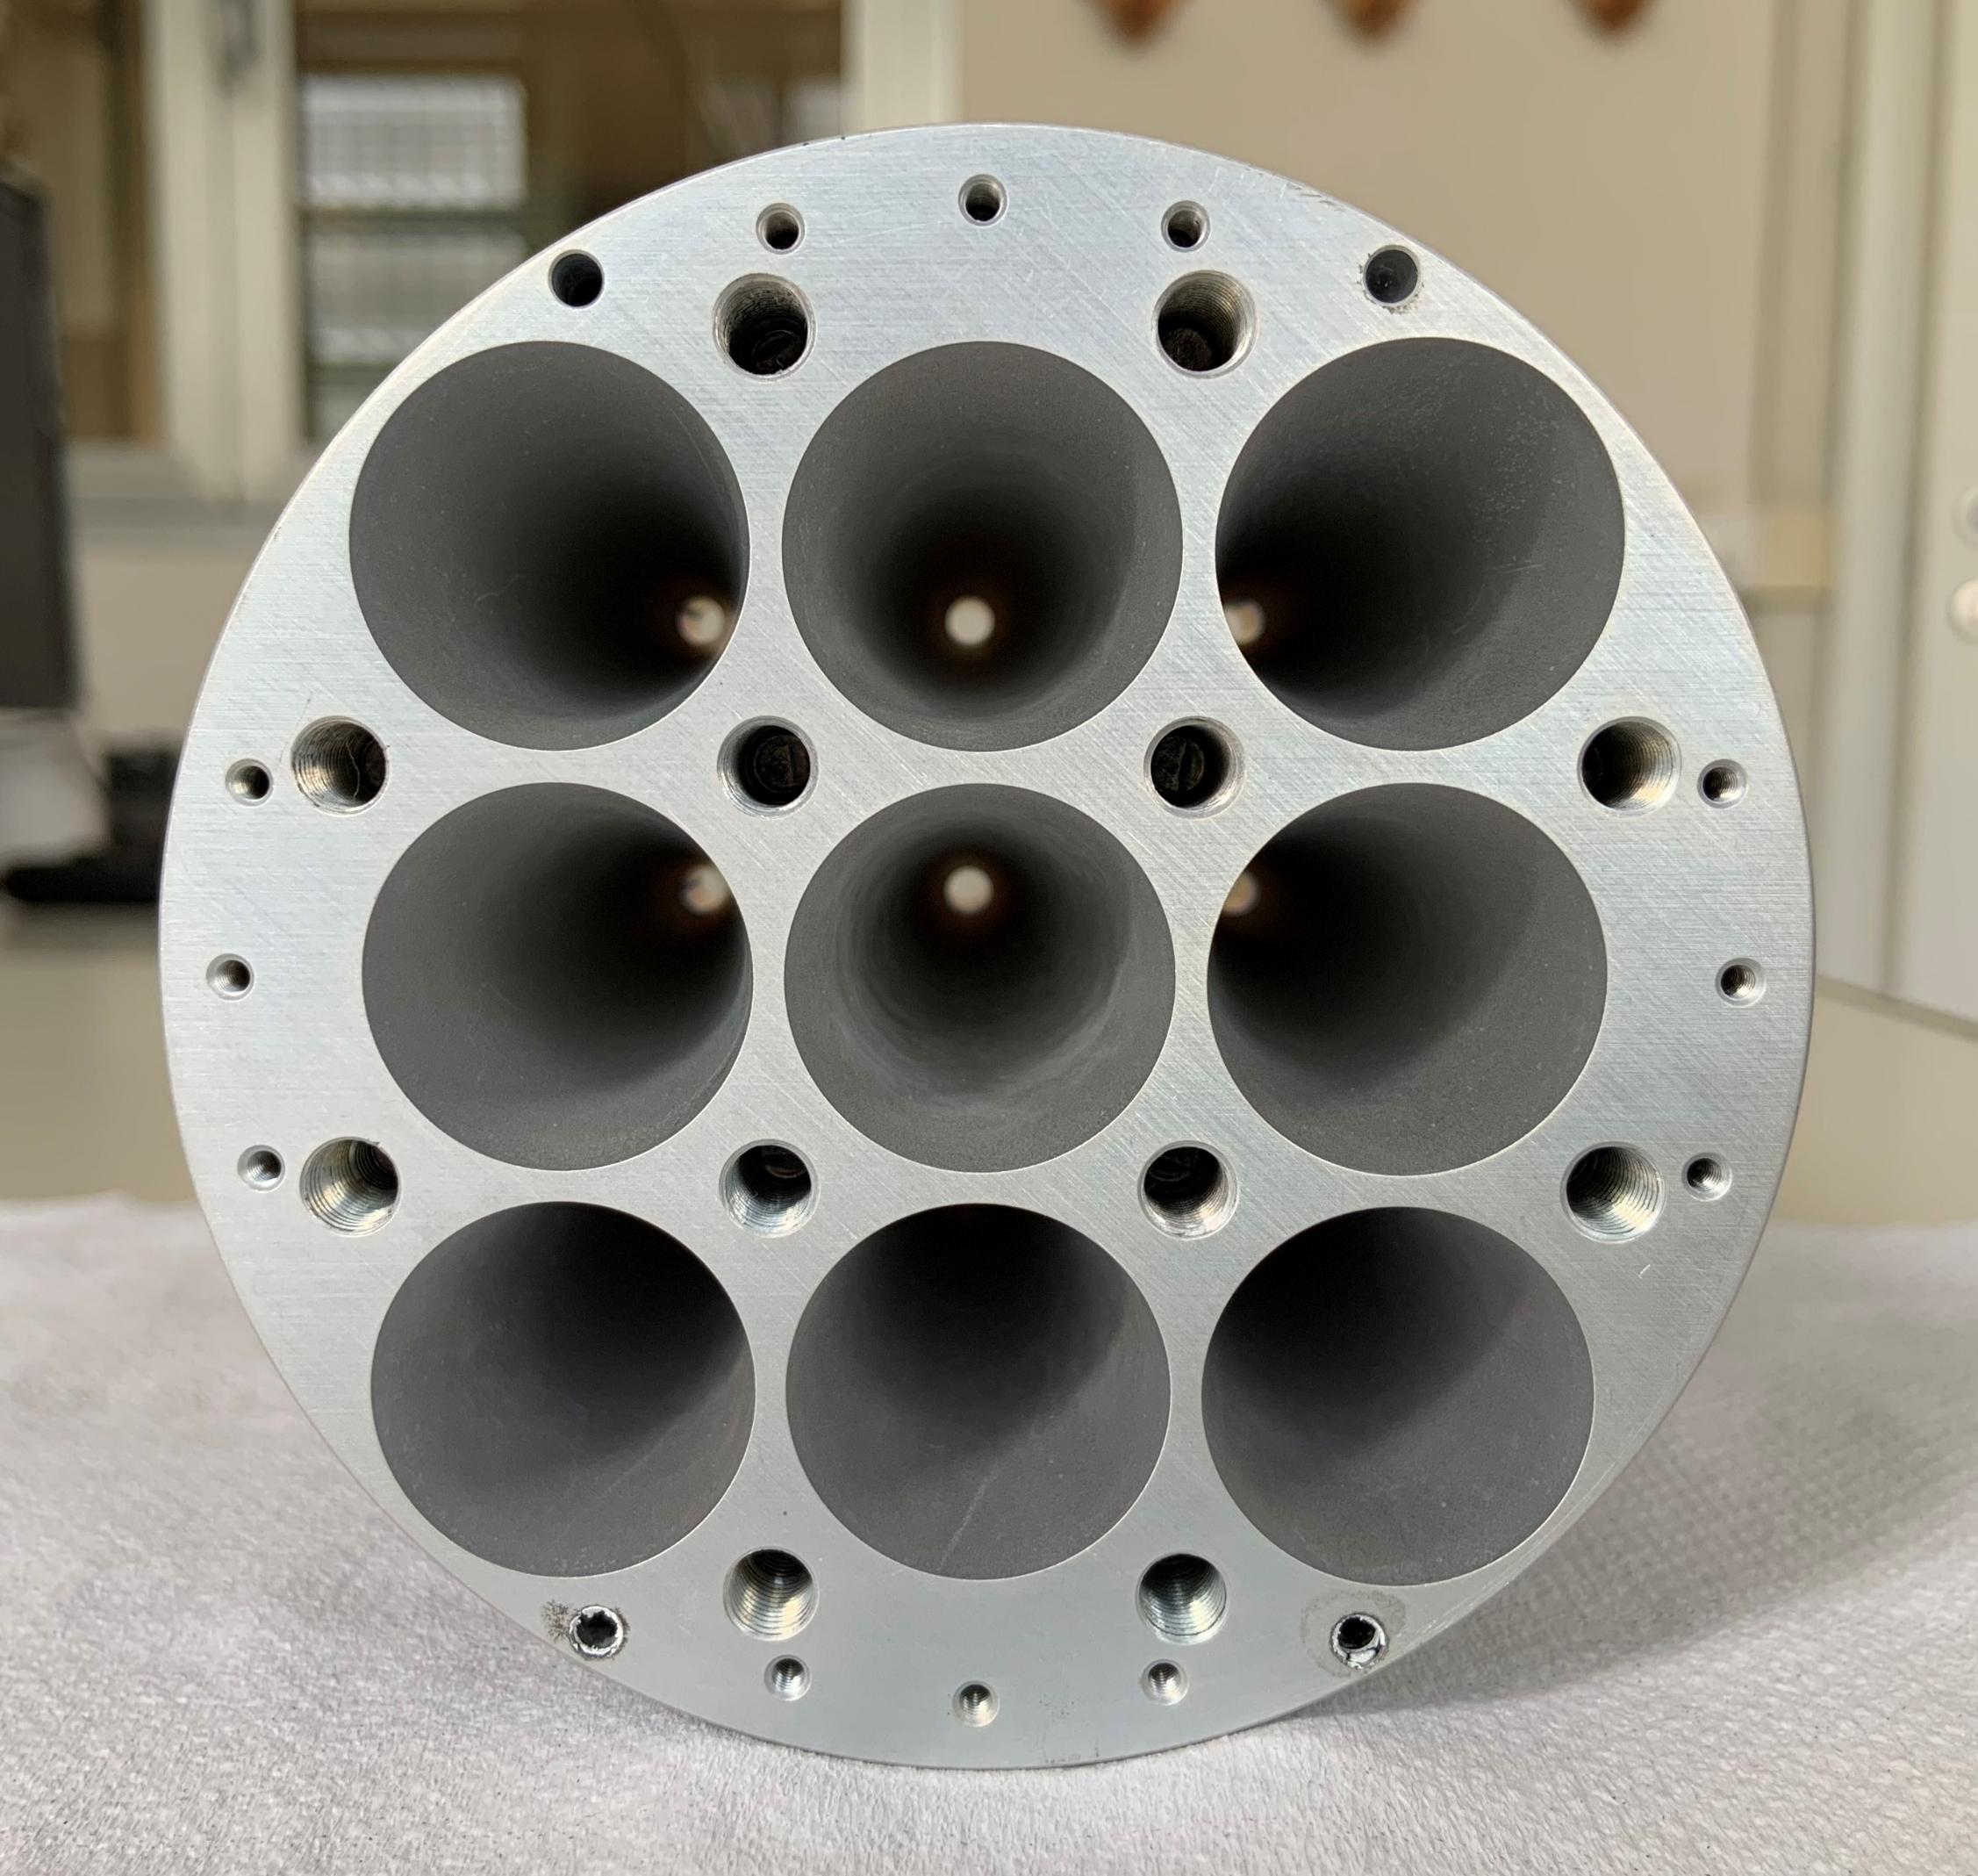
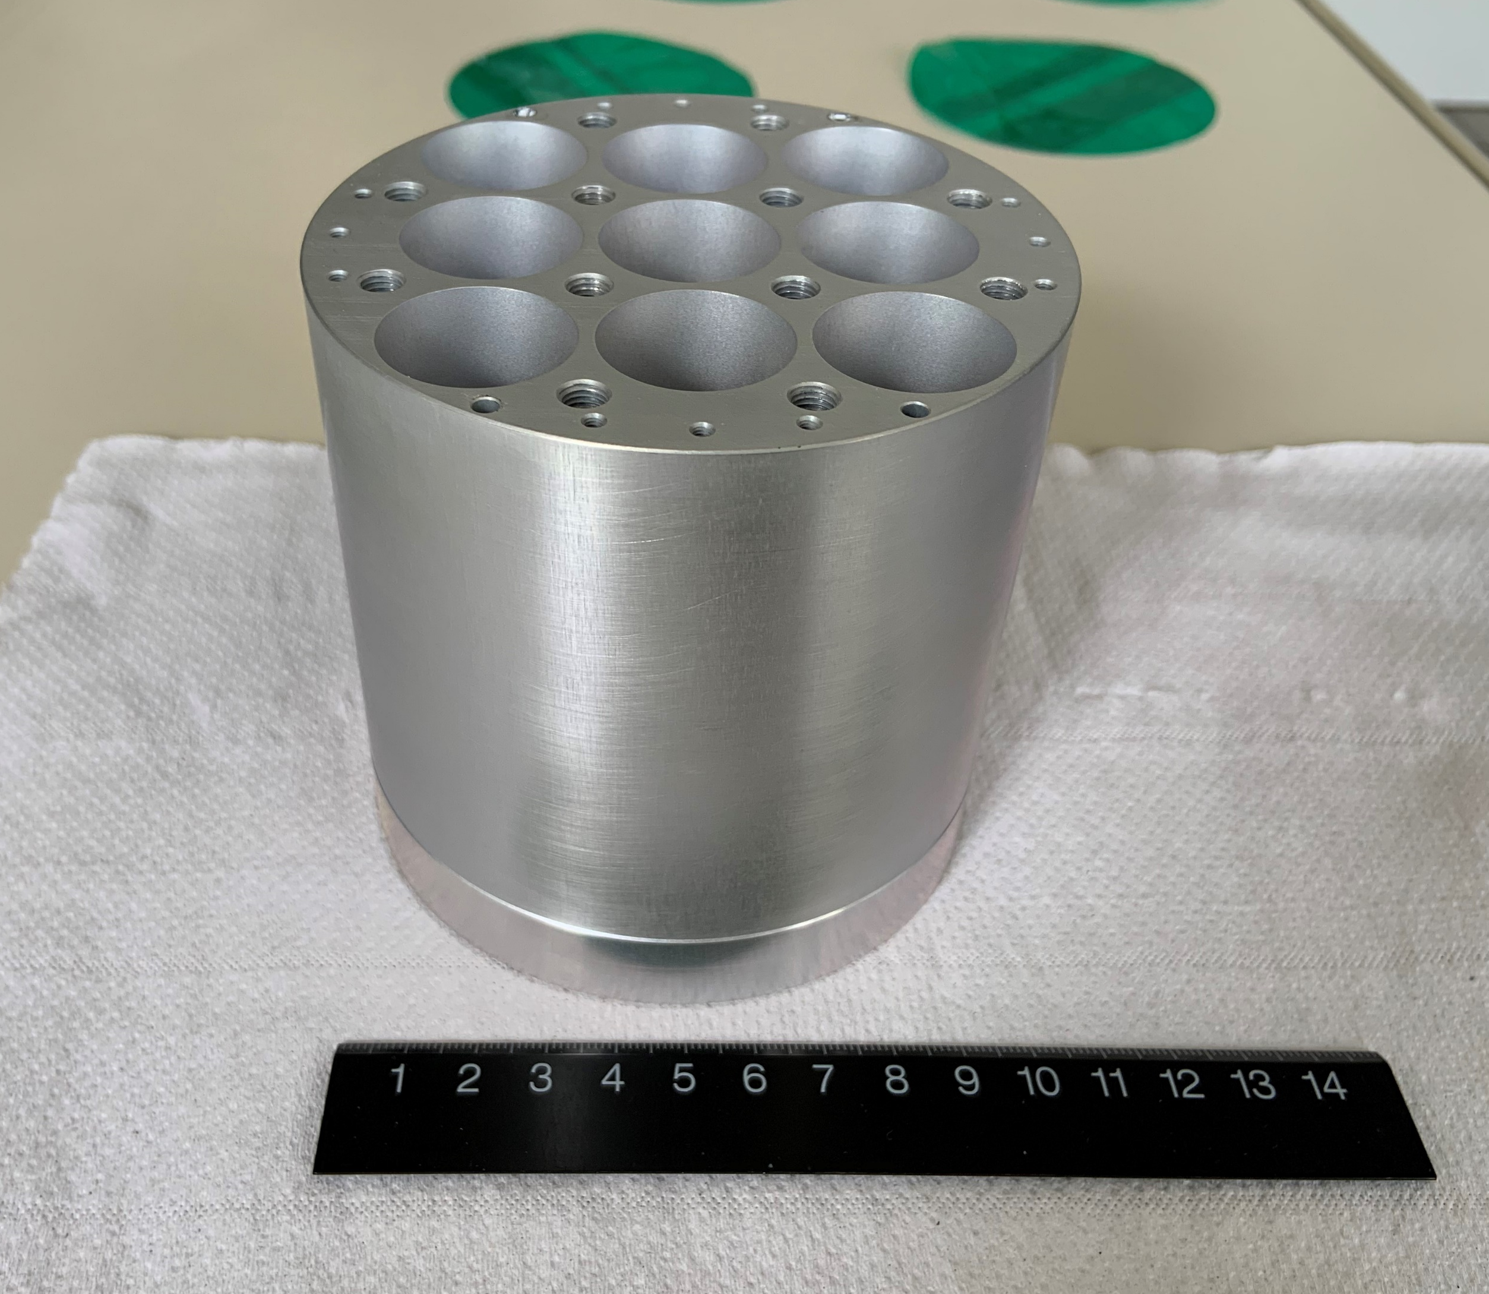
The high-frequency array
Profile: 4 mm circular waveguide + linear profile
[measures in mm]
SCAR AAA 2021
08/09/2021

Slide 11
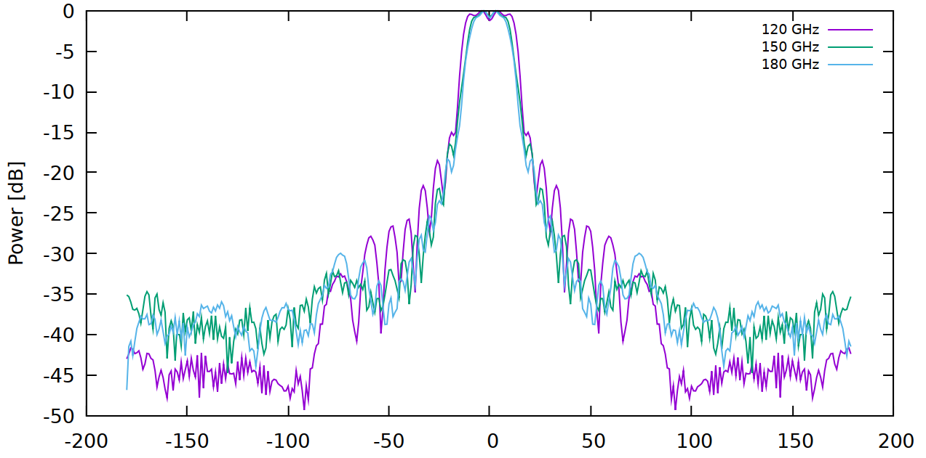
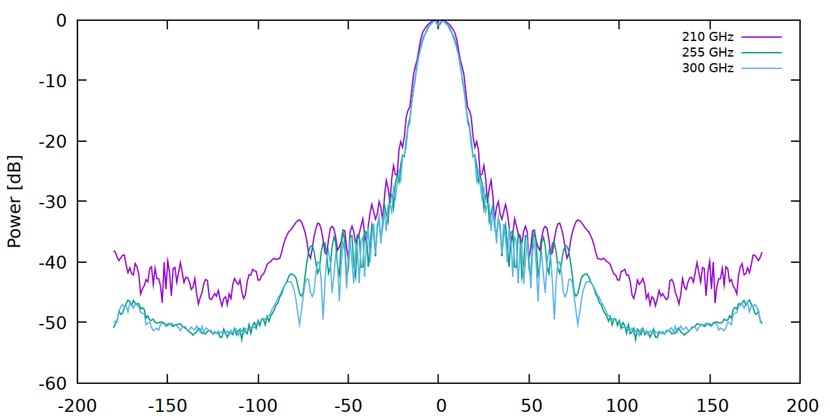
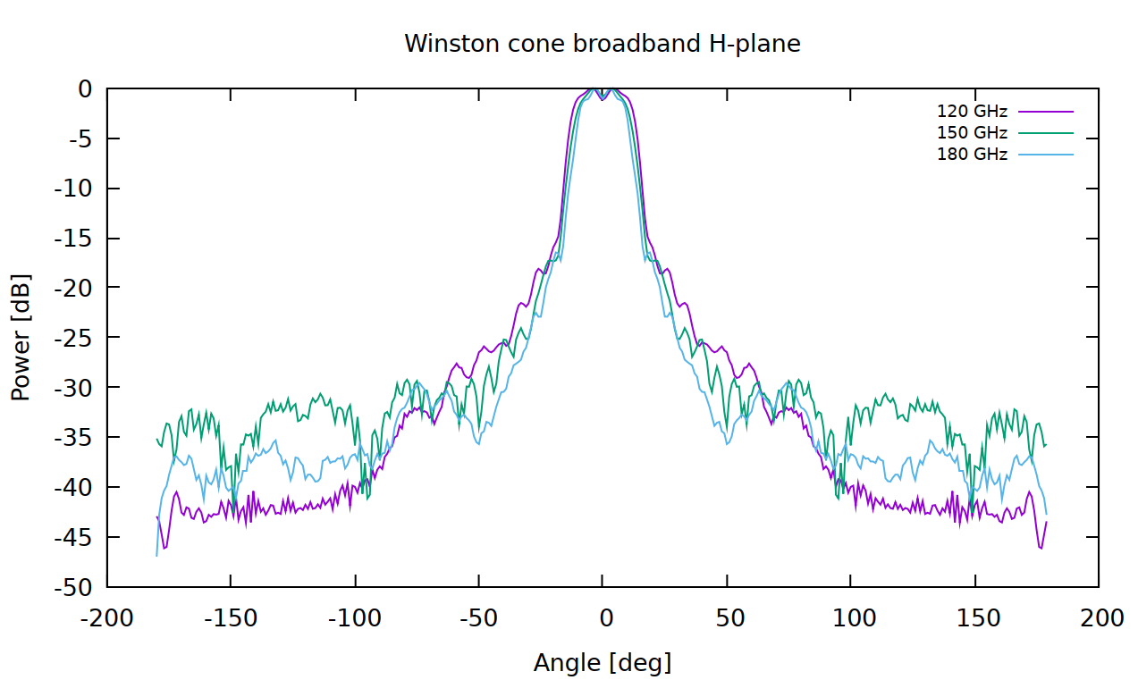
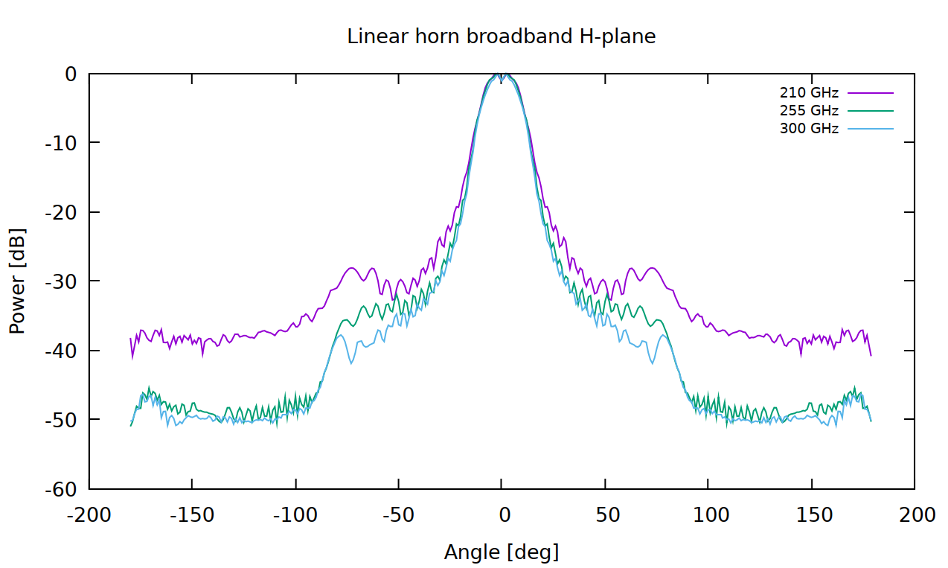
Forecasted broadband performance
Low-frequency array
High-frequency array
Fixed $φ=90°$ plane
Fixed $φ=90°$ plane
Fixed $φ=0°$ plane
Fixed $φ=0°$ plane
SCAR AAA 2021
08/09/2021

Slide 12
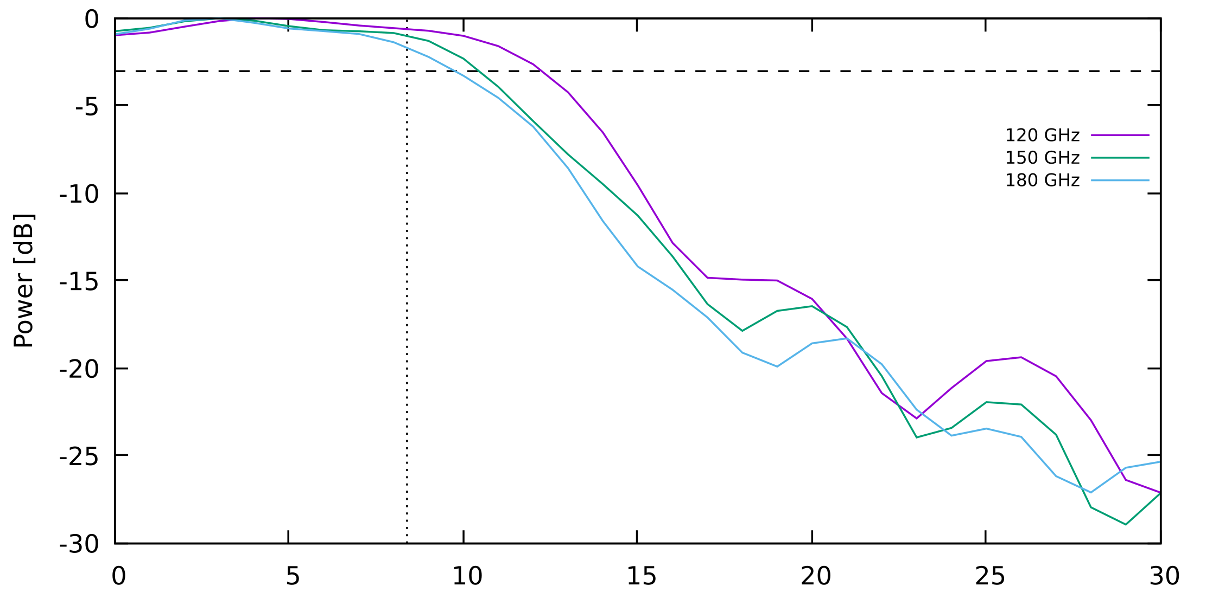
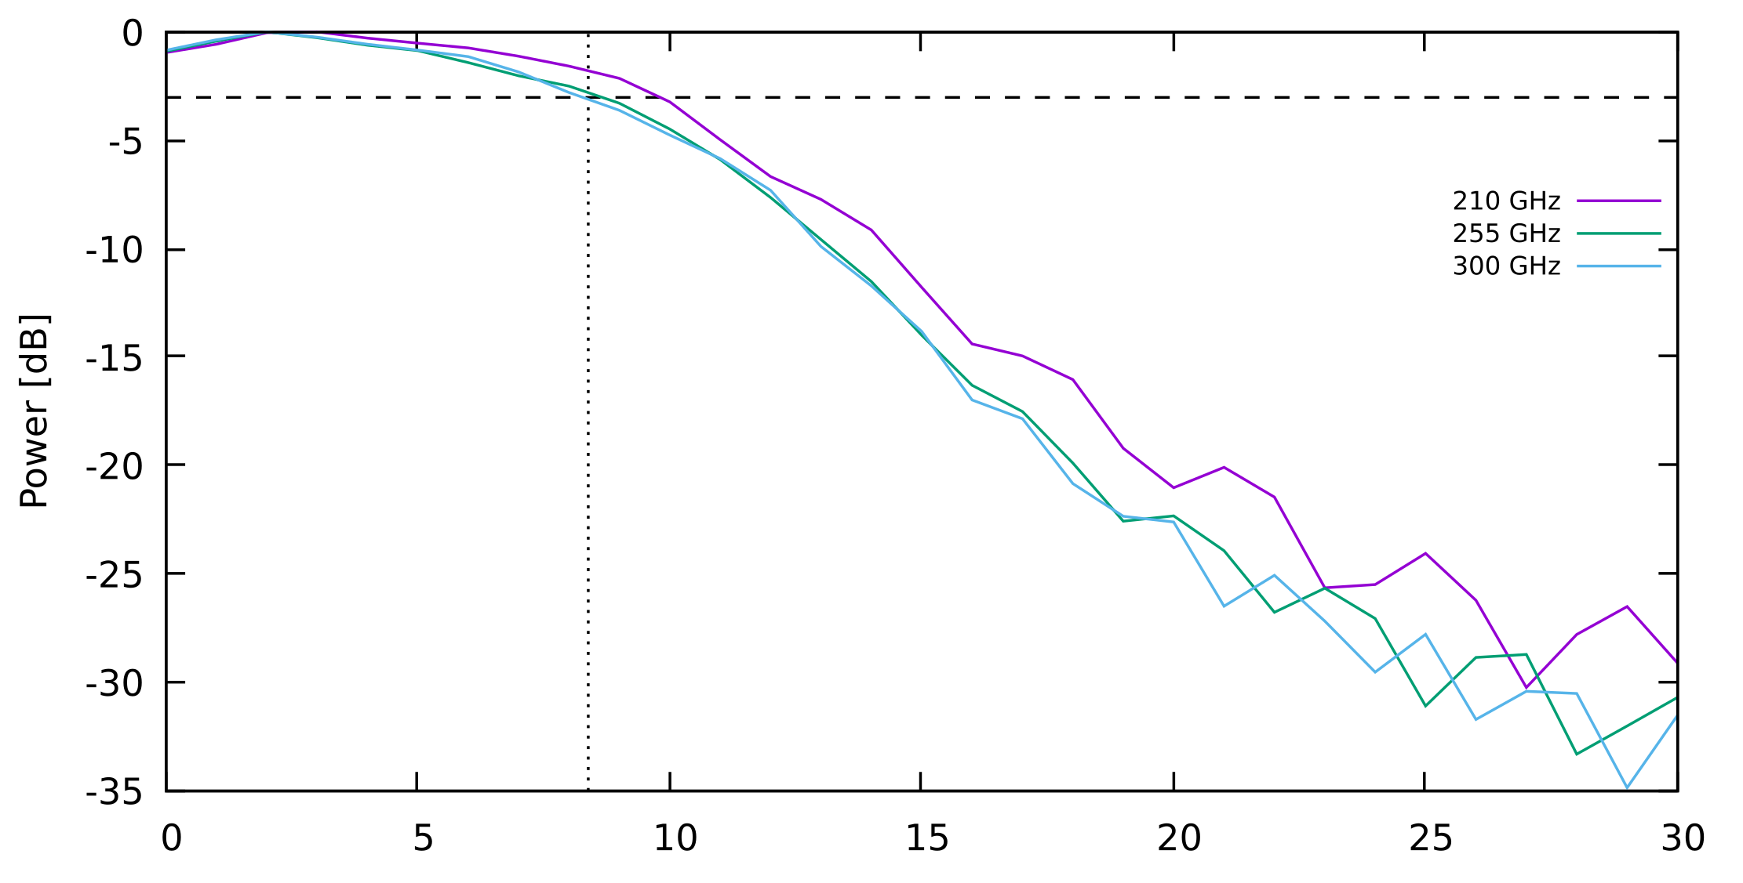
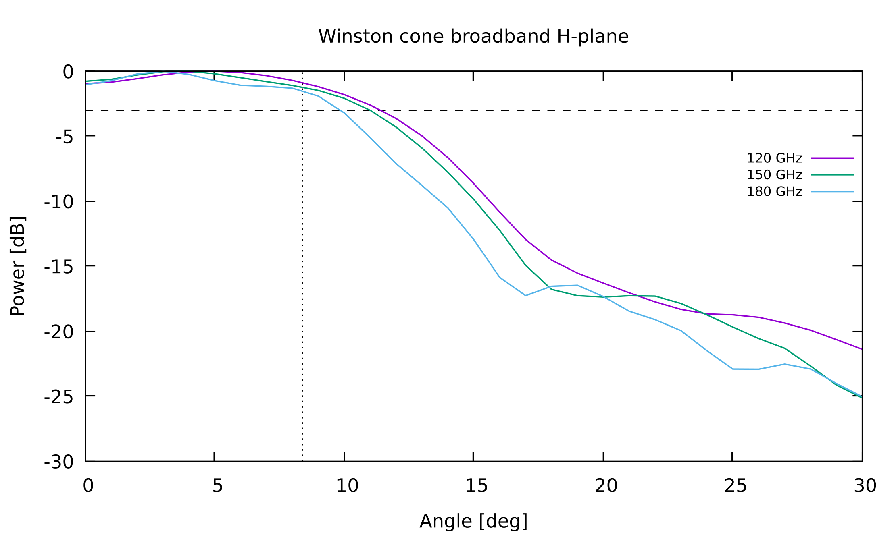
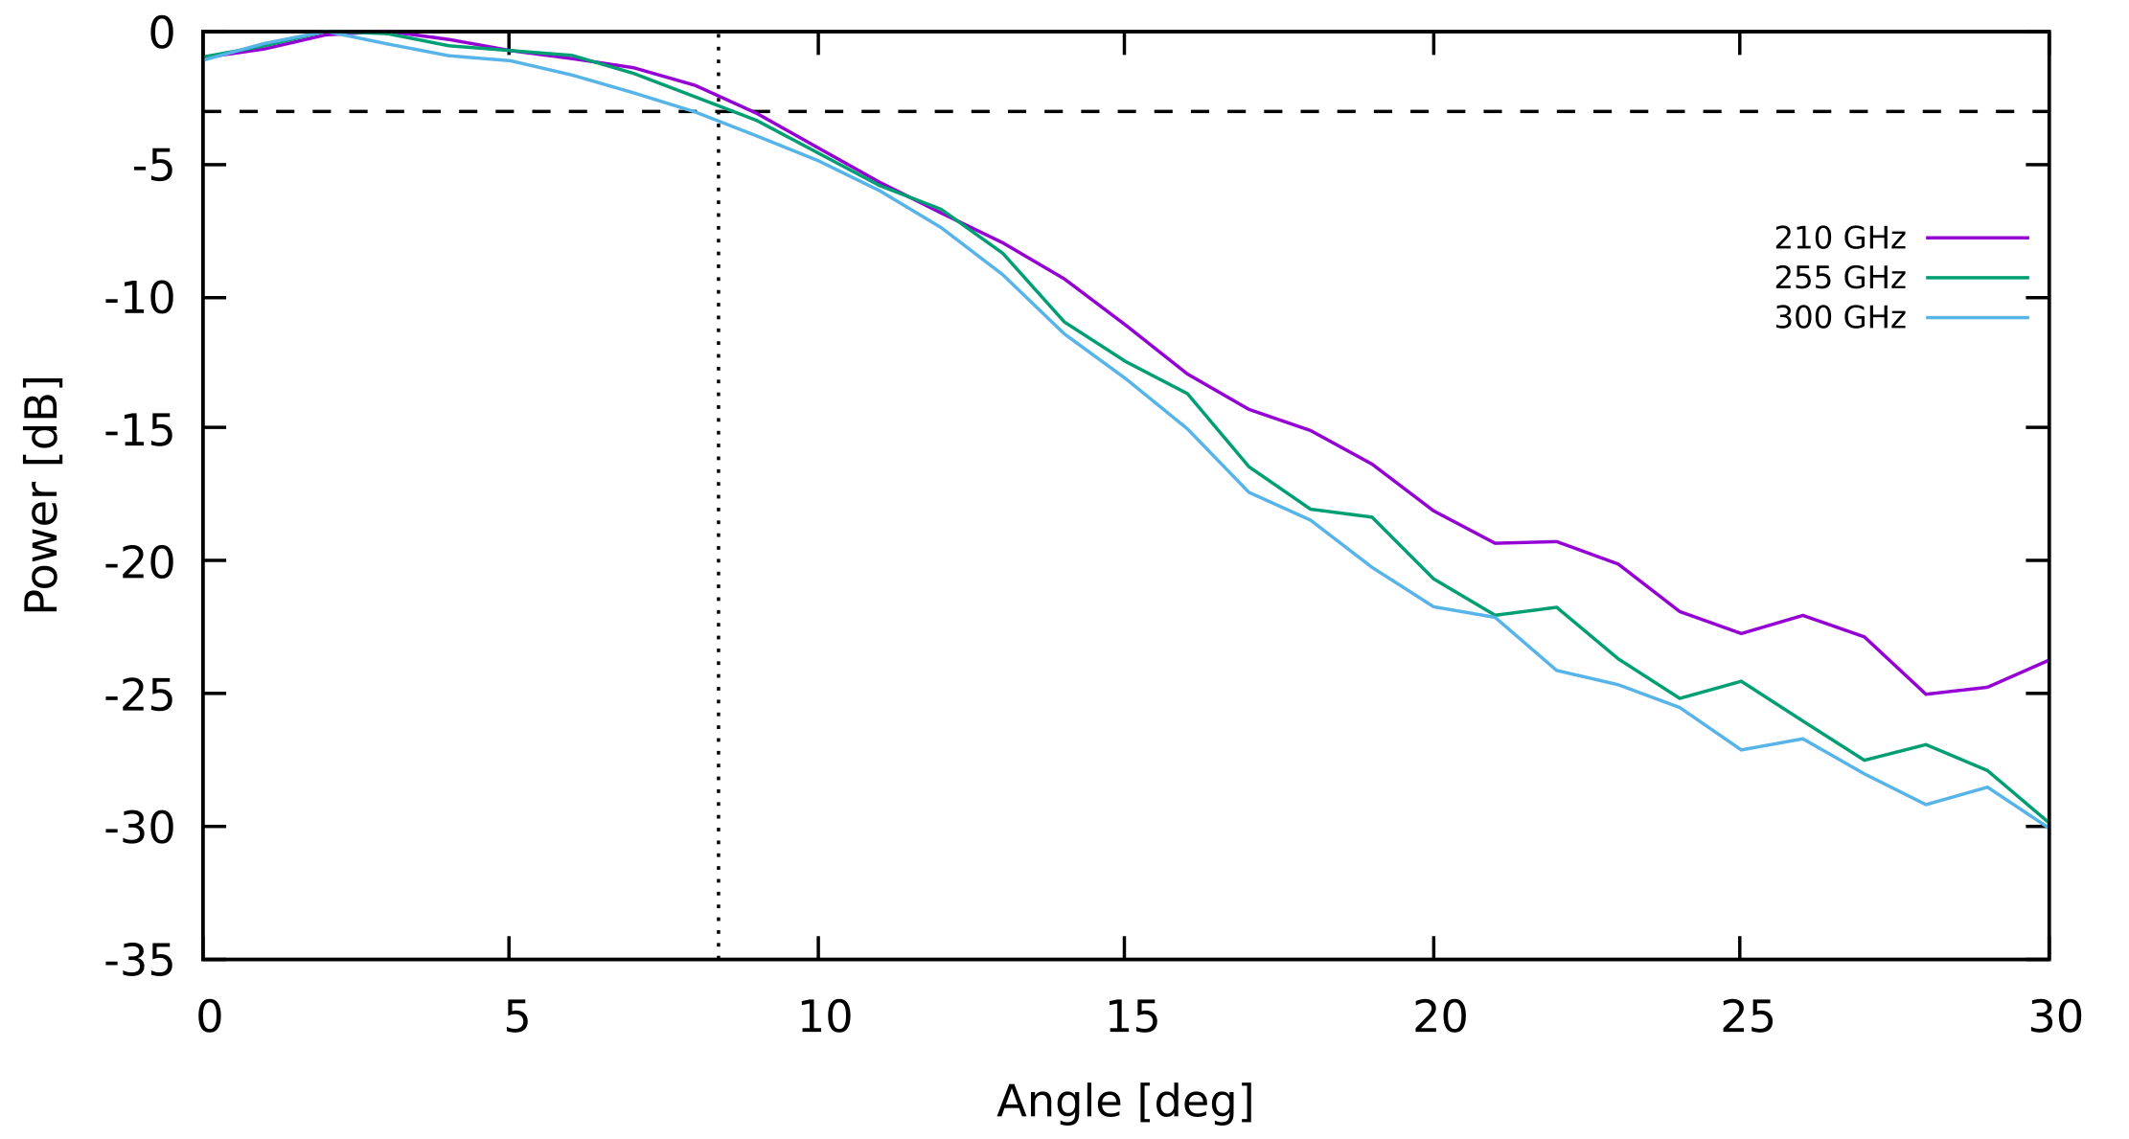
Forecasted broadband performance
Low-frequency array
High-frequency array
Half-power level
Cryostat aperture edge
Fixed $φ=90°$ plane
Fixed $φ=90°$ plane
Fixed $φ=0°$ plane
Fixed $φ=0°$ plane
SCAR AAA 2021
08/09/2021

Slide 13
Forecasted broadband performance
Low-frequency array
High-frequency array
Half-power level
Cryostat aperture edge
Fixed $φ=90°$ plane
Fixed $φ=90°$ plane
To compensate for the slow decrease at the edge of the aperture and further away
the inside of the cryostat is covered with an absorber
the instruments are kept at a very low temperature ($\sim 1$ K)
Fixed $φ=0°$ plane
Fixed $φ=0°$ plane
SCAR AAA 2021
08/09/2021

Slide 14
Summary
The antenna system of COSMO consists of two arrays of nine smooth-walled feedhorns
The 120-180 GHz array is made of platelet Winston cones
The 210-300 GHz array is made of linear horns
The feed-horns are multimoded
The design is the best trade-off between mechanical and electromagnetic requirements, with side lobes below -15 dB and HPBW (Half Power Beamwidth) between $17°$ and $26°$
The arrays are made in aluminum through CNC milling
SCAR AAA 2021
08/09/2021

Slide 16
Back-up slides

Slide 17
Multimode propagation principle
A hollow circular waveguide supports TE and TM mode propagation.
TE11
TM01
TE21
TM11
TE01
TE31
TM21
TE41
TE12
TM02
Solving the Helmholtz equation for a TE (or TM) wave and applying transverse boundary conditions shows that each mode ${TE}_{m,n}/{TM}_{m,n}$ has a cut-off frequency
${f_{c}}_{m,n}^{TE}=\frac{p_{n,m}^{′} }{2πa}c$, where${ p}_{m,n}^{′}$ is the n-th root of ${ J}_{m}^{′}\left(x\right)=0$
${f_{c}}_{m,n}^{TM}=\frac{p_{n,m} }{2πa}c$, where $p_{m,n}$ is the n-th root of $J_{m}\left(x\right)=0$
If $f<f_{c}$ the mode is evanescent
If $f>f_{c}$ the mode propagates
Bessel function

Slide 18
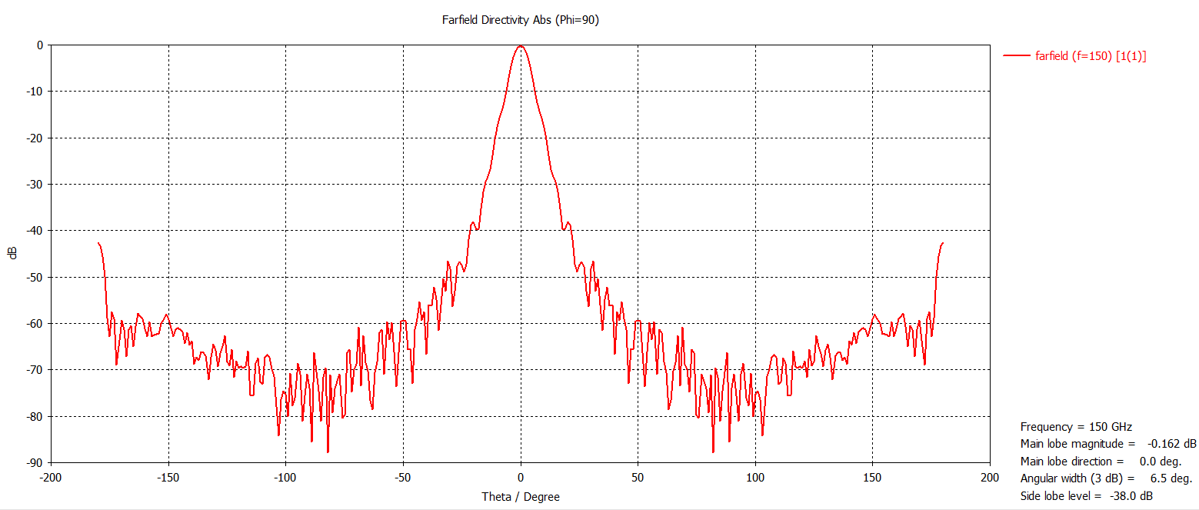
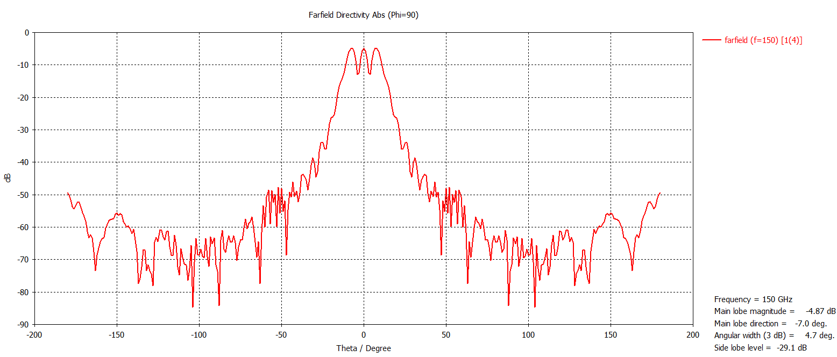
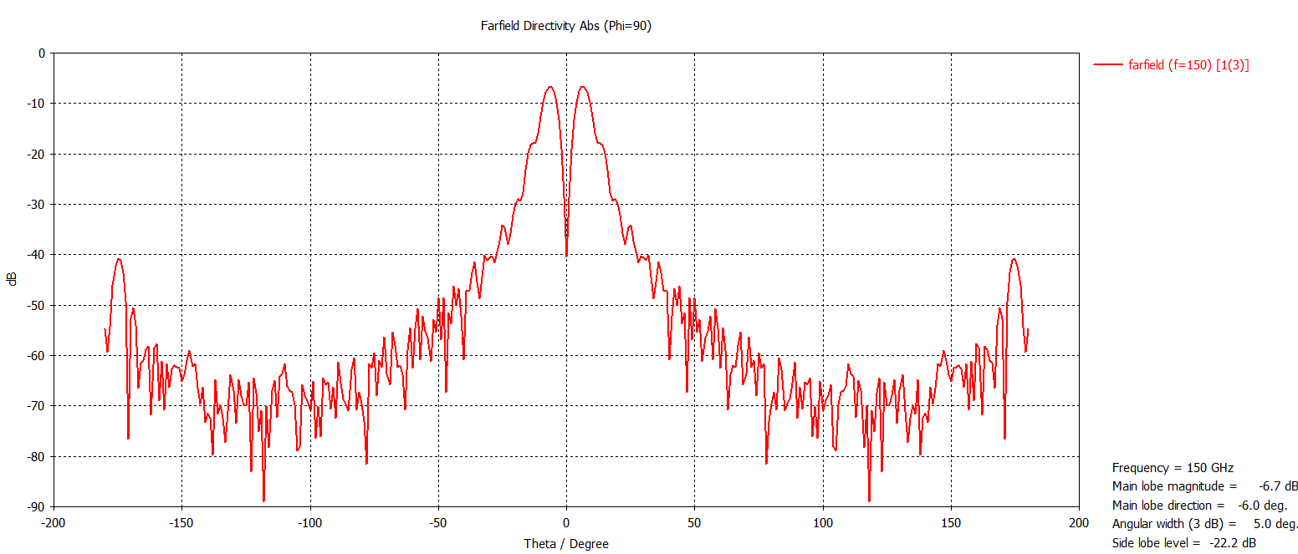
Individual mode beam pattern
Each mode has its own beam pattern. A few examples:
Some beams are symmetric w.r.t. the azimuthal angle $φ$, some are not.
TE11
TE12
TE31

Slide 19
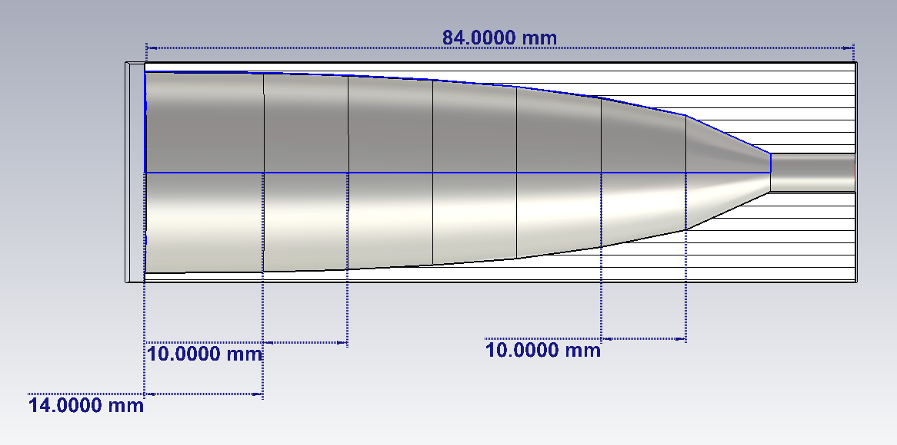
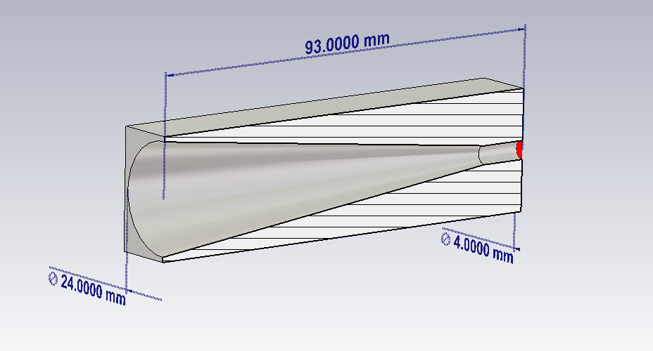
The COSMO antenna profiles
150 GHz array: platelet Winston cone
255 GHz array: linear horn

Slide 20
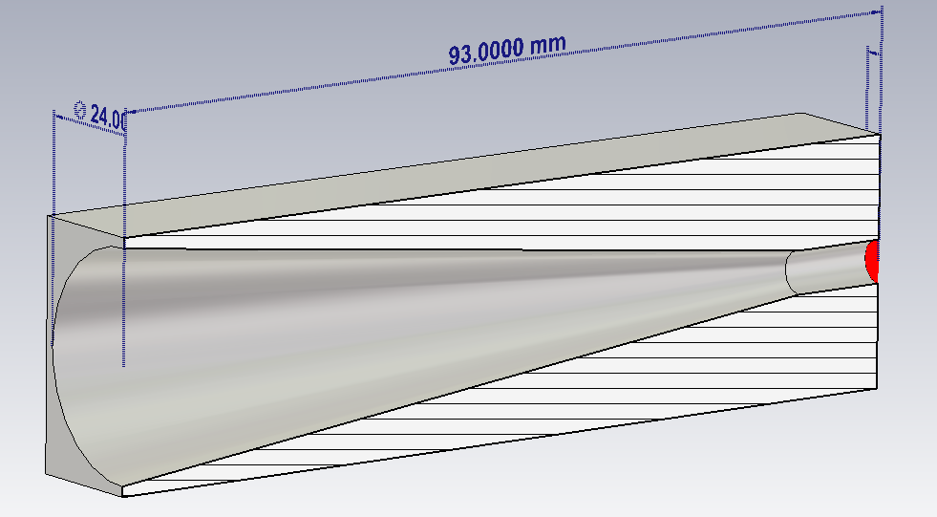
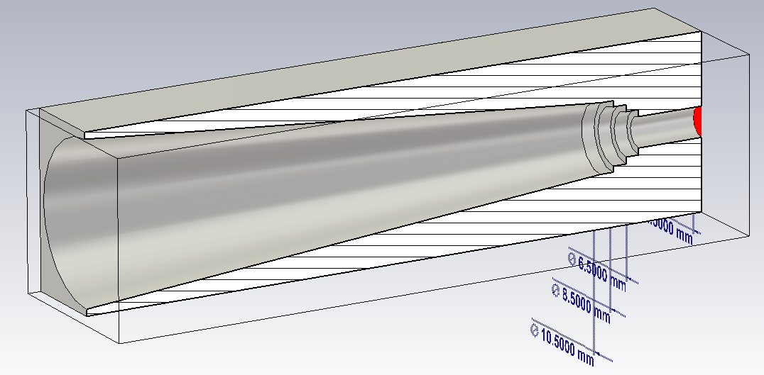
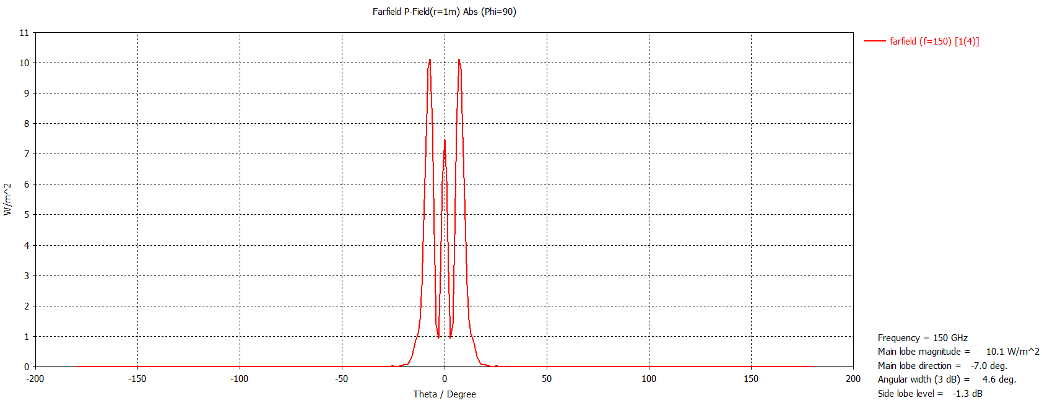
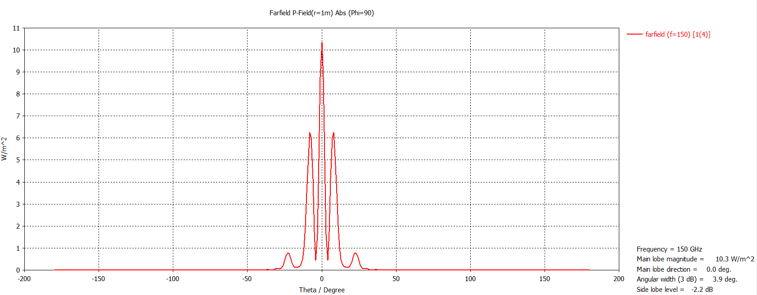
Mode modification
From this
To this
Do this but in a controlled fashion

Slide 21
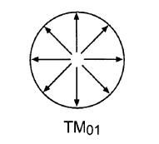
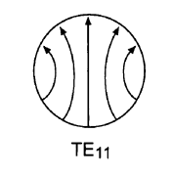
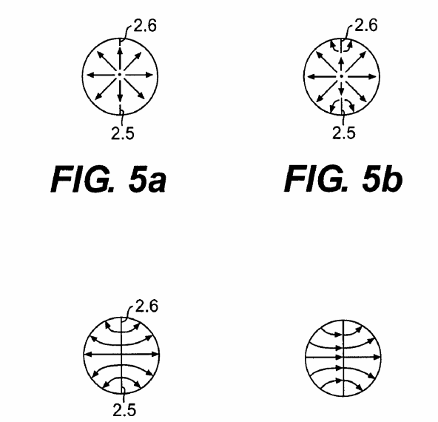
Mode conversion
Credit:
From this
To this
What I want to do:
How I can do it:
Do this but for several modes

