Slide 1
Dome A Wind Turbine
PhD Candidate: Matthew Gerges
Primary supervisor: Michael Ashley
Secondary supervisor: Garth Pearce

Slide 2
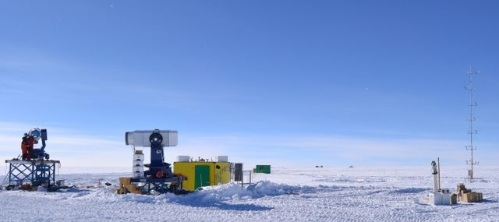
Dome-A
Dome A (Fujia Du - 2015)

Slide 3
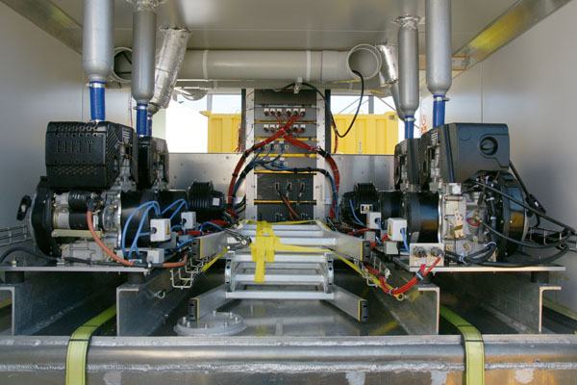
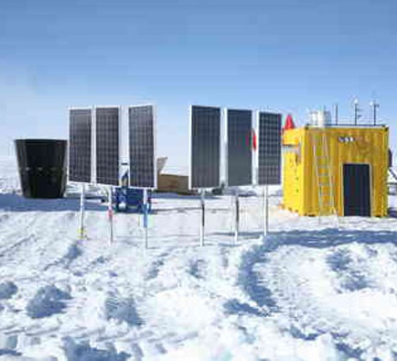
PLATO-A power
Inside of the engine module, showing 6 diesel engines, which run on Jet-A1 fuel. This is the PLATO-F module, it is similar to PLATO- A
(Michael Ashley - 2007)
Solar modules – another dozen modules were later added by PMO (Zhenxi Zhu - 2008)

Slide 4
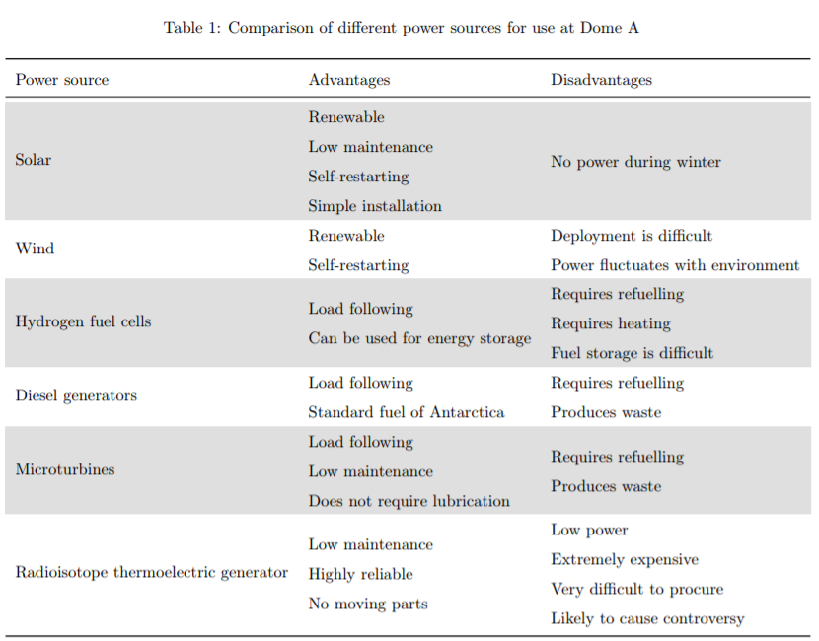

Slide 5
Benefits of wind power
Reduced maintenance
Reduced pollution
Increased power

Slide 6
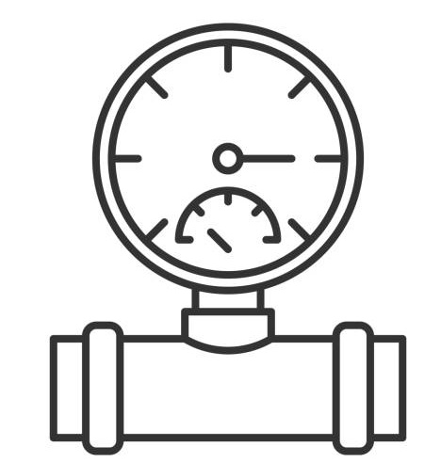
Issues at Dome A: Environment
One of the coldest places on earth (reaching a minimum below of -80º C)
Least windy place on earth (average wind speed of 2.5 m/s measured 2 m above the snow)
Low pressure ~0.56 atm

Slide 7
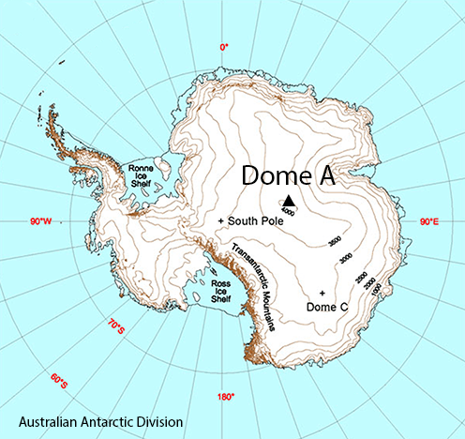
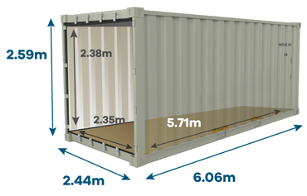
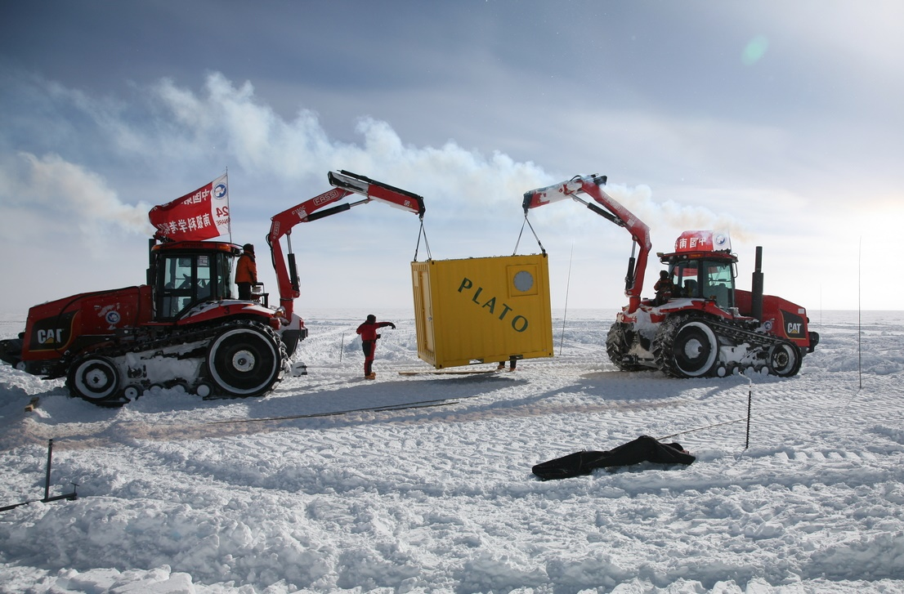
Issues at Dome A: Logistics
(Xu Zhou and Zhenxi Zhu)
Dimensions of a standard 20-foot shipping container
Takes 2 weeks to reach it from the coast.
Maximum crane height at Dome A is 7m

Slide 8
Turbine constraints
Nothing longer than 6m
Able to construct by hand
Easy to maintain i.e. be able to be lowered
Reduce complexity to increase reliability
Function at low temperature
Run at a low wind speed
Aiming for 1kW long term average (10kW peak) power output

Slide 9
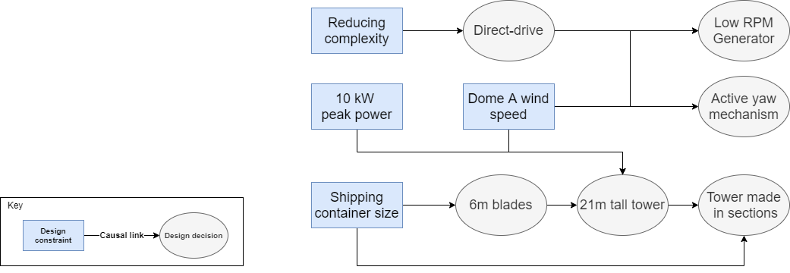
Turbine design

Slide 10
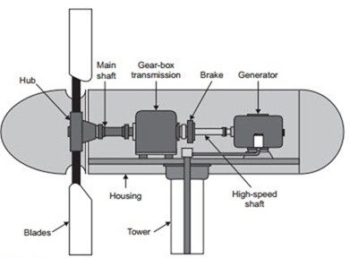
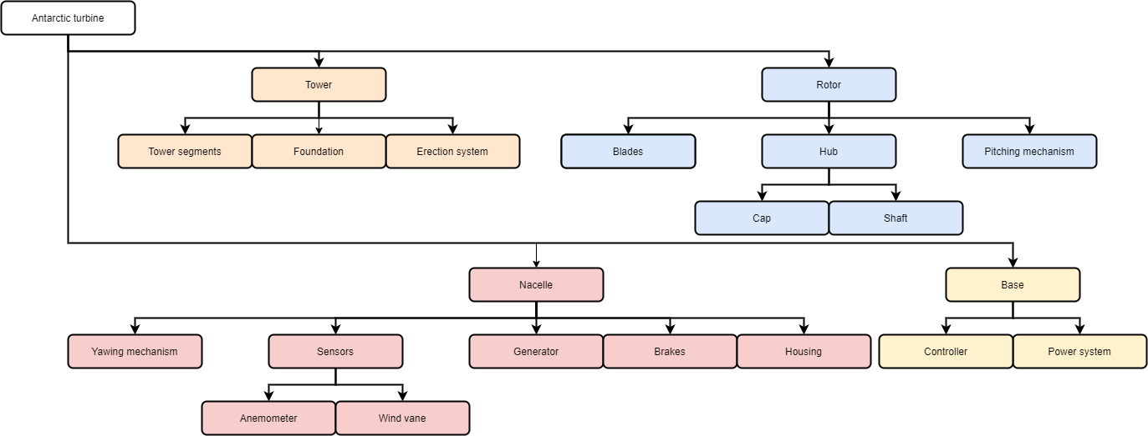
Turbine design
* A gear-box will not be used in our design
*

Slide 11
Weather data
Weather data provided by KLAWS-2 for Jan 2015 – Sep 2016 (Hu 2018)

Slide 12
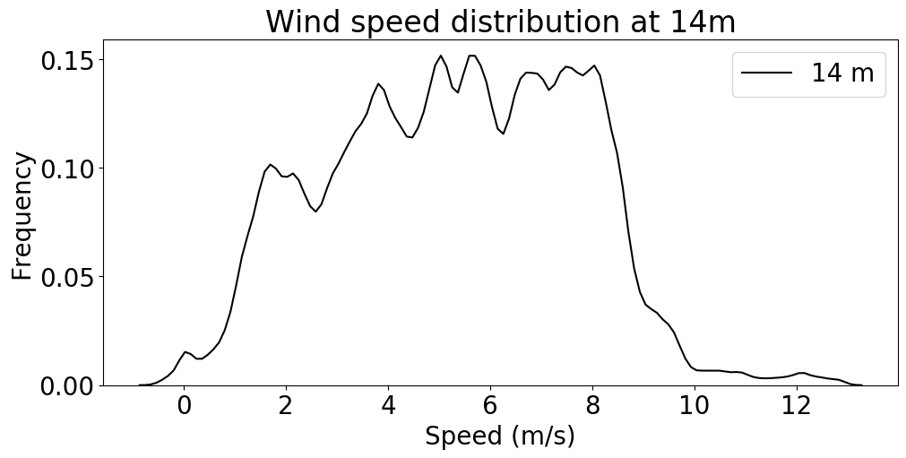
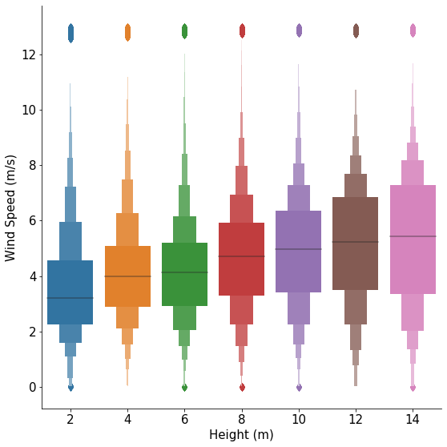
Wind data

Slide 13
Energy simulation
$$wind speed \left(v\right)−−→power\left(P\right)−−→energy (E)$$
$P=πr^{2}ρv^{3}$ $E=ε\sum{(P−L)Δt}$
radius r=6m, density ρ = 0.56 atm, efficiency ϵ = 0.4, Load L = 1kW
Notes:
Final efficiency from Betz limit 16/27 = 0.6 and 70% efficiency

Slide 14
Energy simulation

Slide 15
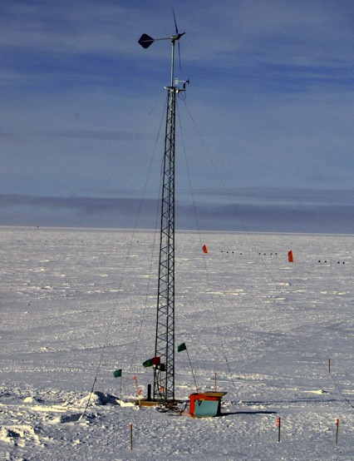
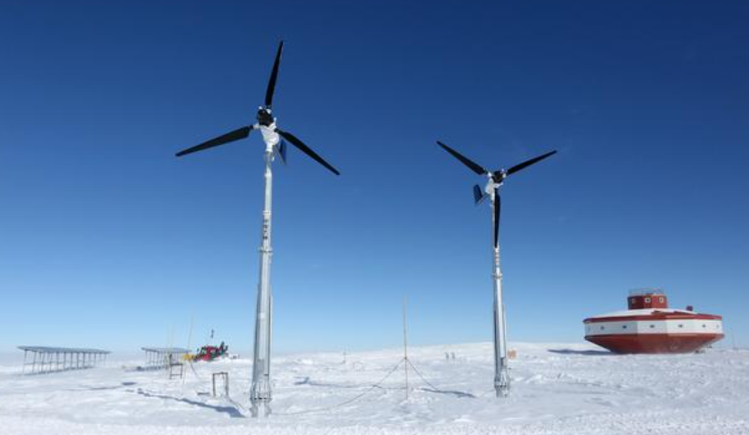
Antarctic wind turbines
Amundson-Scott South Pole Station, Raum wind turbine
(Besson 2014)
ANE turbines at Taishan Station (ANE - 2019)

Slide 16
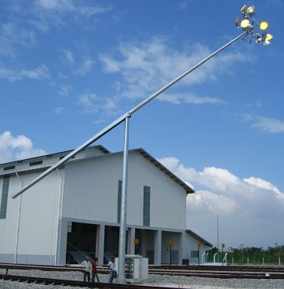
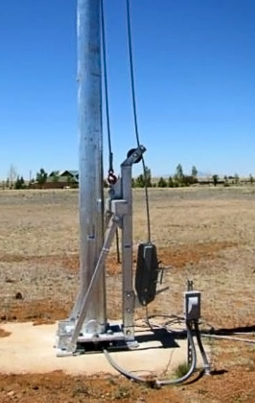
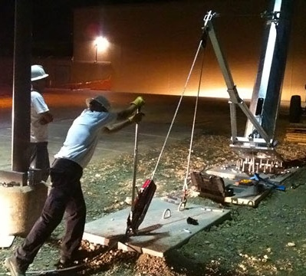
Erection system
Mid-hinge tower (MESTRON)
Vertical gin pole (ARE telecom)
Conventional gin pole (ARE telecom)

Slide 17
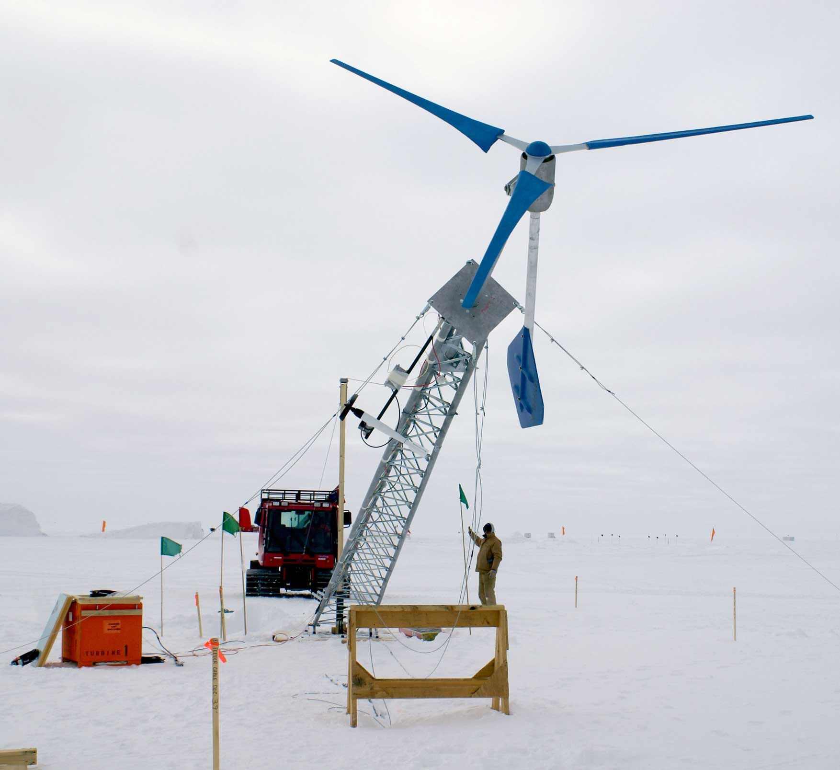
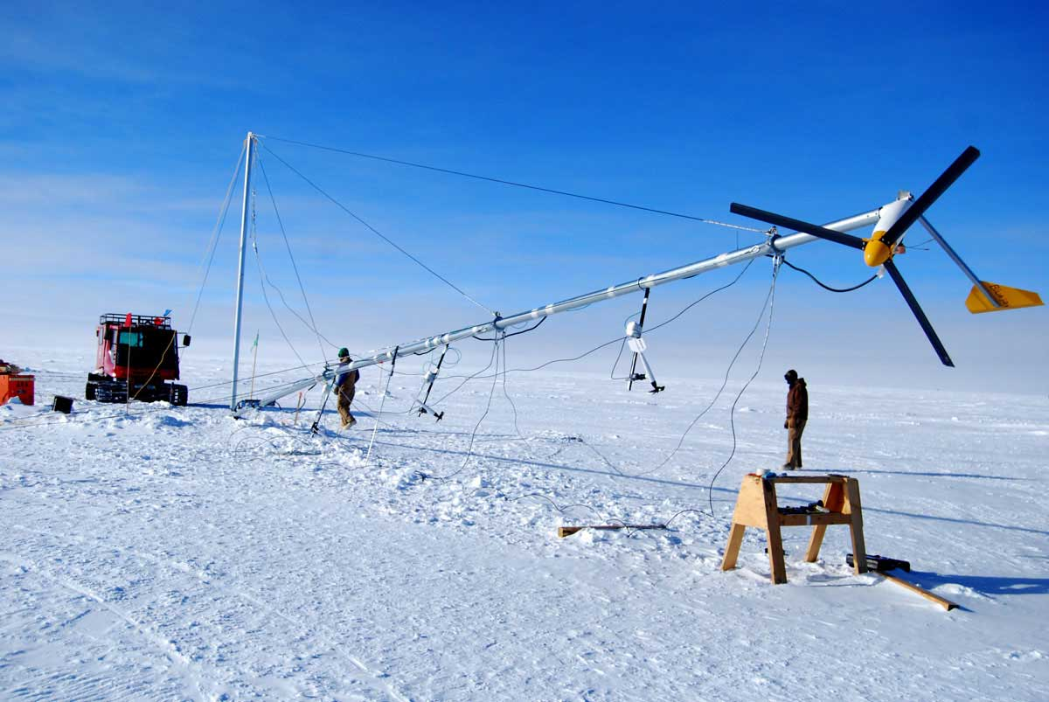
Erection system
Bergey wind turbine erection (Besson 2014)
Raum wind turbine erection (Besson 2014)

Slide 18
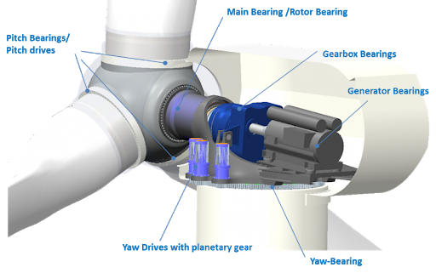
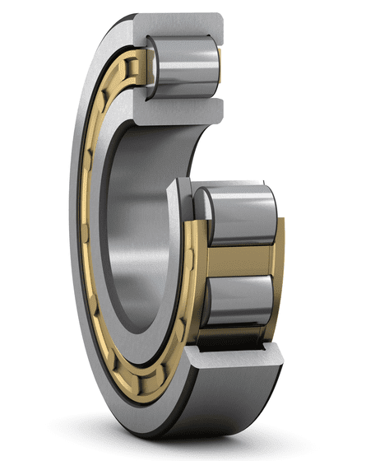
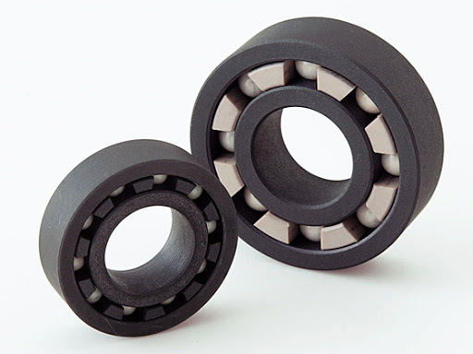
Bearings

Slide 19
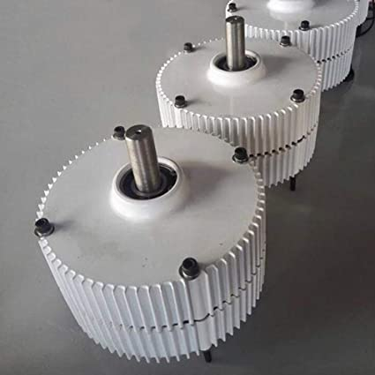
Generators
Permanent Magnet Synchronous Generator
More poles are better
Bearings must be replaced

Slide 20
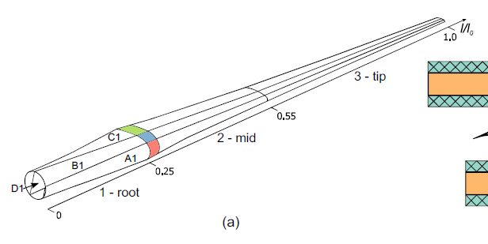
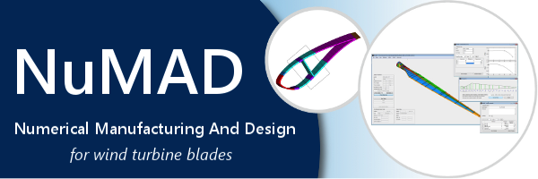
Blade design Rosemary Barnes, UNSW PhD 2016

Slide 21
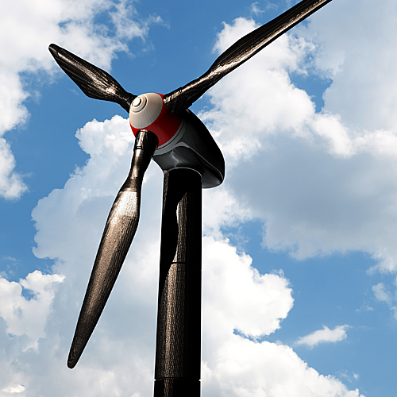
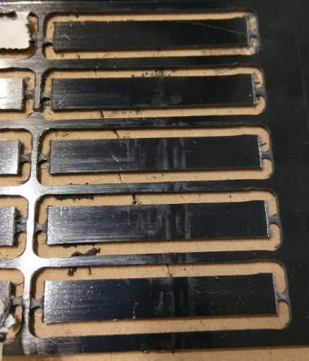
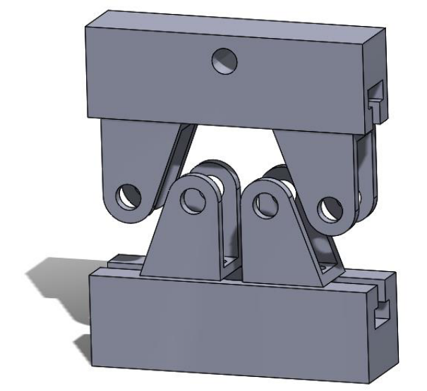
Low temperature carbon fibre Alexander Malicki, UNSW 4th year engineering thesis, 2018
Carbon fibre wind turbine
(SITA Composites)
Carbon fibre test specimens
(Alexander Malicki)
Bending rig render
(Alexander Malicki)

Slide 22
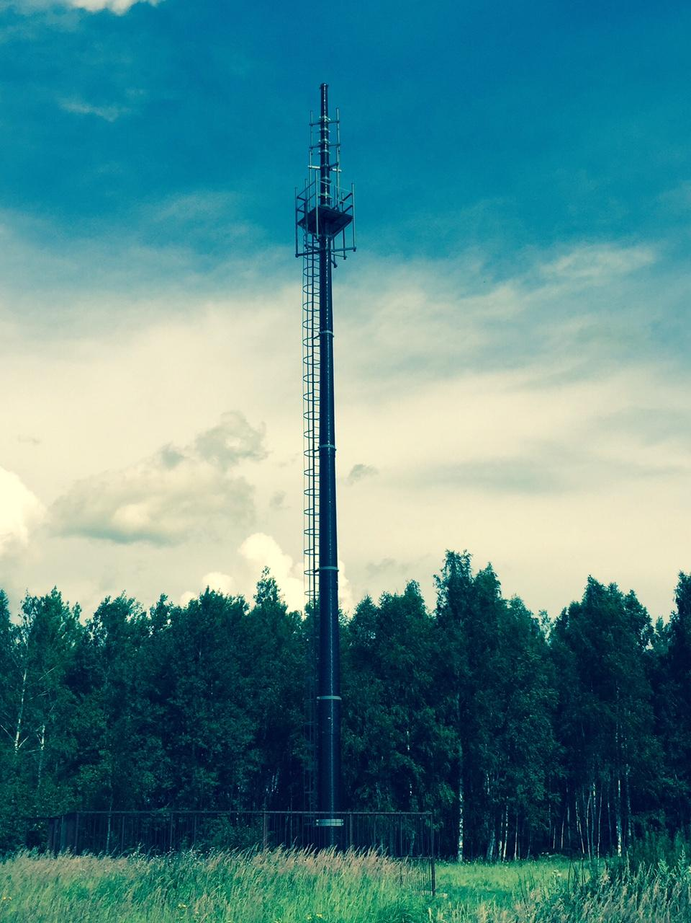
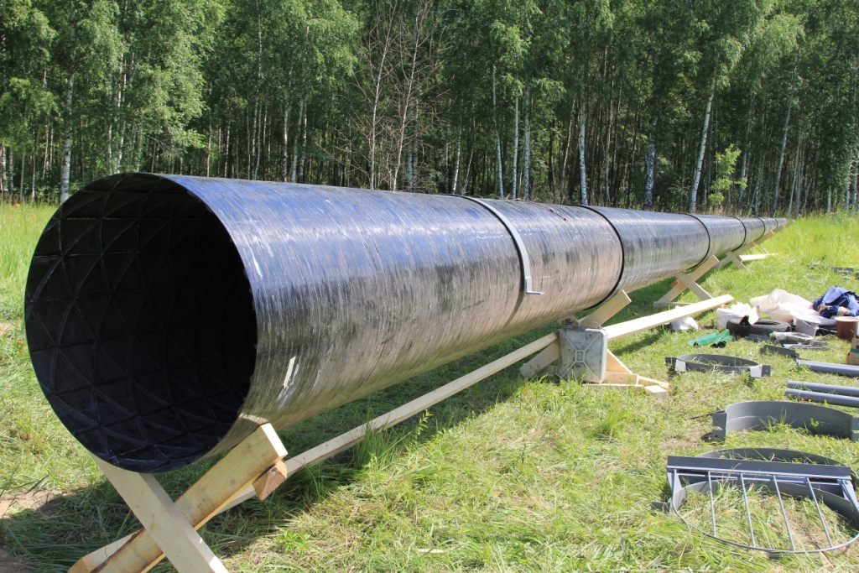
MMC Tower

Slide 23
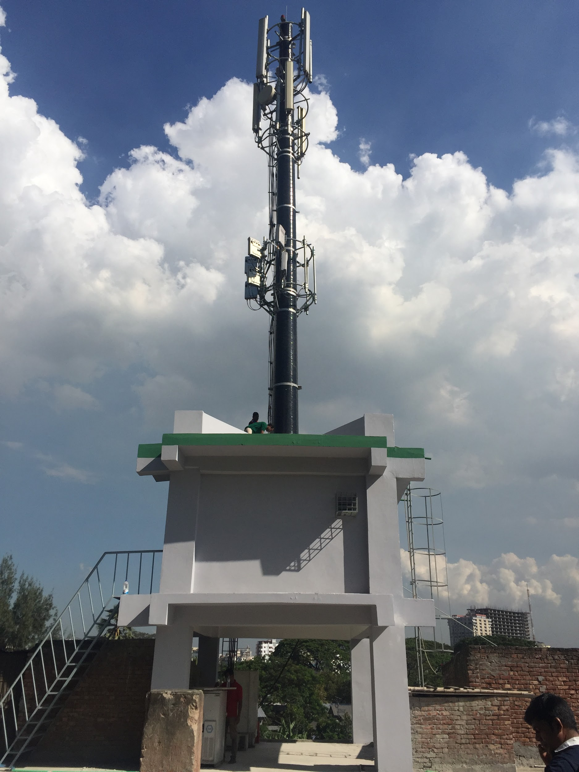
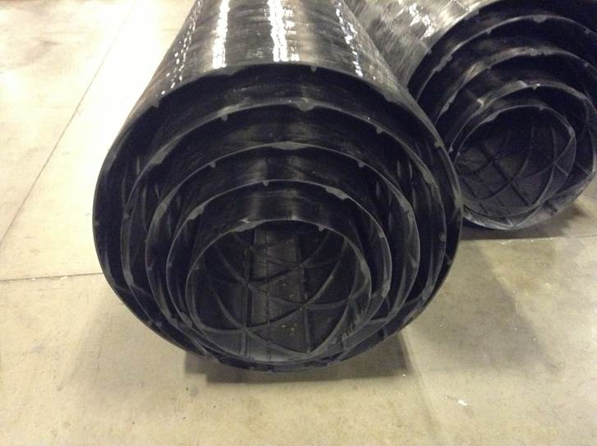
MMC Tower

Slide 24
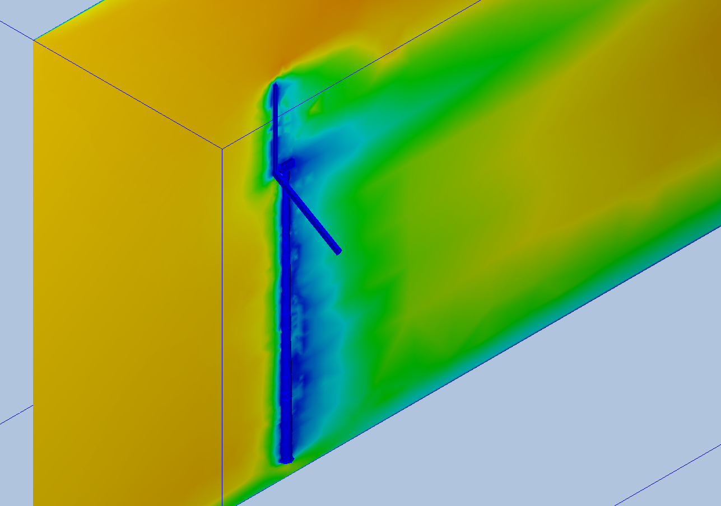
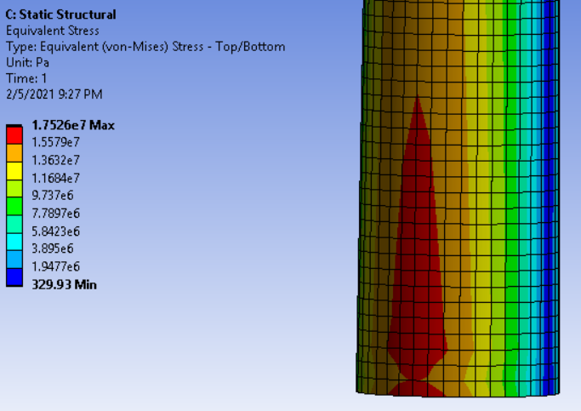
Tower simulation
Notes:
TIA-222-H

Slide 25
Moving forward
Engage with PRIC to work on these future plans and how we can collaborate
Buy the tower
Buy components for cold testing
Manufacture the custom parts such as nacelle and blades
Assemble tower at UNSW initial testing
Send the tower to Dome A early for testing along with meteorological instruments
Send the turbine to Dome A and see how it performs

Slide 26
References
Besson, D. Z., Kennedy, D. M., Ratzlaff, K., & Young, R. (2014). Design, modeling and testing of the Askaryan Radio Array South Pole autonomous renewable power stations.Nuclear Instruments and Methods inPhysics Research Section A: Accelerators, Spectrometers, Detectors and Associated Equipment,763,521–532
Hu, Y., Hu, K., Shang, Z., Ashley, M. C. B., Ma, B., Du, F., Li, Z., Liu, Q., Wang, W., Yang, S., Yu, C., & Zeng, Z.(2018). Meteorological Data from {KLAWS}-2G for an Astronomical Site Survey of Dome A, Antarctica.Publications of the Astronomical Society of the Pacific,131(995), 15001
Ma, B., Shang, Z., Hu, Y., Hu, K., Wang, Y., Yang, X., Ashley, M. C. B., Hickson, P., & Jiang, P. (2020).Night-time measurements of astronomical seeing at Dome A in Antarctica.Nature,583(7818), 771–774
Yi, Z., & Zhongjun, W. (2017). Design and development of infrastructure of the Dome A Kunlun Station.Advances in polar science,28(3), 214–227.

Slide 27
Also, any good acronym suggestions are appreciated

Slide 28
Back up slides

Slide 29
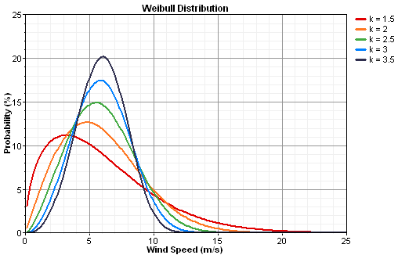
Typical wind speed distribution Weibull

Slide 30
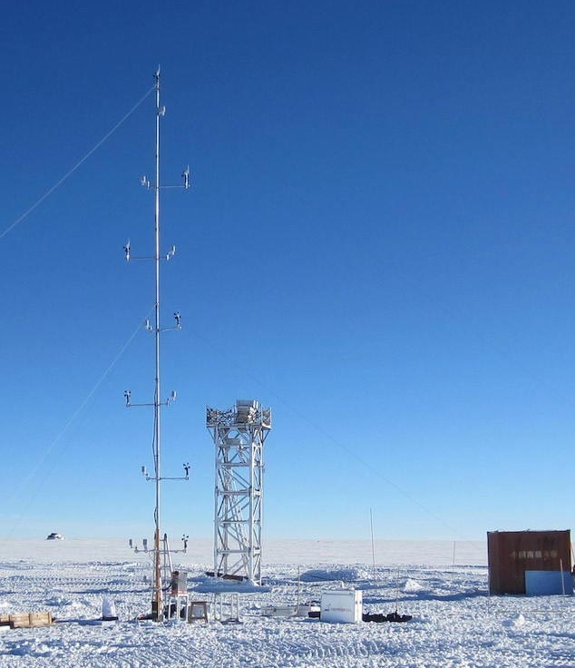
Weather analysis
Data from KLAWS-2G from
1/2015 – 9/2016
Wind speed and temperature every 2m up to 14m
Pressure and humidity at 2m
KLAWS - 2G (Xu Zhou and Zhenxi Zhu)

Slide 31
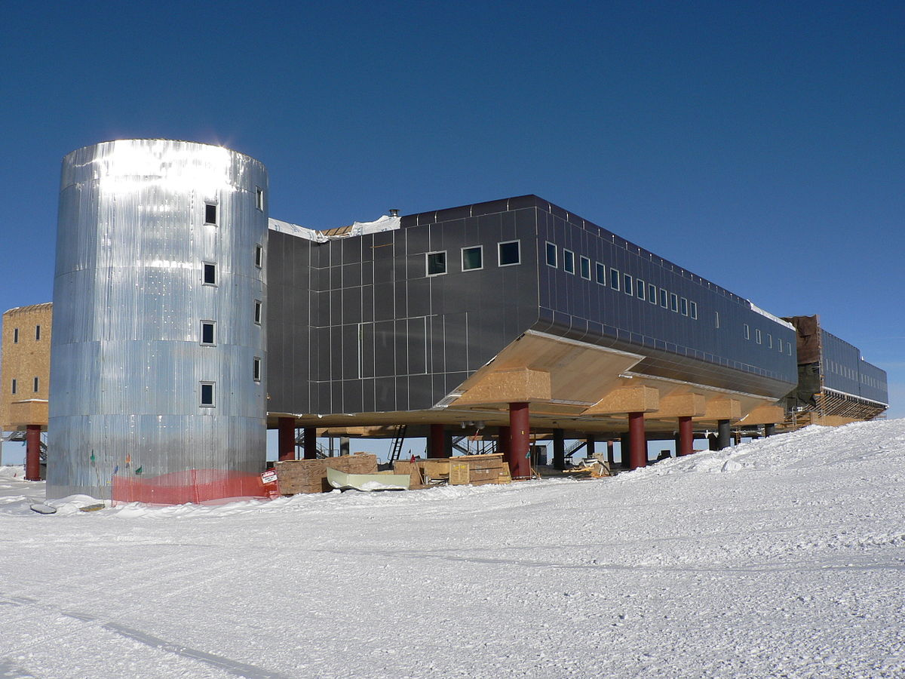
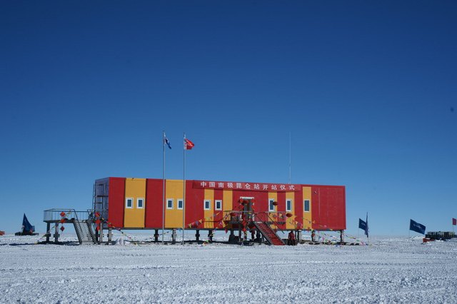
Antarctic construction and foundations
Amundson-Scott South Pole Station (Levent Demirörs)
Kunlun Station (The Polar Research Institute of China)

