Slide 1




Cosmic Ray Flux Correlation between McMurdo and
Jang Bogo Stations
E. Kittiya,^{a,}* W. Nuntiyakul,ª P. Evenson,^{b} A. Saiz,^{c} D. Ruffolo,^{c} S. Oh^{d} and A. Seripienlert^{e}
ªChiang Mai University, THAILAND
^{b}University of Delaware, USA
^{c}Mahidol University, THAILAND
^{d}Chonnam National University, SOUTH KOREA
^{e}National Astroniomical Research Institute of Thailand (NARIT), THAILAND

Slide 2
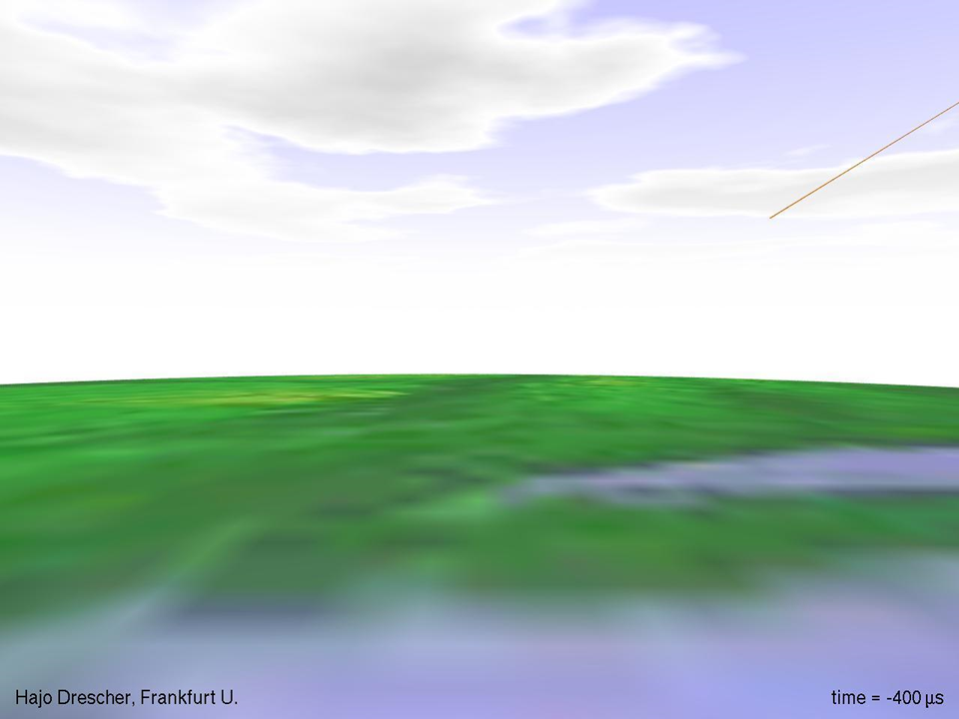
Solar Energetic Particles (SEPs) and Galactic Cosmic Rays (GCRs)
~1% heavier nuclei
~1% Electron
~9% α
~89% Proton
Hajo Drescher, Frankfurt U.

Slide 3
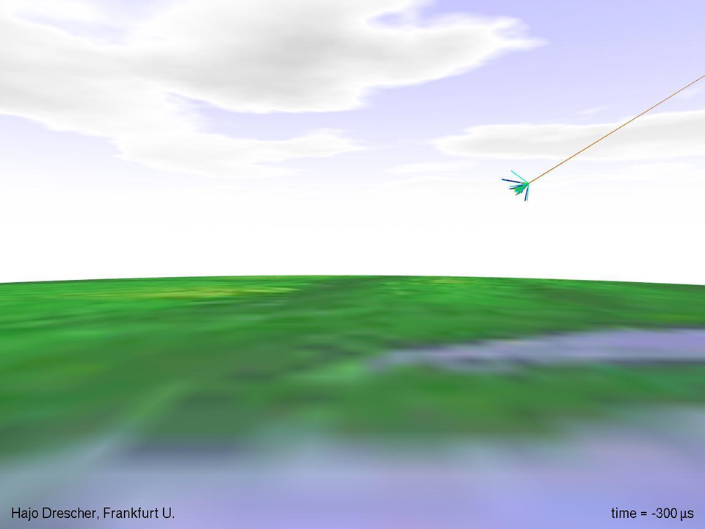
Hajo Drescher, Frankfurt U.

Slide 4
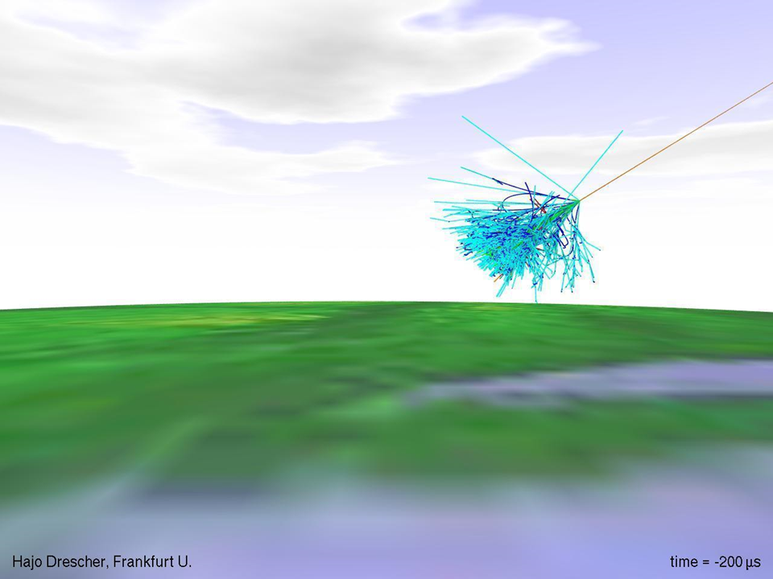
Solar Energetic Particles (SEPs) and Galactic Cosmic Rays (GCRs)
~1% heavier nuclei
~1% Electron
~9% α
~89% Proton
Hajo Drescher, Frankfurt U.

Slide 5

Reflector
(polyethylene)
(Secondary) Neutrons
Producer (Pb)
Tube
Alignment
Piece (wood)
Moderator (polyethylene)
Neutron counter (¹⁰BF₃)
n + ¹⁰B → ⁷Li + ⁴He
courtesy: Nuntiyakul et al.
Figure 3 Standard Neutron Monitor

Slide 6
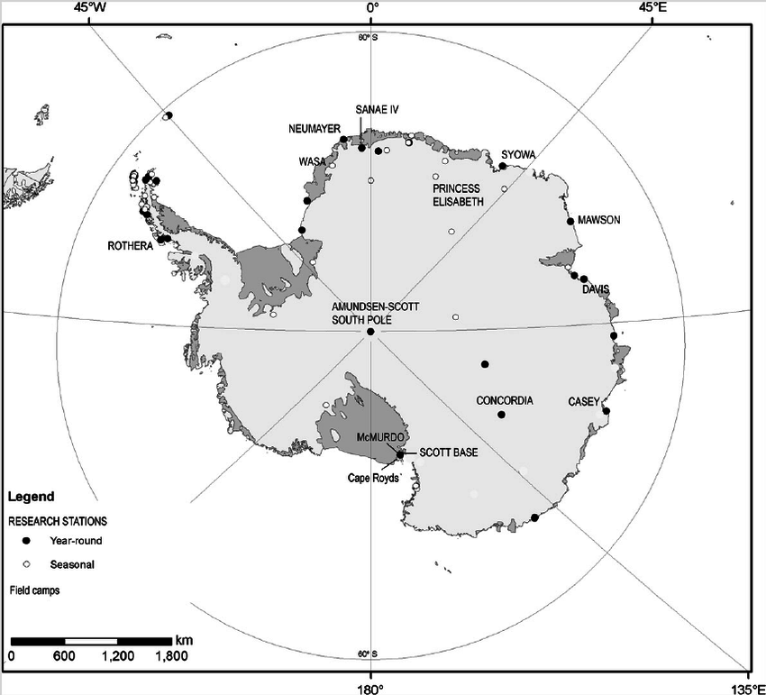
McMurdo
Geographic 77°50′47″S 166°40′06″E
Geomagnetic 77°3′S 85°18′E
Jang Bogo
Geographic 74°37′26″S 164°13′44″E
Geomagnetic 78°58.8′S 72°22.8′E

Slide 7
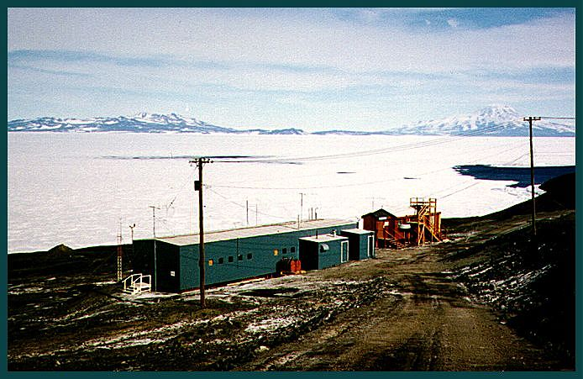
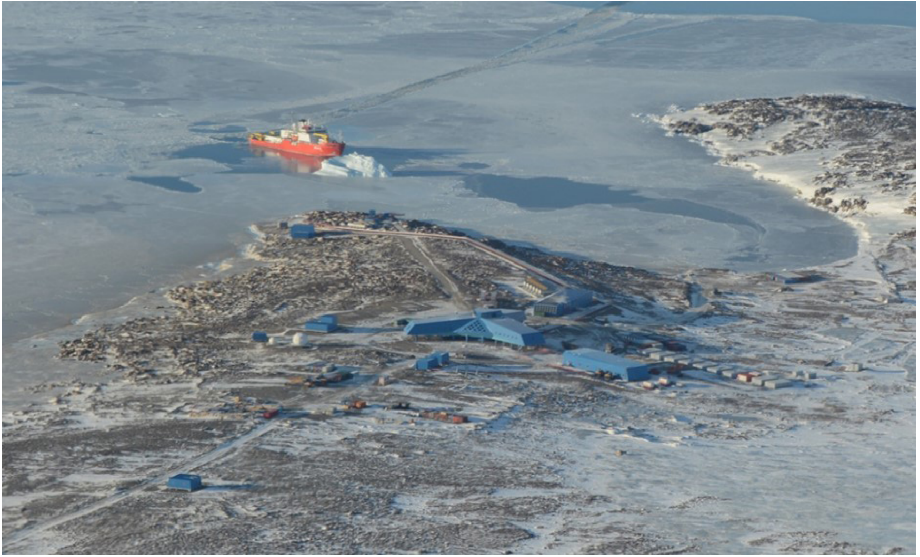
McMurdo and Jang Bogo stations
Figure 1 Bird-eye view of McMurdo Station (courtesy: nmdb database)
Figure 2 Bird-eye view of Jang Bogo Station
(courtesy: KOPRI)

Slide 8
McMurdo and Jang Bogo stations
x 18
x 6-1
x 12-1
Figure 4 12-1 counter tubes located at McMurdo during December 2015 to October 2016
Figure 5 6-1 counter tubes located at Jang Bogo during December 2015 to October 2016
Data during December 2015 to October 2016 has been analyzed in this work!
Notes:
In McMurdo station there was orginally 18 detectors. 6 of them was moved to Jang Bogo. We retrieve data obtained during December 2015 and October 2016. At that time one of the tube in McMurdo and Jang bogo is broken

Slide 9
Count
The number of neutrons interacting in the NM’s proportional tube
The energy of secondary neutrons relates to the counting rate.
Solar activity
  Coronal Mass Ejection (CME) ⬇ Forbush Decrease (FD)
  Solar Eruption ⬆ Ground Level Enhancement (GLE)
Asymptotic Direction
Detector relative position
Other effects such as pressure, etc.

Slide 10
Relative count at Forbush decrease
Nuntiyakul et al.

Slide 11
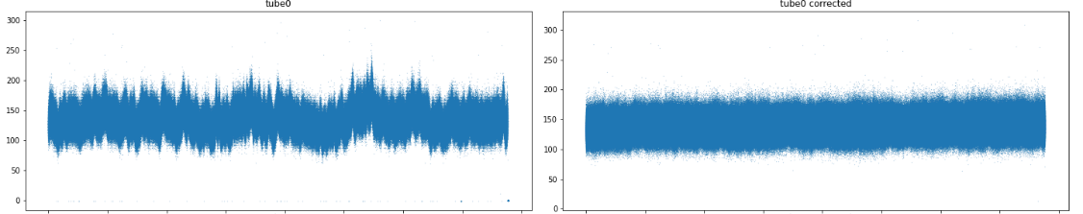
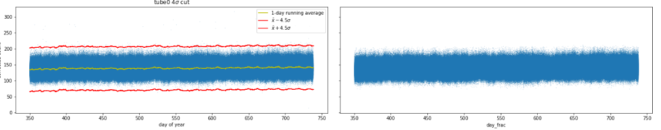






Data correction and cleanup
$P_{0}$ is defined for each stations
Uncorrected count ($c_{i}^{∗}$)
$$c_{i}=c_{i }^{∗}e^{−β\left(P−P_{0}\right)}$$
Corrected count $c_{i}$
count
Missing data marked as 0 or -1
day
day
Corrected count $c_{i}$
Corrected count $c_{i}$ w/o outlier
count
Notes:
First we corrected the data for pressure using the exponential relation. The missing data marked as 0 or -1 are excluded from the process.

Slide 12
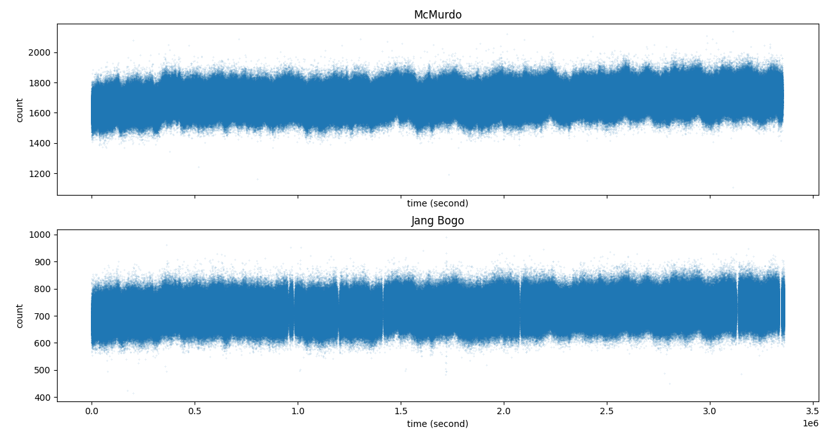
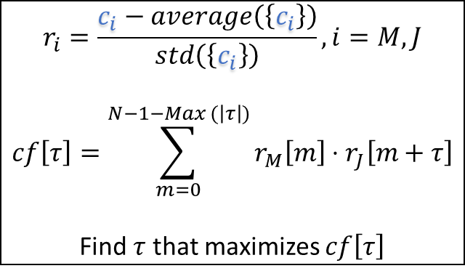
Whole station count
McMurdo summed over 11 tubes
count (c_{M})
$$r_{i}=\frac{c_{i}−average\left(\left\{c_{i}\right\}\right)}{std\left(\left\{c_{i}\right\}\right)},i=M,J$$
$$cf\left[τ\right]=\sum_{m=0}^{N−1−Max (\left|τ\right|)}{r_{M}\left[m\right]⋅r_{J}\left[m+τ\right]}$$
Find $τ$ that maximizes $cf\left[τ\right]$
Jang Bogo summed over 5 tubes
count (c_{J})
Notes:
$Max (\left|τ\right|)$ term is to limit m so that we still have $r_{J}\left[m+τ\right]$
Here the count is summed over all tube of each station so that the pattern is more apparent

Slide 13
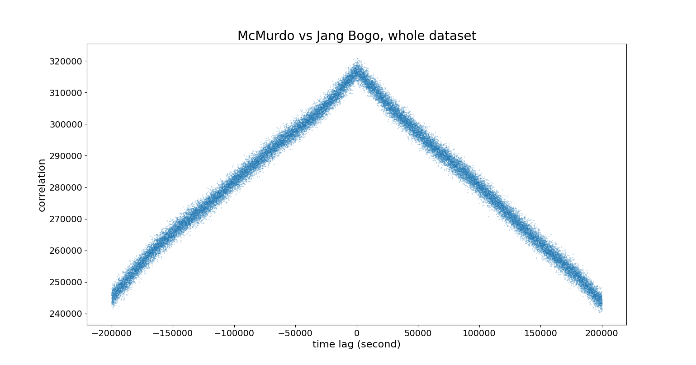

Nuntiyakul et al.
Time lag (τ, second)
$$Max \left(\left|τ\right|\right)$$
Notes:
kink

Slide 14
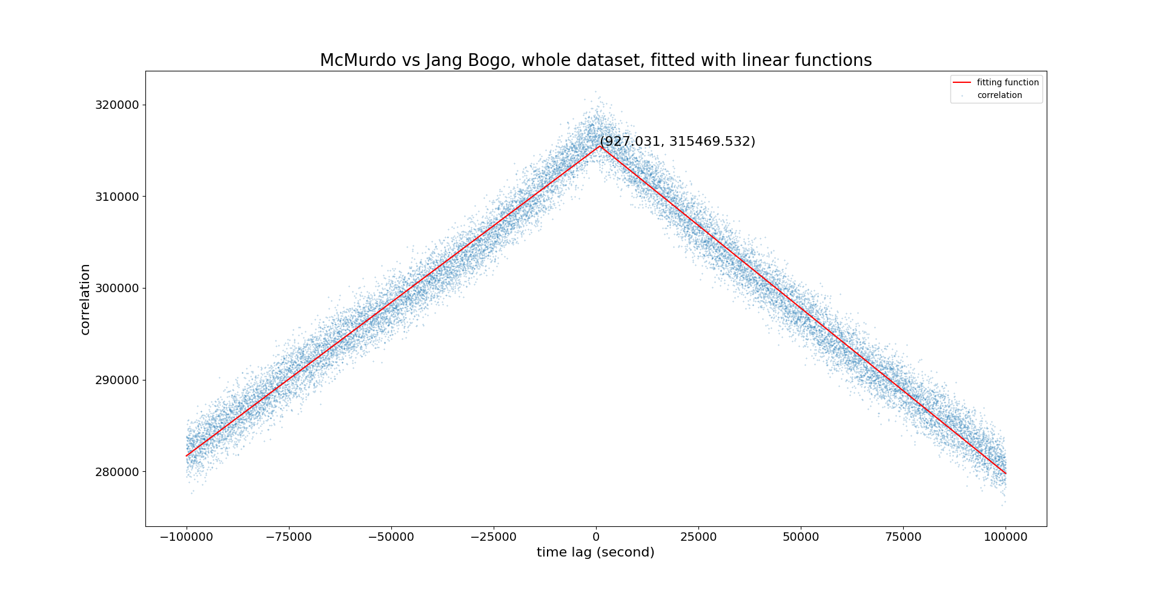

Slide 15
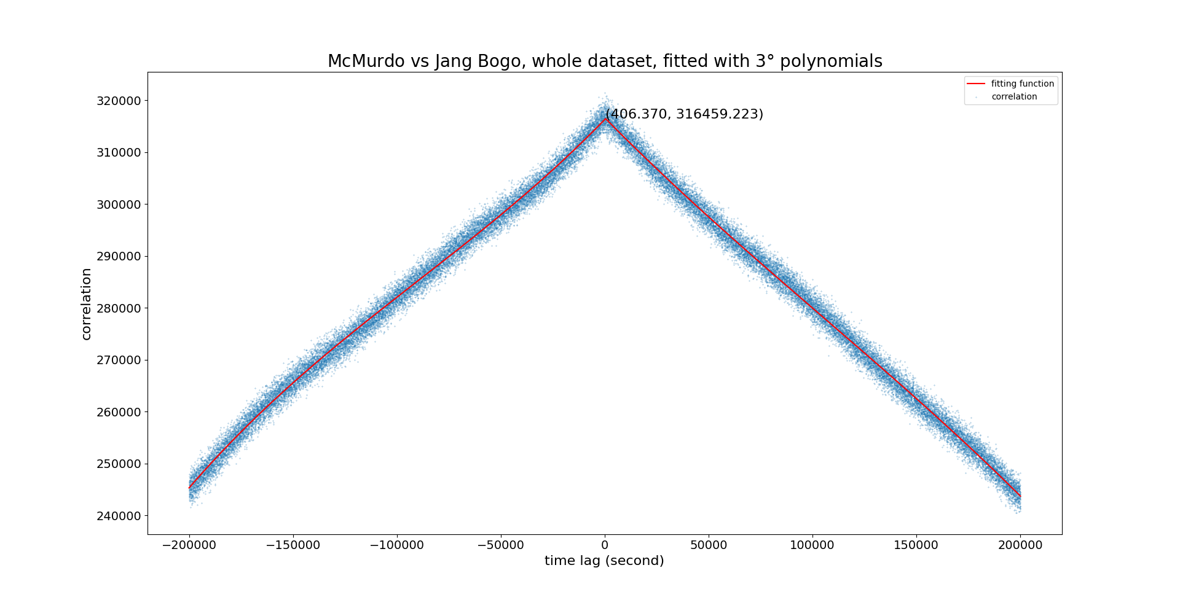

Slide 16


Slide 17
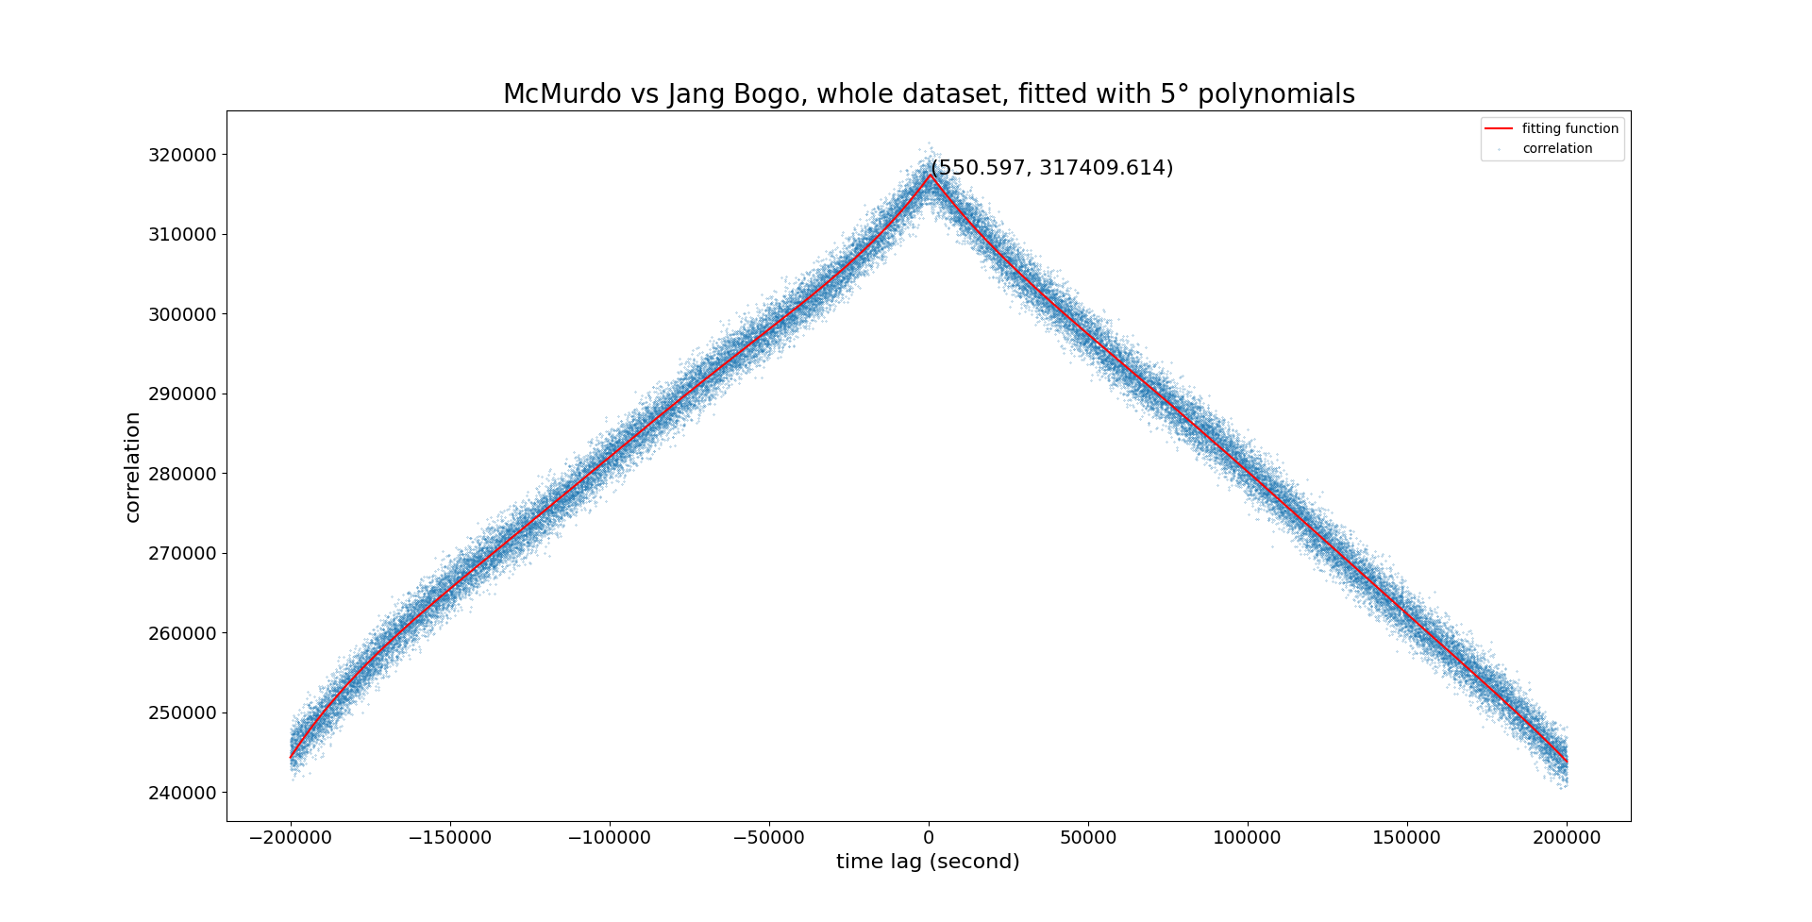

Slide 18
Which one?
Introduce variation while keeping the middle value
  By randomly removing data
Inspired by k-fold cross-validation (k=5 in this work)

Slide 19
(AAA.AA, ZZZ.ZZ)
excluded data (1/5)
fitting function

Slide 20
(BBB.BB, YYY.YY
excluded data (other 1/5)
fitting function

Slide 21
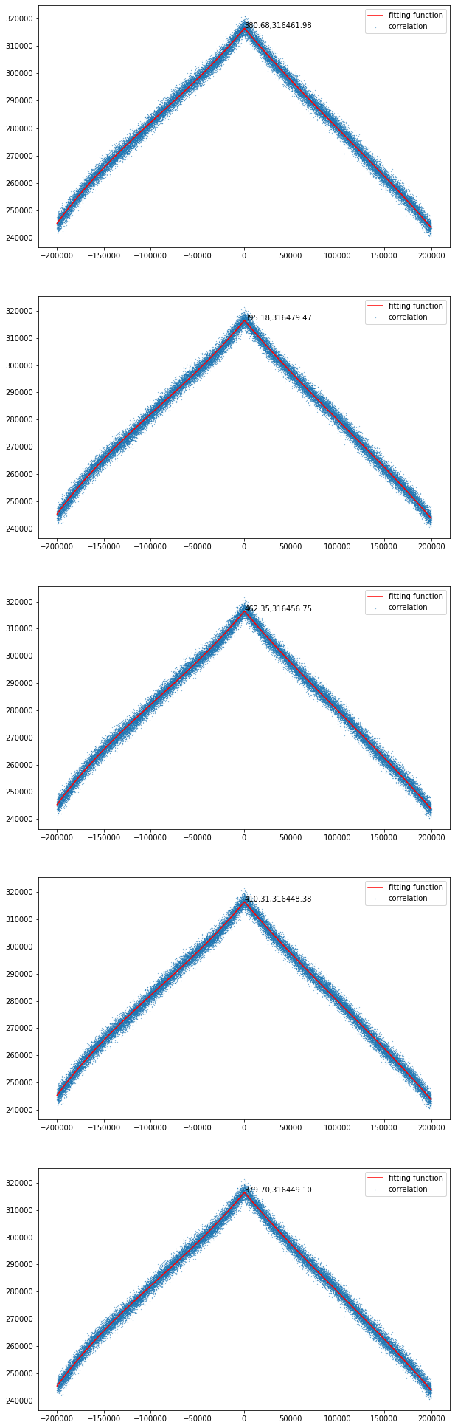
5-fold cross-validation
1/5 removed
other 1/5 removed

Slide 22
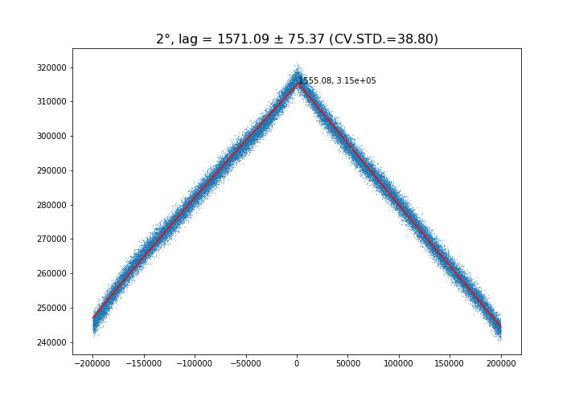
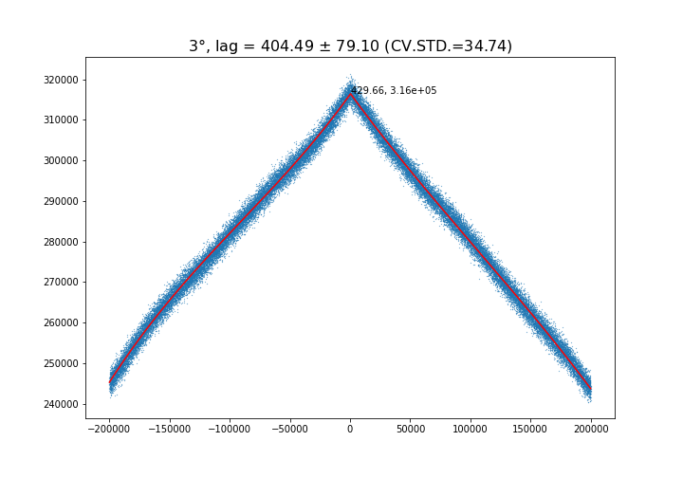
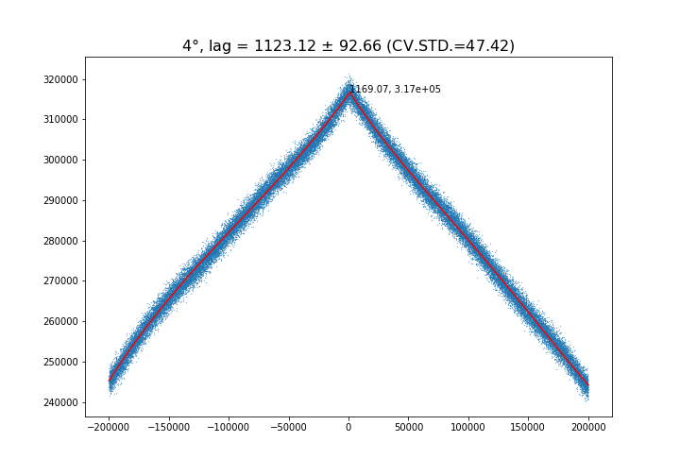
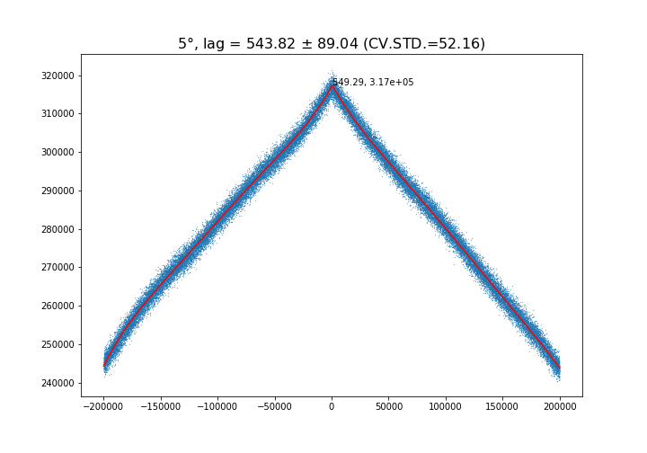
5-fold cross-validation
CV.STD = cross-validation STD
calculated from 5*iteration values of τ at peak
iteration = 1000

Slide 23
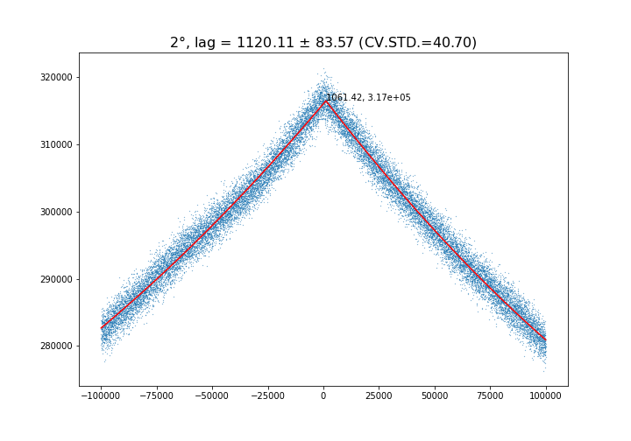
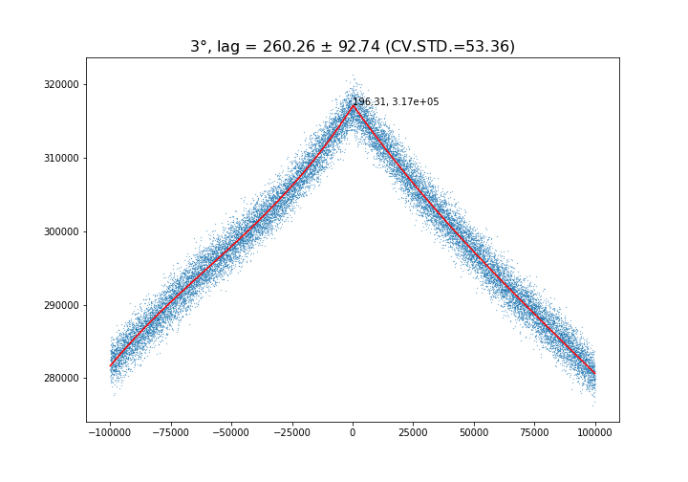
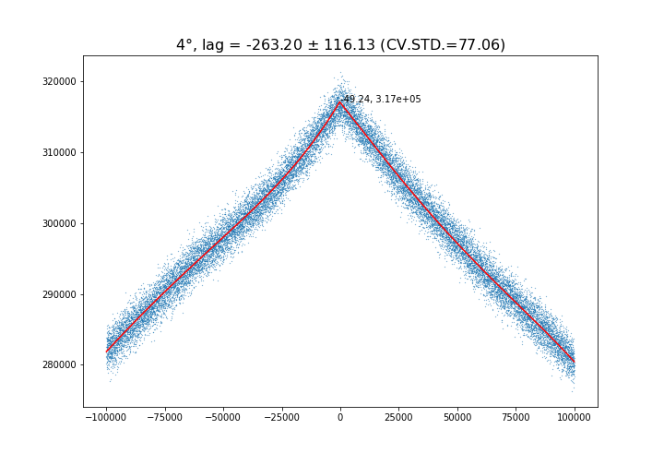

5-fold cross-validation

Slide 24
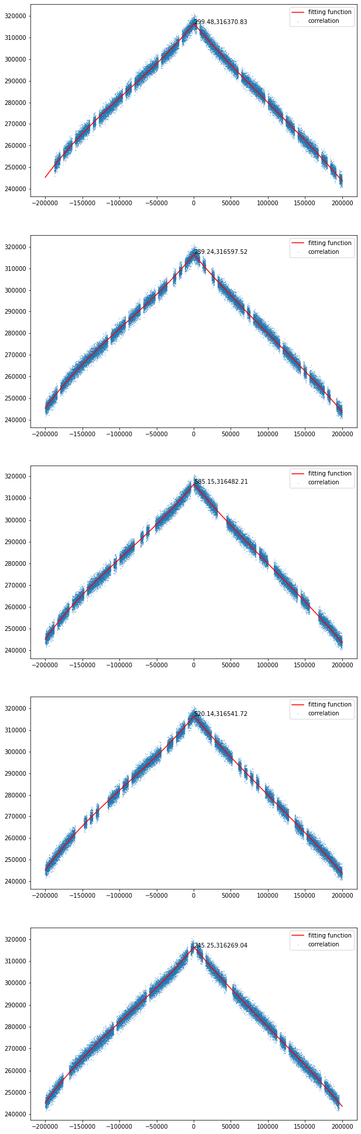
5-fold cross validation, 100 chunks
1/5 of chunks removed
other 1/5 of chunks removed

Slide 25


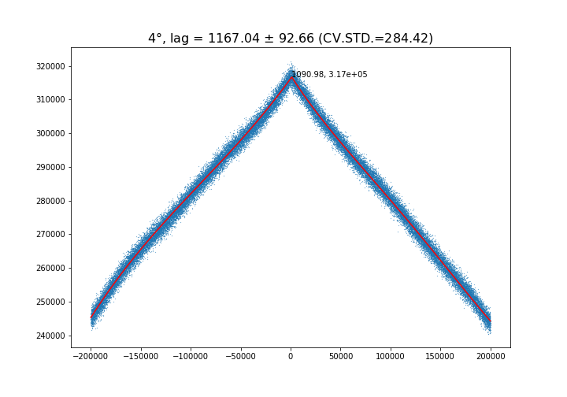

5-fold cross validation, 100 chunks

Slide 26


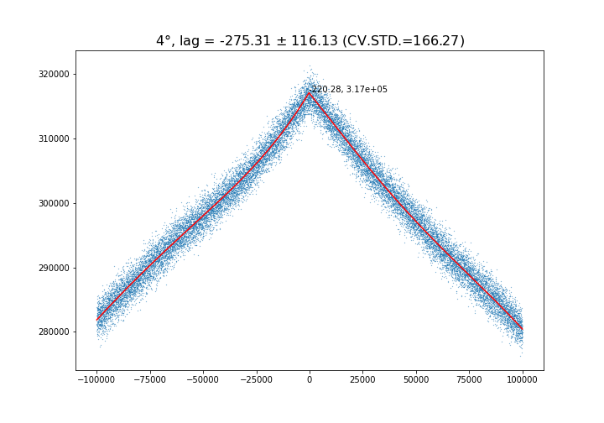

5-fold cross validation, 100 chunks

Slide 27
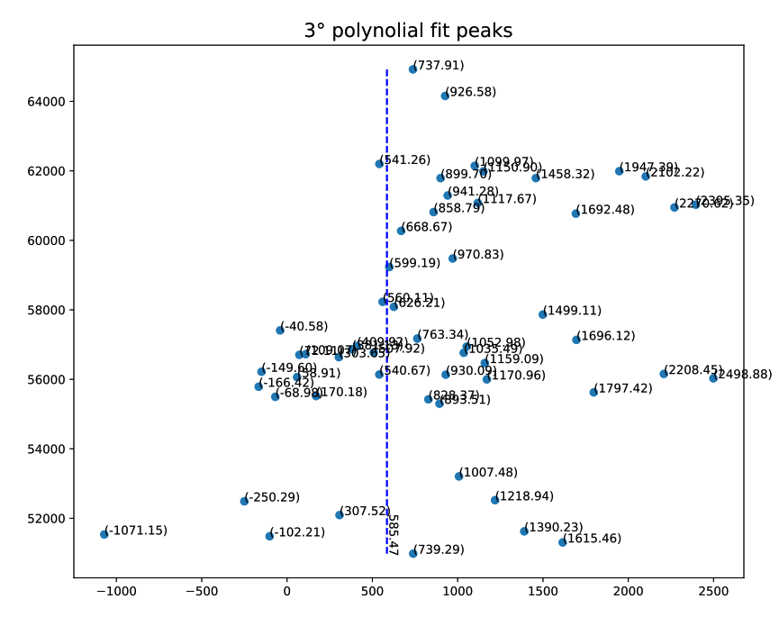

Tube-tube cross-correlation
$Max \left(\left|τ\right|\right)$ = 200000 seconds
local time zero lag
correlation peak lag time

Slide 28
Thank you

Slide 29
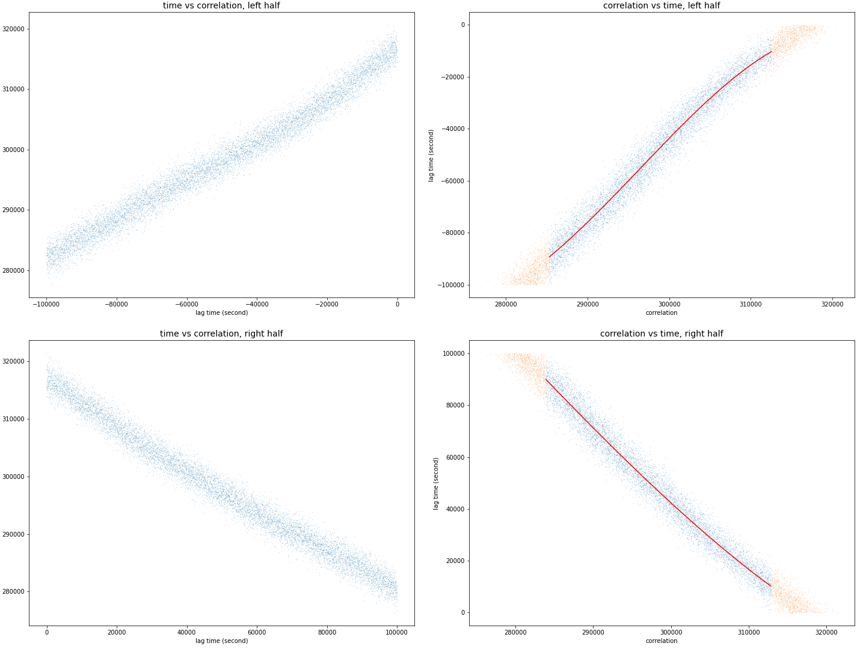
4766.78
4461.36
std = 4766.78 seconds
std = 4461.36 seconds

Slide 30
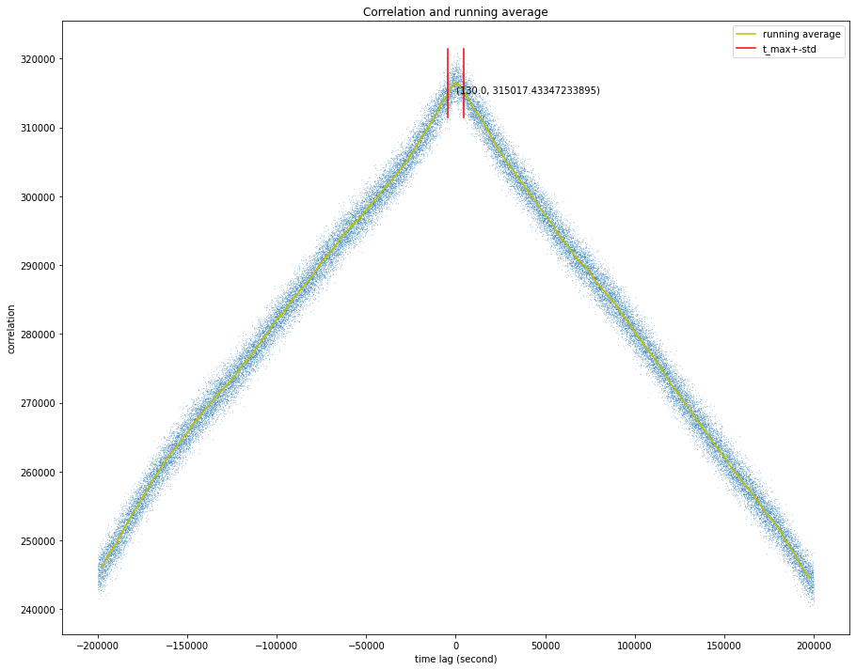
4616.29
McMurdo vs Jang Bogo

