Slide 1
Cryoscope A technology pathfinder for time domain astronomy in the NIR
SCAR AAA 2021
Roger Smith and Mansi Kasliwal
The convergence of many new technologies will soon enable high cadence surveys of the infrared sky for the first time. We describe a pathfinder telescope currently under construction, which will demonstrate a technology for imaging over a field of view two orders of magnitude greater than previously achieved in the thermal infrared. The novel optical design not only delivers diffraction limited image quality over large fields, but its double meniscus corrector serves as the entrance window to a fully cryogenic optical path that assures low thermal background in spite of the large field of view. We describe the window manufacturing and support strategies which allow scaling to apertures larger than a meter, and the various methods to prevent ice precipitation. A new, cheaper, growth process for large format infrared detectors is showing promise of making a 600 megapixel NIR focal plane feasible. High speed direct drive telescope mounts, now commercially available, will be upgraded to provide the vibration isolation necessary to take advantage of the exquisite seeing.

Slide 2
To catch transients in NIR
49 deg² every1000s with SNR>5 for magnitude 23.3 at 2.3<λ<2.55µm
WIDE
FoV = 0.6 deg²
= Current record
VISTA @ ESO
DEEP
DARK
(Low sky background)

Slide 3
200 times wider field
WIDE
FoV = 47 deg²
24K * 24K pixels
DEEP
DARK
Cheaper IR detectors developed by NSF-ATI

Slide 4
Smaller pixels & darker sky
WIDE
FoV = 47 deg²
24K * 24K pixels
DEEP
1.2 m aperture
1 arcsec pixel
Diffraction limited
DARK
Dark sky @ 2.4µm
Cold window (slightly above ambient)
30m tower
Dome C

Slide 5
Optics to match good seeing
Scan whole night sky in less than a “day”…
WIDE
47 deg² FoV
24K * 24K pixels
DEEP
1.2 m aperture
1 arcsec pixel
Diffraction limited
DARK
Dark sky @ 2.4µm
Cold window (slightly above ambient)
Cryogenic optical path
Image stabilizing telescope mount
New Optical design

Slide 6
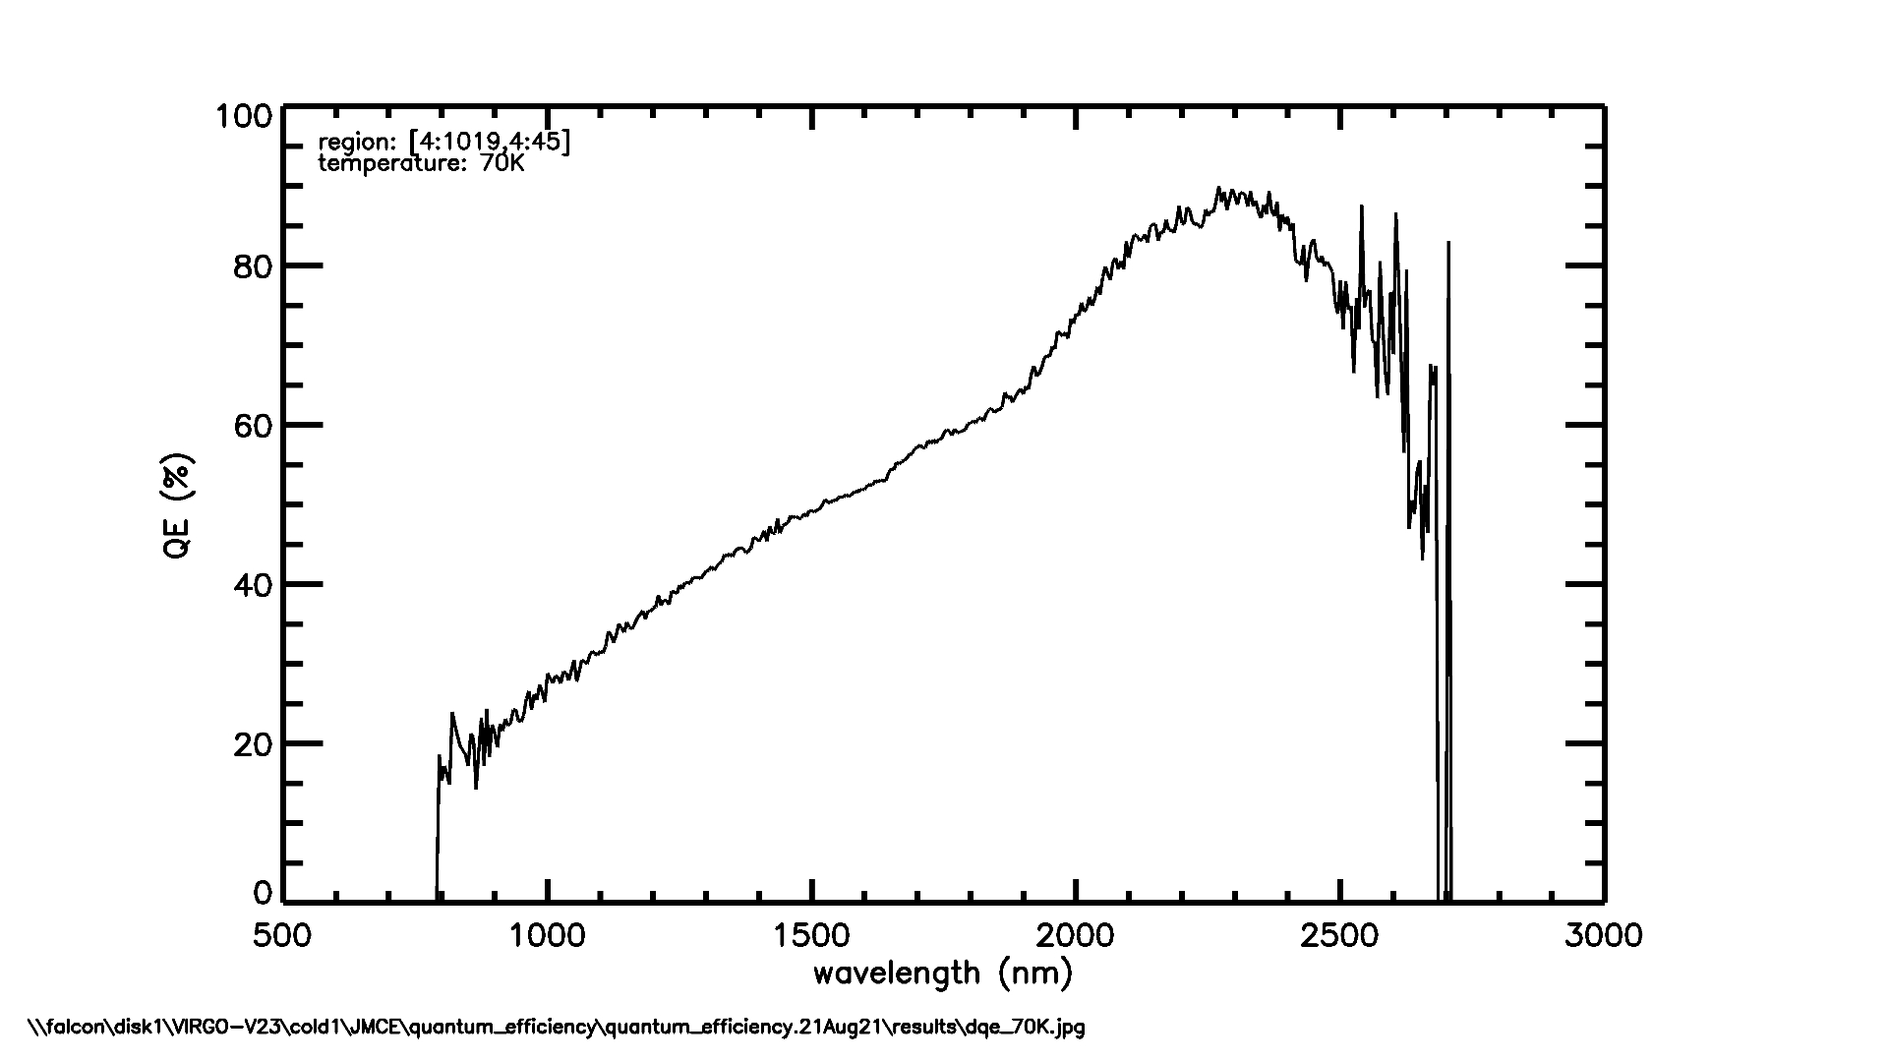
Cheaper large format IR detectors: ✔︎ good QE
NSF-ATI grant has funded development at Raytheon of MBE-on-silicon process for making large NIR detectors 4x cheaper. (PI: Don Figer)
~80% QE in K_dark passband
Peak of QE curve can be tuned for peak in middle of passband.
27e- read noise prior to multiple sampling.
K_{dark} passband

Slide 7
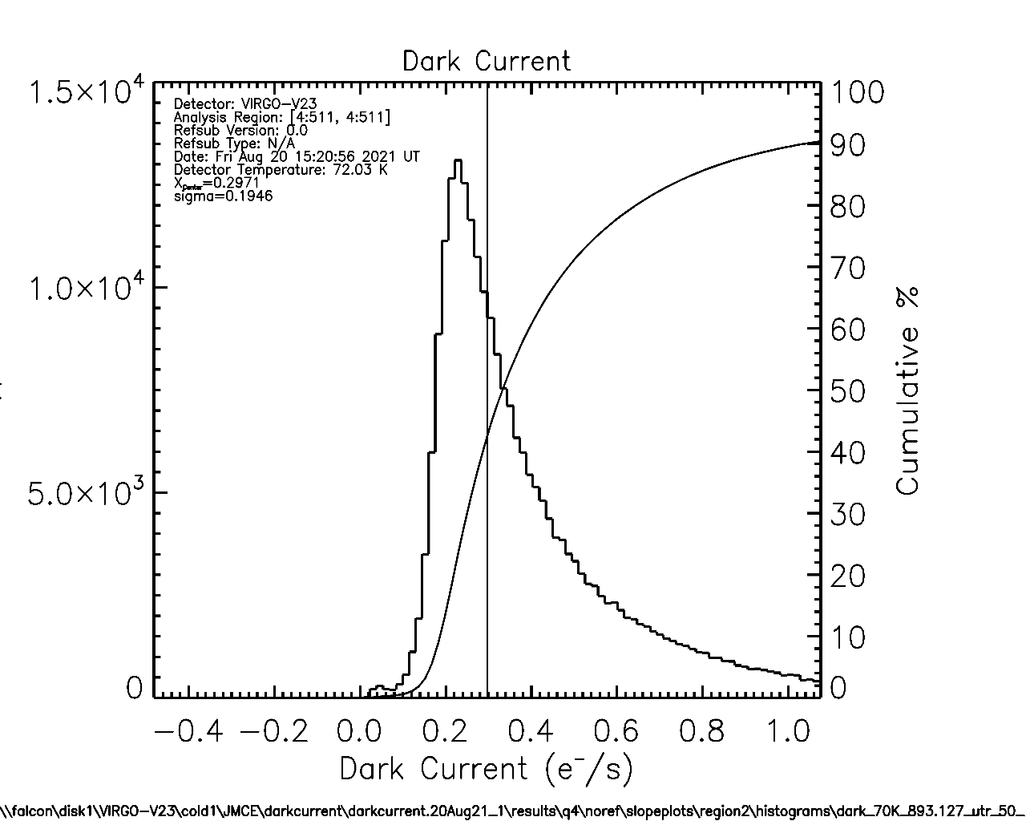
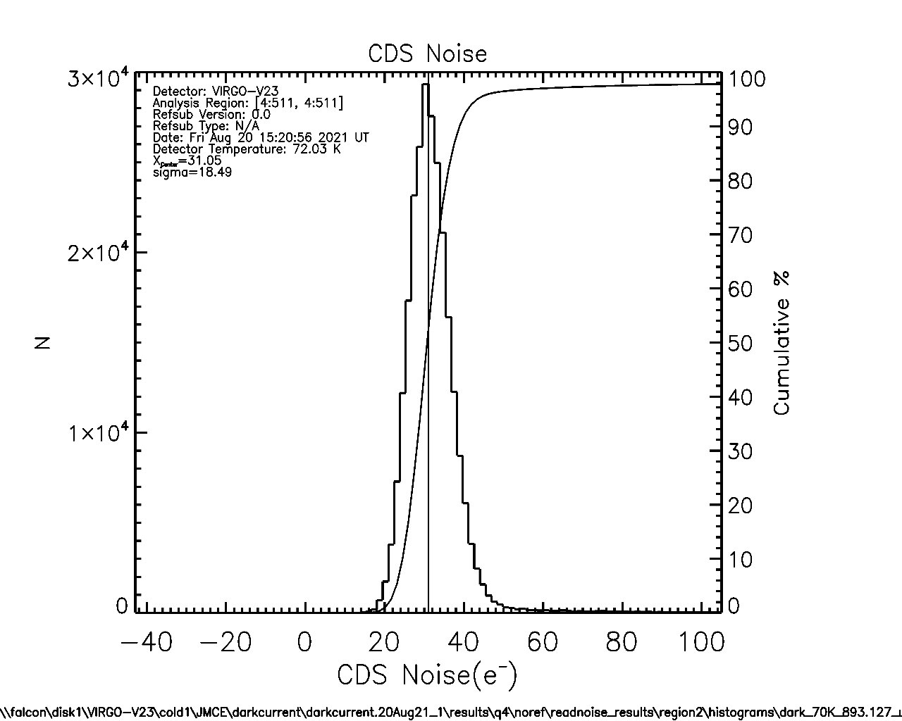
Low dark current. Tight noise distribution
✔︎ Require < 10 e-/s ︎
✔︎ Require < 31 e-

Slide 8
Hybridize to SC 4Kx6K ROIC
4K*6K Readout IC by Sensor Creations Inc
Funded by NASA SBIR grant (via WFIRST)
Currently under test
Cryoscope will deploy 6x4 mosaic
24K*24K pixels
Instantaneous Field of View = 49 deg²
Beam obstruction by 6x4 mosaic is only 8%
10 µm pixels → 1.031 arcsec/pixel
telescope focal length = 2.0 m
1.2m aperture
f/1.66
→ FWHM at diffraction limit = 4.2 µm
71.12 mm
43.795 mm
8’’ wafer

Slide 9
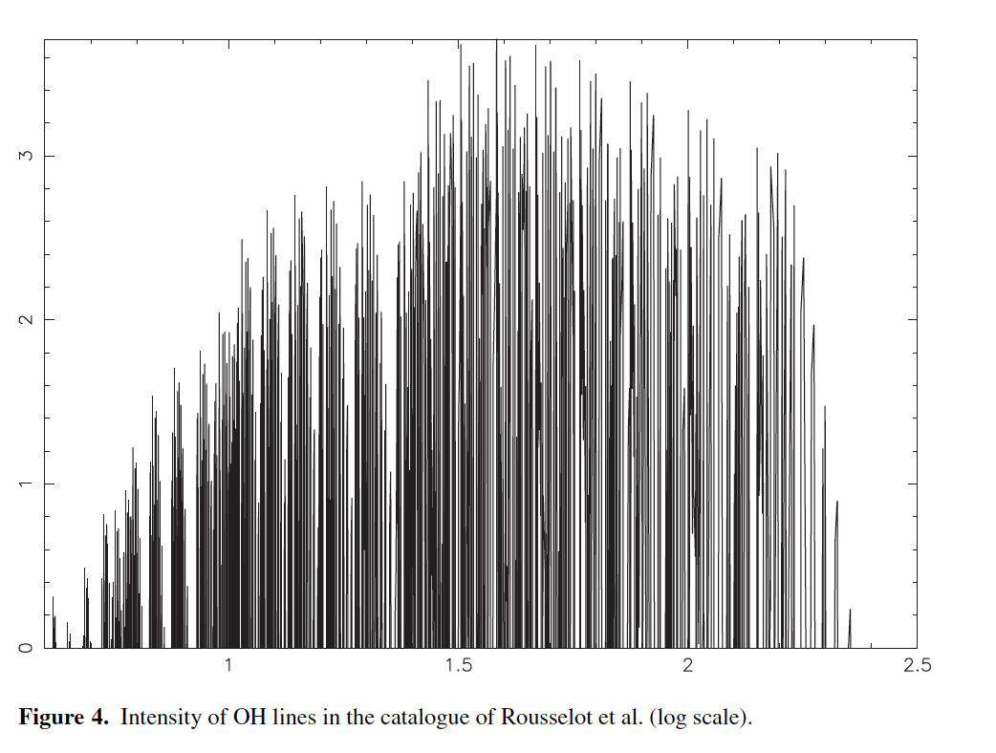
Air glow lines
Log intensity
Optimum passband starts at 2.26 µm
Wavelength 9µm)
2.26
K_dark

Slide 10
South Pole - atmospheric transmission
K_dark
Lower water column at Dome C (higher altitude, lower temperature)
South Pole: 2835 m
Dome C: 3233 m
Dome A: 4093 m

Slide 11
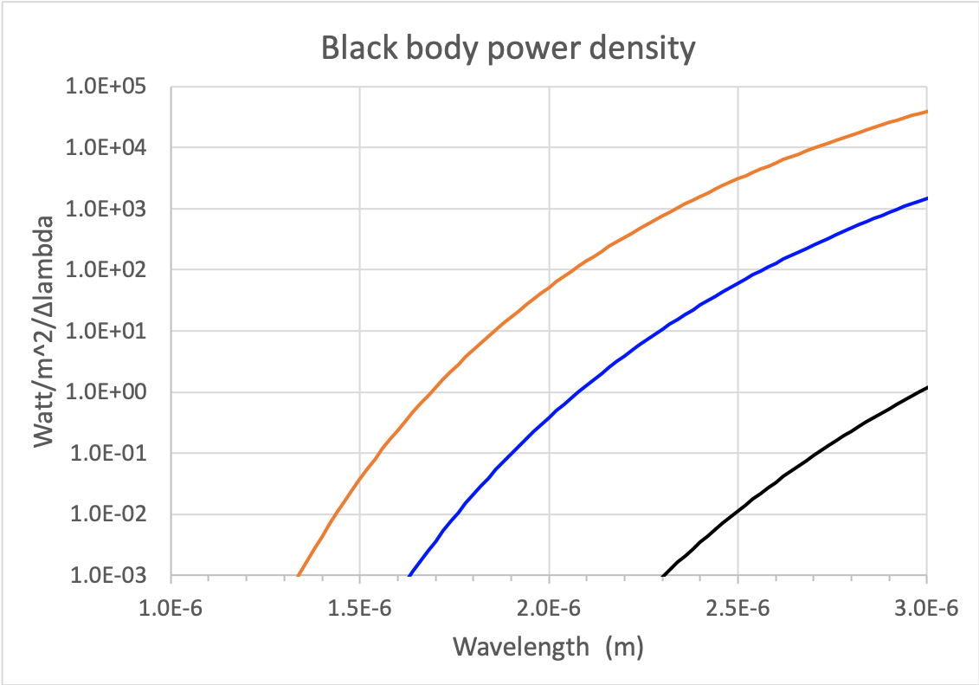
Black body power density
Telescope on Mauna Kea (277K)
Reduced emission from telescope helps but very widefield designs have higher emissivity thus need to be as cold as sky.
Telescope Dome C @30m (233K)
Sky over Dome C ? (173K)

Slide 12
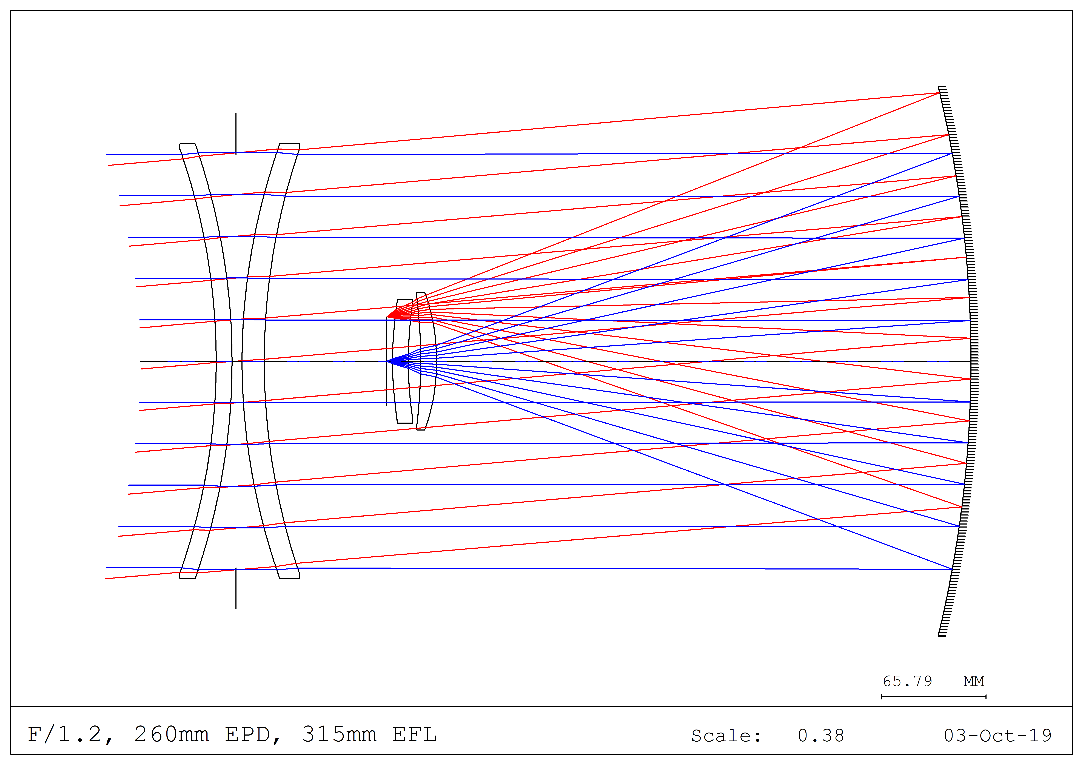
Fucik Telescope
Diffraction limited
Excellent image quality even at f1.2 and 100 sq.deg.
All fused silica corrector → scalable to large aperture.
Arizona Mirror labs are developing glass slumping to fabricate large menisci economically.
Similar lenses are used in prime focus correctors.
Shorter than a Schmidt → smaller primary for given aperture and FoV

Slide 13
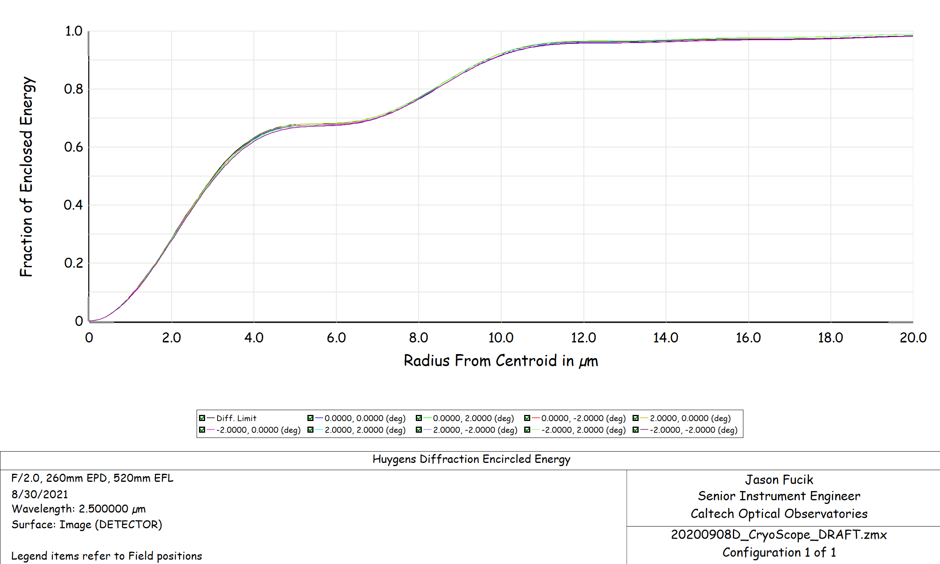
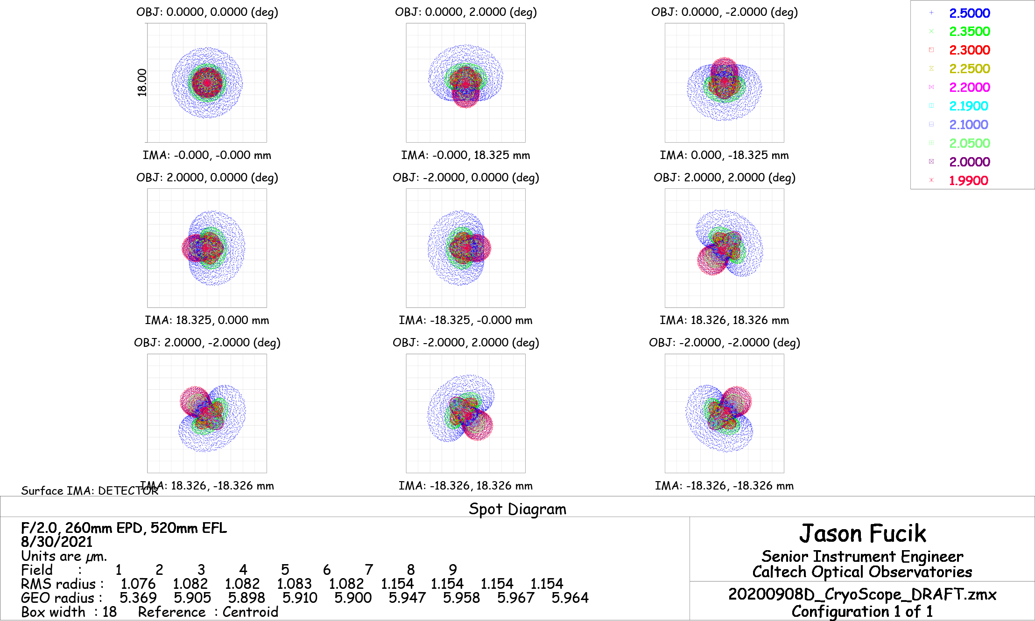
Negligible aberrations !
Pathfinder
4.06 deg x 4.06 deg field of view
260mm aperture at f/2
Spots are much smaller than 18 µm pixel
RMS radius < 1.2 µm
diffraction limit
With aberrations, all field points
18µm pixel for pathfinder

Slide 14
Dome C

Slide 15
Why a cryogenic telescope ?
Usual measures to block rays from warm telescope limit FoV.
…but without re-imaging optics and cold Lyot stop, telescope emissivity is closer to 1 than the ~2% emissivity of optics.
At top of inversion layer (25-30m above ice), T= ~230 K ← not cold enough
We really want telescope temperature < sky temperature < 200 K.
2nd corrector element of Fucik optical design can serve as window, so full optical path can be cryogenically cooled.

Slide 16
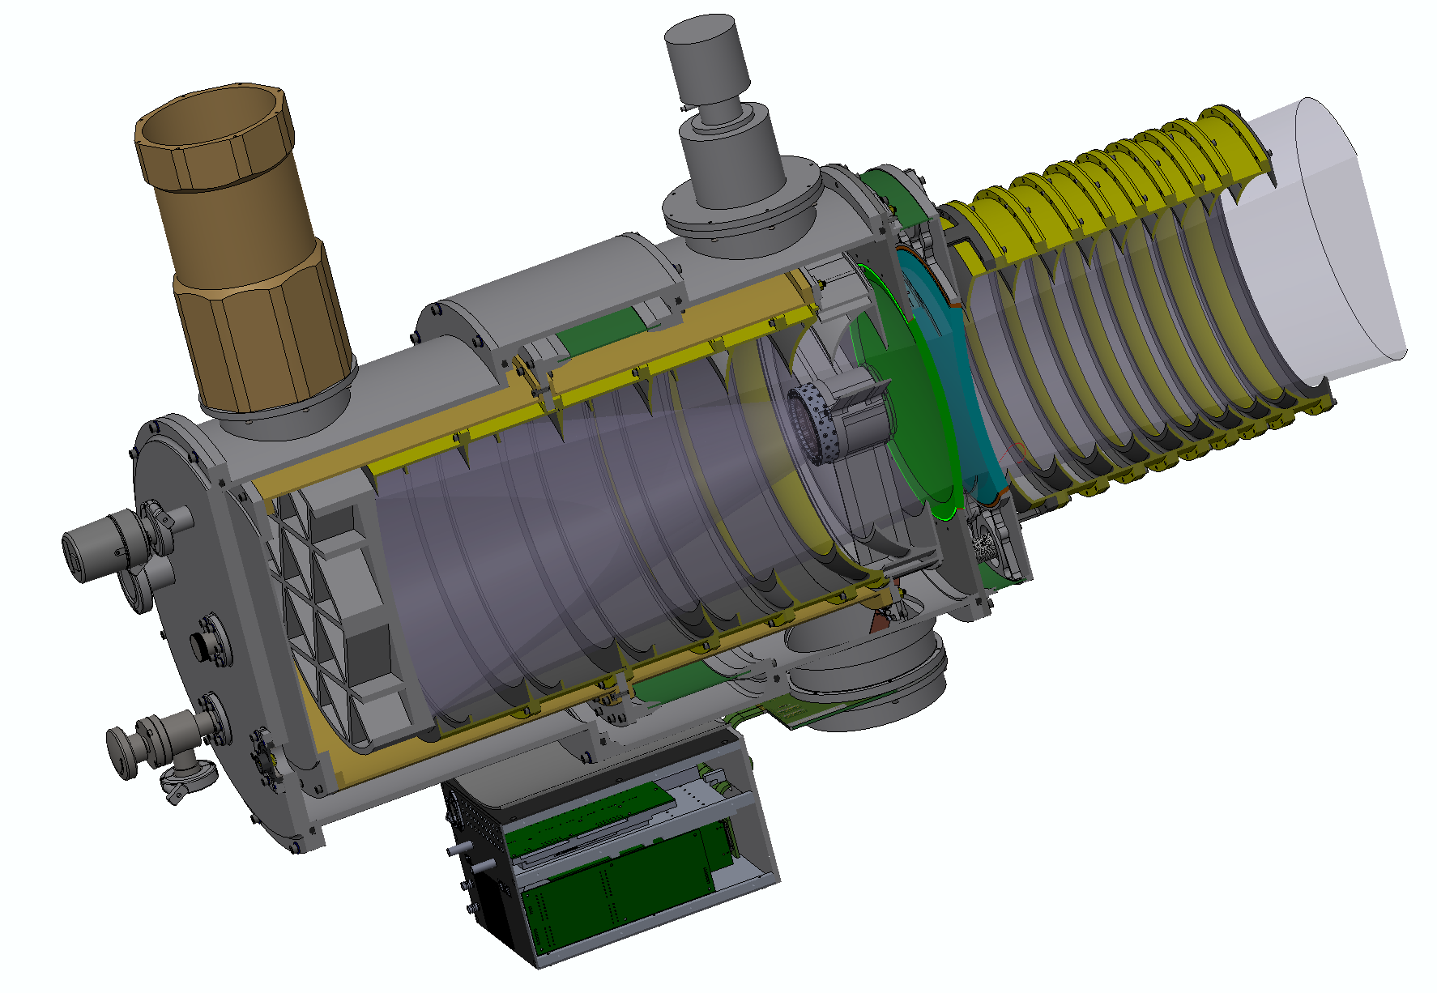
Cryoscope pathfinder
Zeolite desiccant [6]
Pulse Tube cryocooler
Thermal standoff for front baffle
Thermal isolator,
G10 cylinder
Warm baffles
outside FoV radiatively heat first element
IR Labs ND5 for pre-cool with LN2
Conductive thin Al cylinders
= structural support
+ light seal
Detector
at prime focus
Concave corrector
Convex window
Field flatteners [2]
One more Narcissus baffle to be added here
Narcissus baffles return most thermal radiation to window
Diamond turned Al primary
~75% light weighted
Vacuum Interface Board
Commissioning in April 2022
Detector controller
STA Archon-DC

Slide 17
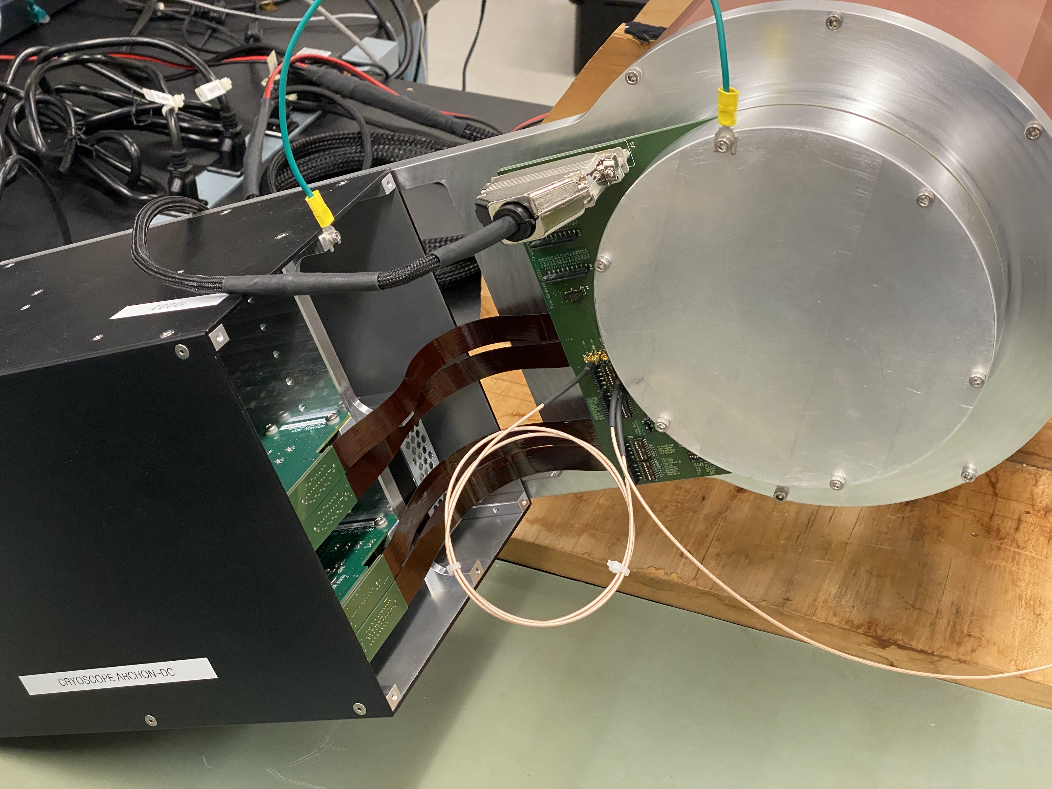
Detector test system assembled
This is a lab test dewar, not Cryoscope.
Allows early testing of components to be used in Cryoscope: controller, wiring and detector.
Readout waveforms in development now.
Tests Cryoscope detector control software.

Slide 18
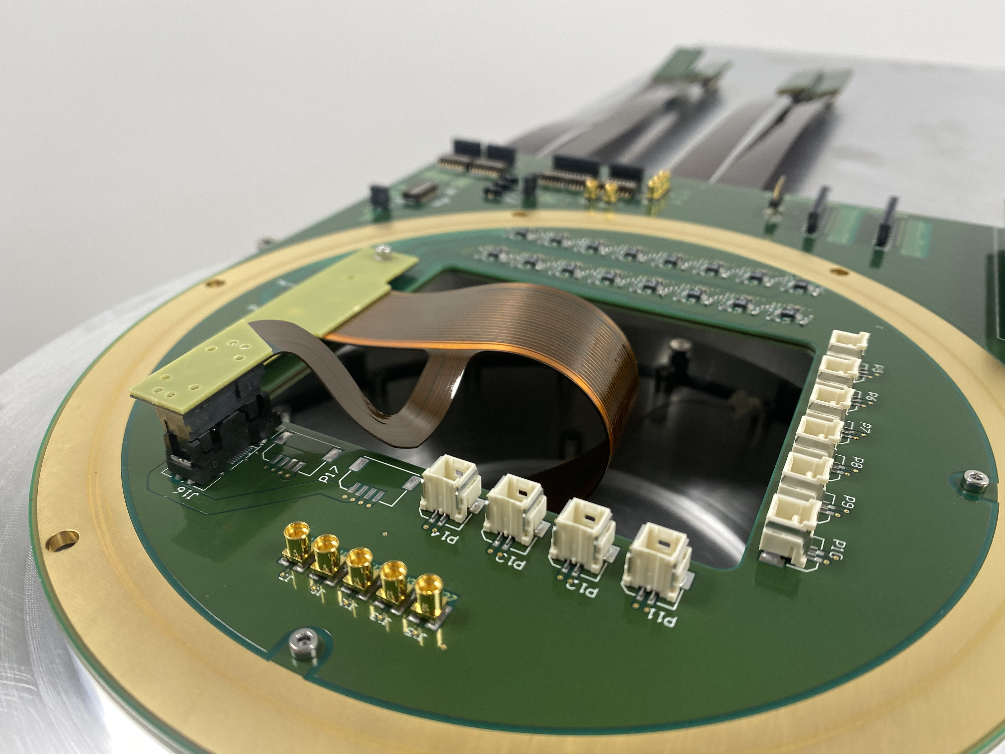
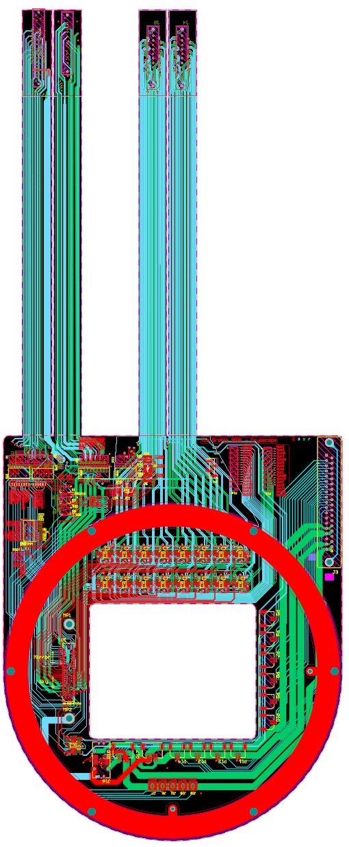
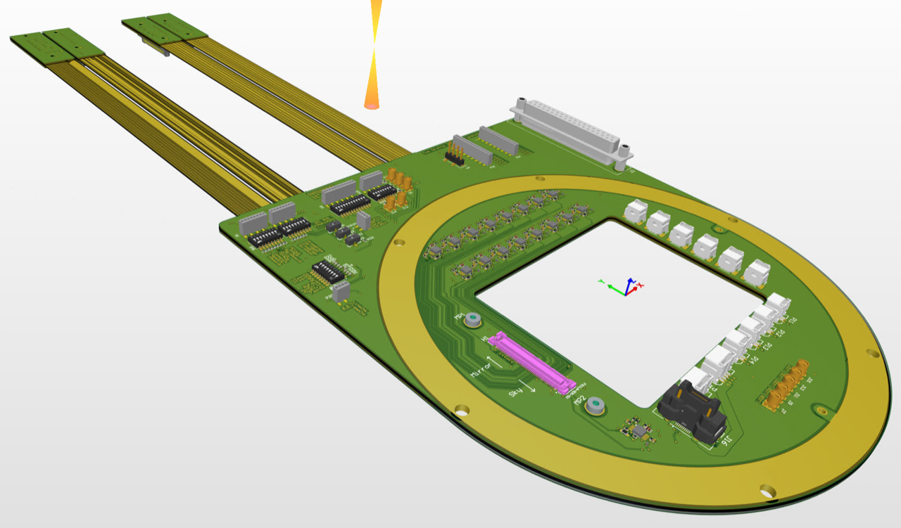
Vacuum Interface board
Connects directly to detector controller boards
Flexible section
Preamps
(in vacuum)
Smooth surface for O-ring contact (both sides)
Connector for flex circuit to detector,
Routed inside spider

Slide 19
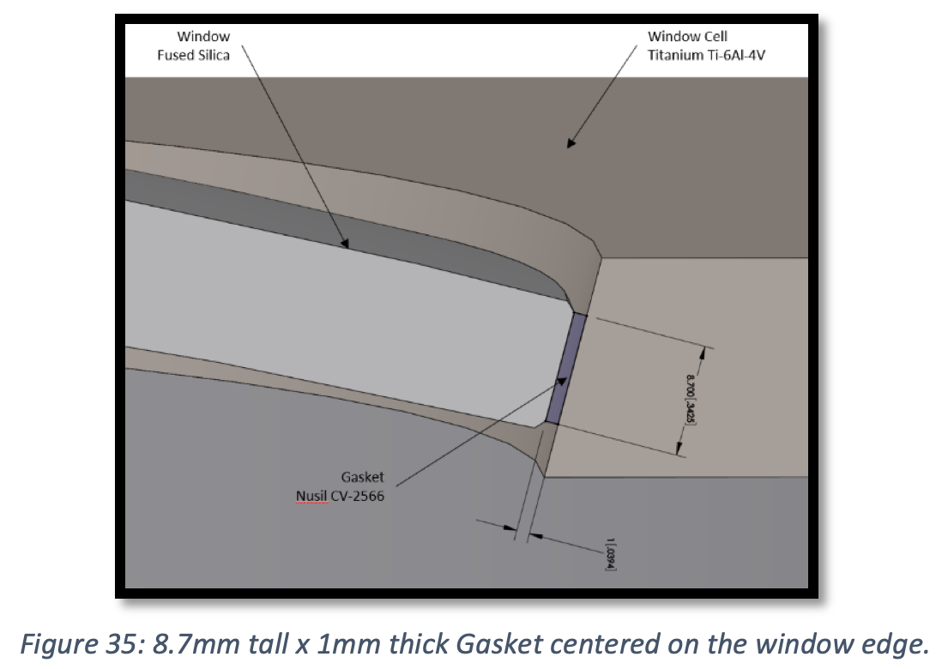
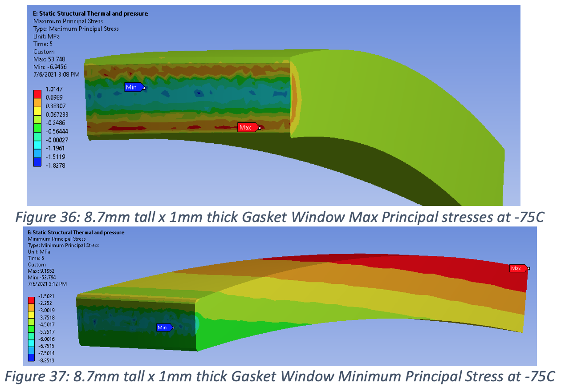
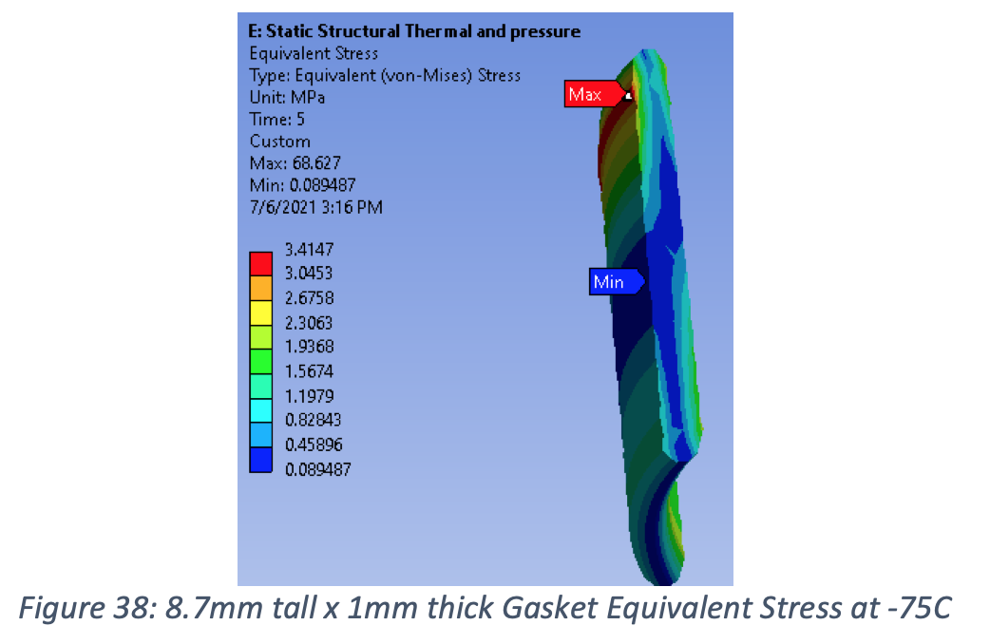
Window Stress Analysis
Titanium for CTE match
Tangential support by silicone gasket keeps glass in compression
FoS =35 ✔︎
Tension
Nusil CV2566 gasket
Factor safety = 35
FoS =2 ✔︎
Compression

Slide 20
>80% of radiation from window is returned to window (non-sequential ray tracing)
Config | Total Input | Total Missed* | Total Enters Window | Total Detector** | Total Exiting Window and Reflected Off Baffles** | Baffle 1** | Baffle 2** | Baffle 3** | Baffle 4** | Baffle 5** | Baffle 6**
Cone Baffles | 1.0000 W | -- W | 0.3990 W (100%) | 0.0009 W (0.2%) | 0.1758 W (44.1%) | 0.1276 W (32.0%) | 0.0246 W (6.2%) | 0.0132 W (3.3%) | 0.0072 W (1.8%) | 0.0020 W (0.5%) | 0.0013 W (0.3%)
Elliptical Baffles | 1.0000 W | -- W | 0.3990 W (100%) | 0.0005 W (0.1%) | 0.1990 W (49.9%) | -- | -- | -- | -- | -- | --
Mixed Baffles E(2,3,4);C(1,5,6) | 1.0000 W | -- W | 0.3990 W (100%) | 0.0005 W (0.1%) | 0.1569 W (39.3%) | 0.1270 W (31.8%) | 0.0267 W (6.7%) | -- | -- | 0.0020 W (0.5%) | 0.0012 W (0.3%)
Since making the above table, this number has been raised to 80%
with addition of baffle here
Source: window radiates light into π² steradians equally
Further improvement is anticipated by filling this gap
Three points of measurement: front/back side of window and detector

Slide 21
Neglible out-of-field light scatters onto detector (non-sequential ray tracing)
Config | Total Input | Total Missed* | Total Enters Window | Total Detector** | Total Exiting Window and Reflected Off Baffles** | Baffle 1** | Baffle 2** | Baffle 3** | Baffle 4** | Baffle 5** | Baffle 6**
Cone Baffles | 1.0000 W | 0.3076 W | 0.4499 W (100%) | 0.0363 W (8.1%) | 0.2361 W (52.5%) | 0.0099 W (2.2%) | 0.0170 W (3.8%) | 0.0284W (6.3%) | 0.0487 W (10.8%) | 0.0710 W (15.8%) | 0.0584 W (13.0%)
Elliptical Baffles | 1.0000 W | 0.3076 W | 0.4499 W (100%) | 0.0017 W (0.4%) | 0.4024 W (89.4%) | -- | -- | -- | -- | -- | --
Mixed Baffles E(2,3,4);C(1,5,6) | 1.0000 W | 0.3076 W | 0.4499 W (100%) | 0.0017 W (0.4%) | 0.3764 W (83.7%) | 0.0086 W (1.9%) | -- | -- | -- | 0.0749 W (16.6%) | 0.0565 W (12.6%)
Flux Entering Window
5
6
Source: sends light equally into 2.8° - 15°
3
4
1
2
Two points of measurement: front side of window and detector
*Light that does not enter corrector lens 1.
** Percent calculated from total flux entering the window.
Detector Flux
Flux Exiting Window

Slide 22
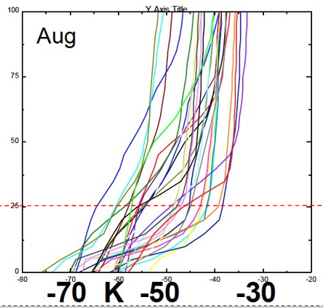
Dry air supply
Relative humidity drops significantly as air equilibrates to higher ambient T
-40 C
Wide flat duct equilibrates air to ambient as it rises
25 m boundary layer
1 C/m temperature rise
Blower
RH=100%
-65 C
Inlet
Ice

Slide 23
Image stabilizing telescope mount
Must isolate telescope from vibration of tower:
Use low friction bearings rated for low temperature.
Direct drive torque motors, so coupling is magnetic only.
Active feedback from bright stars provided by sensor using sub-array readout.
Use optical encoders only during slews.
Torque motor in telescope mounts by planewave.com
Custom bearings and servo are under discussion with Planewave.
Masters Student in Robotics at JHU is planning to test cryogenic bearing and develop image stabilizing servo

Slide 24
Conclusion
Cryoscope will validate:
New optical design (diffraction limited over wide field)
Cryogenic optical path
Low sky background (when telescope emission is suppressed).
Window temperature control (narcissus baffle performance)

Slide 25
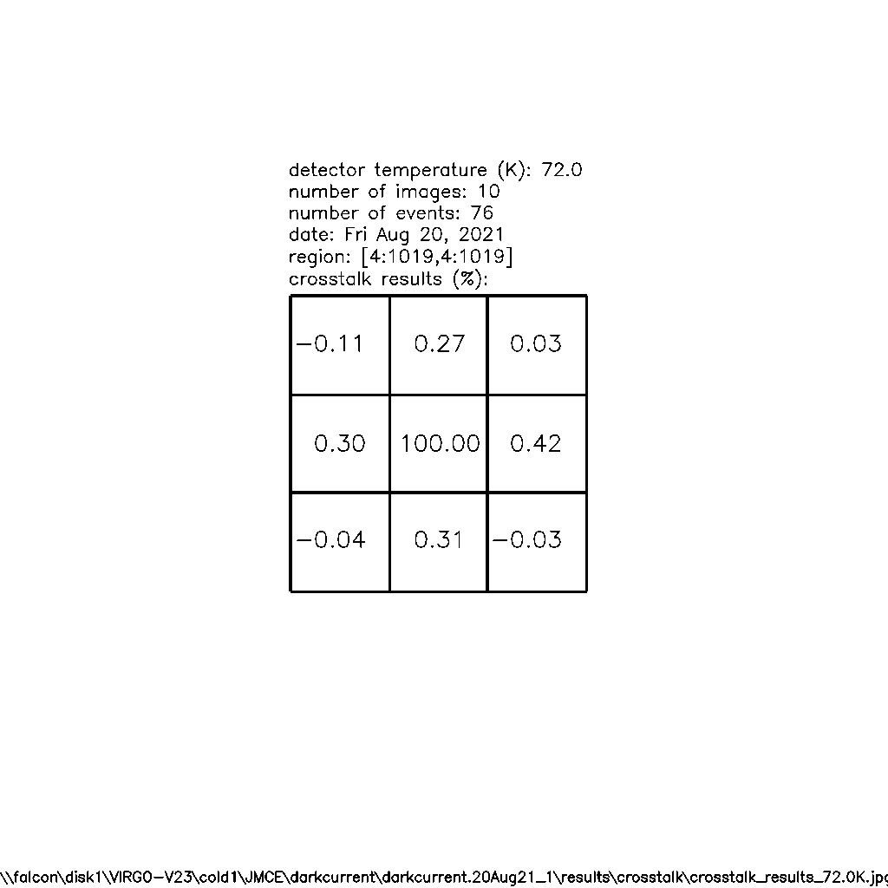
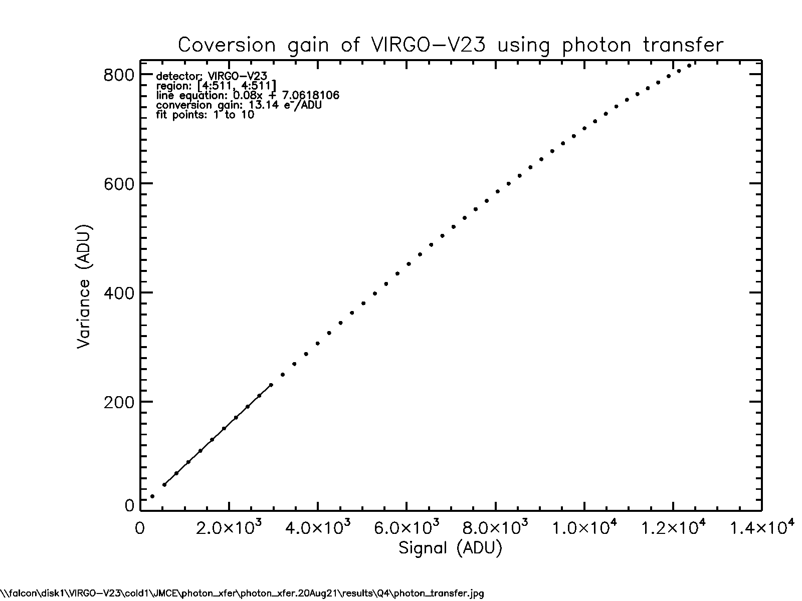
✔︎ Good well capacity ✔︎ Low Interpixel Crosstalk
This non-linearity is low for NIR detector
%
Full well > 160 ke-

Slide 26
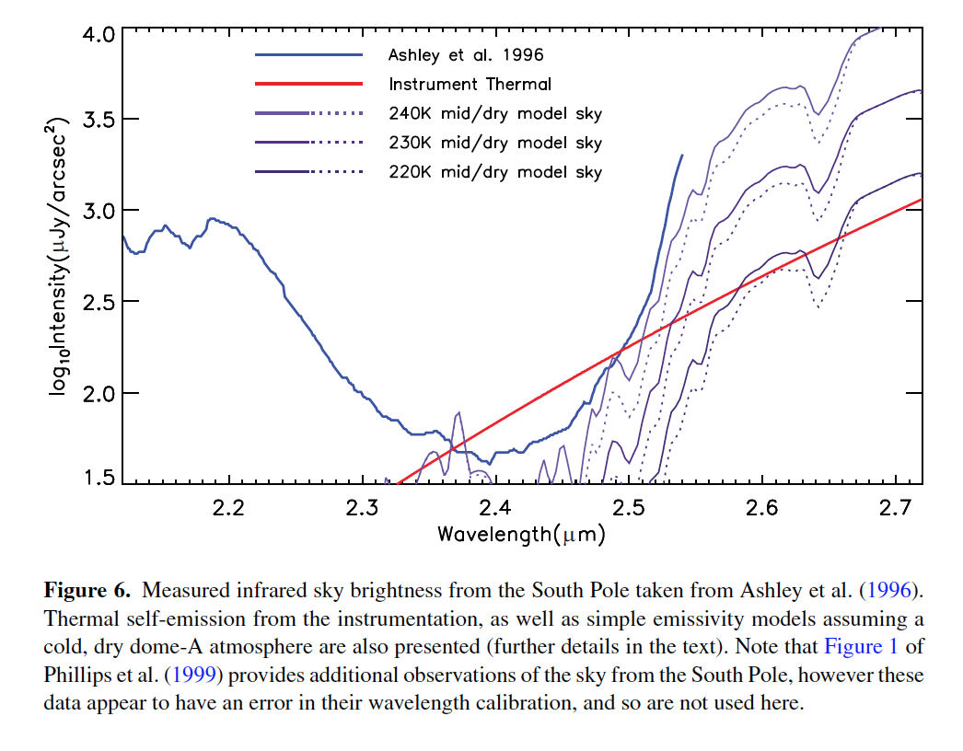
Background: sky + telescope
Low sky temperature pushes rising edge of blackbody curve beyond 2.55 µm.
Reduced emission from telescope helps but very widefield designs have higher emissivity thus need to be colder.
Sky is probably colder than this
We will eliminate this

Slide 27
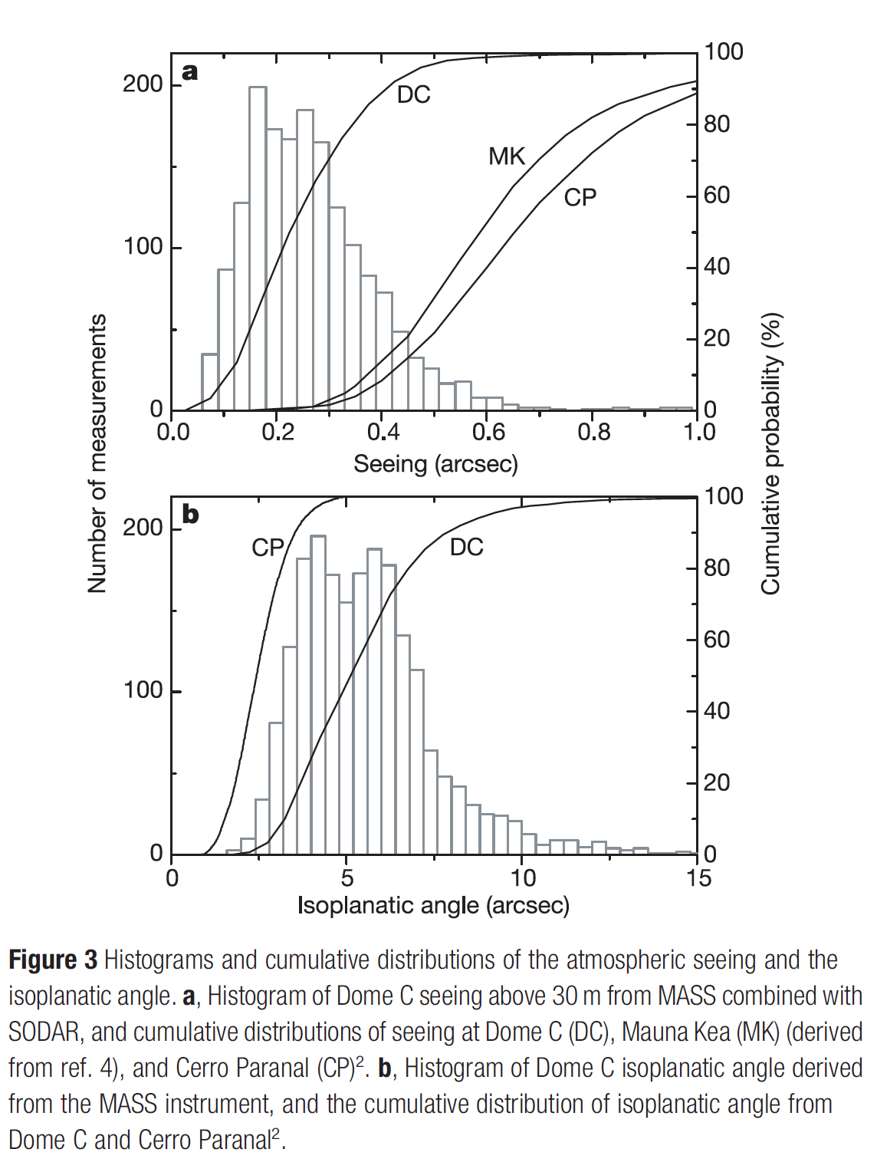
Dome C seeing
These numbers are for 30m above ice.
75% of time, seeing is better than Cryoscope diffraction limit (0.4”).
Full potential when mounted on tower.
Pathfinder (0.26m aperture) is small enough to be mounted on existing building.

Slide 28
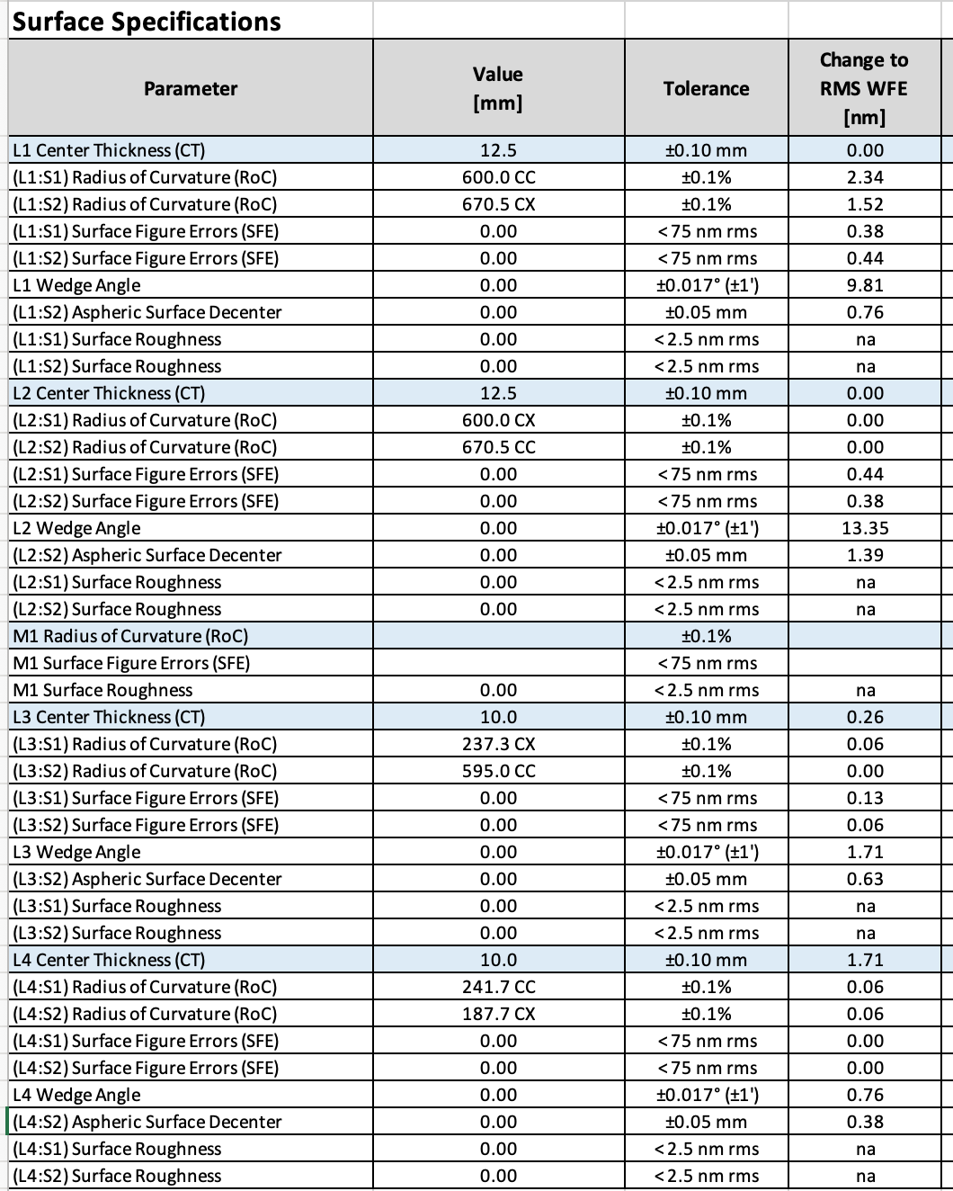
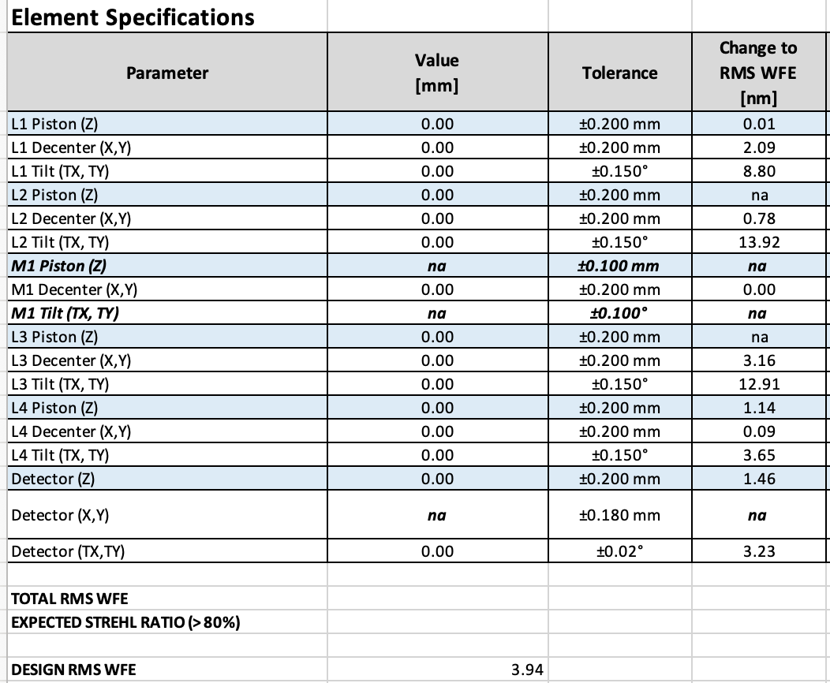
Optical tolerances are quite loose
→ Manufacturing tolerances
→ Mounting, alignment and flexure tolerances

Slide 29
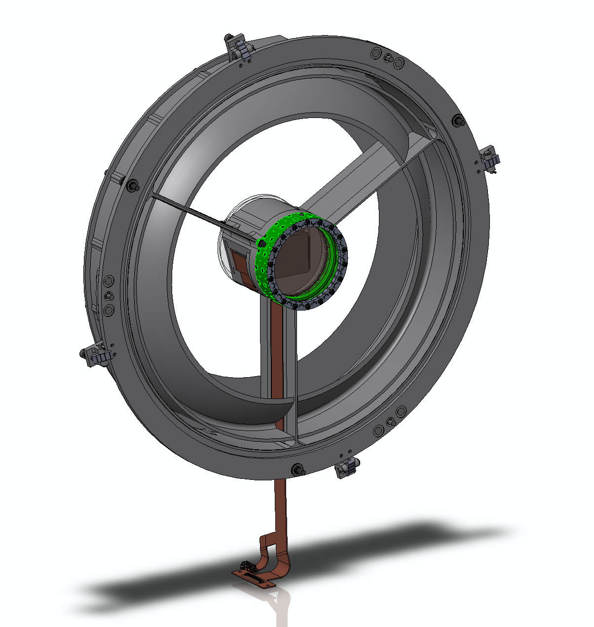
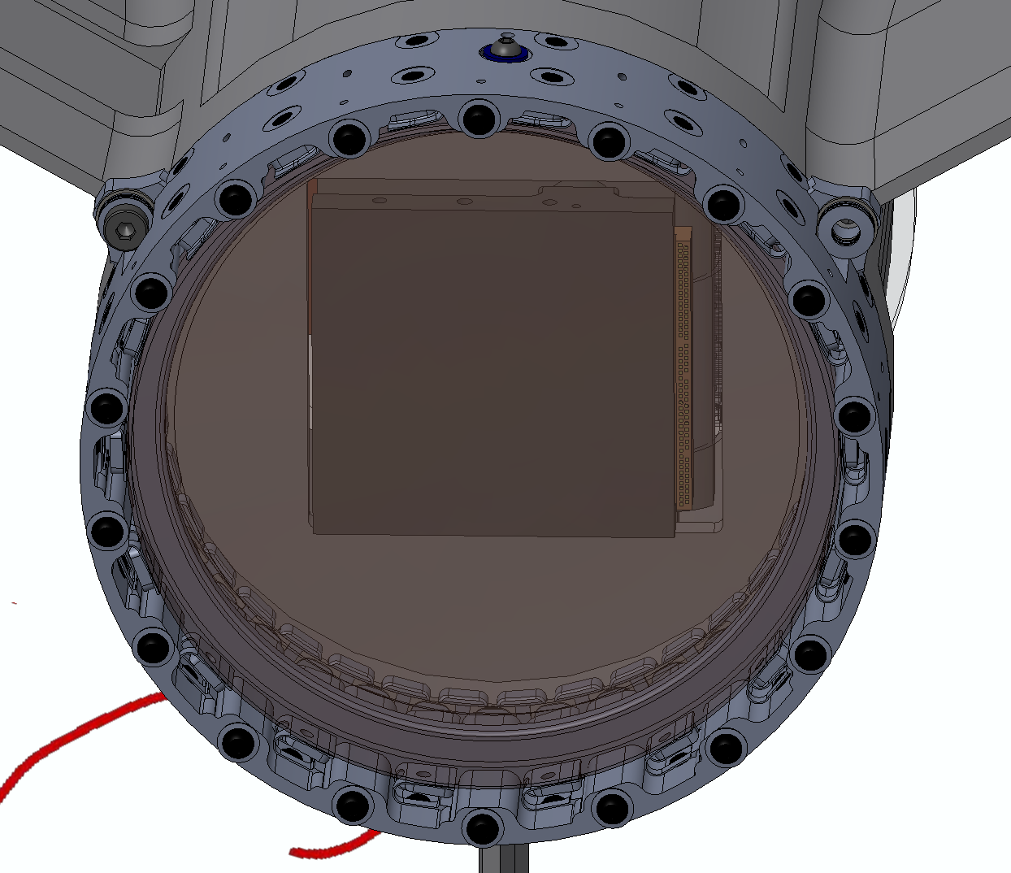
Detector
Temporary screws inserted here retract springs to facilitate lens installation
2nd narcissus baffle
Flex cable hidden in channel in spider
3D printed stainless steel lens holder with integrated radial springs.
The axial spring plate (not shown at right) is also printed.

