Slide 1

The IceCube Detector Part II
The Upgrade: Extending DeepCore’s Reach into GeV Physics and New Devices for Precision Calibration of the Ice
K. Hanson, University of Wisconsin – Madison / WIPAC Madison Bootcamp June 11, 2021

Slide 2
Neutrino Physics with the Upgrade
Testing PMNS Unitarity; Theta-23 Octant; NMO; ...

Slide 3
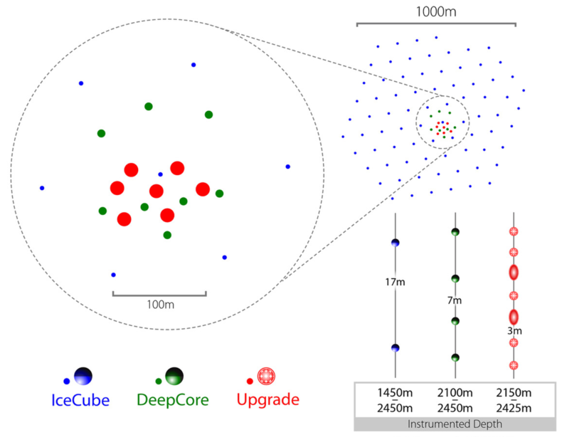
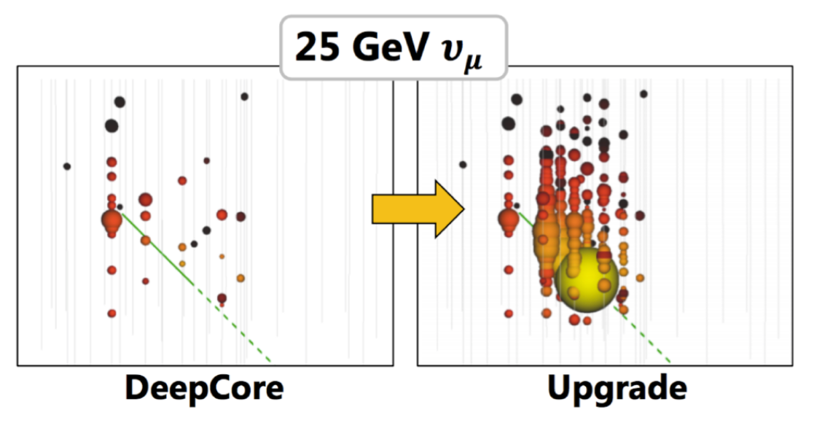
Low Energy Neutrino Events: DeepCore vs Upgrade
Problem: Events in IceCube DeepCore start to become sparse and hard to reconstruct < 25 GeV.
Solution: deploy modules more densely. DeepCore I.S. spacing of 75 m drops to 25 m in Upgrade; double density in z.

Slide 4
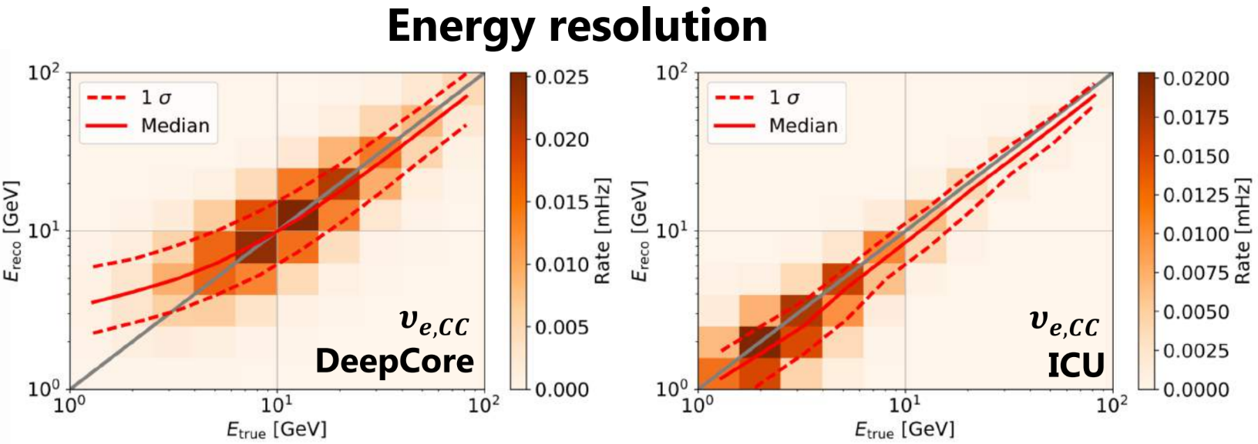
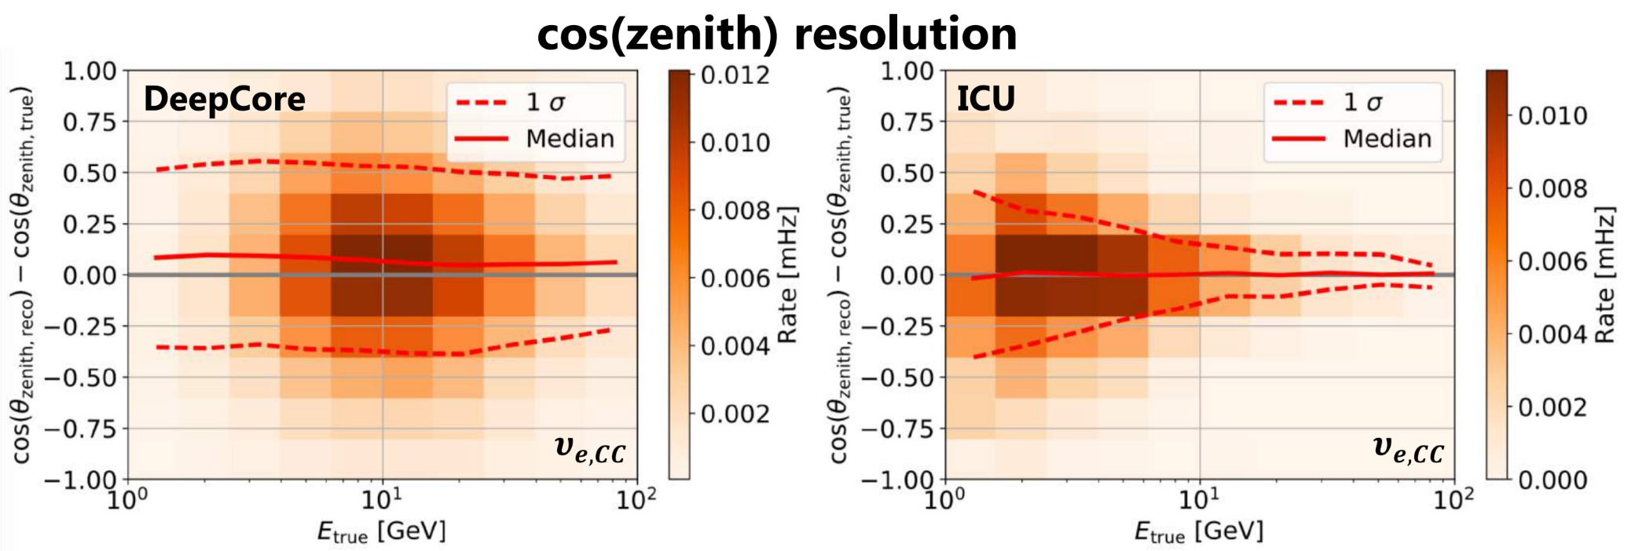
Low Energy Neutrino Events: DeepCore vs Upgrade

Slide 5
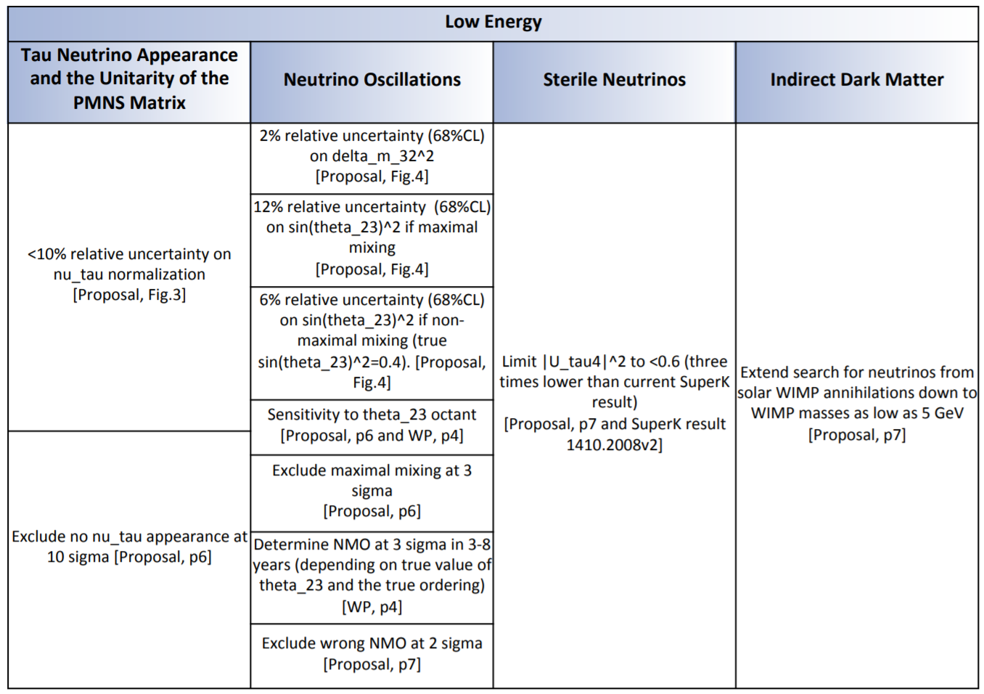
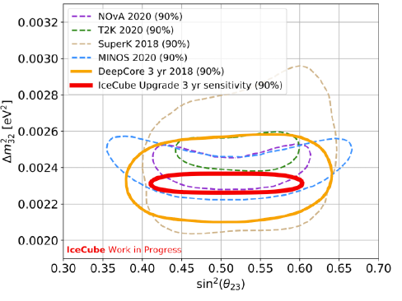
Low Energy Physics Goals

Slide 6
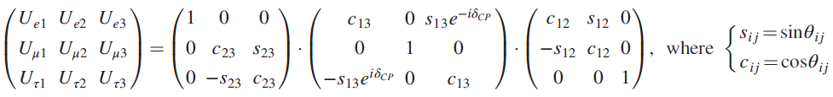

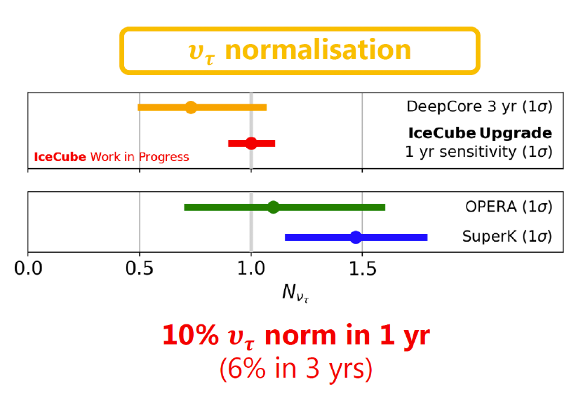
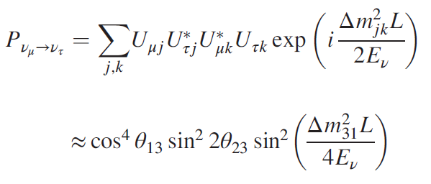
PMNS Unitarity Testing

Slide 7
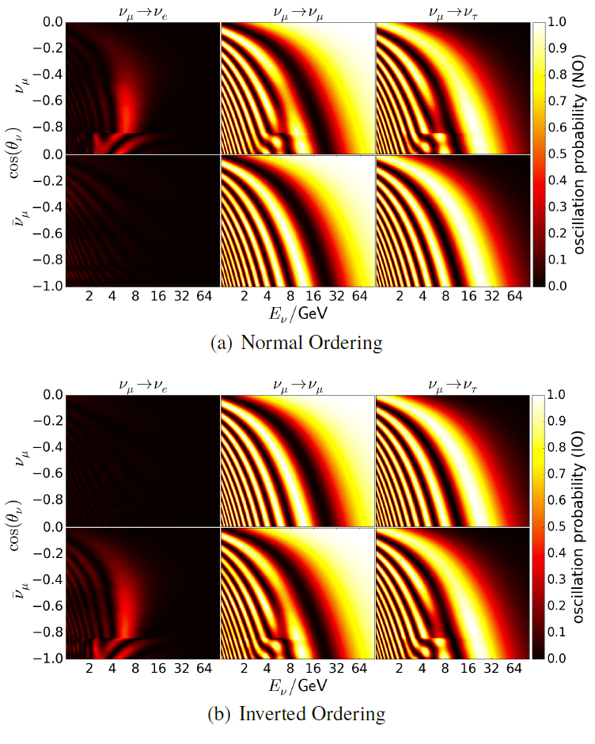
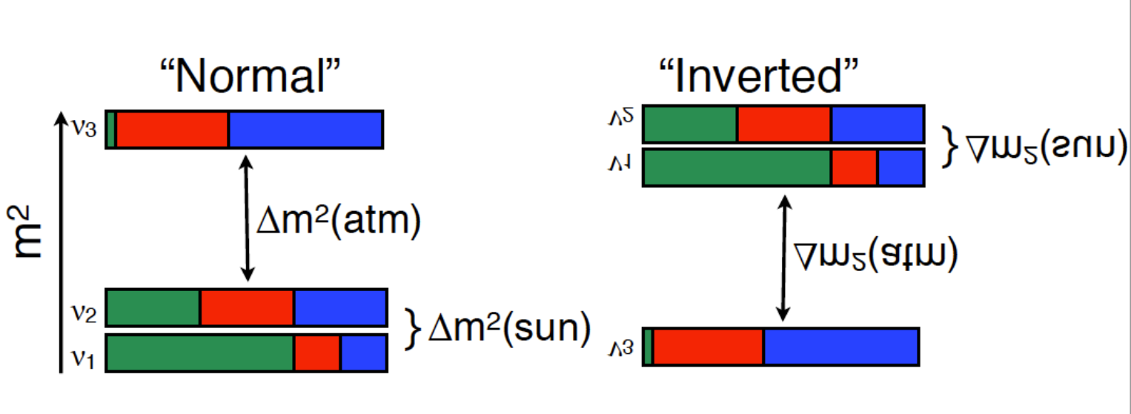
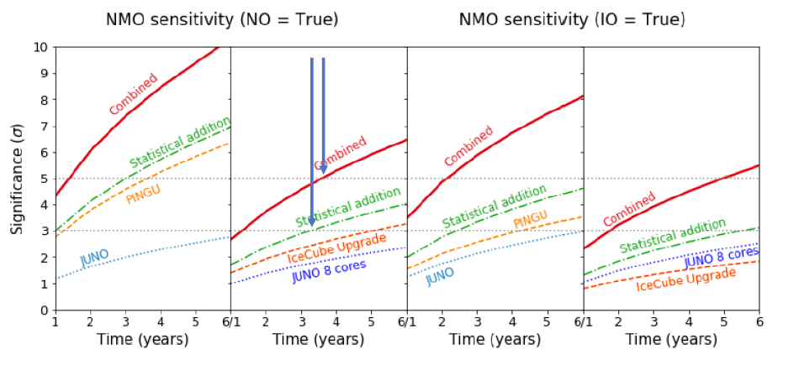
Neutrino Mass Ordering

Slide 8
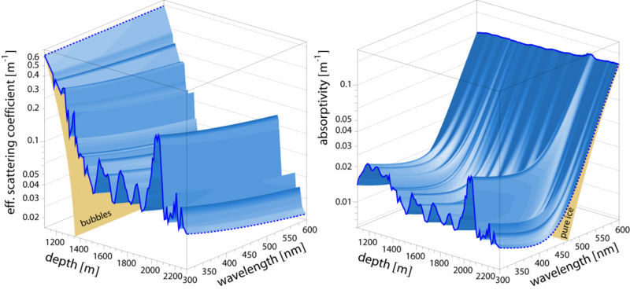
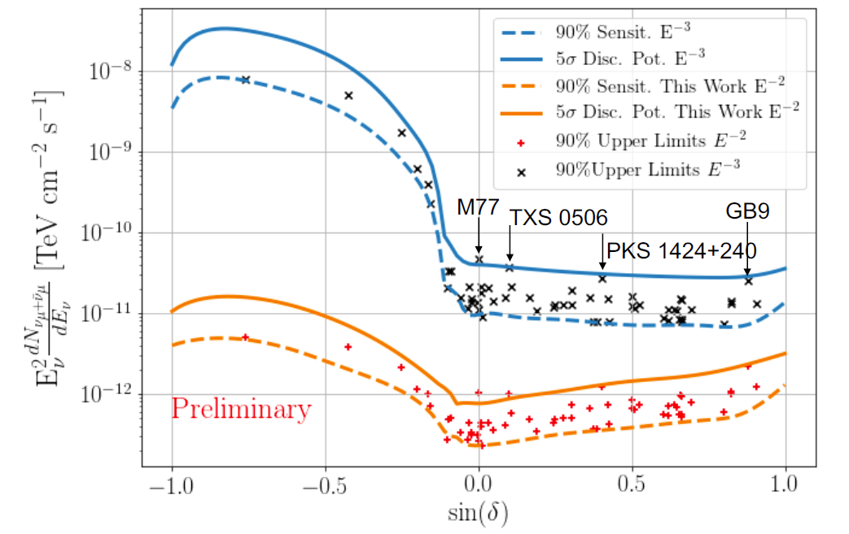
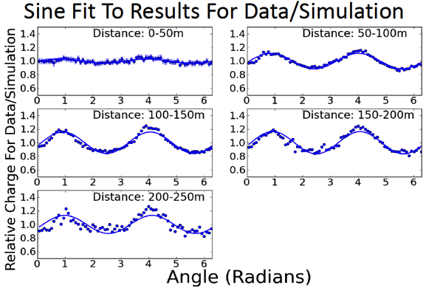
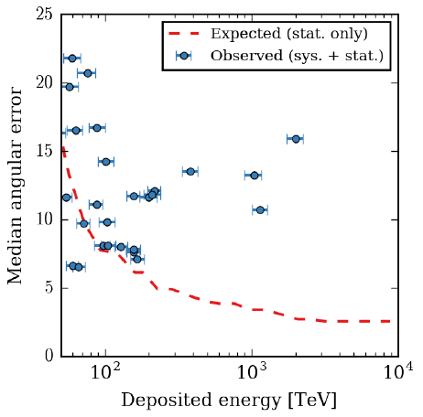
Precision Calibration of the Ice
Goal: improve knowledge of ice (absorption, scattering, scattering function, hole-ice) to re-analyse archival IceCube data and immediately resolve sources which are borderline with current IceCube.

Slide 9
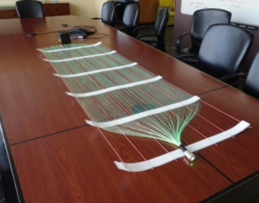
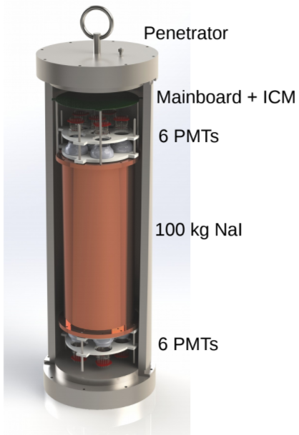
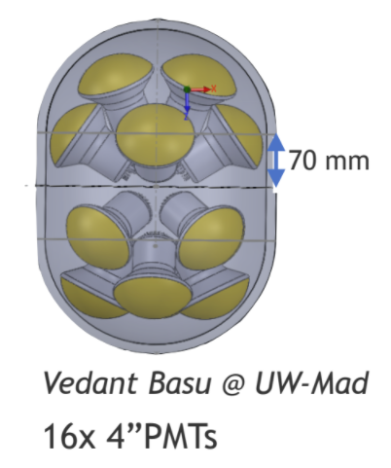
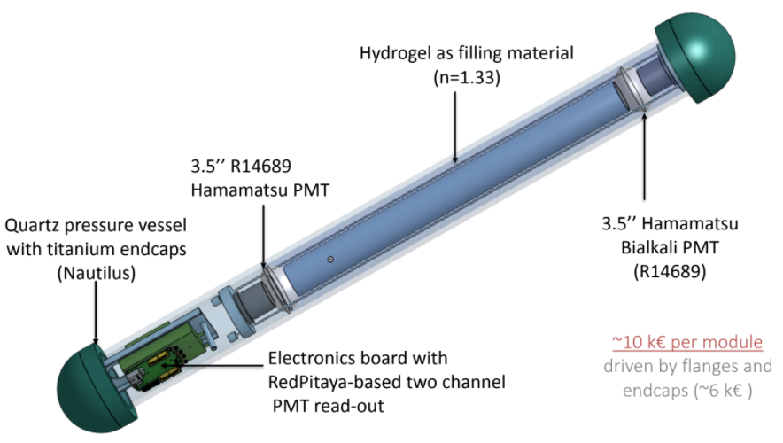
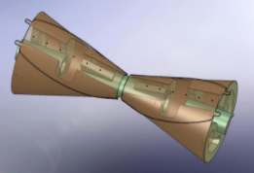
New Modules for Next-Gen Arrays

Slide 10
Upgrade Array Elements

Slide 11
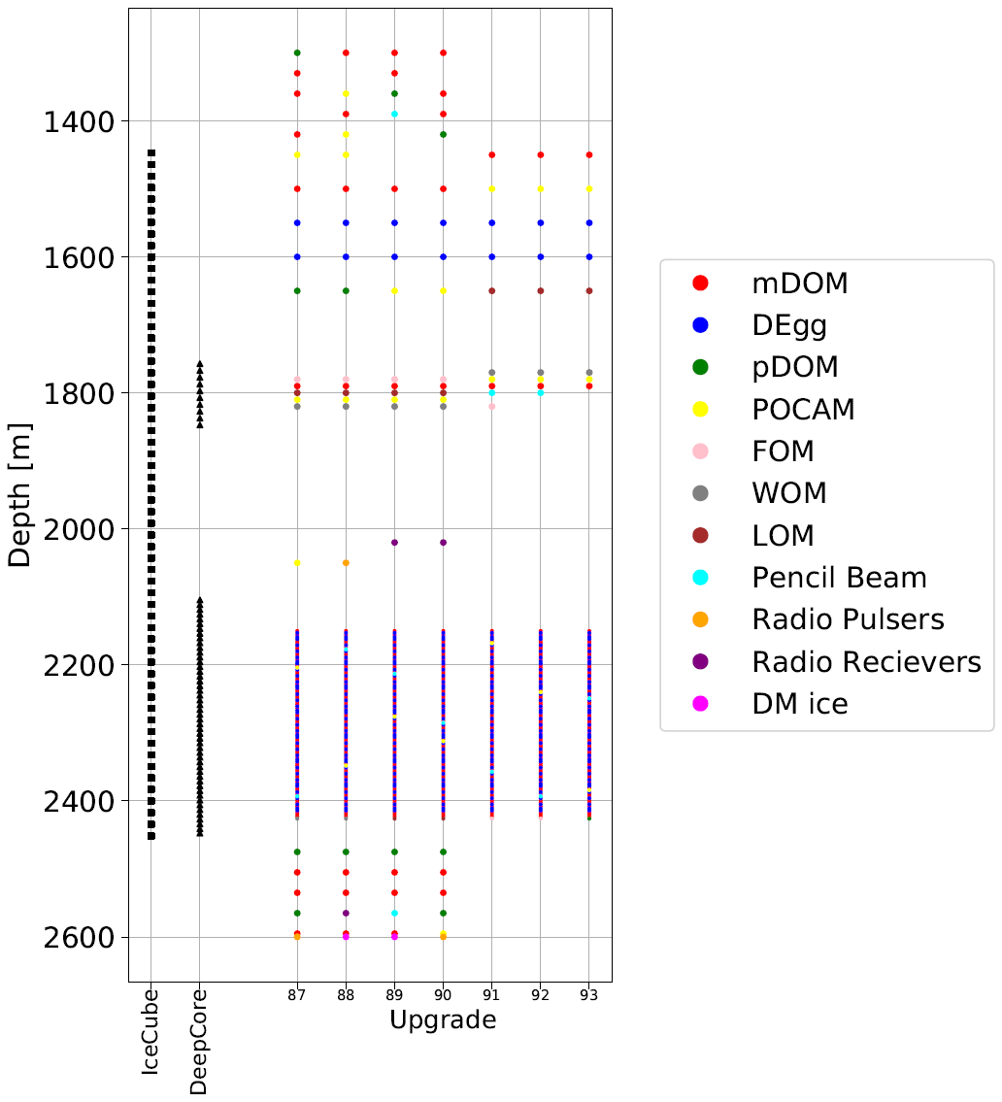
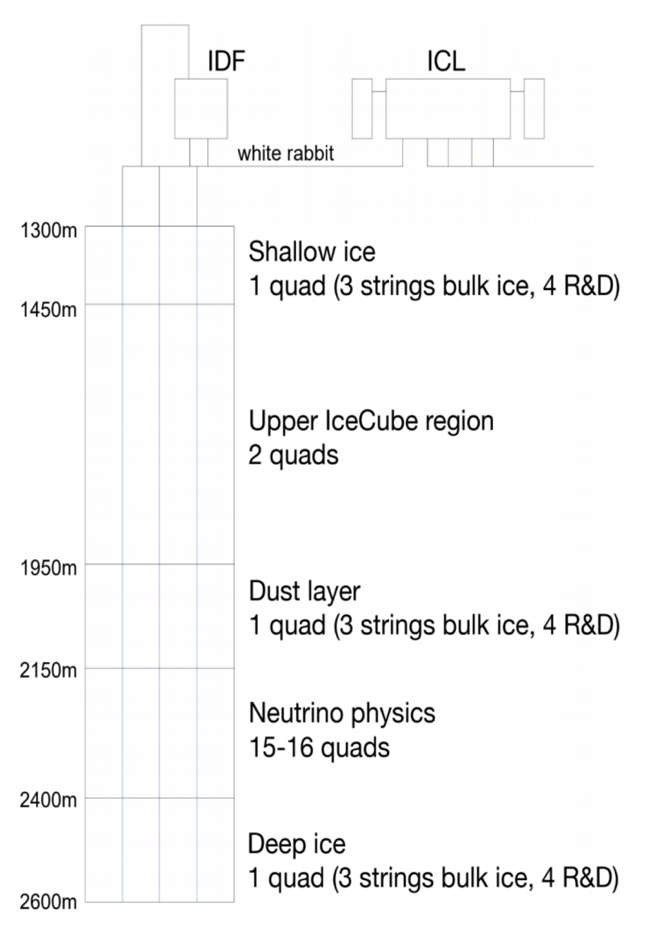
Array Configuration
Optical Sensors
430 mDOMs (DESY and MSU)
300 D-Eggs (Chiba U)
20 IceCube DOMs w new MB (UW)
Calibration Devices
2000 Small Imaging CMOS Camera
20 POCAM (Precision Optical Calib Module)
10 Pencil Beam modules
10 Acoustic geometry calibration modules
5 “Swedish” Camera modules

Slide 12
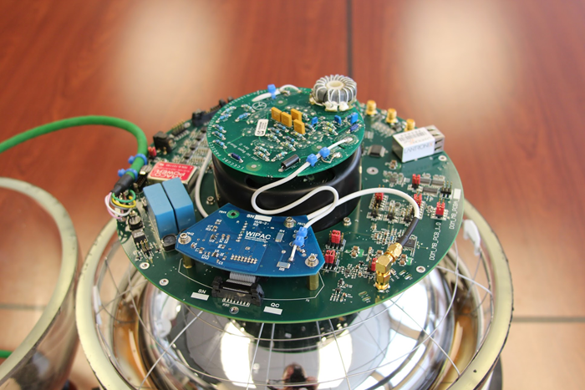
The PDOM (Six Thousand Dollar DOM)
“We can rebuild it. We have the technology. We can make it better than it was before: better, lower power, faster ...” (70’s music plays)
100% reuse IceCube DOM PMT, gel, PV – will use modules built and not deployed in IceCube.
New HV module, Mainboard
Eliminate ATWD + 40 MSPS A/D
Replace with 250 MSPS A/D (ADS4149)
Altera Cyclone V FPGA
STM32H uC
Main intent: cross-calibration of existing IceCube modules.

Slide 13
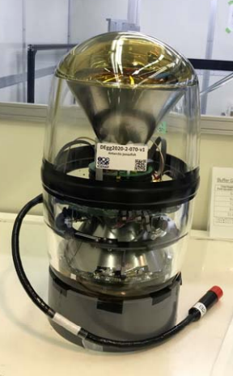
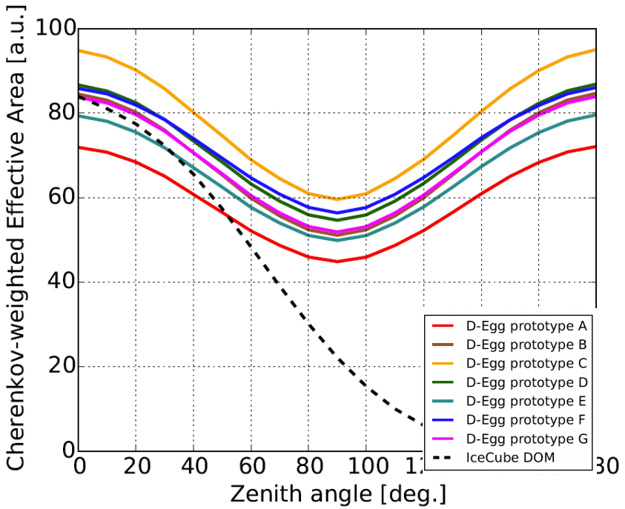
D-Eggs (Dual-PMT, Egg-Shaped Digital Optical Module)
Features
2x Hamamatsu 8” HQE R5912 PMT 30% more p.c. area rel to IceCube DOM – twice the effective photon area
UV transparent glass/gel
(Could) fit smaller diameter hole
MB: 2-ch variant of PDOM MB – 2x 250 MSPS digitizers

Slide 14
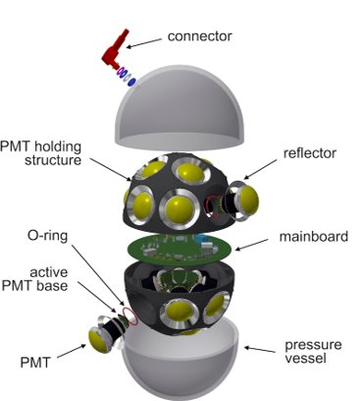
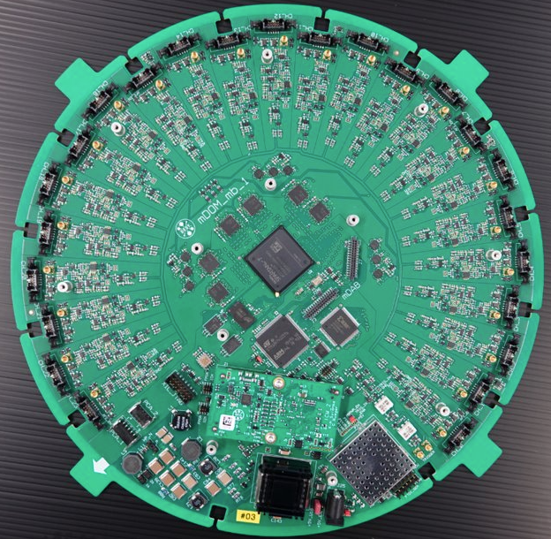
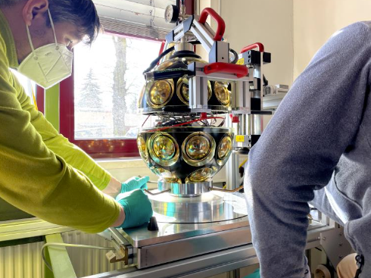
mDOMs (multi-PMT) Digital Optical Modules
24 3” Hamamatsu R15458-02 PMTs w integrated uBase
Each channel 120 MSPS 12-bit sampler
LE timing by FPGA discriminator 1.04 ns
24 independent channels gain directional information, also increased dynamic range
Initial indications background noise much higher than IceCube DOMs ~ 10x

Slide 15
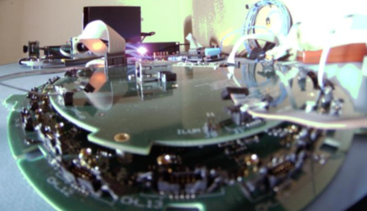
Calibration Devices
Cameras, POCAMs, acoustic geometry calibration, ...

Slide 16
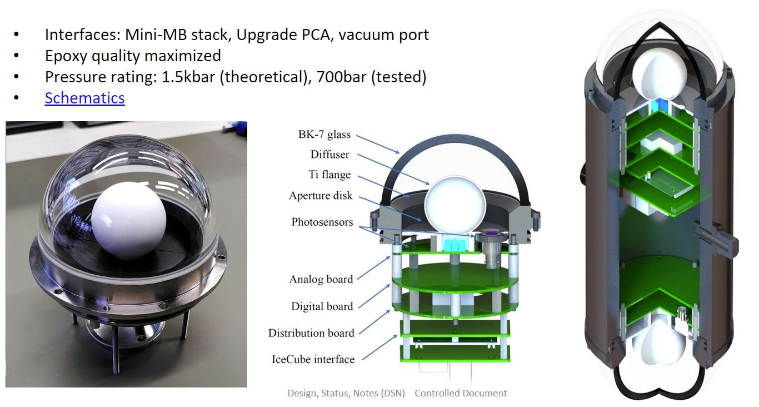
POCAM
Purpose: emission of isotropic calibrated ns-scale light pulses of different wavelengths

Slide 17
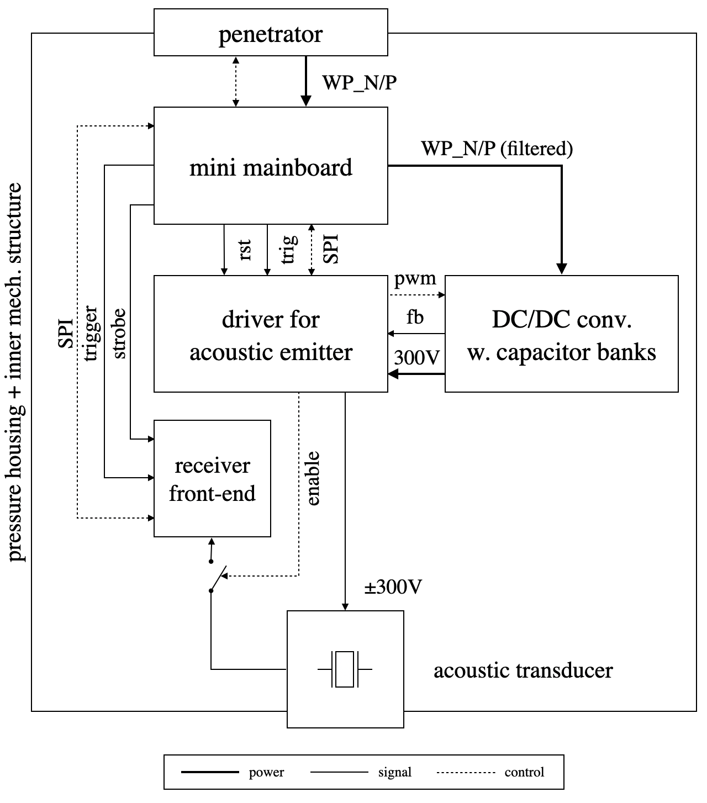
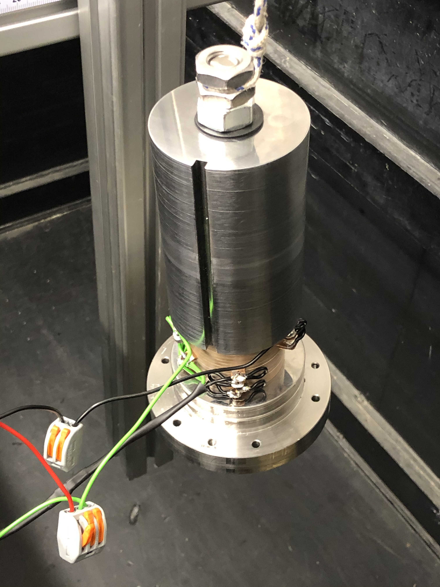
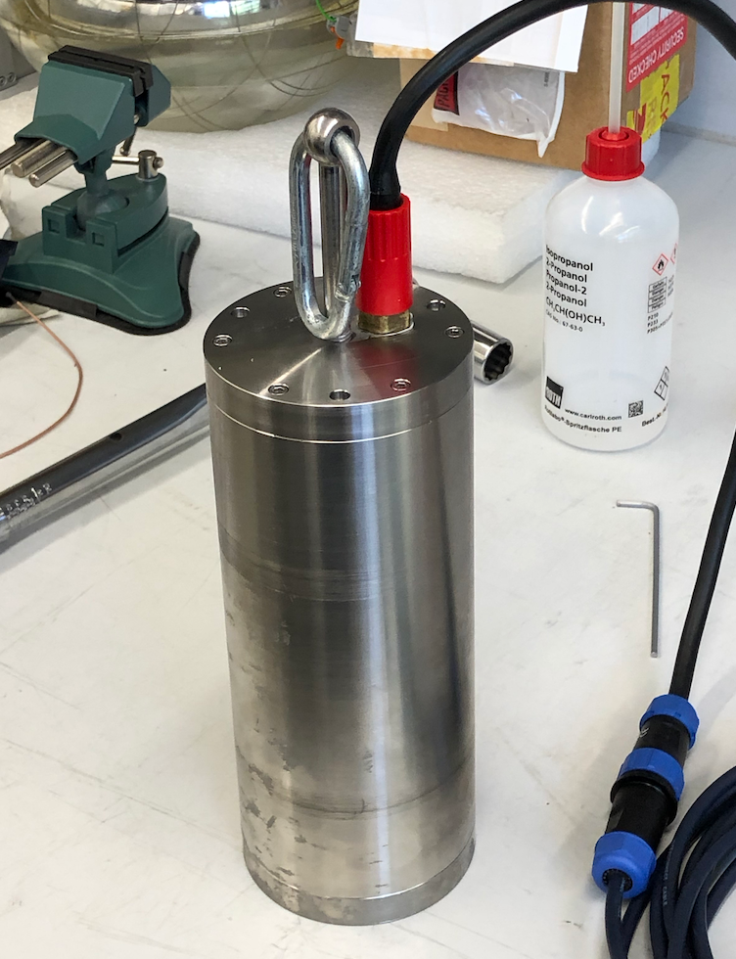
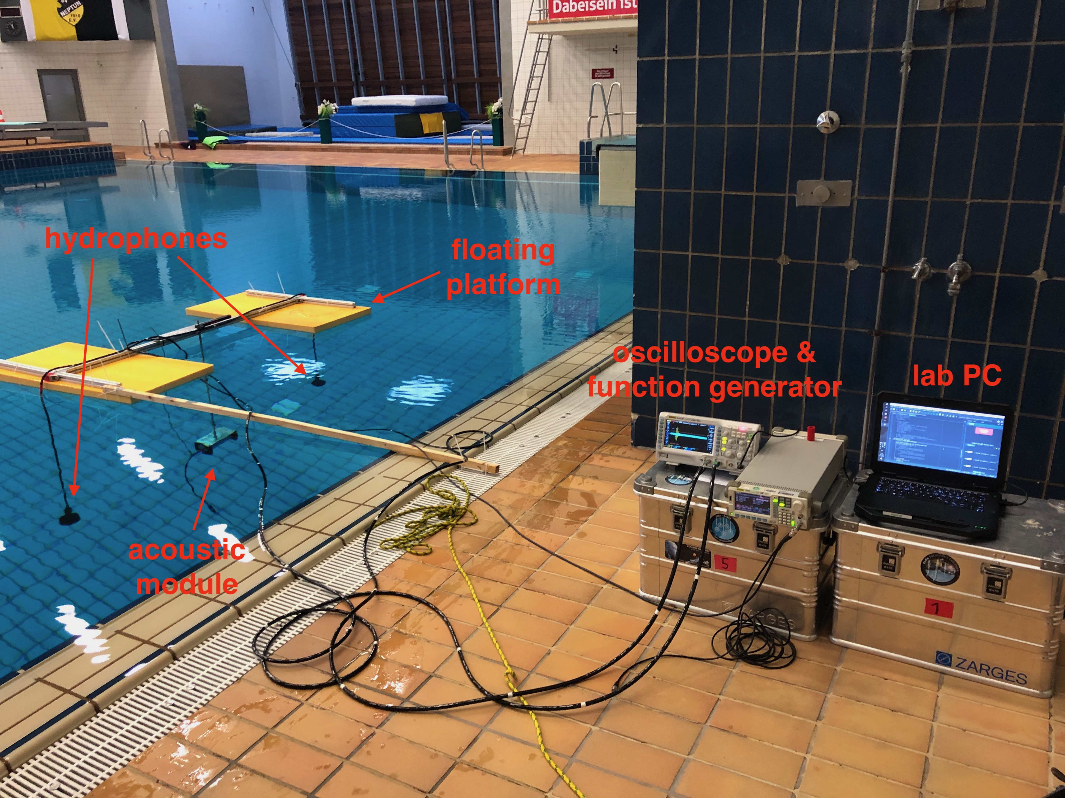
Acoustic Modules
Emits 5-40 kHz acoustic pings over 100’s of meters for precise (10 cm?) geometric determination of location

Slide 18
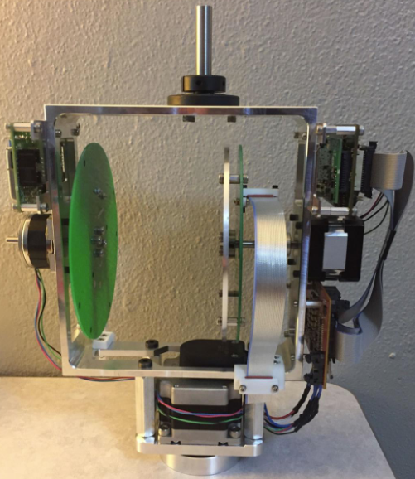
The Pencil Beam
Determine scattering function of ice by:
* Point 1 deg beam any direction to better than
1 degree;
* LED pulses 1 ns FWHM
* 8 possible wavelengths

Slide 19
EHWD
Reusing the IceCube Hot Water Drill

Slide 20
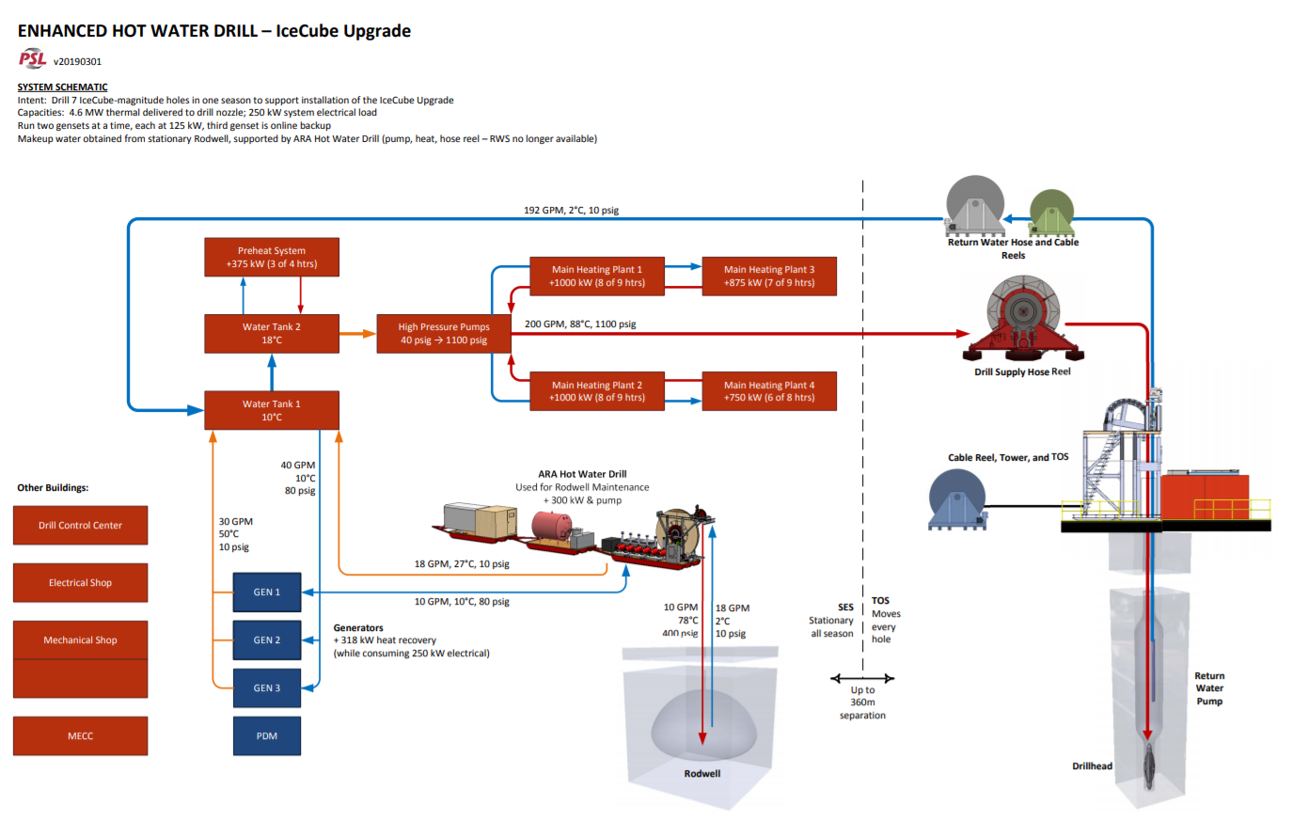

Slide 21
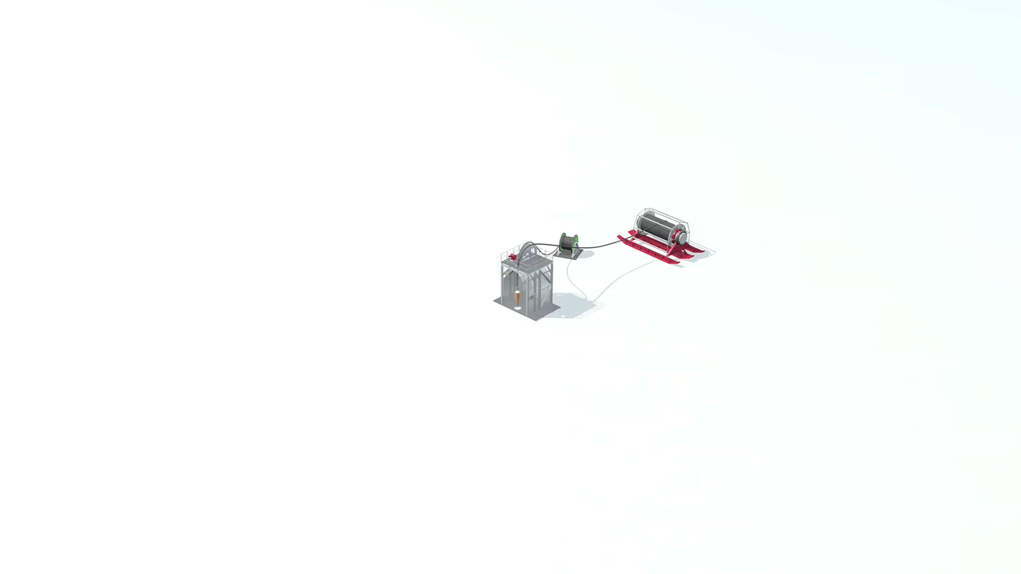

Slide 22
Status & Outlook
While IceCube has mostly smooth-sailed through the pandemic and was not significantly negatively impacted by the loss of the 2020/2021 polar season, the Upgrade had a lot of work scheduled.
The original performance management baseline of $22.9 million (US only) and 5 years is no longer achievable.
Working with NSF to rebaseline the project for 6 or even 7 year project execution.
Critical to 6 year project (i.e. deployment of sensors in 23/24) is some activity at Pole this year.
Earliest delivery of data from deployed instrumentation May 2024.

