Slide 1
Calibration and the Ice Model
Dawn Williams
University of Alabama
IceCube Bootcamp 2021

Slide 2
IceCube Detector and Ice references
The IceCube Neutrino Observatory: Instrumentation and Online Systems
https://arxiv.org/abs/1612.05093
Calibration and Characterization of the IceCube Photomultiplier Tube
https://arxiv.org/abs/1002.2442
The IceCube Data Acquisition System: Signal Capture, Digitization, and Timestamping
https://arxiv.org/abs/0810.4930
Measurement of South Pole ice transparency with the IceCube LED calibration system
https://arxiv.org/abs/1301.5361
Evidence of Optical Anisotropy of the South Pole Ice
https://arxiv.org/pdf/1309.7010.pdf
Photon Propagation through Birefringent Polycrystals
https://internal-apps.icecube.wisc.edu/reports/details.php?type=report&id=icecube%2F201902001
Energy Reconstruction Methods in the IceCube Neutrino Telescope
https://arxiv.org/abs/1311.4767
In-situ calibration of the single-photoelectron charge response of the IceCube photomultiplier tubes
https://arxiv.org/abs/2002.00997

Slide 3
Acknowledgment
The ice model is developed in the IceCube Calibration working group
Much of the material in this presentation comes from the work of Ryan Bay, Dima Chirkin, Martin Rongen and Chris Wendt and many others

Slide 4
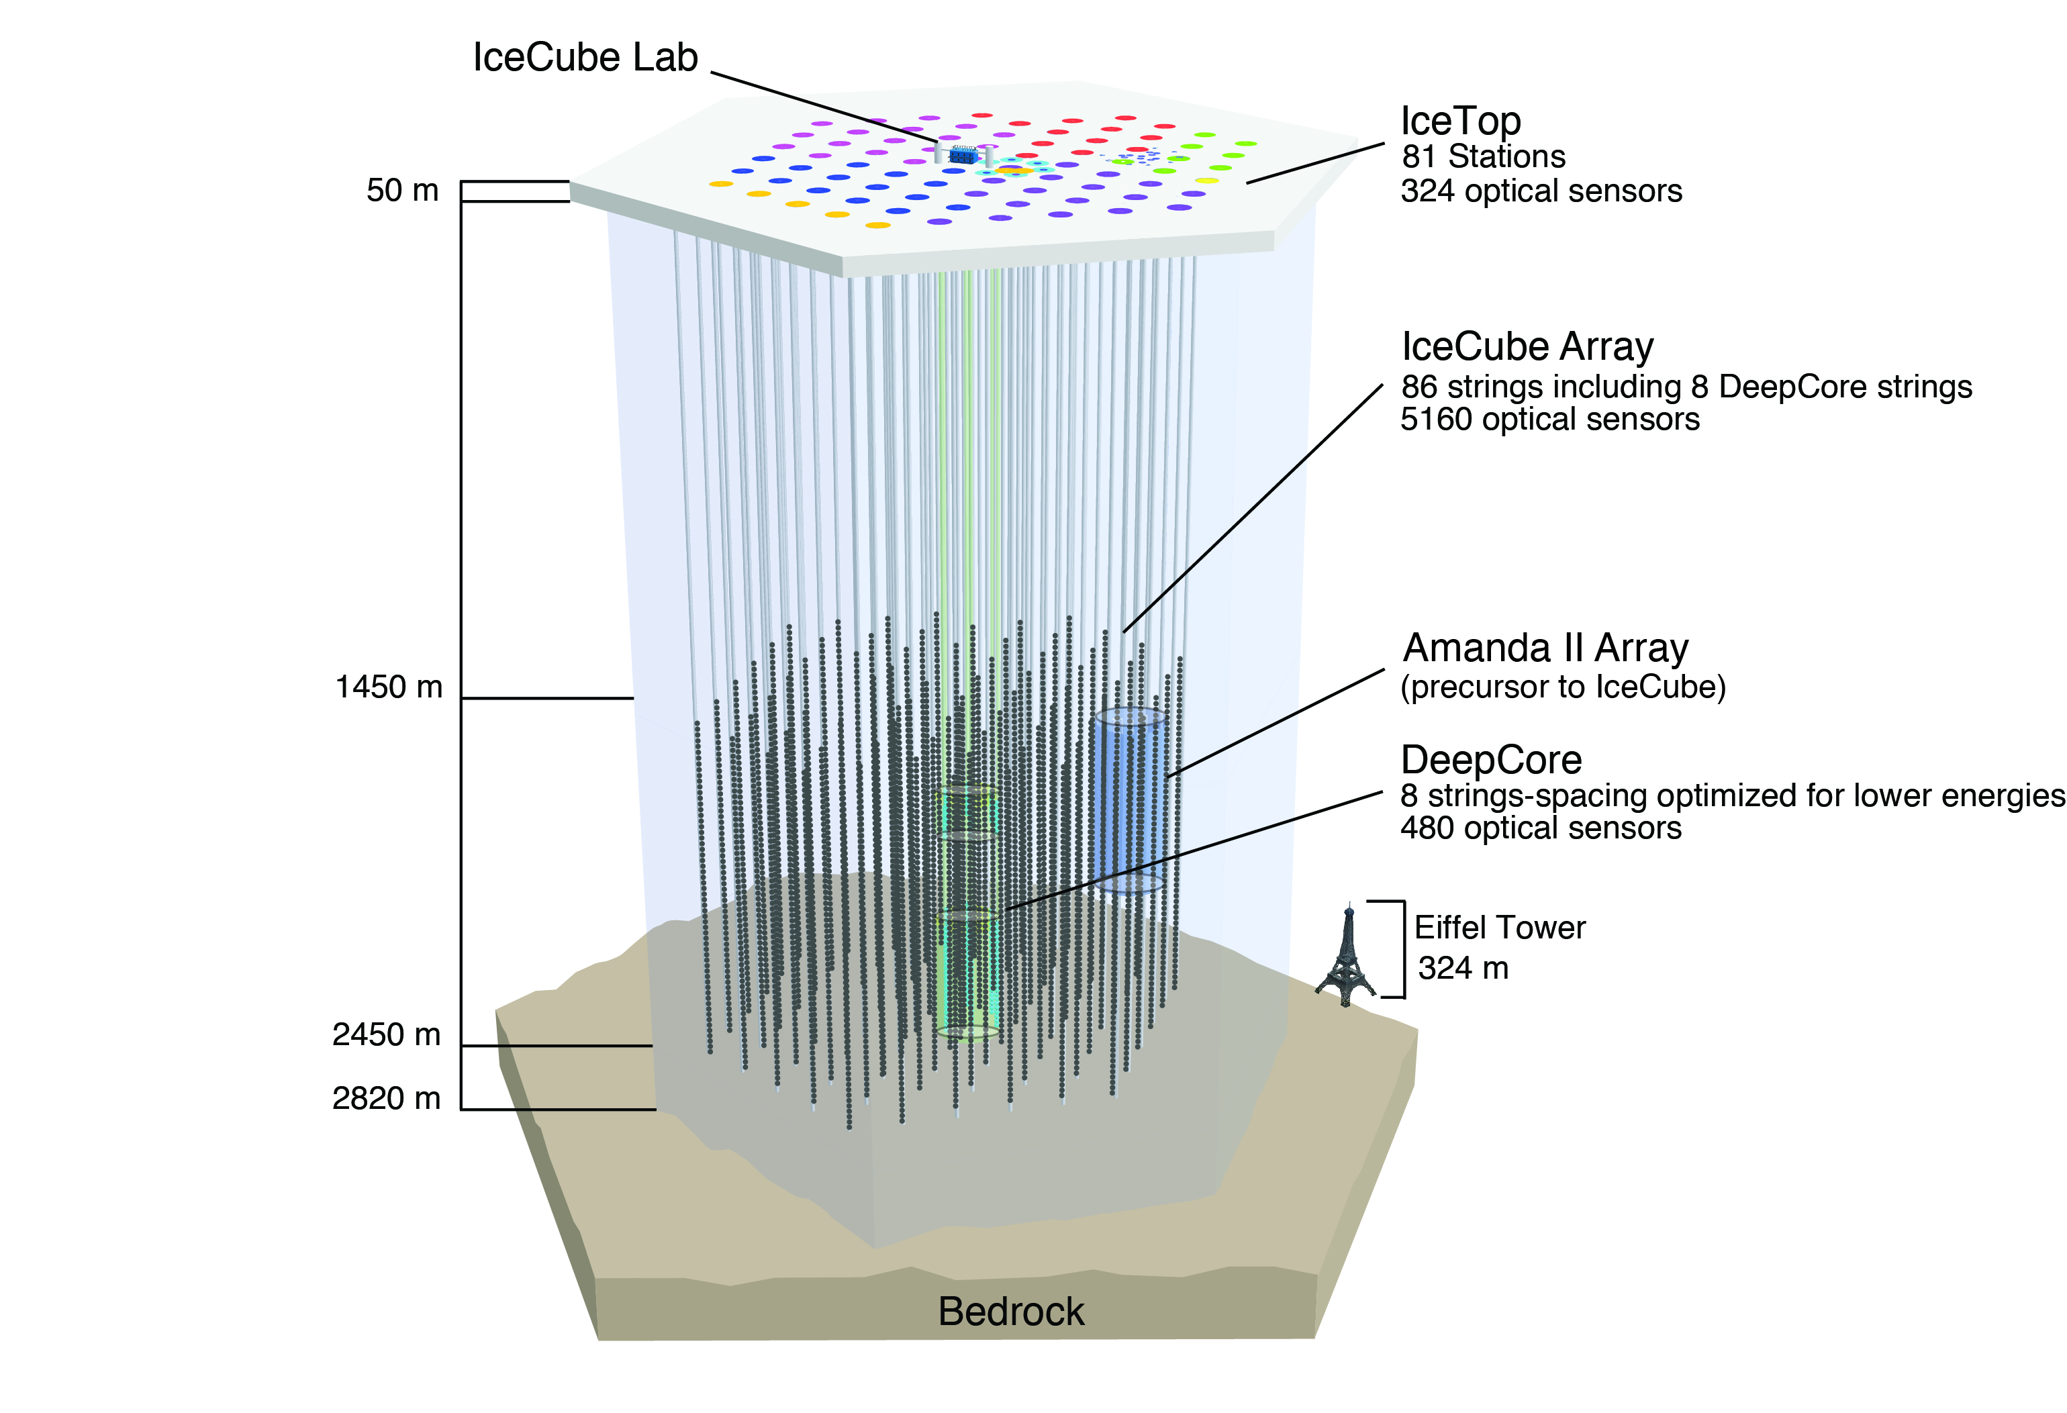
IceCube
Strings are numbered 1-86
DOMs are numbered 1-60, top to bottom (in ice)
Surface (IceTop) DOMs are numbered 61-64, not used in flasher analysis

Slide 5
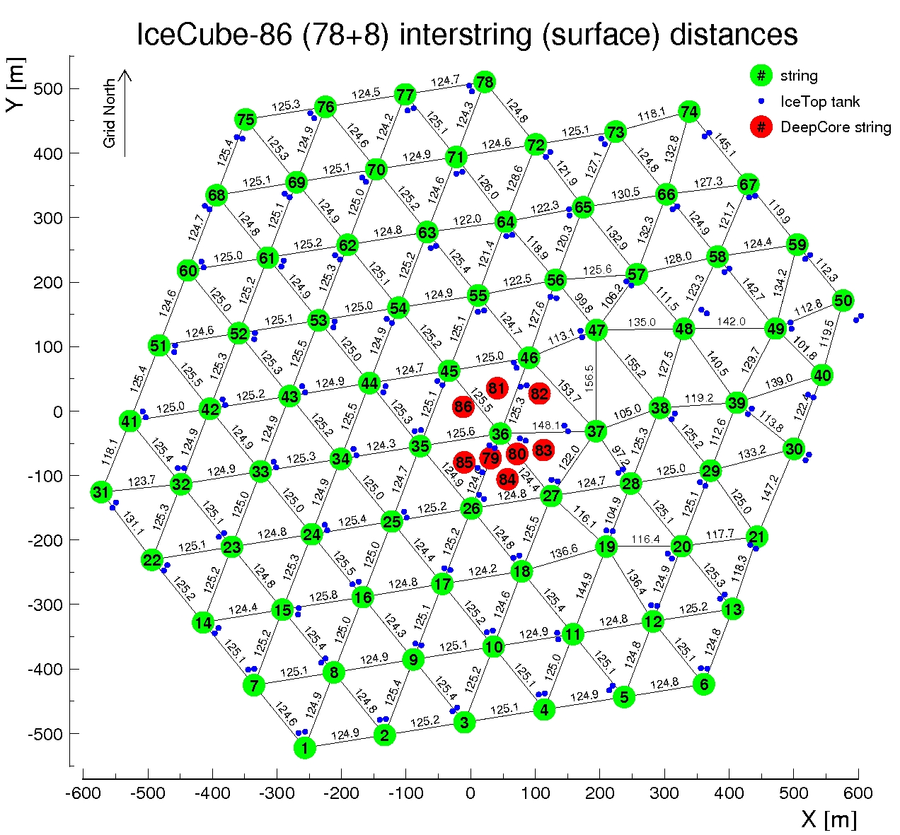
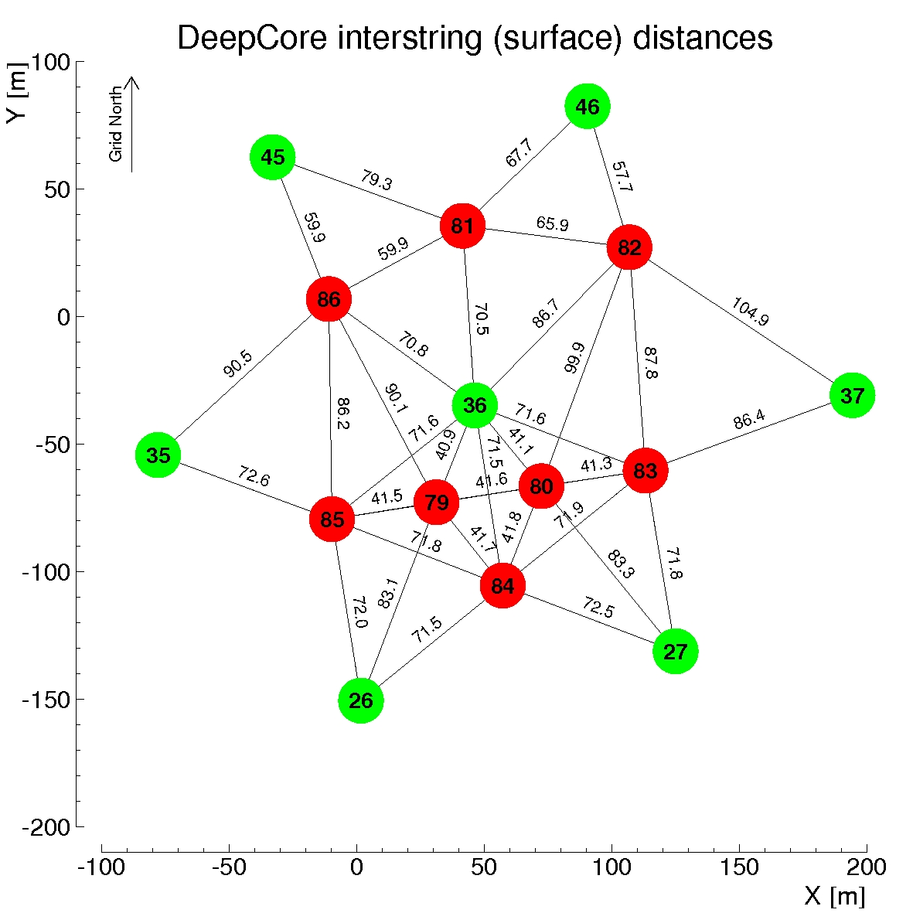
IceCube Strings

Slide 6
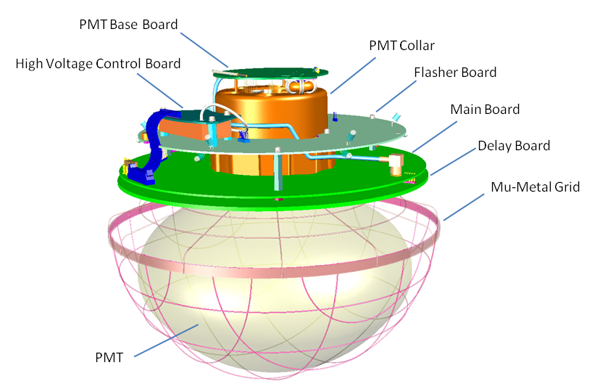
IceCube Digital Optical Module (DOM)
Every DOM in IceCube is equipped with flasher LEDs
This gives us a controlled light source at every location in the detector

Slide 7
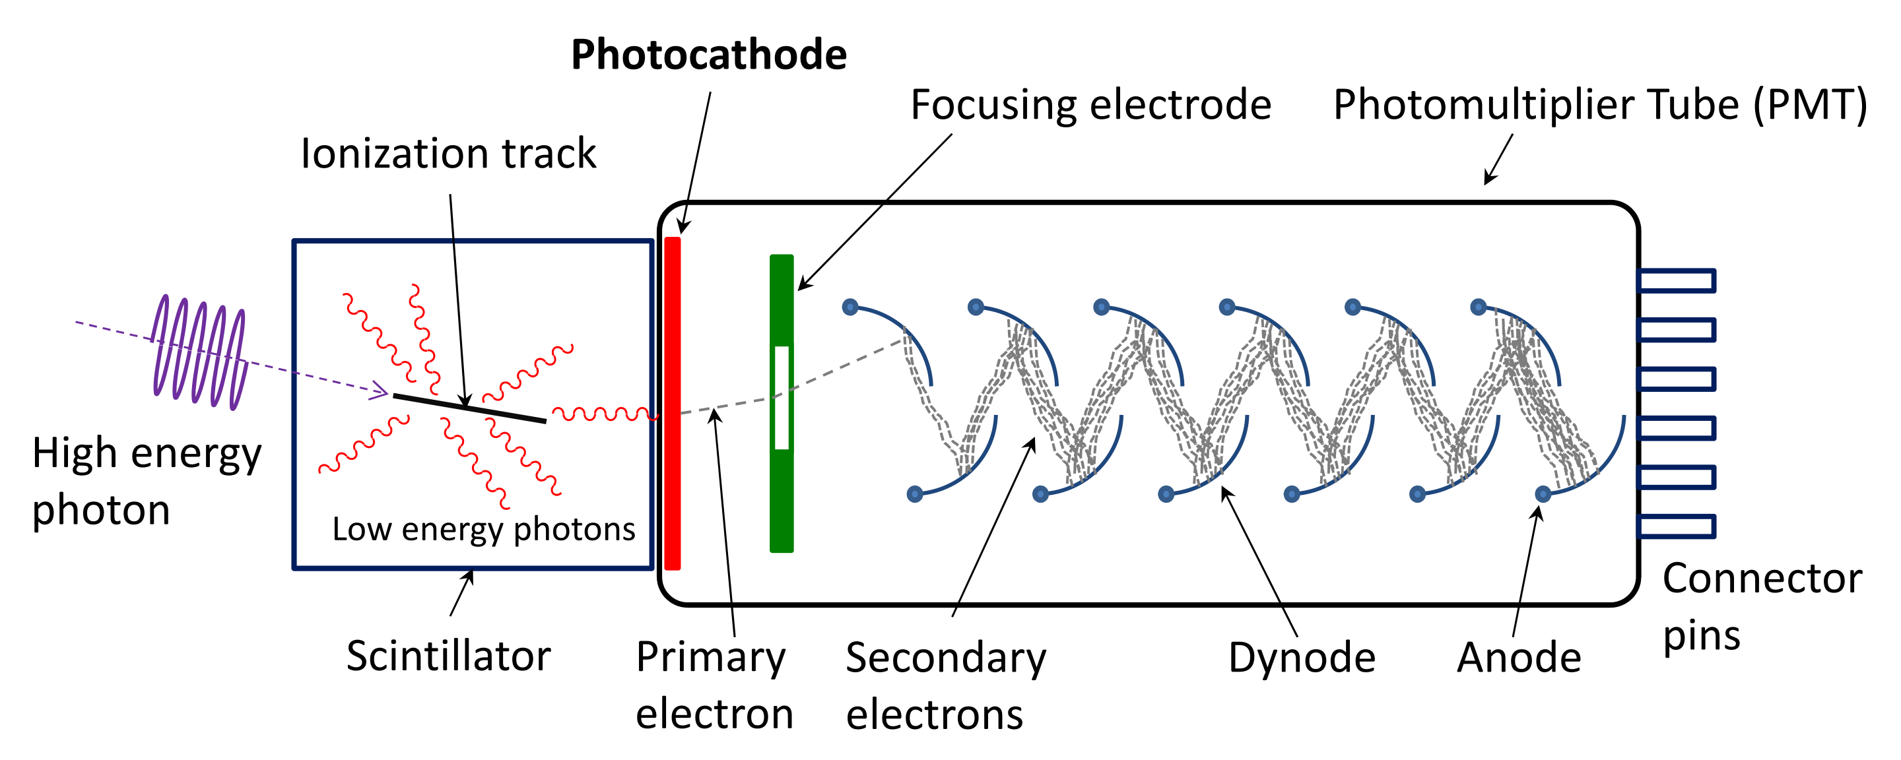
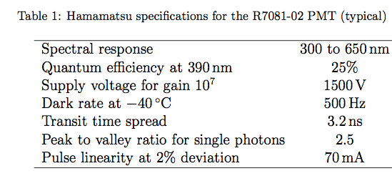
Signal in a Photomultiplier Tube

Slide 8
DOM Output: single photoelectron
This is what we record when light hits the DOM: a waveform

Slide 9
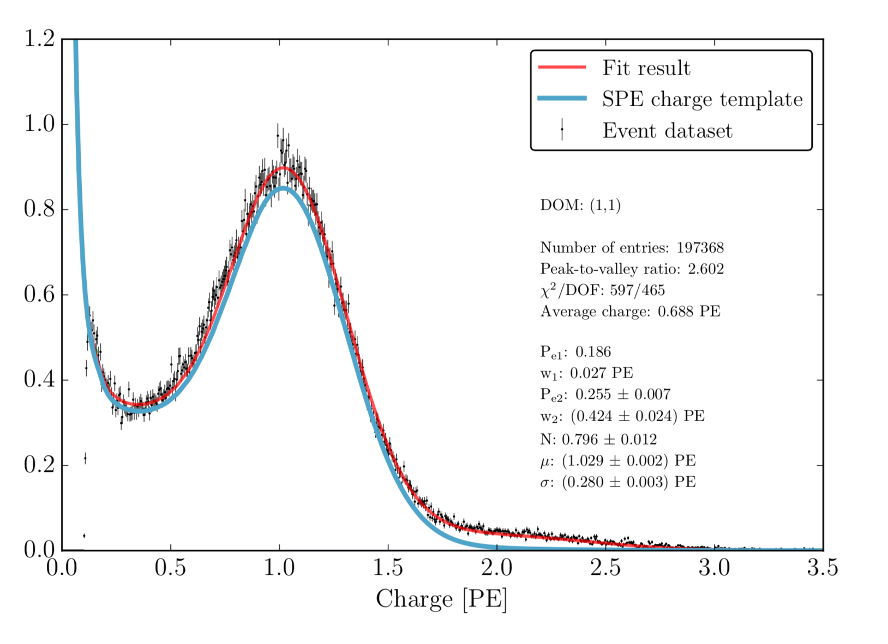
Single Photoelectron Charge Distribution
This is measured individually for every single DOM and forms the basis for energy calibration

Slide 10
DOM output: complex waveform
ATWD
FADC

Slide 11
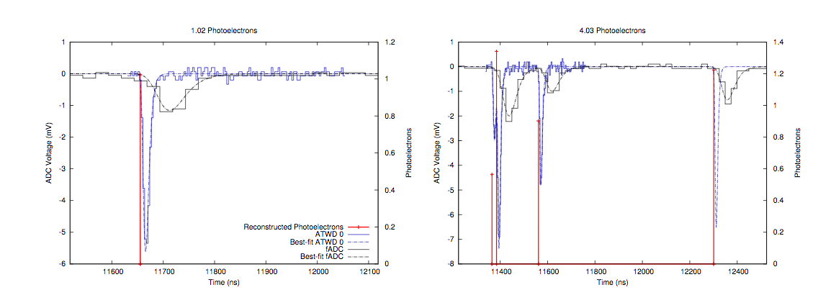
Waveforms to pulses

Slide 12
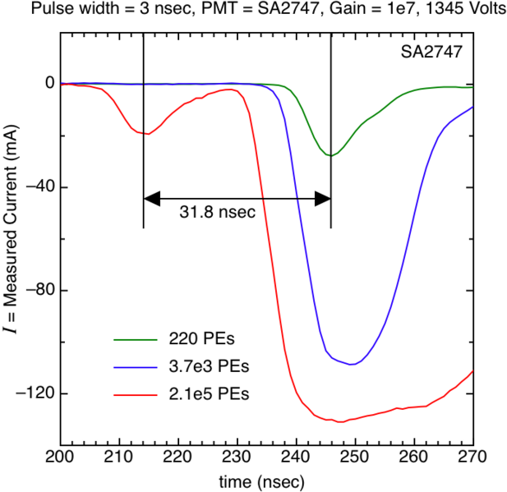
Pulses in a PMT
Pre-pulses: result of photons striking first dynode instead of photocathode
Late pulses: result of photoelectrons backscattered off the first dynode
Afterpulses: result of ions created near the last dynode that accelerate back to the photocathode and produce multiple photoelectrons

Slide 13
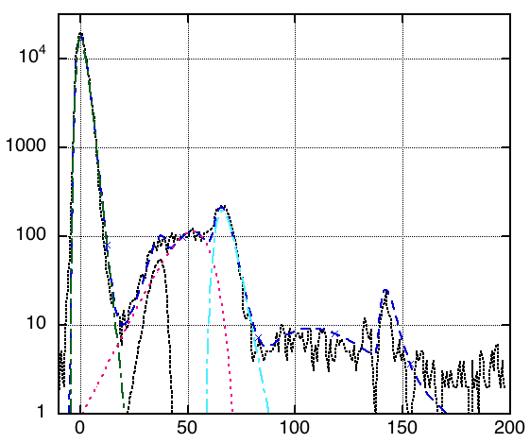
Pulses in a PMT
Pre-pulses: result of photons striking first dynode instead of photocathode
Late pulses: result of photoelectrodes backscattered off the first dynode
Afterpulses: result of ions created near the last dynode that accelerate back to the photocathode and produce multiple photoelectrons
Time (ns)

Slide 14
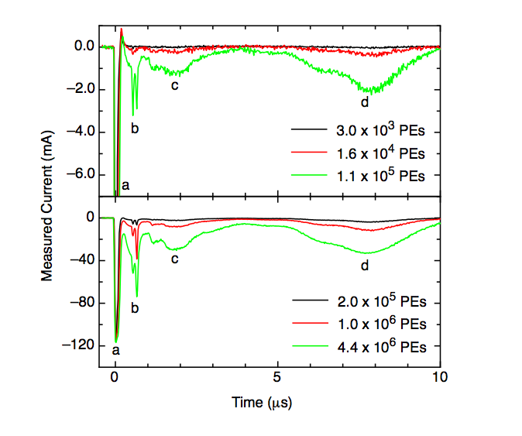
Pulses in a PMT
Pre-pulses: result of photons striking first dynode instead of photocathode
Late pulses: result of photoelectrodes backscattered off the first dynode
Afterpulses: result of ions created near the last dynode that accelerate back to the photocathode and produce multiple photoelectrons

Slide 15
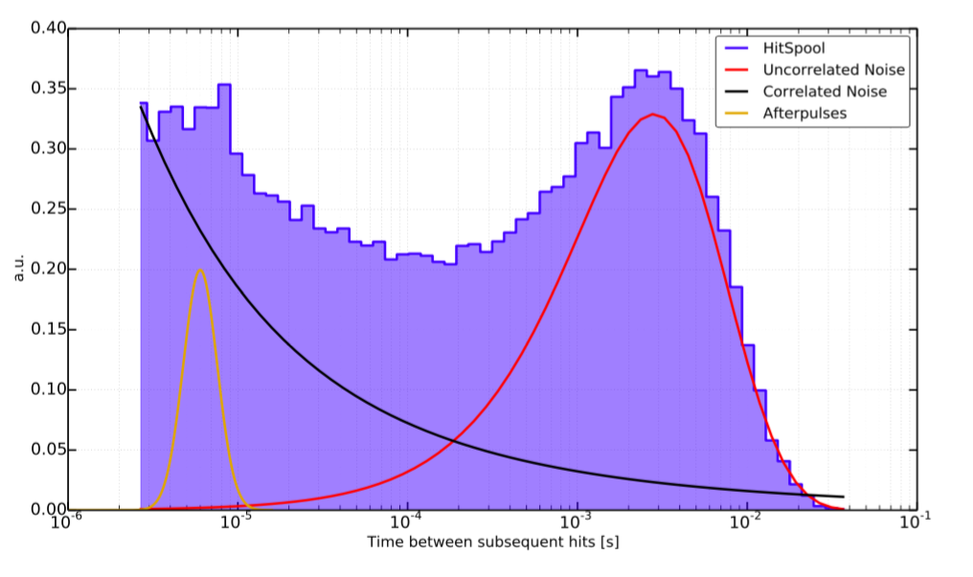
Noise
Distribution of time between hits for noise events – important for low energy events

Slide 16
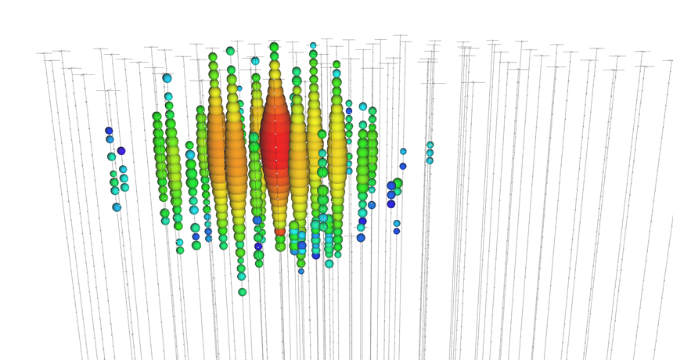
An IceCube neutrino (“Big Bird”)
How do we know how much energy Big Bird has?
How do we know where it comes from?

Slide 17
The ideal picture
Étienne Bourbeau

Slide 18

The ideal picture
Étienne Bourbeau

Slide 19
The ideal picture
Étienne Bourbeau

Slide 20
The ice model
The ice is as much a part of the detector as the DOMs!
The ice is our calorimeter, support structure and shielding
For a complete history of the ice model see here https://wiki.icecube.wisc.edu/index.php/Ice_models

Slide 21
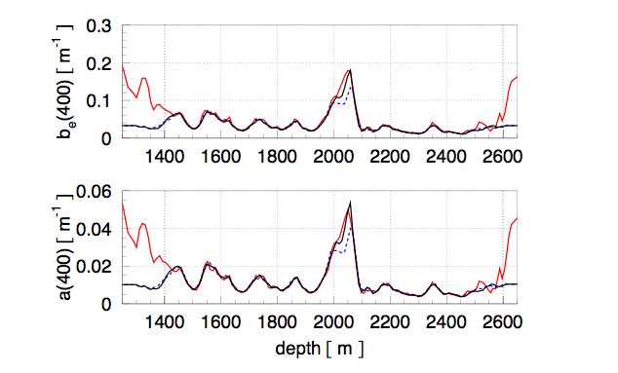
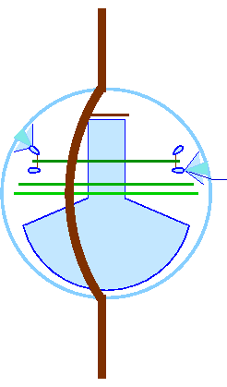
Calibration: from photon to data
Propagation through ice
Light source
We need to know how light propagates in ice.
Major propagation processes are absorption and scattering

Slide 22
Ice vs. water
This type of experiment can be done in water (DUMAND, ANTARES/NEMO/NESTOR → KM3NET, Baikal → GVD) or ice (AMANDA →IceCube)
Water has good scattering properties, poor absorption properties
Ice has good absorption properties, poor scattering properties
Scattering affects direction, absorption affects energy
Ice has practical advantages over water for detector construction, IceCube was the first cubic kilometer neutrino detector

Slide 23
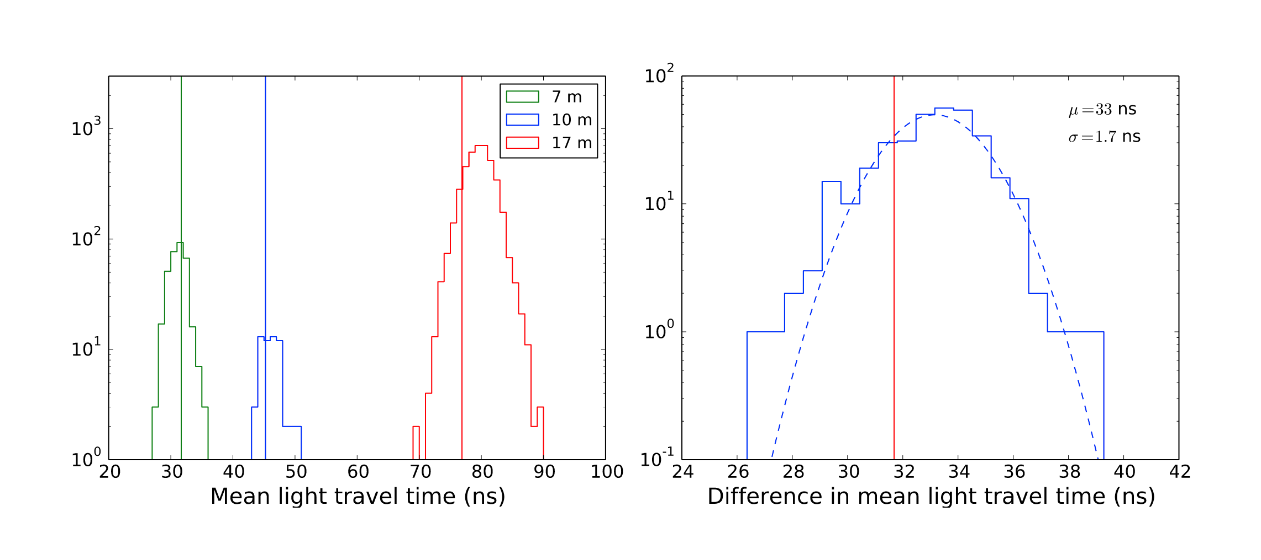
Effect of Scattering in Ice
Light arrives later than it should.

Slide 24
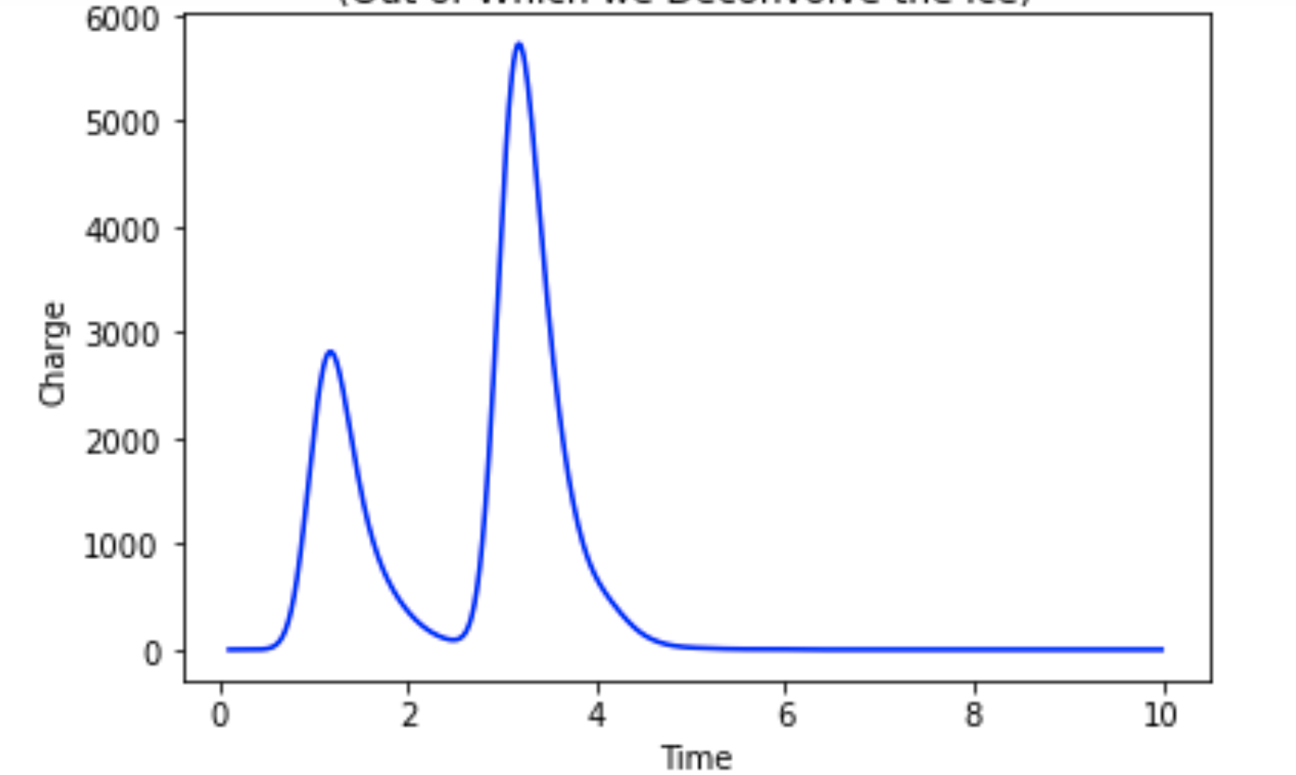
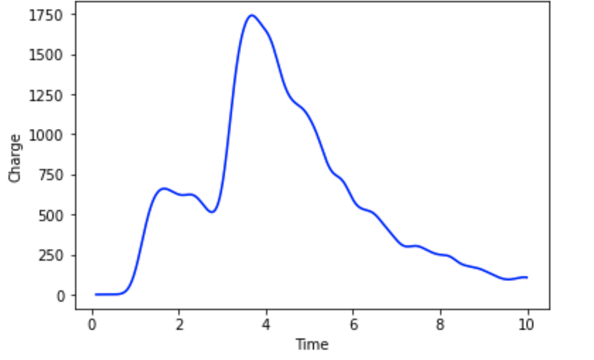
Effect of scattering in ice (toy simulation of tau double pulse waveform)
No scattering
Scattering

Slide 25
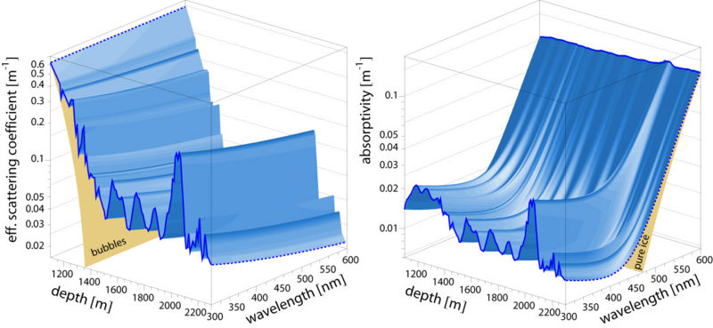
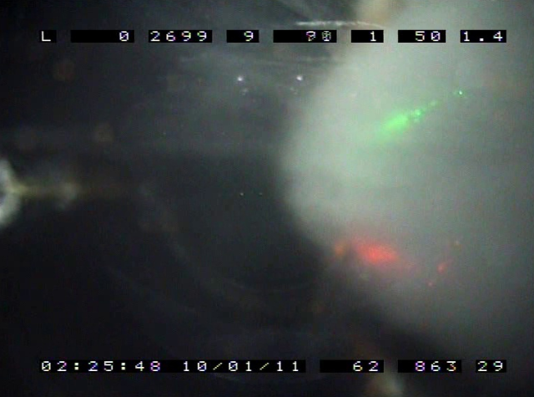
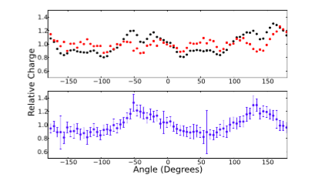
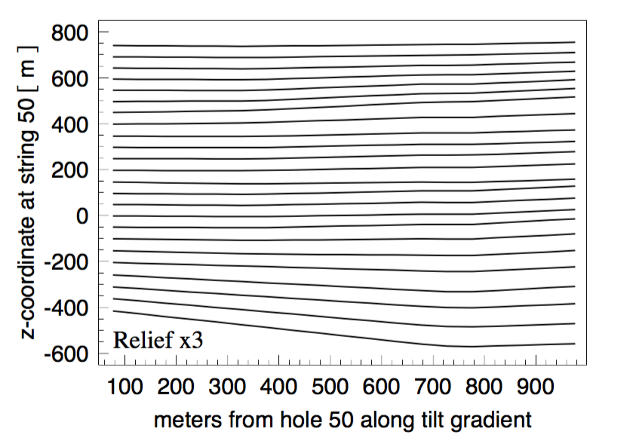
The ice is complex…
No bubbles in undisturbed ice at IceCube depths (clathrates)
Layers of dust cause depth-dependent scattering and absorption
The dust layers are not horizontal…
And the scattering is anisotropic…
And the melted and refrozen ice in the holes has a bubble column in the center…

Slide 26
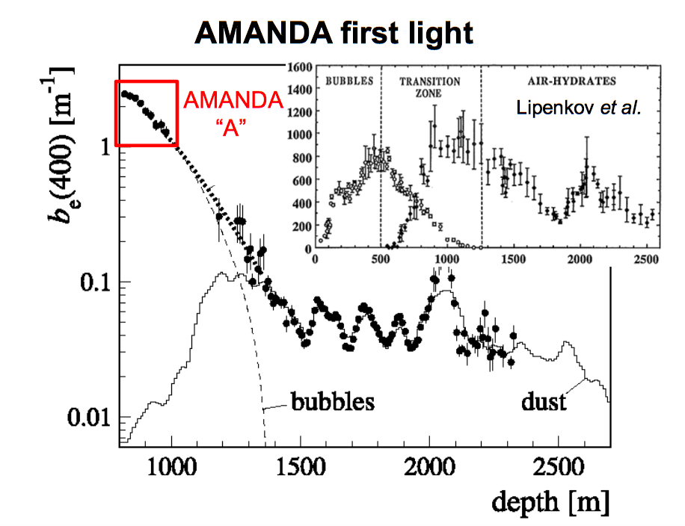
What causes scattering in ice?
Multiple dust layers, an especially thick layer at about 2000 m depth is called “THE dust layer” in IceCube vernacular
Ryan Bay

Slide 27
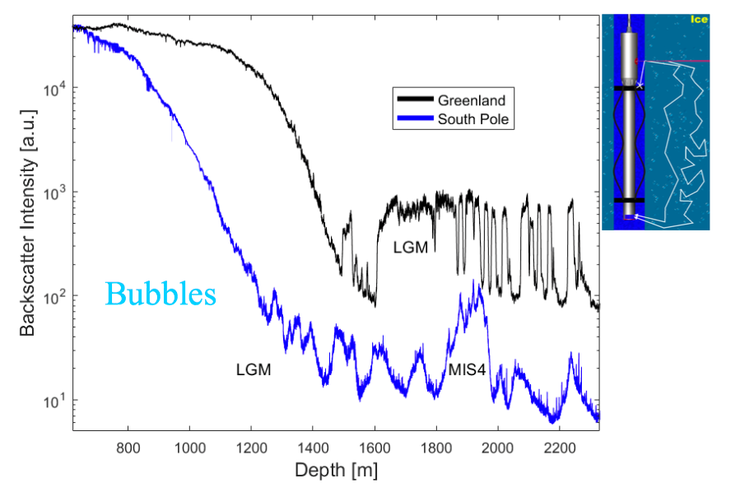
Why not Greenland? Ask the IceCube DustLogger
LGM = Last Glacial Maximum, 26.5 kya
MIS4 = Marine Isotope Stage 4, 71 kya
Ryan Bay

Slide 28
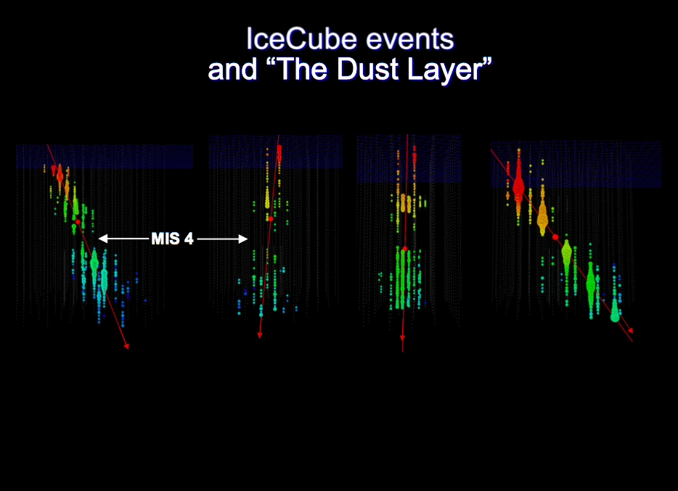

Slide 29
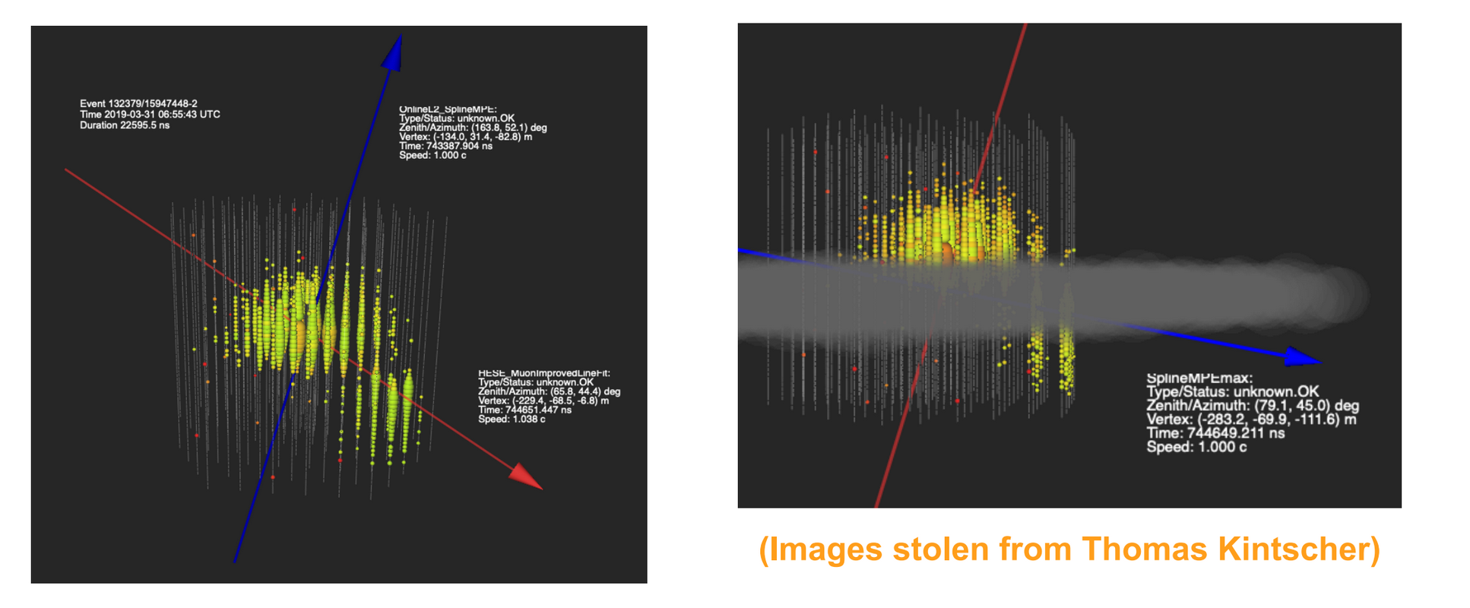
Effects of the dust layer: IC-190331

Slide 30
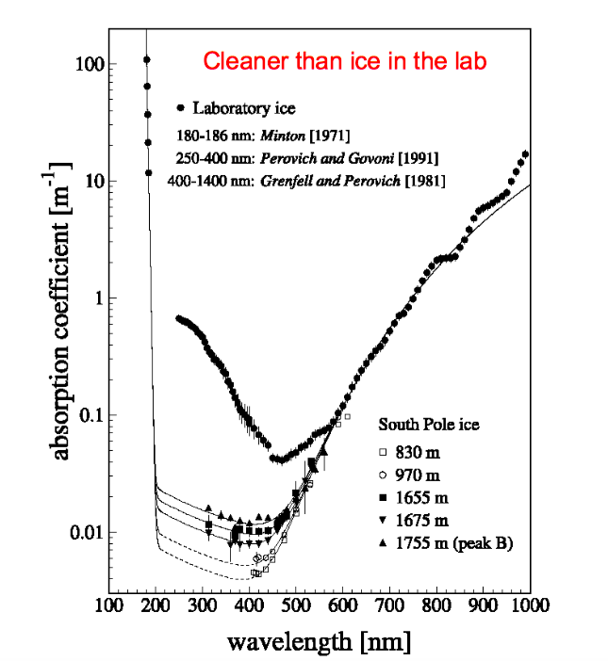
Absorption in South Pole Ice
Ryan Bay

Slide 31
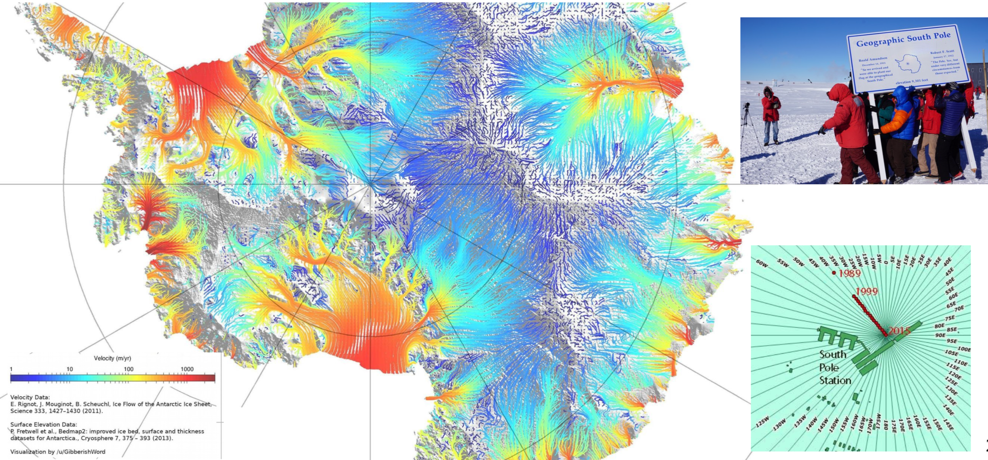
Ice flow in Antarctica

Slide 32
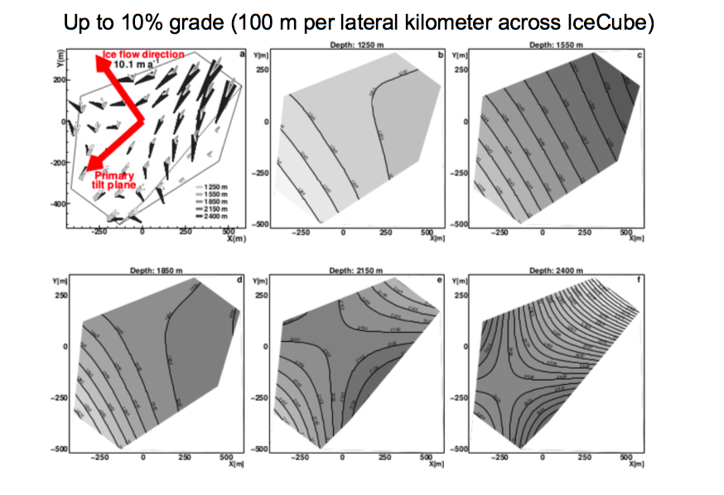
Dust layer tilt at the Pole
Ryan Bay

Slide 33
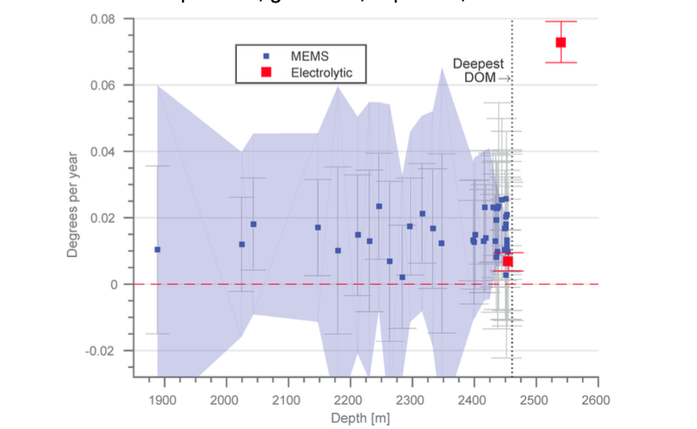
Why not drill deeper? Is shear a problem?
Ryan Bay

Slide 34
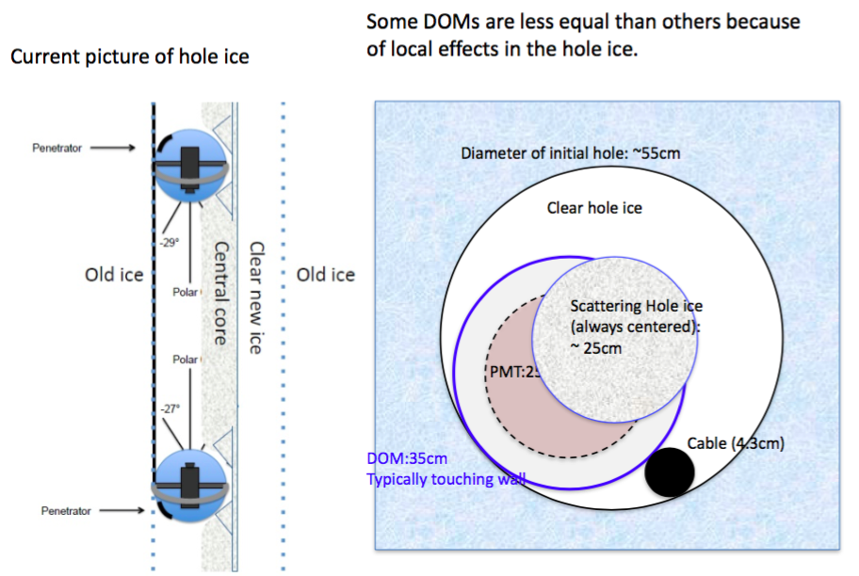
The hole ice
Albrecht Karle

Slide 35
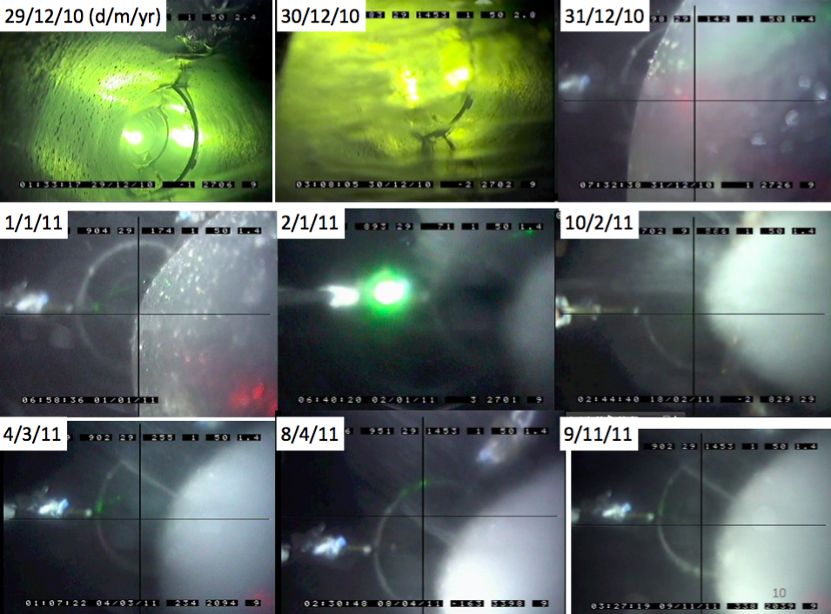

Slide 36
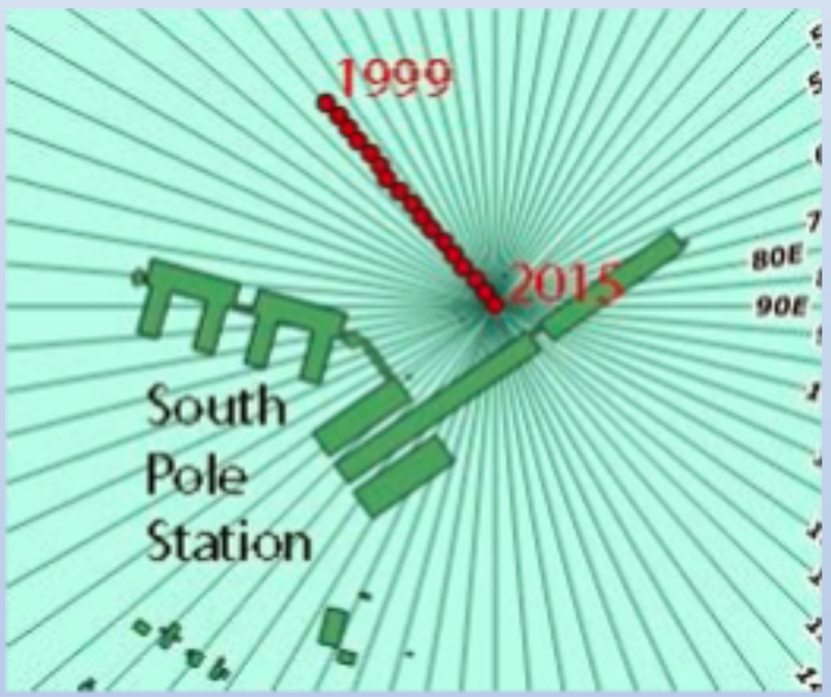
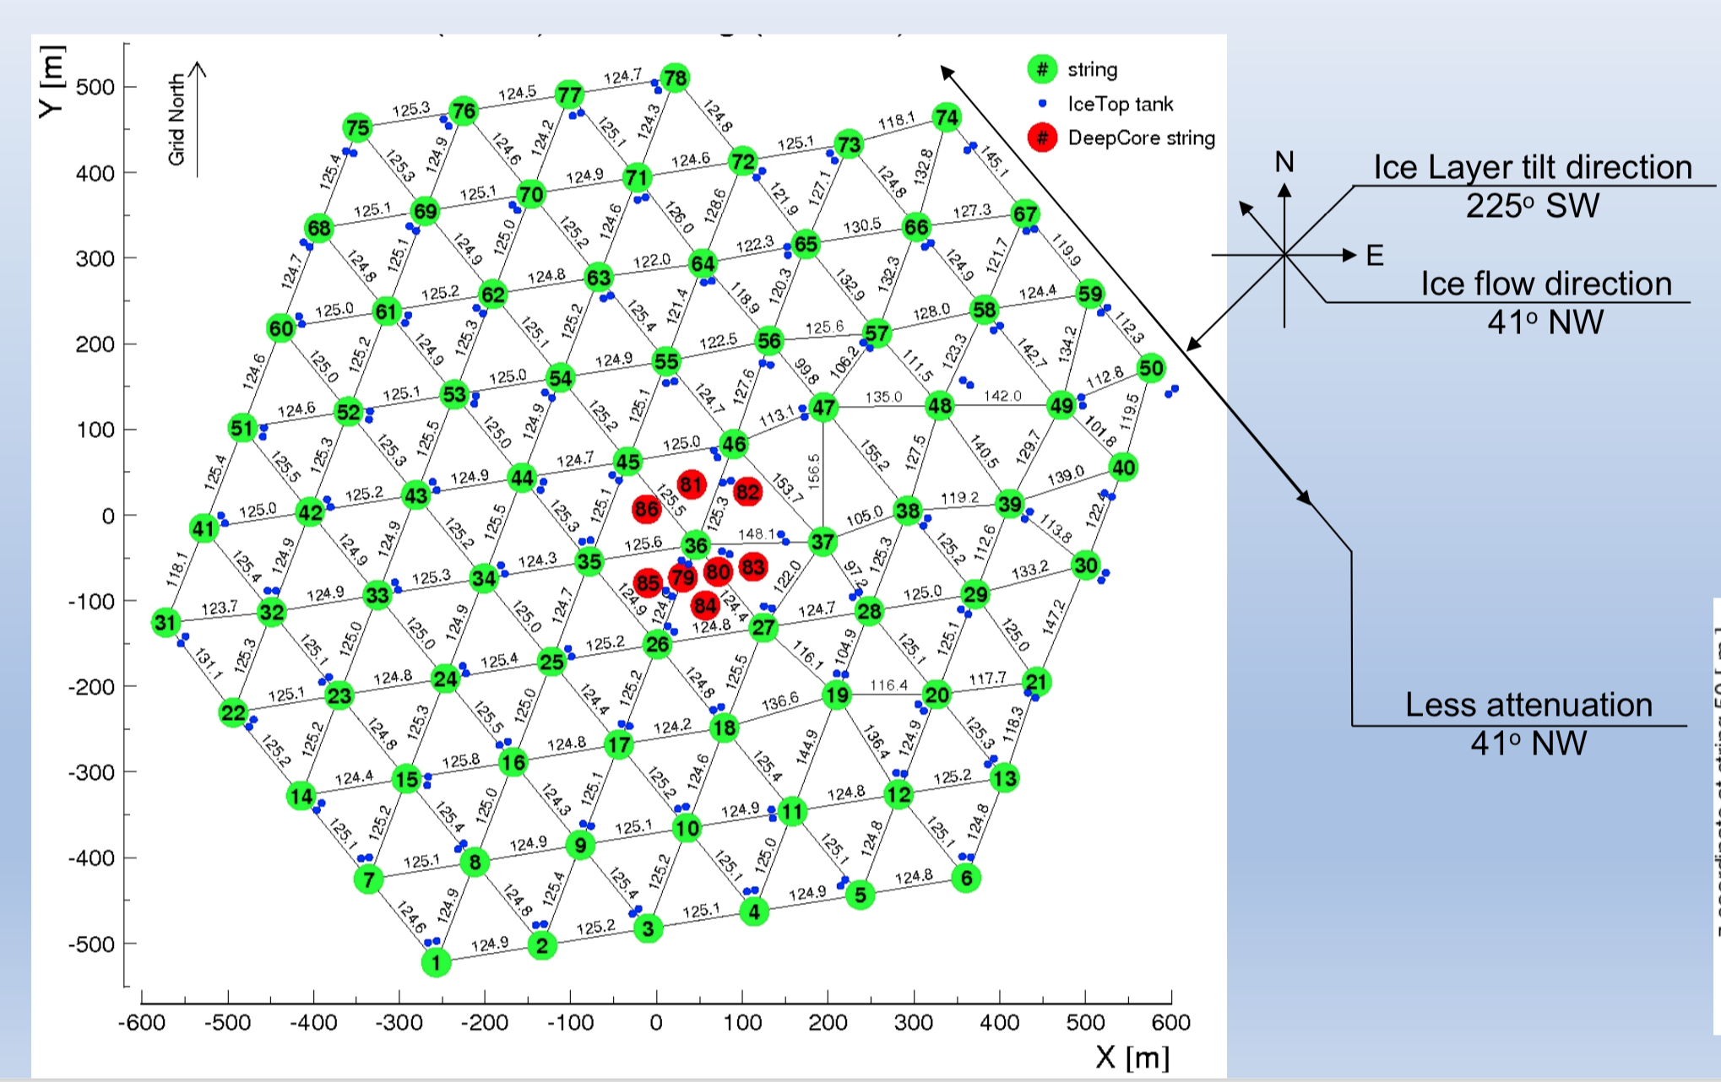
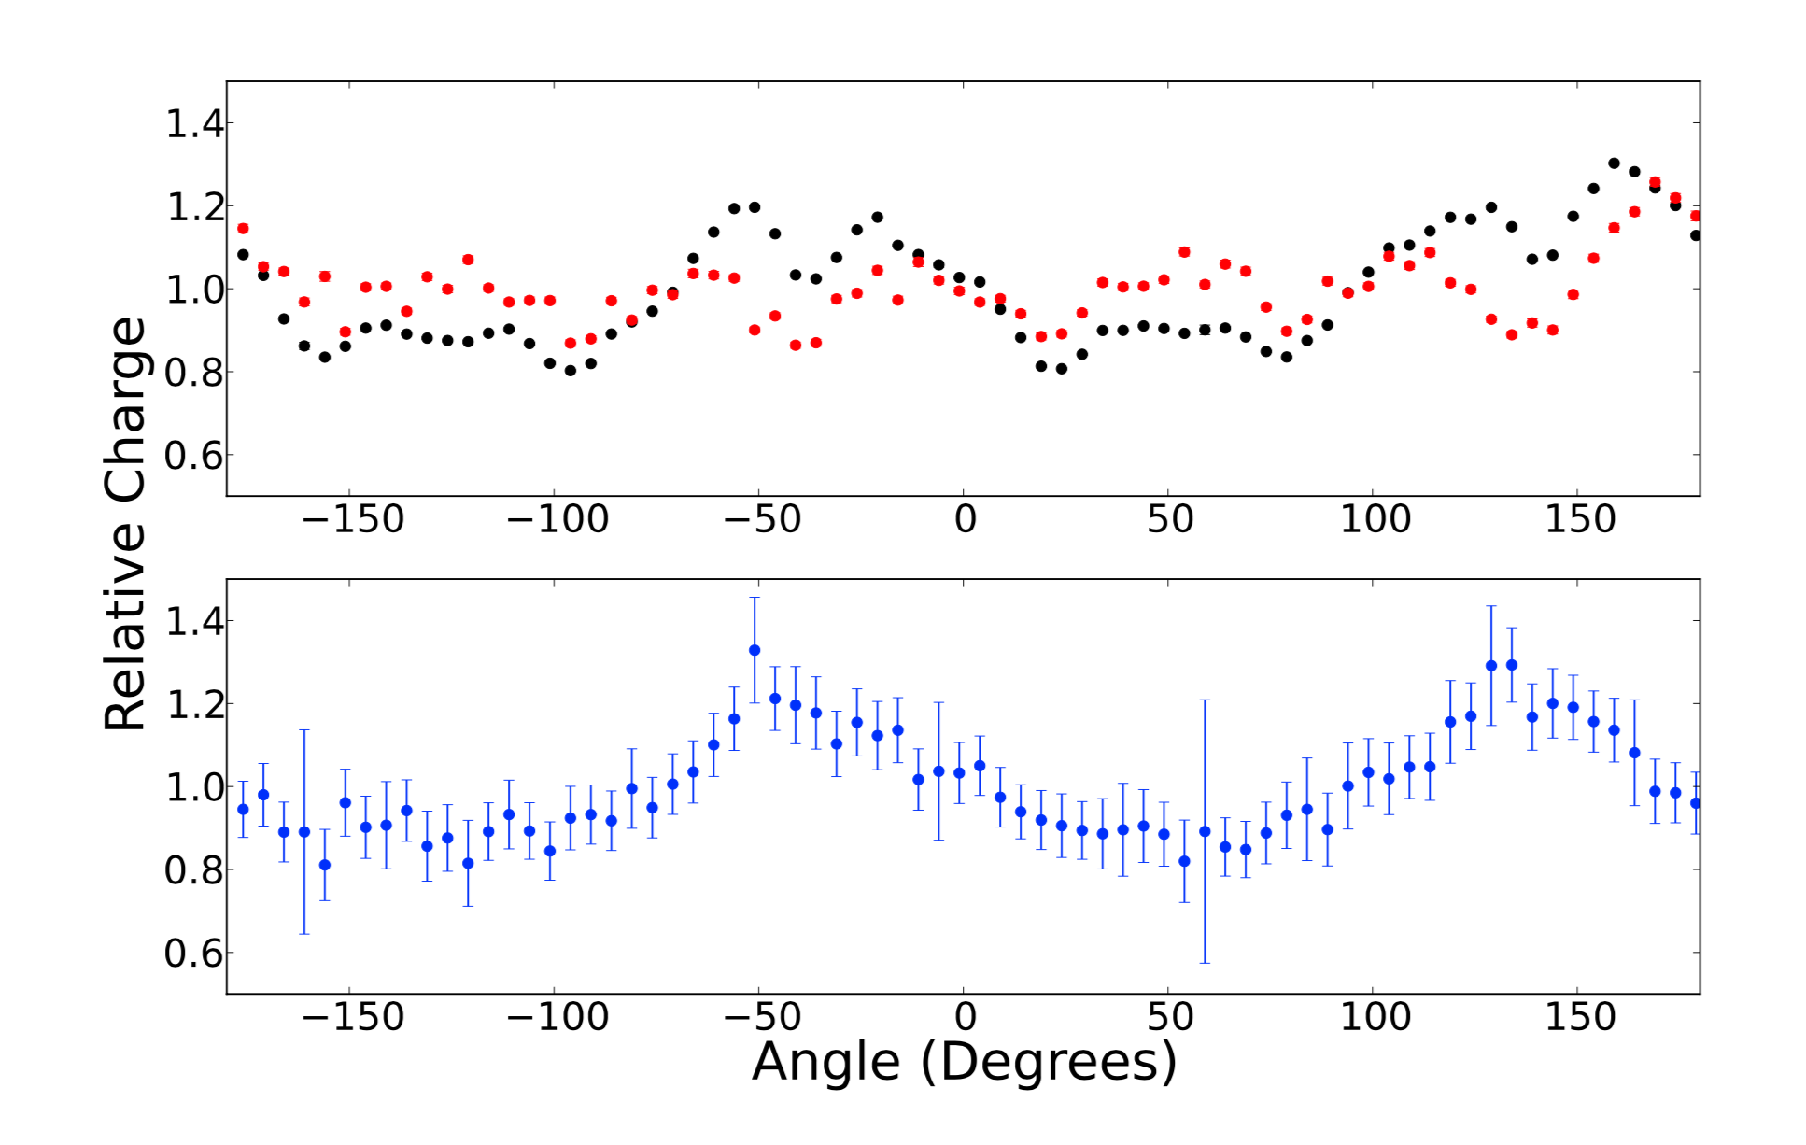
Anisotropy
What causes the anisotropy in the ice properties?

Slide 37
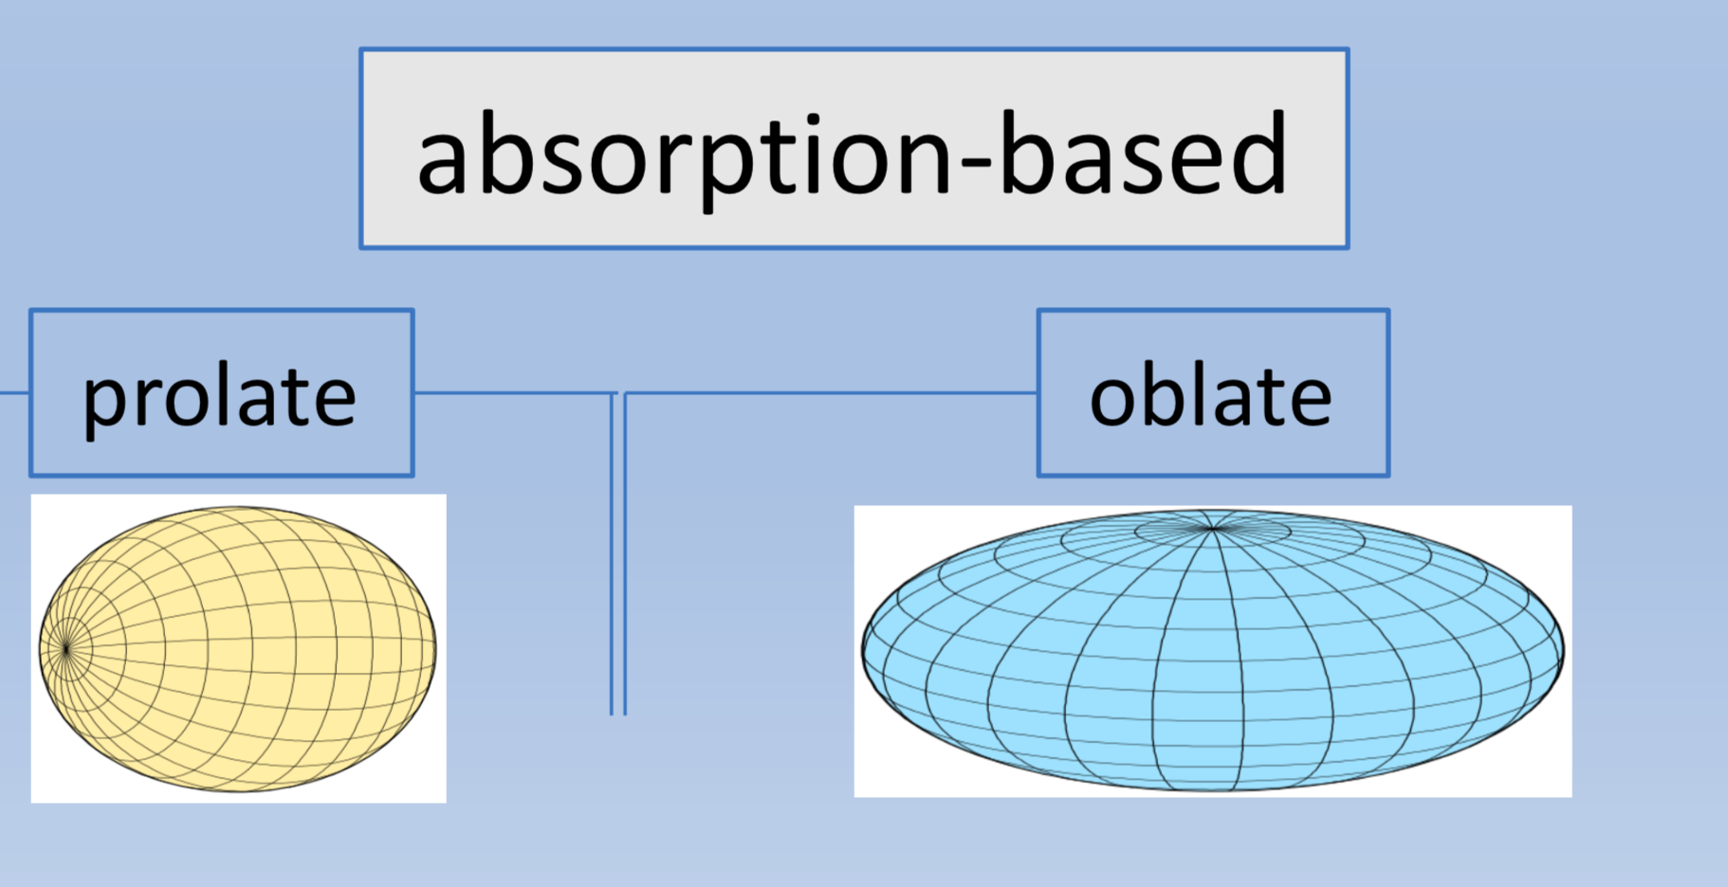
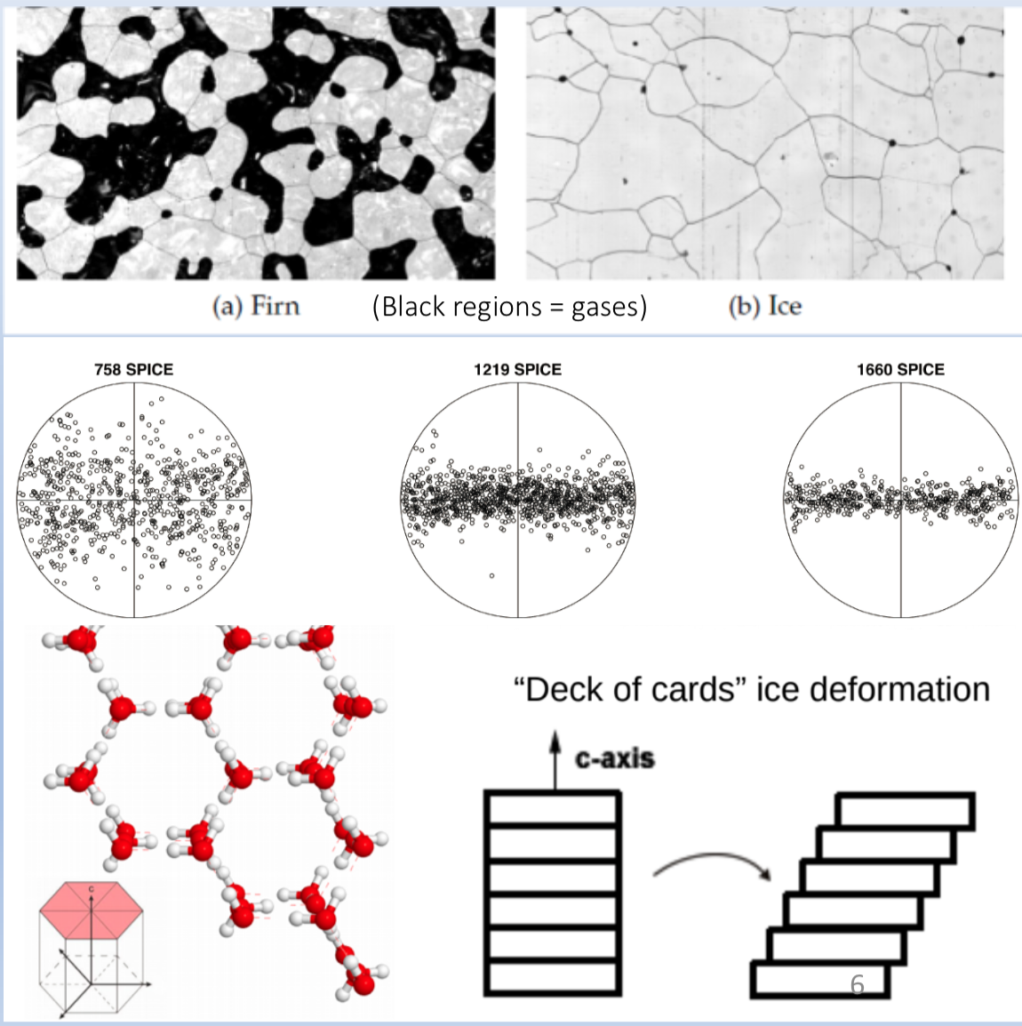
Modeling anisotropy
Until recently we thought the anisotropy might be caused by the shape/orientation of the dust grains in ice, but our current thinking is that the anisotropy is caused by birefringence due to the crystal structure of the ice itself.

Slide 38


Our Understanding of IceCube’s ice
Étienne Bourbeau
“Hole” Ice
Bubble column ??????
$κ_{1}$
Ice
layers
$κ_{2}=κ_{3}$
anisotropy
Ice Tilt
RDE’s

Slide 39
In Reality
Étienne Bourbeau

Slide 40
In Reality
Étienne Bourbeau

Slide 41
Sources of light in the ice
The “dust logger” (deployment only)
Occasional glowing due to the DOM HV supply
Dark noise – mostly single hits, mostly in the glass, radioactive decay, scintillation (hundreds of Hz per DOM)
Cosmic ray muons (several kHz)
Products from neutrino interactions
Artificial light sources
LED flashers
Laser “standard candle” 💀
Laser lighting for the “Swedish camera” (R.I.P.)

Slide 42
Calibration: from photon to data
Propagation through ice
Light source
We use flashers:
To verify that DOMs are properly connected and functioning during commissioning
To verify the detector geometry
To study the optical properties of the ice
To study the response of the DOMs themselves

Slide 43
Flasher wiki references
https://wiki.icecube.wisc.edu/index.php/Flashers
https://wiki.icecube.wisc.edu/index.php/CDOM_Info

Slide 44
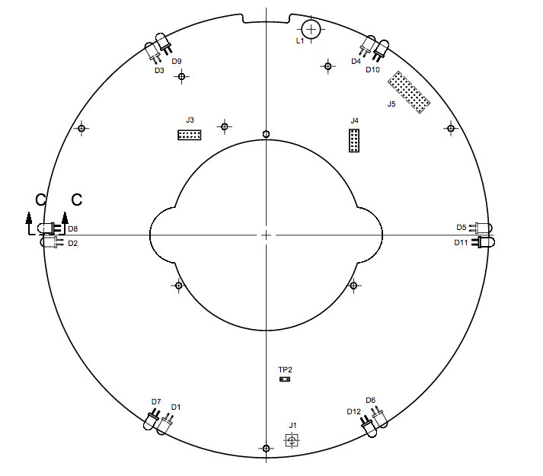
LED Flasher Board
12 LEDs
Arranged in pairs, evenly spaced 60° apart
1&7, 2&8, 3&9, 4&10, 5&11, 6&12, going clockwise seen from above
1-6 are tilted, upward at about 45° from horizontal
7-12 are horizontal

Slide 45
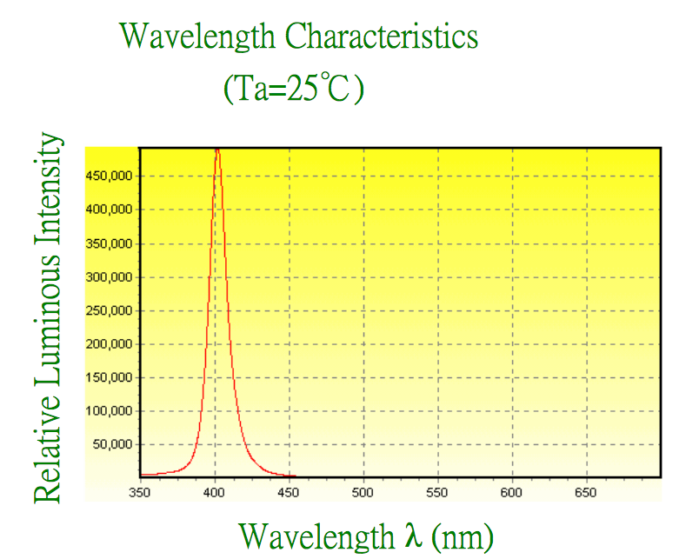
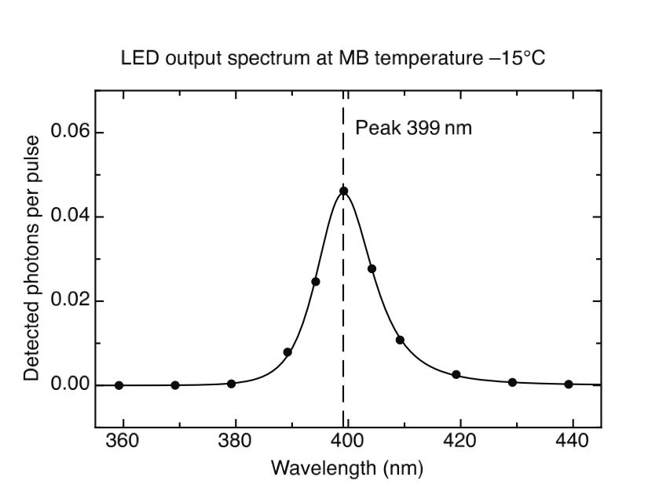
Flasher properties
The vast majority of IceCube LEDs are ETG-5UV405-30, nominally 405 nm wavelength, actually 399 nm, FWHM of 14 nm

Slide 46
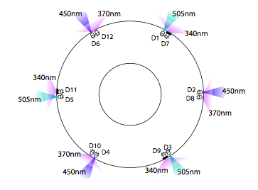
cDOMs
8 DOMs each on string 14 and string 79 have multiwavelength flashers called cDOMs
See the CDOM wiki for the appropriate masks
For the remainder of this lesson we will use the standard 400 nm flashers

Slide 47
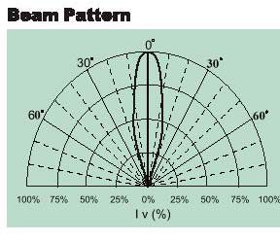
Flasher properties: Angular emission profile (beam width)
Nominal beam width is 30° in air
In ice, accounting for refraction from air to glass and glass to ice, the beam width is 10°
Can be modeled as a 2-D Gaussian with σ = 10° in both directions

Slide 48
Flasher operating parameters
Parameter | Allowed values | Description
string | 1 - 86 | String where flashing DOM is located
DOM | 1 – 60 | Flashing DOM number
brightness | 0 - 127 | LED driver current intensity, up to 240 mA
width | 0 - 127 | 2x duration of LED current pulse, in ns
mask | 0001 - 0FFF | Hex representation of bitmask controlling which LEDs flash
rate | 0 - 610 | Rate of LED flashes in Hz

Slide 49
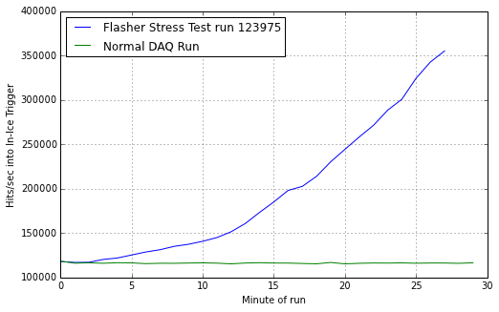
Flasher operation: String and DOM
Multiple flashers can be run simultaneously
The data acquisition system can withstand at least 3x the normal background rate from muons (~70 bright flashing DOMs simultaneously)
A typical run might have a few to ~30 flashers simultaneously
Neighboring flashers on the same string cannot run simultaneously
Old DOMs (produced in 2004 and 2005) have “afterburst” properties
Flashers cannot be synchronized using the current firmware

Slide 50
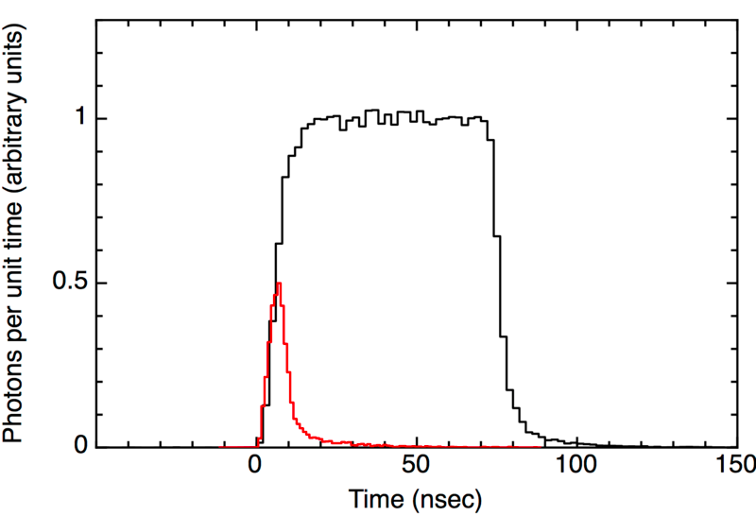
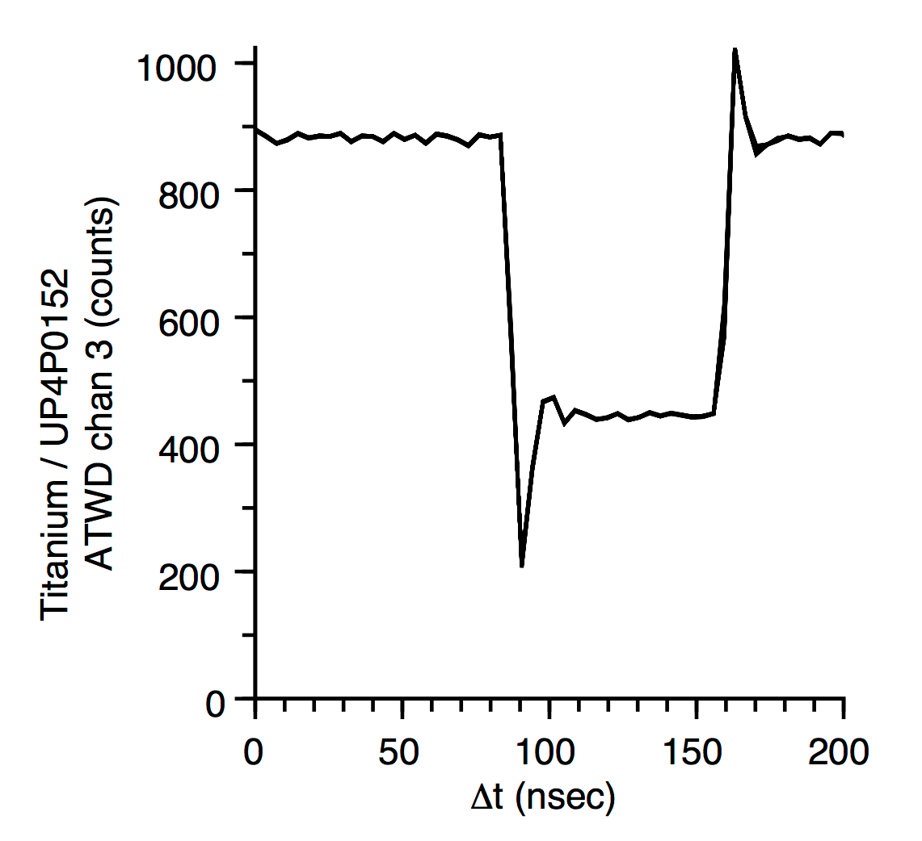
Running flashers: brightness and width
Maximum photon output per LED is 1.17e10 photons per flash
With all 12 LEDs running this is about equal to a 500 TeV cascade
The brightness and width parameters determine the photon output
Width: duration of driver current, effectively 10-70 ns
Brightness: amplitude of driver current, up to 240 mA
Width 15
Width 124

Slide 51
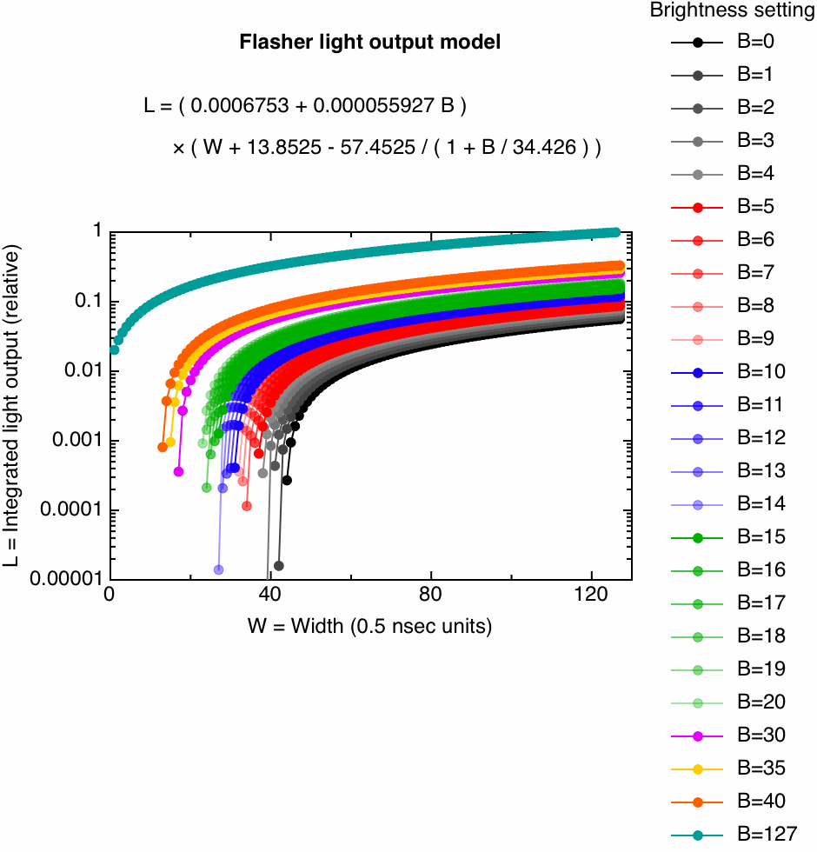
How light output scales with brightness and width

Slide 52
Running flashers: mask
The 12 LEDs can be run in an combination. Each LED is controlled by a bit, and the “mask” is the hex representation of the bits
Example: flash LED 7 only
horizontal
tilted
LED | 12 | 11 | 10 | 9 | 8 | 7 | 6 | 5 | 4 | 3 | 2 | 1
Bit | 0 | 0 | 0 | 0 | 0 | 1 | 0 | 0 | 0 | 0 | 0 | 0
HEX mask is 0064

Slide 53
Running flashers: mask
The 12 LEDs can be run in an combination. Each LED is controlled by a bit, and the “mask” is the hex representation of the bits
Example: flash all tilted LEDs
horizontal
tilted
LED | 12 | 11 | 10 | 9 | 8 | 7 | 6 | 5 | 4 | 3 | 2 | 1
Bit | 0 | 0 | 0 | 0 | 0 | 0 | 1 | 1 | 1 | 1 | 1 | 1
HEX mask is 003f

Slide 54
Running flashers: mask
The 12 LEDs can be run in an combination. Each LED is controlled by a bit, and the “mask” is the hex representation of the bits
Example: flash all horizontal LEDs
horizontal
tilted
LED | 12 | 11 | 10 | 9 | 8 | 7 | 6 | 5 | 4 | 3 | 2 | 1
Bit | 1 | 1 | 1 | 1 | 1 | 1 | 0 | 0 | 0 | 0 | 0 | 0
HEX mask is 0fc0

Slide 55
Running flashers: rate
Maximum rate is 610 Hz, lower rates are 610 Hz divided by a power of 2
The setting in the configuration is an integer, the actual value of the rate is the next lowest value to that integer which is 610 divided by a power of 2
So for example if the rate setting is 2, the actual rate is 1.191 Hz = 610 Hz/2⁹

Slide 56
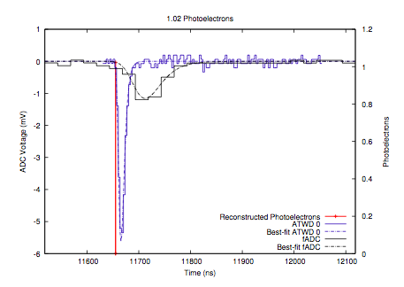
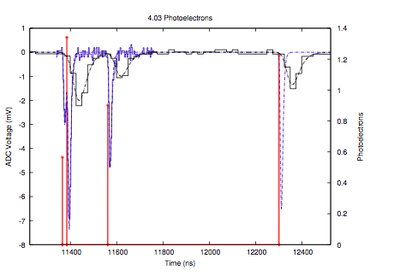
Flasher data processing
Raw waveform
(ADC counts)
Calibrated waveform
(mV)
Pulses
(PE)

Slide 57
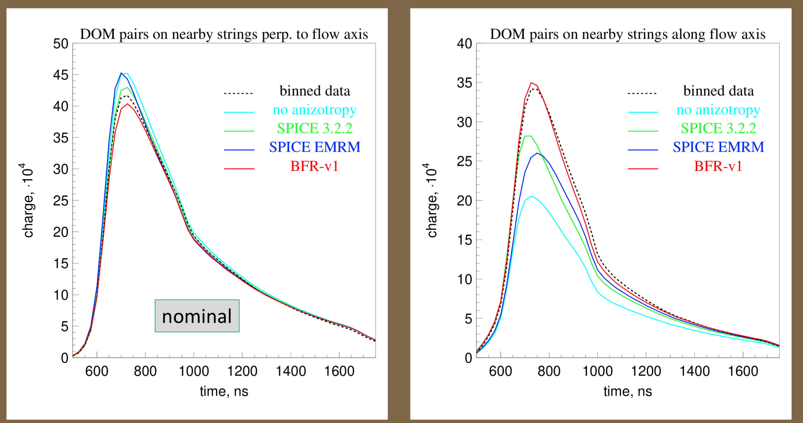
Flasher data and the ice model

Slide 58
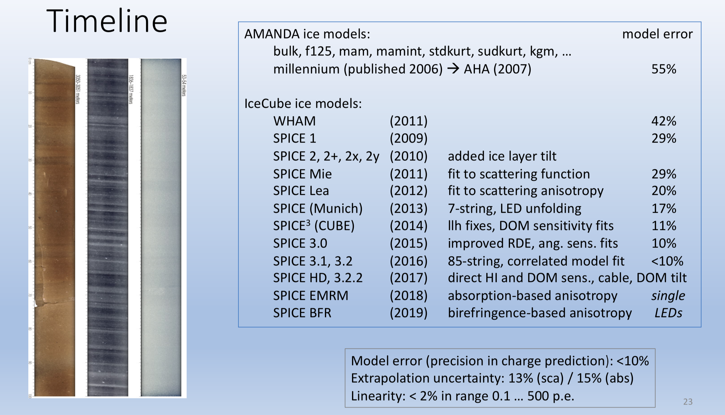
History of flasher data and the ice model

Slide 59


The IceCube Upgrade

Slide 60




IceCube Upgrade sensors are more densely spaced, with multi-PMT designs, increased photocathode area

Slide 61





Upgrade Calibration Goals
Device | Goal
Cameras | 3
Flashers | 1, 6
POCAM | 2, 3, 6
PencilBeam | 4, 6
Acoustic Modules | 5, 6
Dust Logger | 4, 6
Upgrade timing and geometry measurements
DOM optical efficiency determination in situ to better than 3%
2x reduction in uncertainty due to refrozen hole ice
Determine the source and depth dependence of anisotropy in optical scattering in bulk ice
Measure acoustic properties of bulk ice for Gen2
Measure properties of ice below instrumented IceCube volume

Slide 62
The future: calibration in the IceCube Upgrade
Device | IceCube | IceCube Upgrade | Note
Flasher LEDs in DOMs | All DOMs | All DOMs | Upgrade spacing will be below a scattering length
Cameras | 1 camera, not onboard DOM | Onboard DOMs, additional standalone cameras | Camera has been very useful in informing us about hole ice conditions
Standalone light sources | 2 laser ”standard candles” | POCAM and Pencil Beam | POCAM and Pencil beam designed to be isotropic/multidirectional and probe hole ice and scattering function respectively
Acoustic sensors | None | Modules on each string | Cross-check geometry measurements, R&D for extended detector calibration
Inclinometers | 50 | All DOMs | Mainboard mounted off the shelf component

Slide 63






Light sources onboard the modules: LED flashers
mainboard
Calibration board
cameras
flashers

Slide 64




Cameras
mDOM: 2 outward cameras, 1 downward
D-egg: 3 outward cameras

Slide 65




External light sources
Pencil Beam
Precision Optical Calibration Module (POCAM)

Slide 66

The Pencil Beam in the Upgrade

Slide 67
Summary
The ice is a fundamental part of our detector and knowledge of the ice is critical to the science of IceCube
Our model of the ice has been evolving in complexity ever since IceCube was constructed
The IceCube Upgrade will deliver improved measurements of the ice which will be used as the basis of knowledge for the next generation IceCube detector

Slide 68
Backup

Slide 69

Vocabulary
DOM = digital optical module
Basic sensor unit
String = cable with 60 DOMs
86 strings in final detector
IceTop = surface detector
InIce = all strings
DeepCore = closely spaced center strings

Slide 70
Vocabulary
Photomultiplier tube or PMT = light detector
HV = high voltage
Photoelectron: an electron ejected from a metal surface in the PMT by a photon
Mainboard = digitizing electronics
ATWD = analog transient waveform digitizer
128 samples, 3 ns per sample
FADC = fast analog to digital converter
Waveform = digitized current pulse
Timestamp = time a waveform was recorded
Flashers = onboard LEDs for calibration

Slide 71

IceCube PMT

Slide 72
Vocabulary
Hit = single DOM sees light (threshold = 0.25 PE)
Local coincidence = neighboring DOMs see light within a certain time window
Hard Local Coincidence (HLC) = no information is sent on unless local coincidence condition is met
Soft Local Coincidence (SLC) = only minimal information is sent on unless local coincidence condition is met
These decisions are all made in the ice by the onboard electronics

Slide 73
Vocabulary
Trigger = multiple DOMs hit in a certain pattern or time window
Simple majority (SMT) = some number of DOMs hit, currently 8, i.e. SMT8
Calibration trigger = flashers
Minimum bias/minbias trigger = capture whatever is in the detector regardless of pattern
Many others

Slide 74
Vocabulary
Event = all information captured within a certain time window around a trigger
An event may have multiple triggers
Event Builder = software that constructs events
Processing and filtering (PNF) = software that runs online data reduction
Online = realtime data processing
Offline = non-realtime data processing

