Slide 1
A Gen-2 calibration borehole with the U.S. Rapid Access Ice Drill (RAID)? Jeff Severinghaus (University of California, San Diego) John Goodge (University of Minnesota, Duluth)

Slide 2

Why rapid-access ice drilling?
Conventional ice coring takes ~5 yr, $50M
High risk of not getting target ice
Most new science targets are near the bed
(e.g. last interglacial, >1 million yr old ice, subglacial biology, bed and till properties)
Borehole logging is a new science frontier
Geophysical instruments, heat flow probes need boreholes

Slide 3
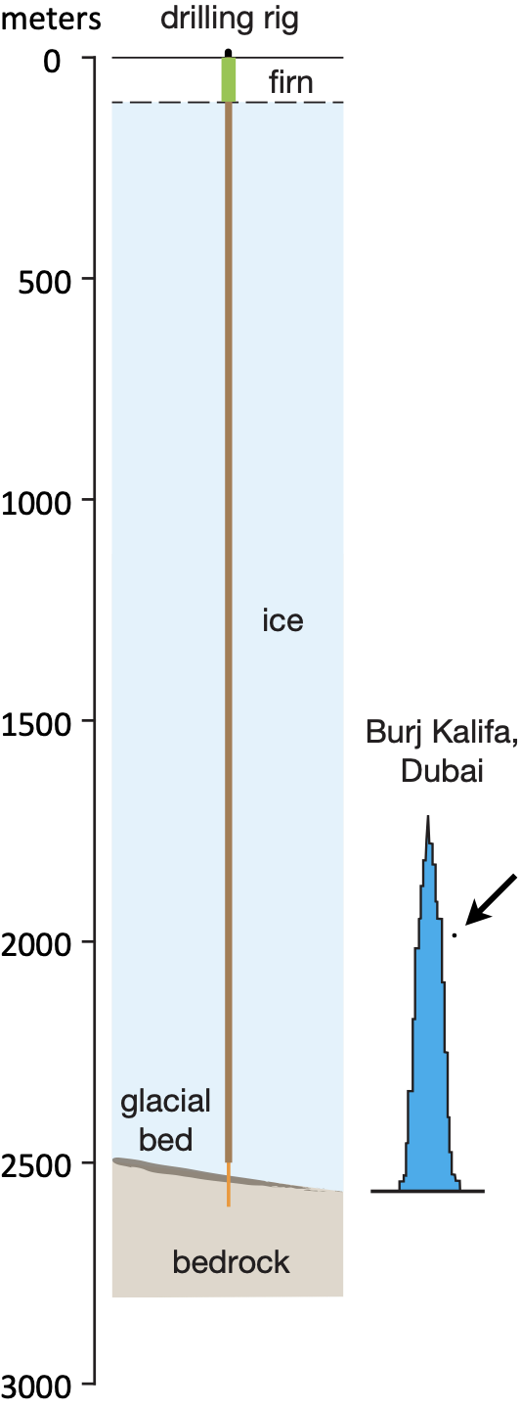
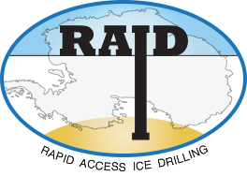

Rapid Access Ice Drill (RAID)
new concept for exploring deep ice & bedrock
ability to go deep (2500-3300 m)
cuts entire ice sheet in two days
rapid mobility on sleds allows for many holes
creates observatory of legacy holes
potentially transformative with new multi-disciplinary opportunities
Notes:
in 2012 started a collaboration with an ice scientist to design and construct a new drilling platform to...
2500 m = 8000 ft
Tom Cruise for scale

Slide 4
Closed-loop fluid circulation to remove ice chips: the key to fast drilling
Drill fluid
Rotating drill pipe
ICE
chips
3000 m
borehole

Slide 5
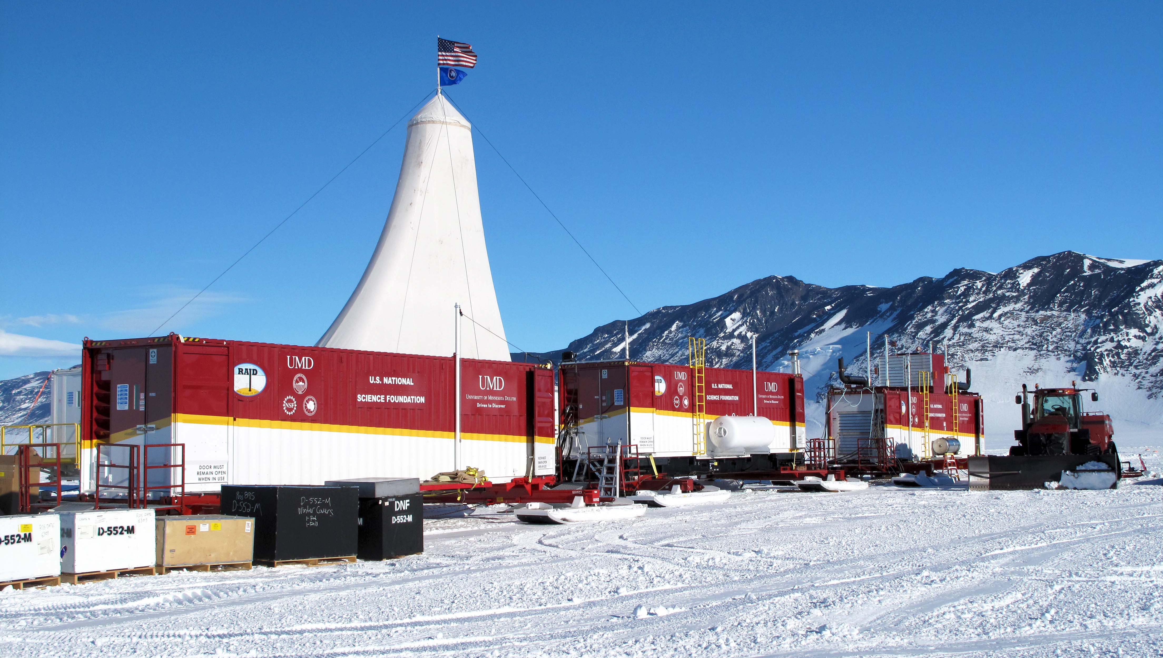
Successful RAID test at Minna Bluff, Antarctica (2019-2020)

Slide 6
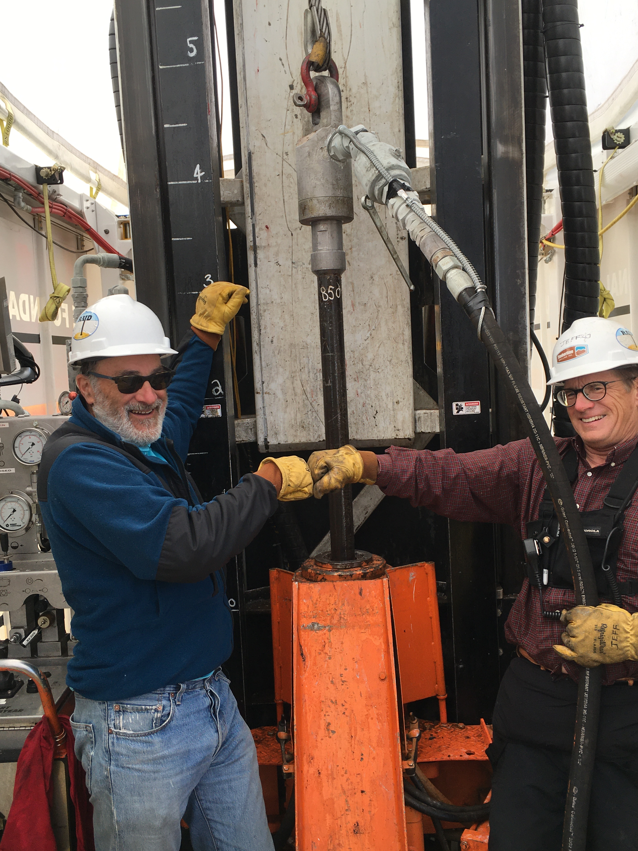

Slide 7
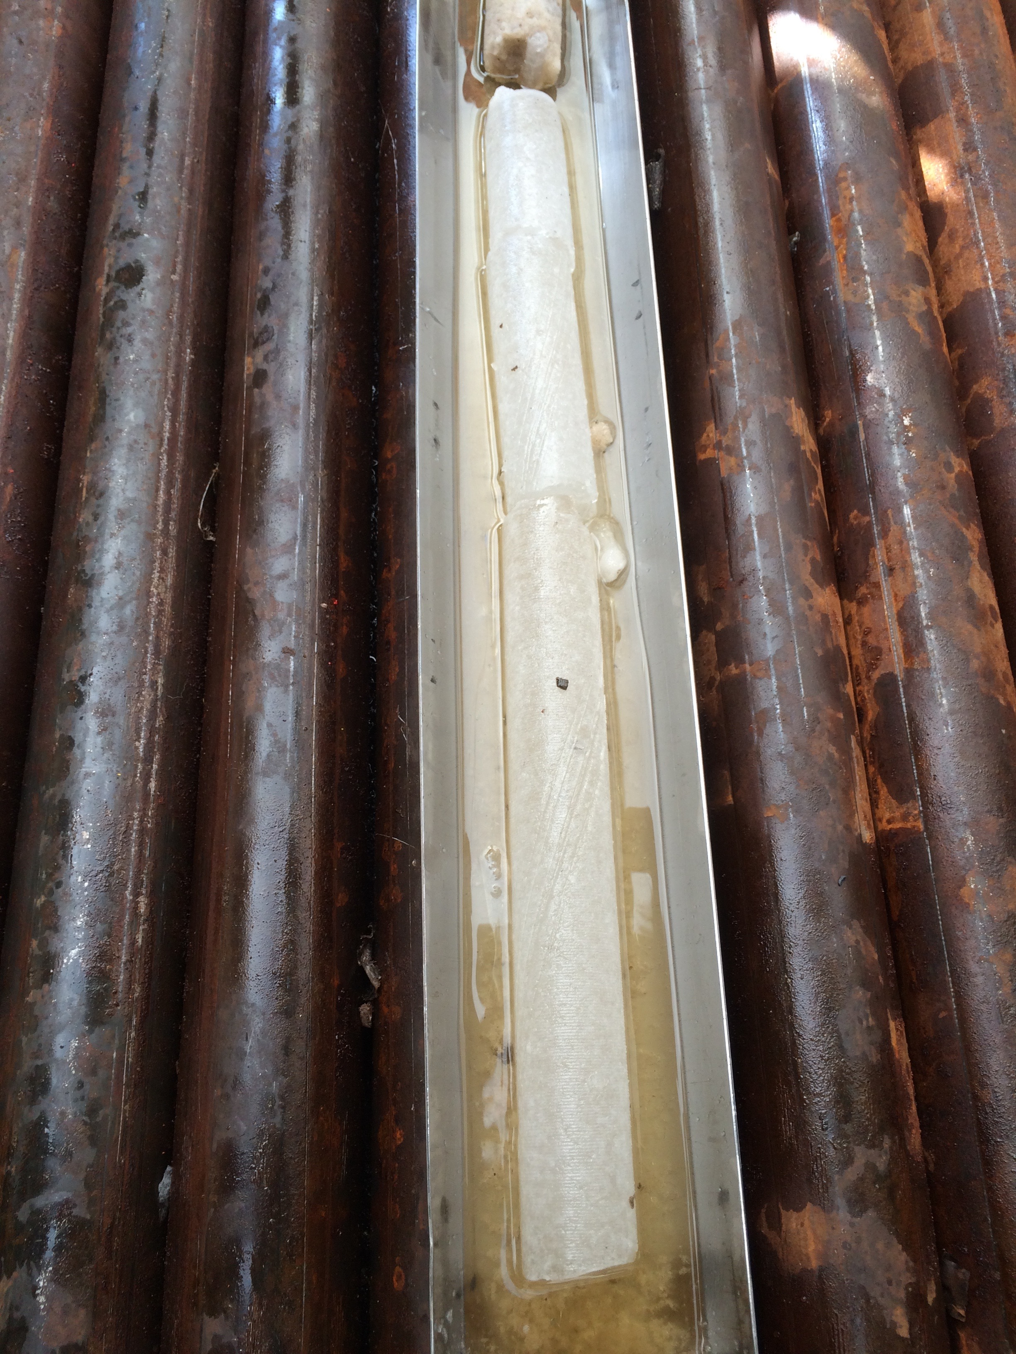
Ice core taken by RAID just above bedrock, Minna Bluff Jan. 2020
Age of ice: ~15,000 yr BP
Air-based (δ¹⁸O_{atm}) dating
Successful borehole optical dust log for rapid ice dating (Ryan Bay, Delia Tosi)

Slide 8
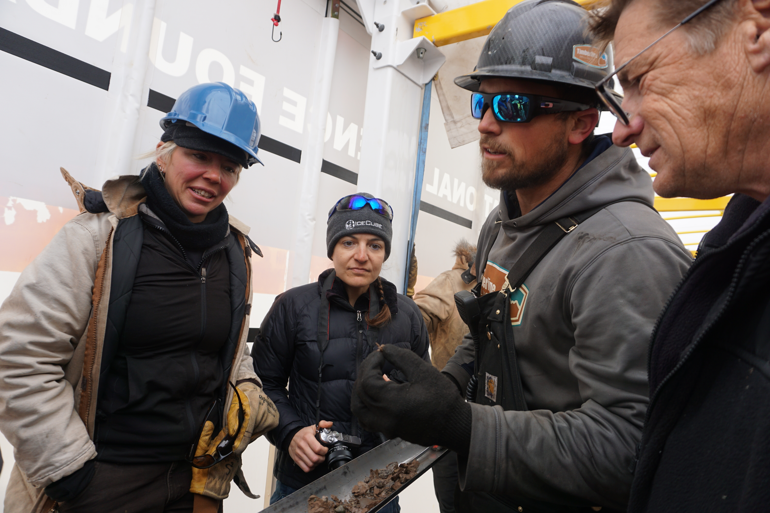
One meter deeper…

Slide 9
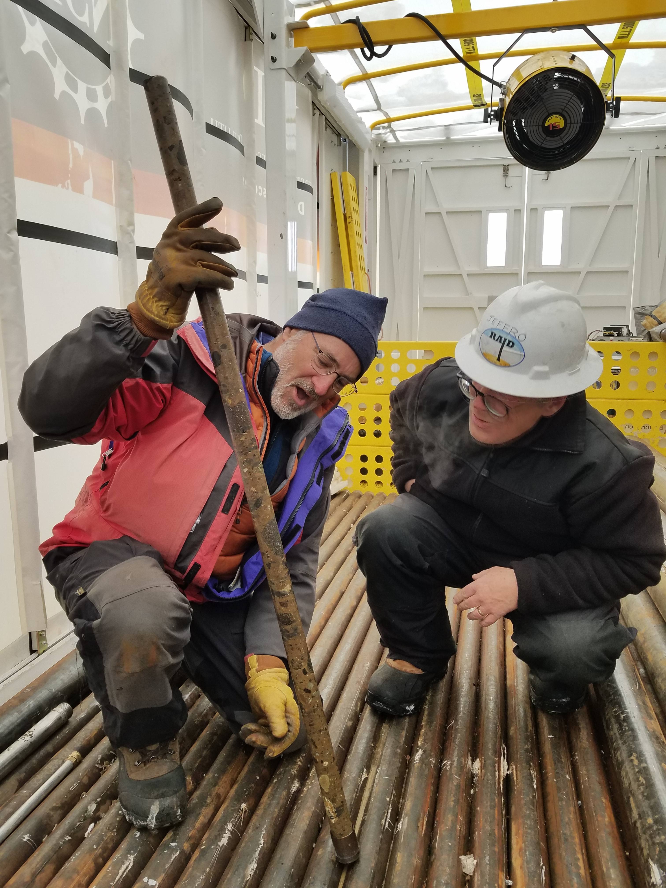
0.5 meter deeper still….

Slide 10
Limitations of RAID
Designed for speed, not for perfectly vertical hole. Borehole can be up to 10 deg off vertical
Cannot penetrate wet bed (for bio stewardship)
Five ski-mounted modules require 3-5 Challenger tractors to pull, depending on snow conditions & grade
QUESTIONS?

