Slide 1
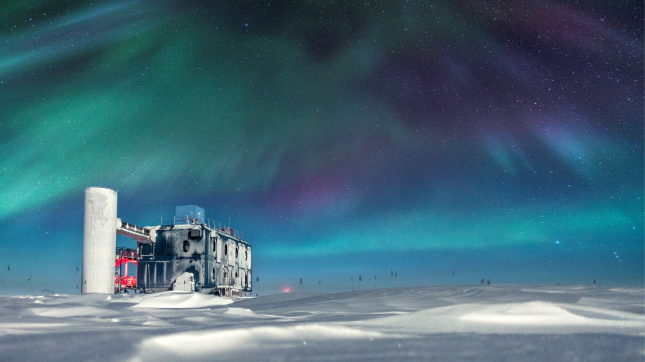
The IceCube Neutrino Observatory and the IceCube Upgrade
Dawn Williams
IceCube Polar Science Workshop
Jan. 19, 2021

Slide 2
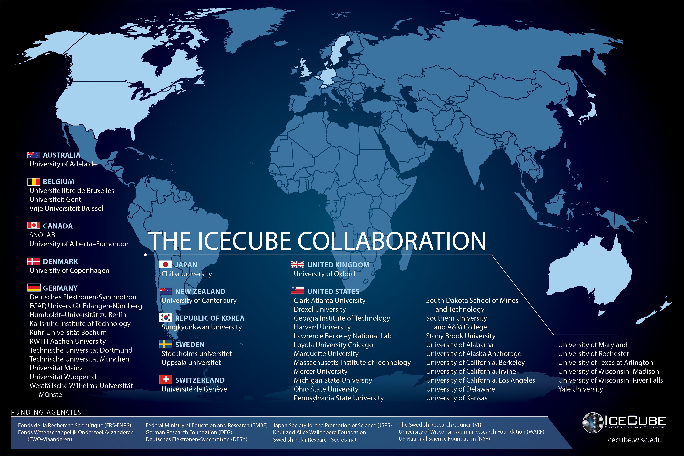

Slide 3
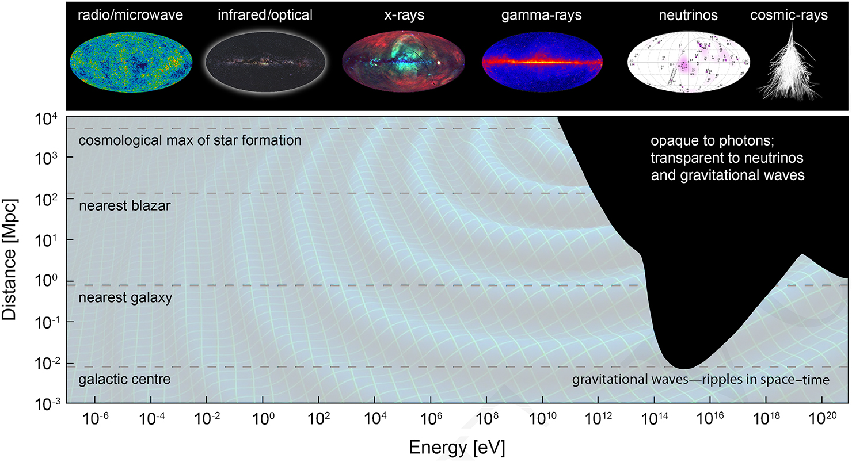
Neutrinos are extremely low mass, weakly interacting, electrically neutral particles which can probe the high-energy universe
Bartos and Kowalski 2017
Notes:
Bumps: IR, CMB, radio. Multimessenger astronomy is a big buzzword, partially because it’s cool and partially because NSF designated it one of their ten big ideas. Distances large, we rely on messengers that traverse the distances between us and astronomical objects. Photons travel long distances only up to certain energies, but we know CRs go to higher energies, we need a messenger.

Slide 4
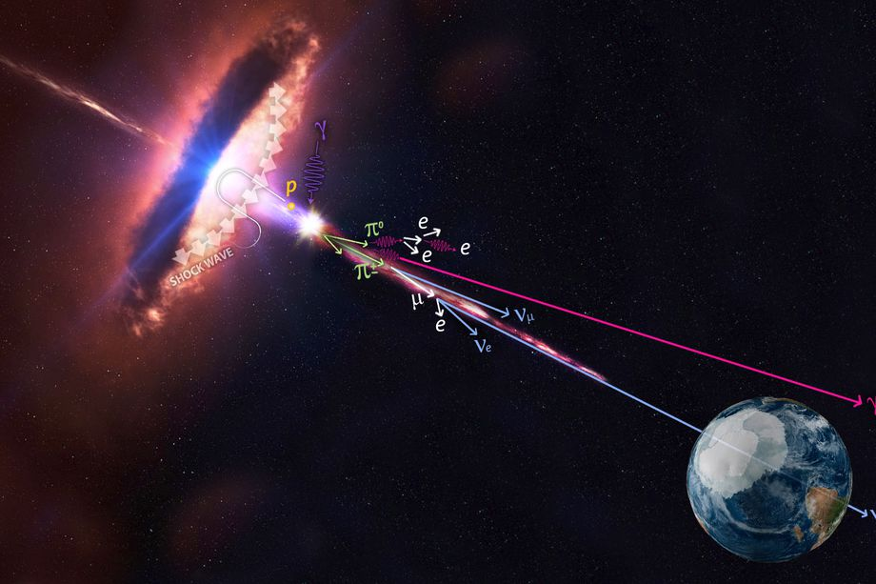
Cosmic accelerators as neutrino sources
Due to the large distances/low fluxes involved, a very large detector is required to detect high energy neutrinos from cosmic accelerators
IceCube/NASA
Notes:
Halzen and Klein Physics Today 61, 5, 29 (2008); doi: 10.1063/1.2930733

Slide 5
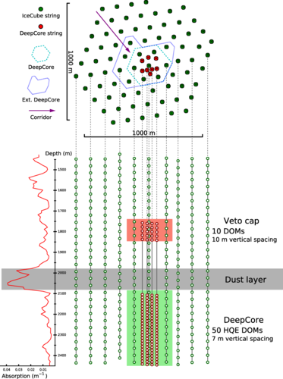
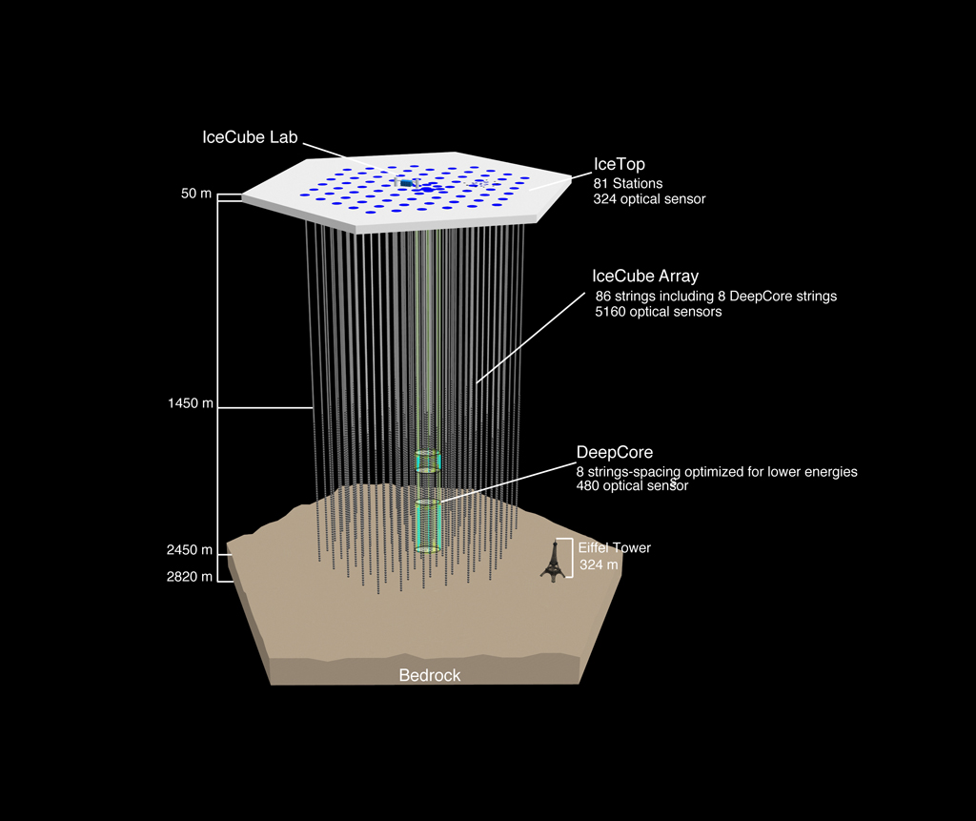
The IceCube Neutrino Observatory
IceCube DeepCore
Notes:
Based on the known CR flux, a cubic kilometer detector should detect about 10 astrophysical neutrinos per year over atmo background

Slide 6
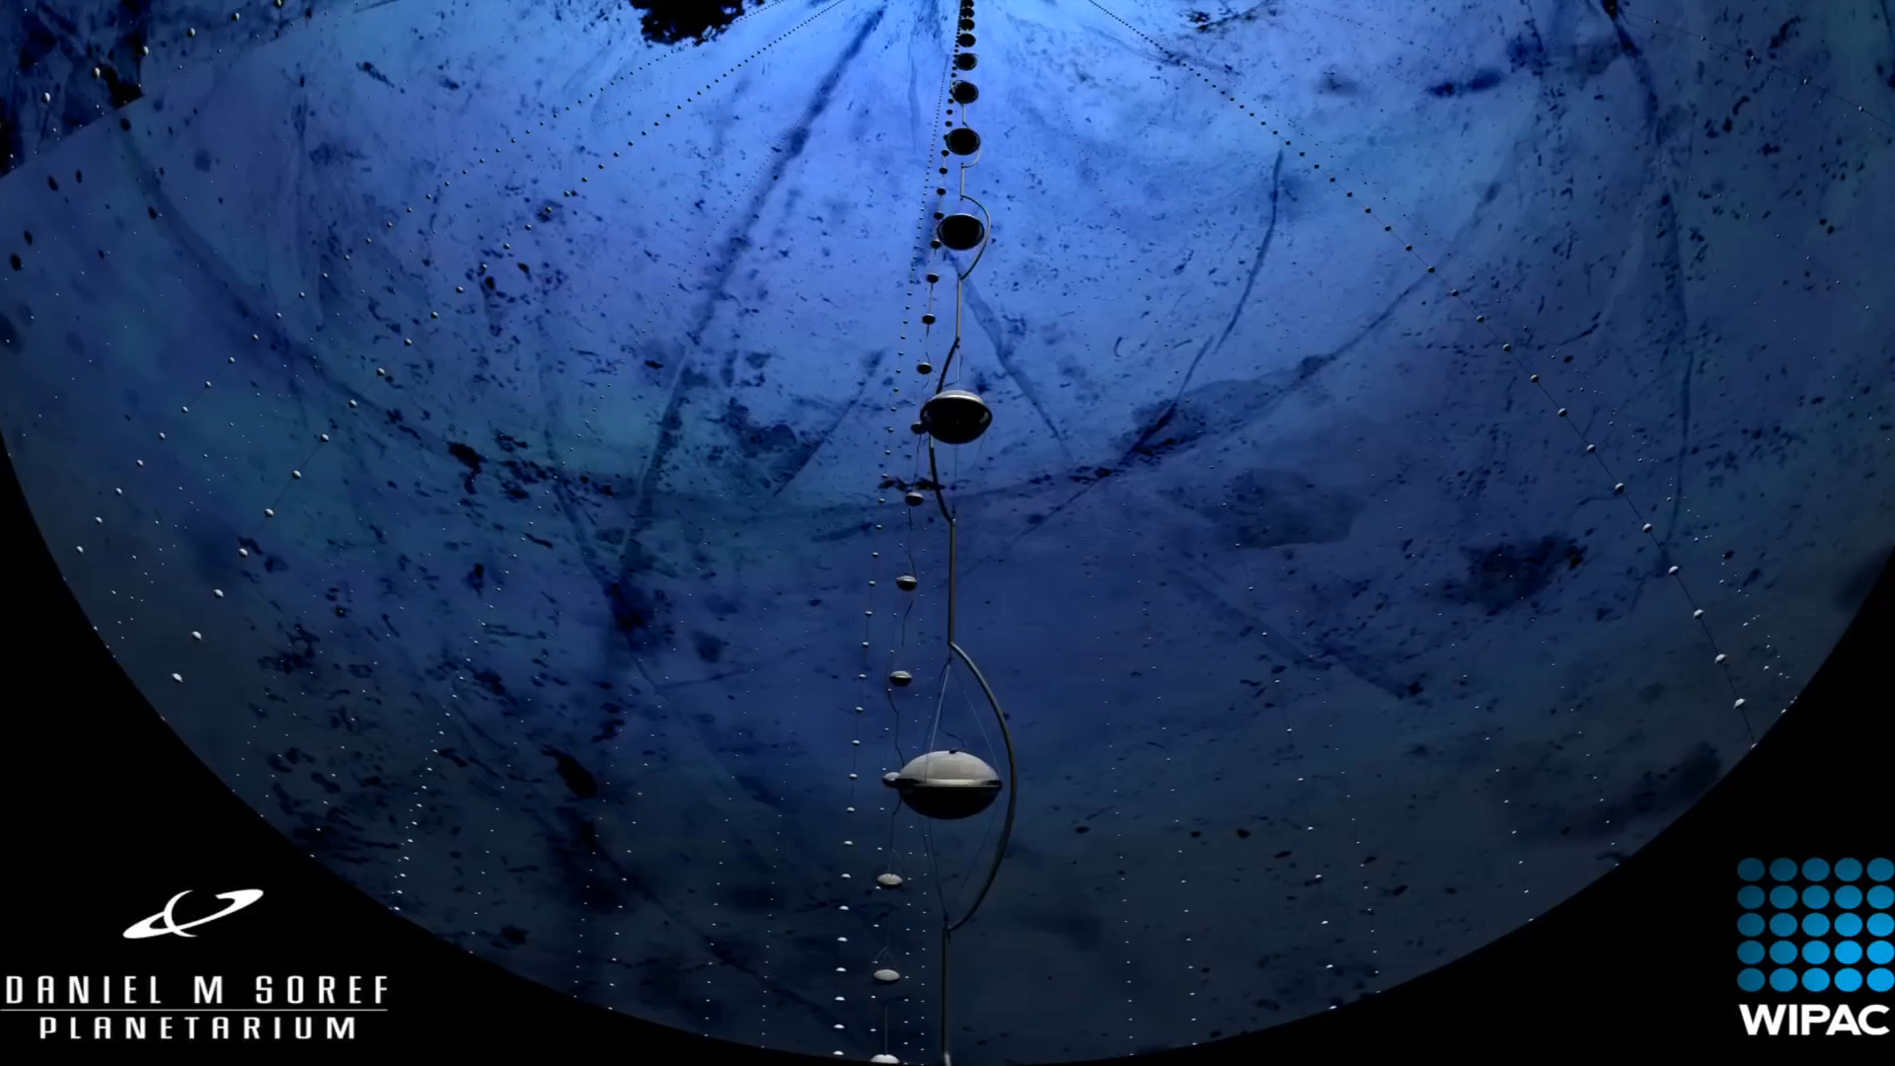
Inside the IceCube DOM
WIPAC/MCM
Notes:
Deep Core modules have higher quantum efficiency. Critical issues: only one PMT facing downward. This means any light from above the module is scattered. We digitize the signal from the PMT with 3.3 ns precision. We have 12 LEDs in each DOM, 6 horizontal and 6 tilted upward. Original use case was to try and imitate cascades, as it turns out their true use was in probing the ice.

Slide 7
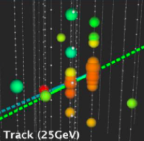
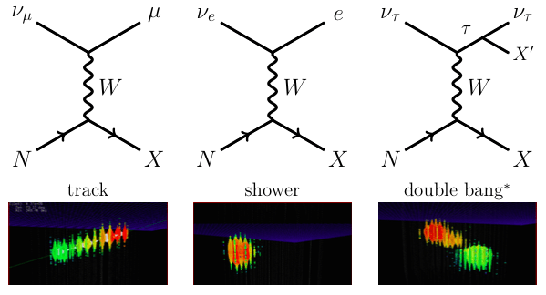
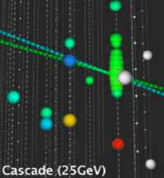
Neutrino Signatures in IceCube
~100 TeV – PeV neutrinos in IceCube
GeV neutrinos in IceCube DeepCore
A shower (cascade) is also observed for all flavor neutral current events, and for taus too low in energy to produce a resolved double cascade

Slide 8
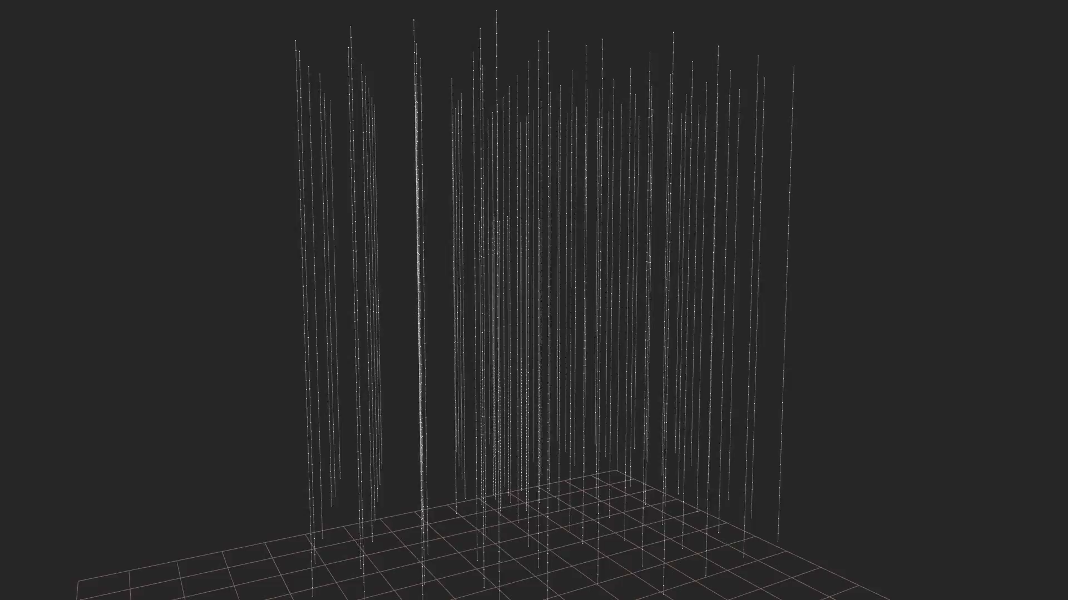
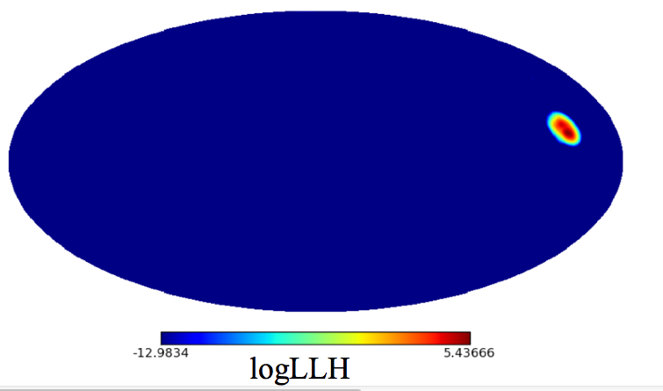
Neutrino Signatures in IceCube: Tracks
Direction: >0.2°
Energy: factor of 2
IceCube Collaboration

Slide 9
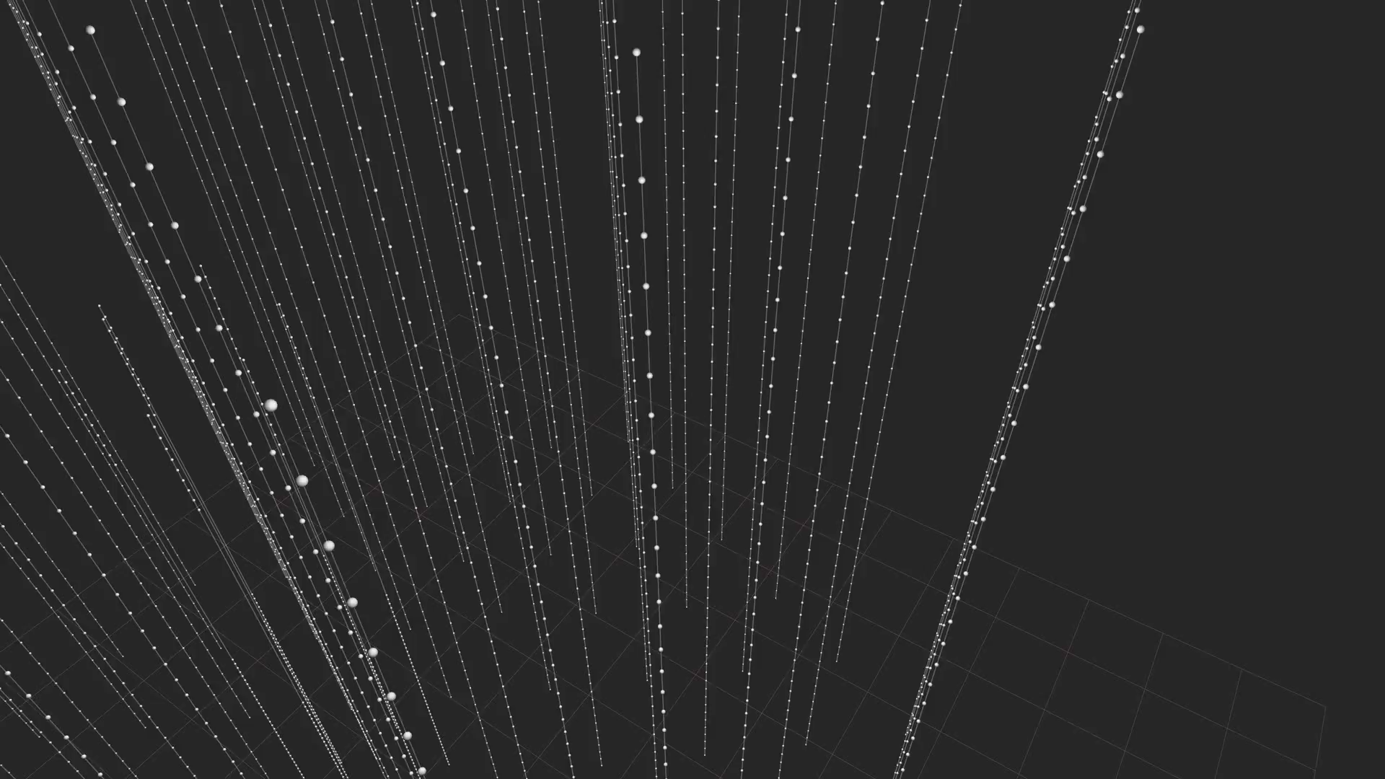
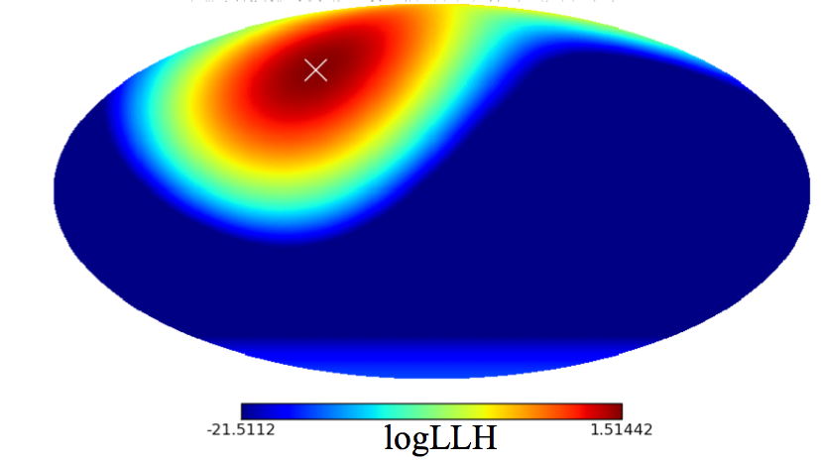
Neutrino Signatures in IceCube: Cascades
Direction: 15°
Energy: 10%
IceCube Collaboration

Slide 10
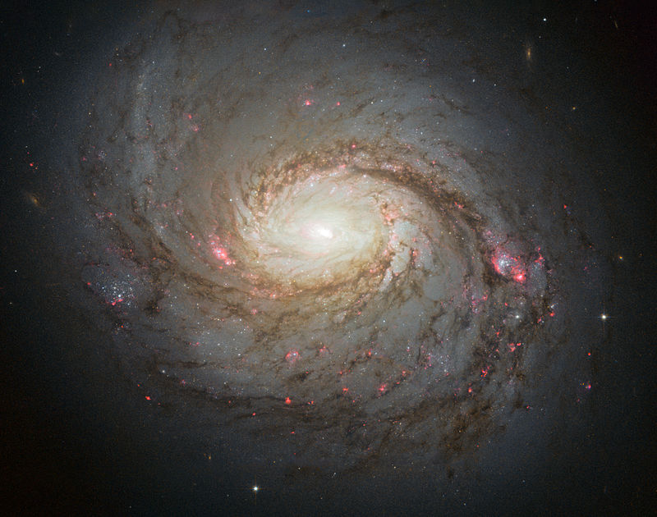
The High Energy Neutrino Sky
M77/ NGC 1068
NASA, ESA & A. van der Hoeven
Excess at the coordinates of NGC 1068
IceCube Coll., Phys. Rev. Lett. 124, 051103 (2020)

Slide 11
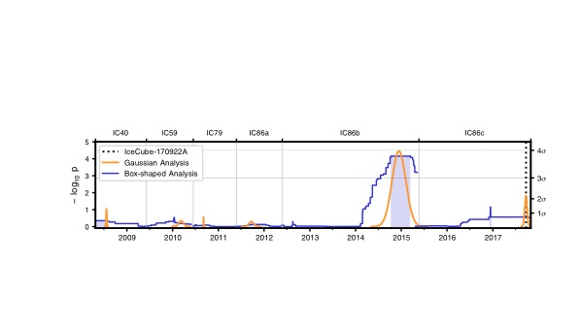
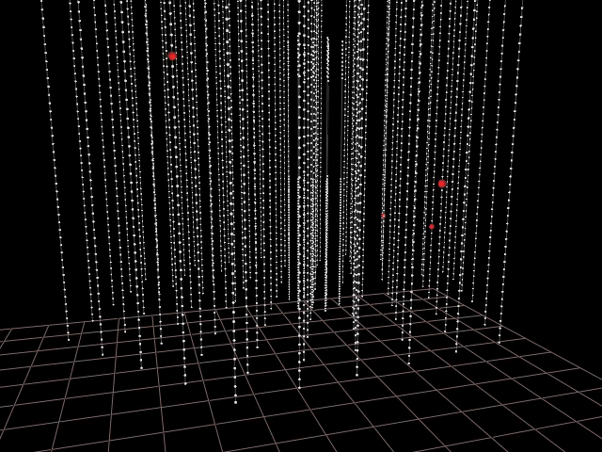
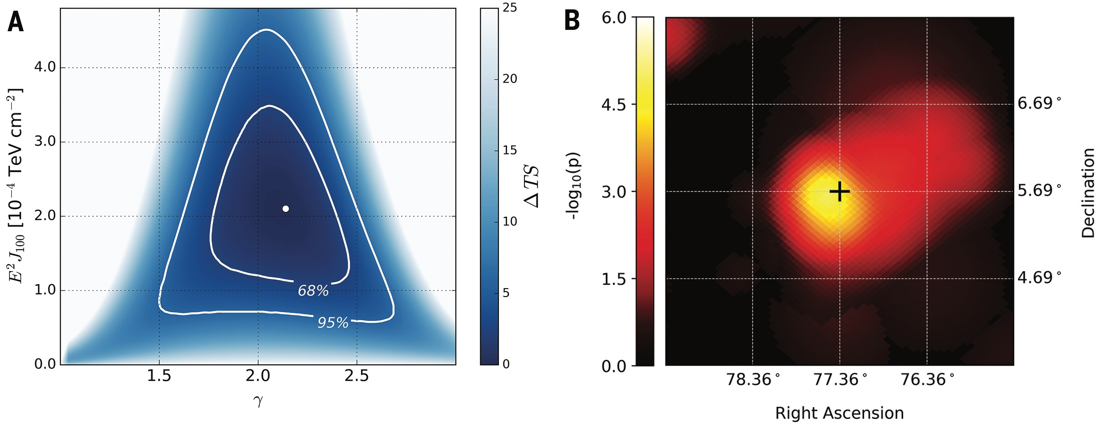
IceCube Science: Multi-messenger Astronomy
Neutrino event IceCube-170922A seen in coincidence with gamma ray flaring blazar TXS 0506+056 on Sep. 22, 2017
Rapid follow-up by electromagnetic telescopes
Neutrino flare found in IceCube archival data between September 2014 and March 2015
Science 13 Jul 2018: Vol. 361, Issue 6398
IceCube, Fermi, MAGIC and 13 additional collaborations
IceCube coll., Science 13 Jul 2018: Vol. 361, Issue 6398

Slide 12
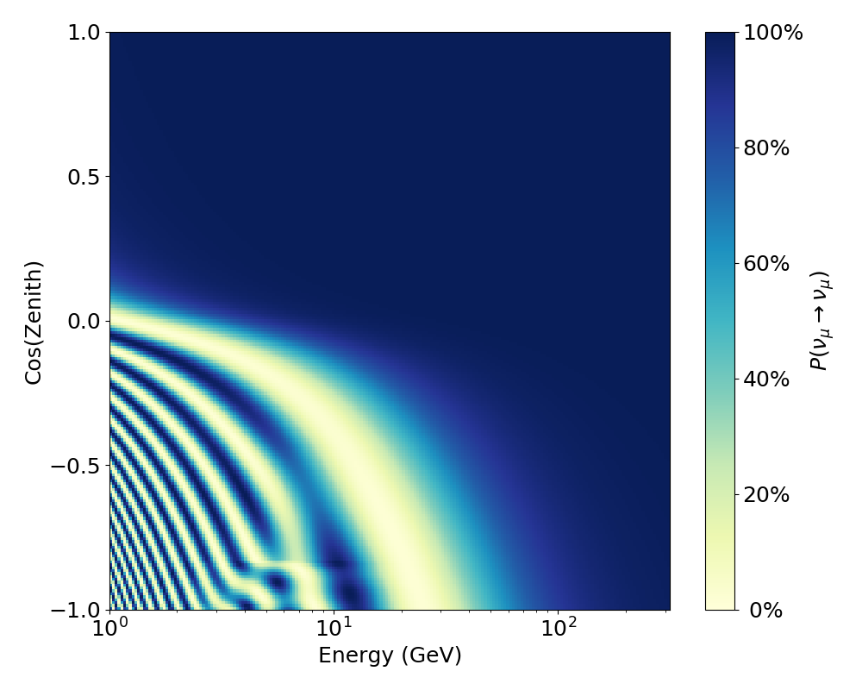
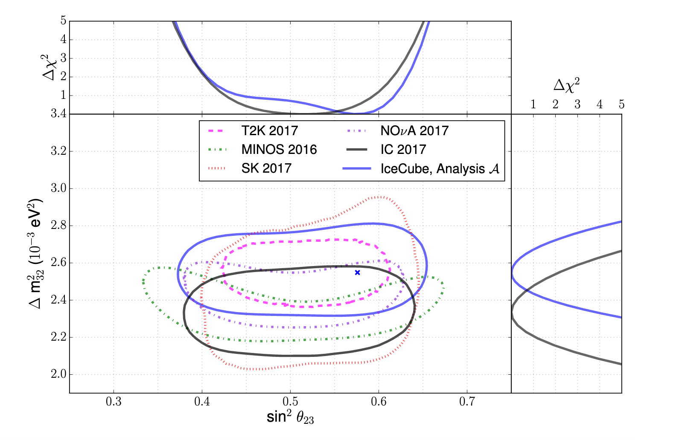
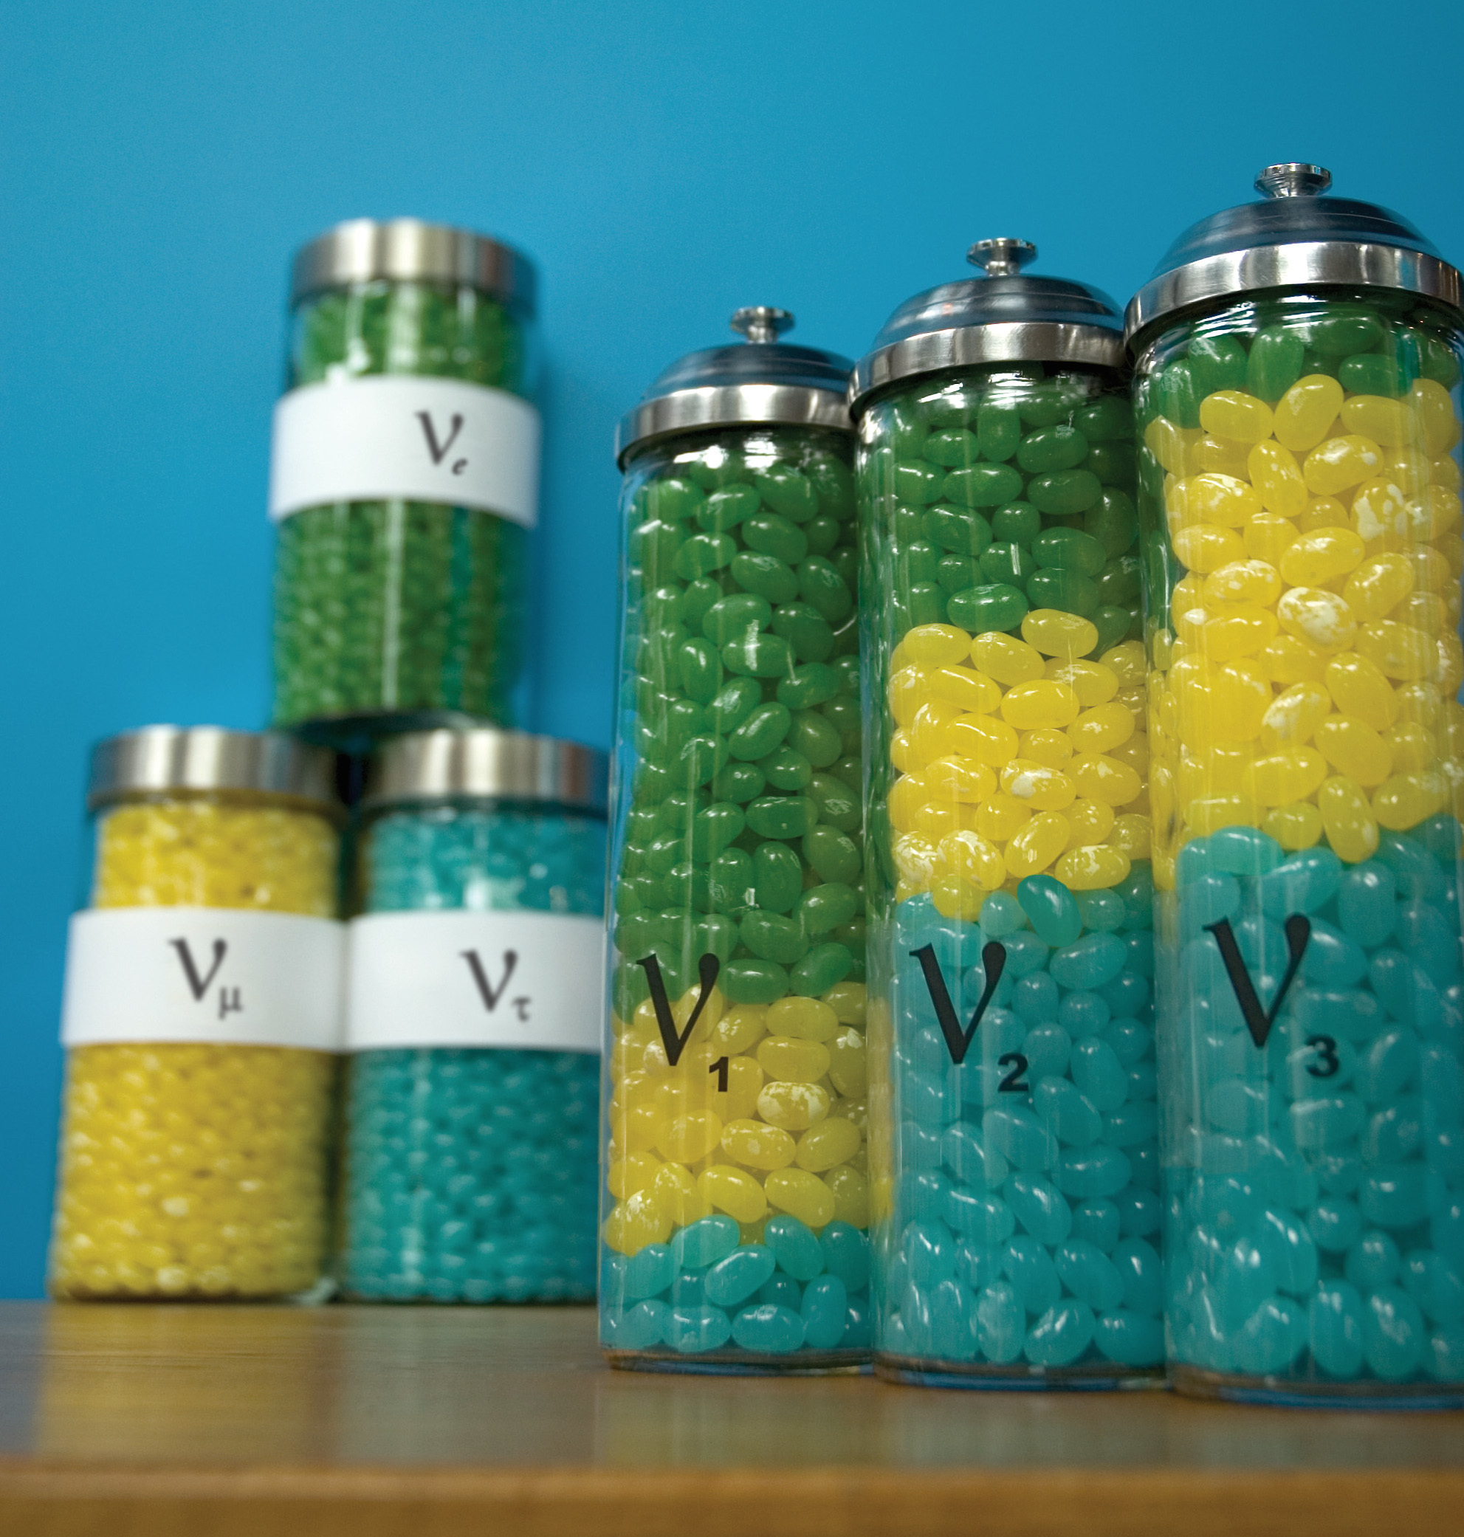
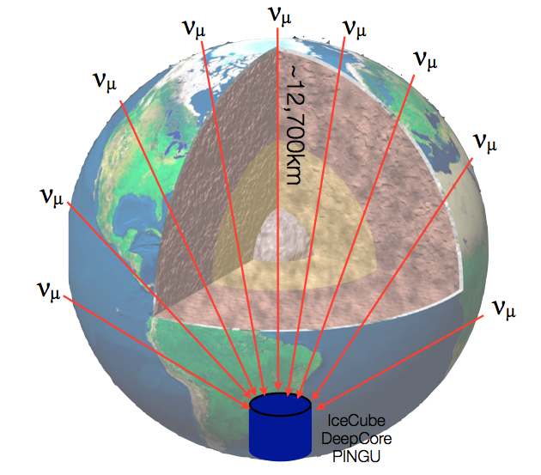
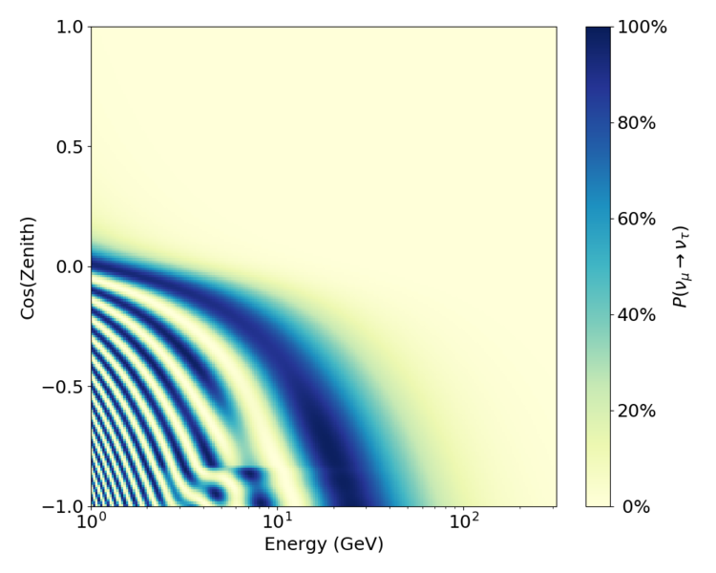
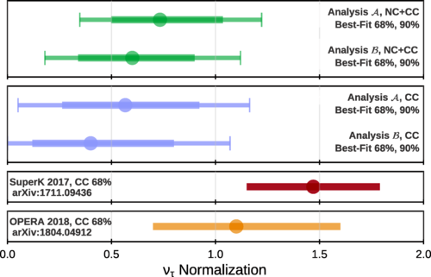
IceCube Science: Neutrino Oscillation Physics
Muon neutrino disappearance
Tau neutrino appearance
Phys. Rev. D 99, 032007

Slide 13
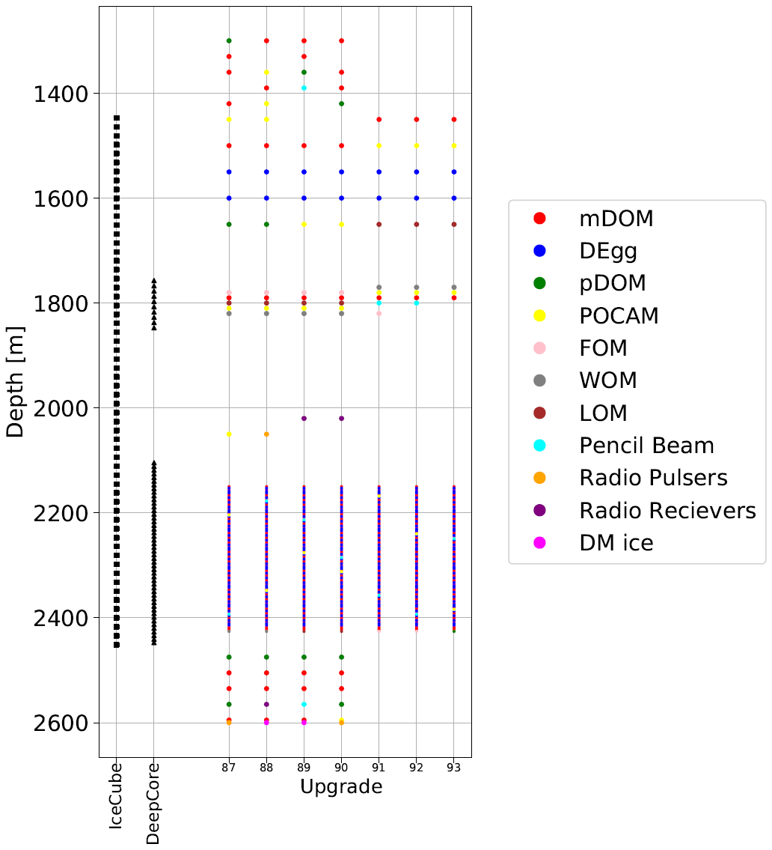
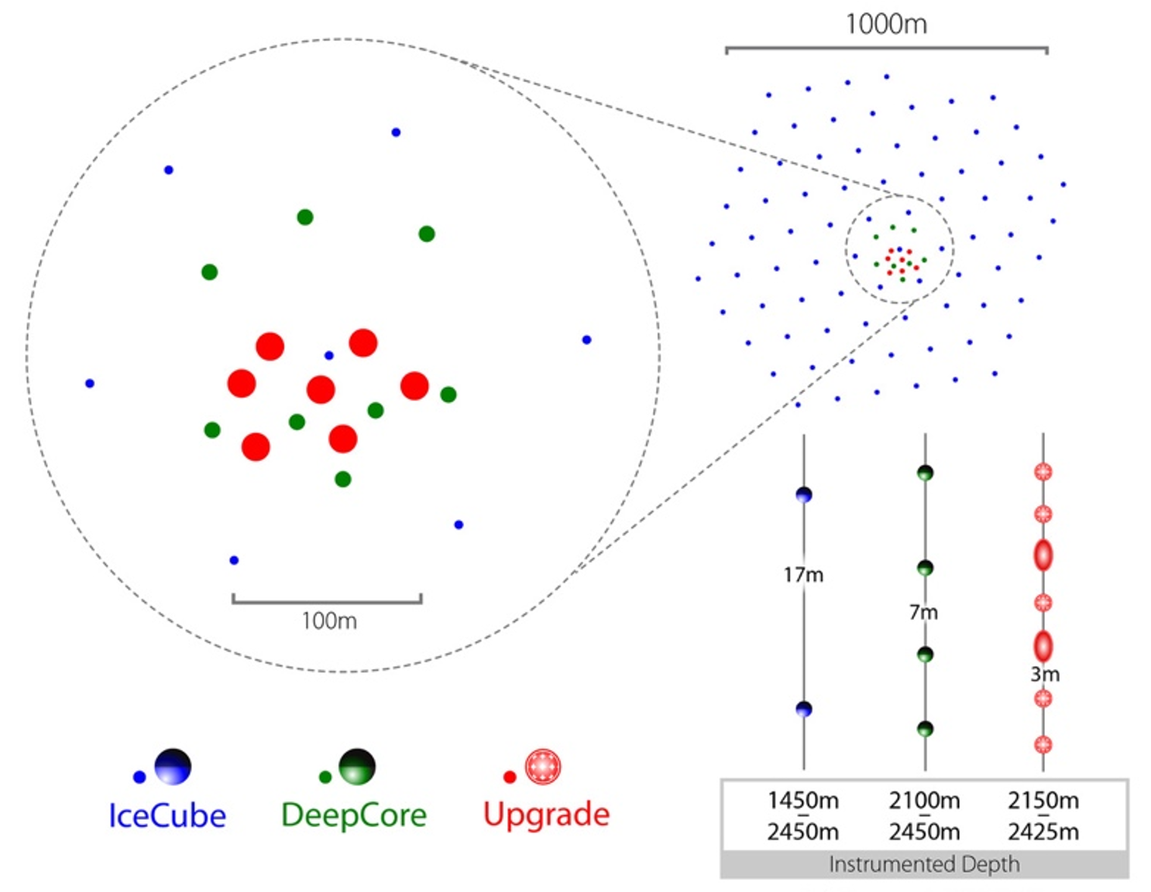
The IceCube Upgrade
7 new strings scheduled for deployment in 2022/23
Currently schedule is under review due to impact of COVID
Atmospheric ντ appearance
Precise calibration of IceCube optical properties and DOM response
Recalibration of high energy neutrino data

Slide 14
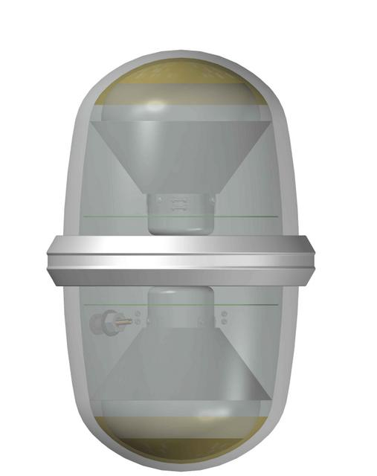
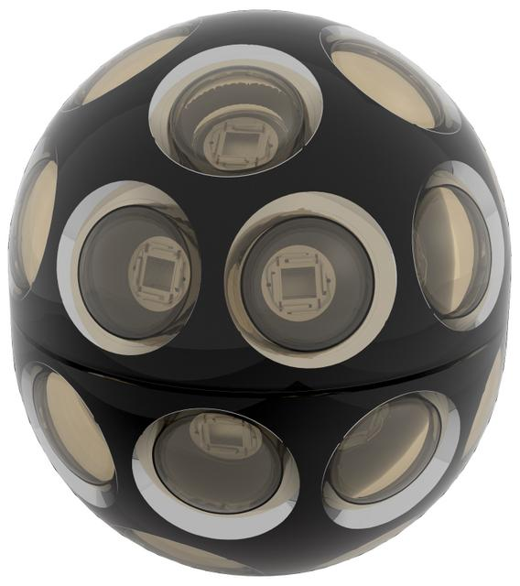
Upgrade sensors and calibration
Increased photocathode area and more uniform directional sensitivity compared to IceCube DOM
LED flashers and cameras included in each module
A smaller number of additional R&D photosensor designs will be deployed
Calibration devices including acoustic sensors, beamed and isotropic light sources, additional cameras, radio calibration, with major emphasis on improving knowledge of the ice – baselines within 1 optical scattering length will be available in the upgrade for the first time
D-egg
mDOM

Slide 15
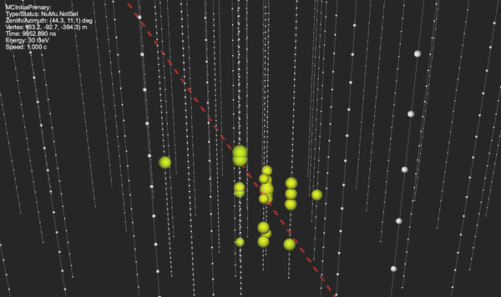
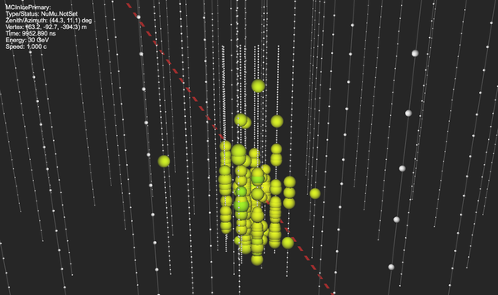
Low energy neutrinos in the IceCube Upgrade
30 GeV, IceCube DeepCore
30 GeV, IceCube Upgrade

Slide 16
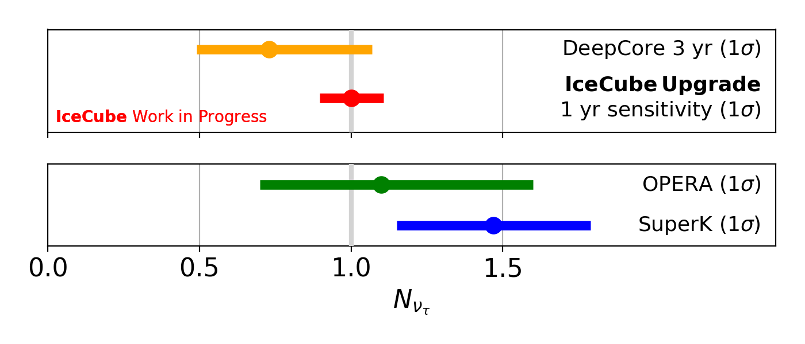
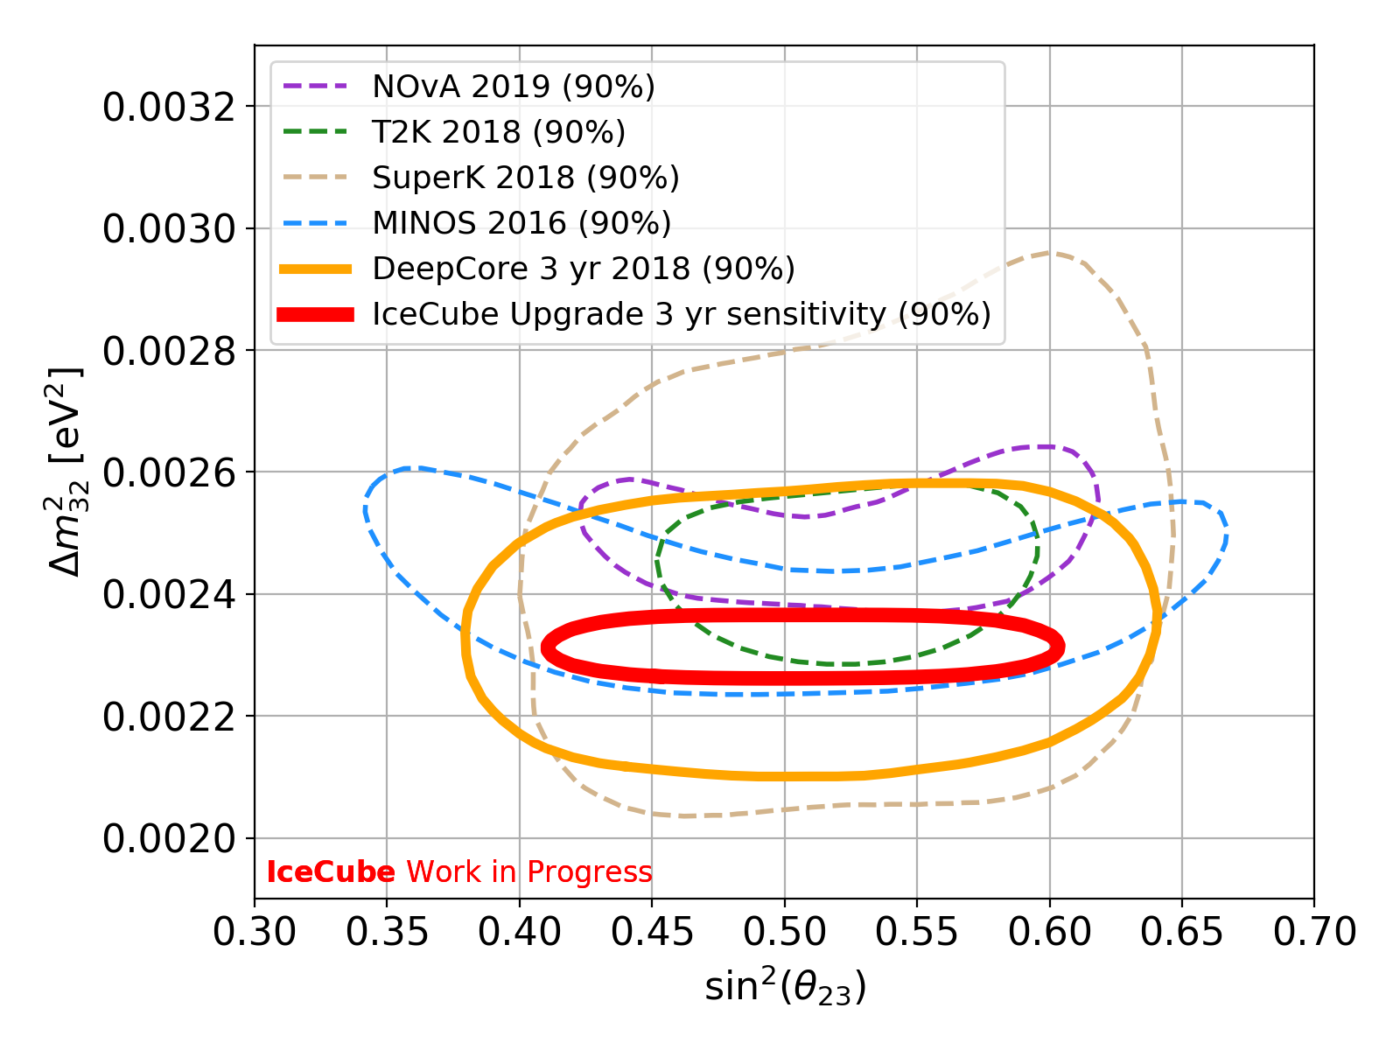
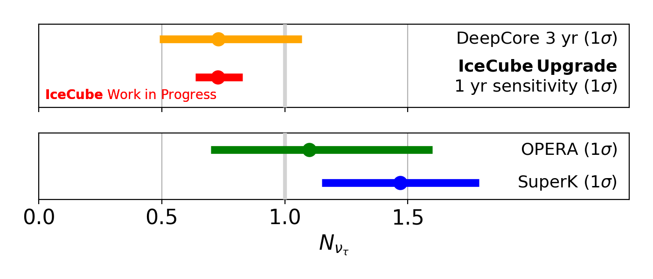
Upgrade sensitivity to neutrino oscillation
IceCube Coll., ICRC 2019
Notes:
Sensitivities will improve as updated reconstruction techniques are applied

Slide 17
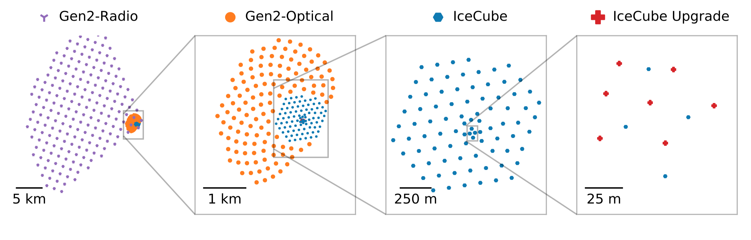
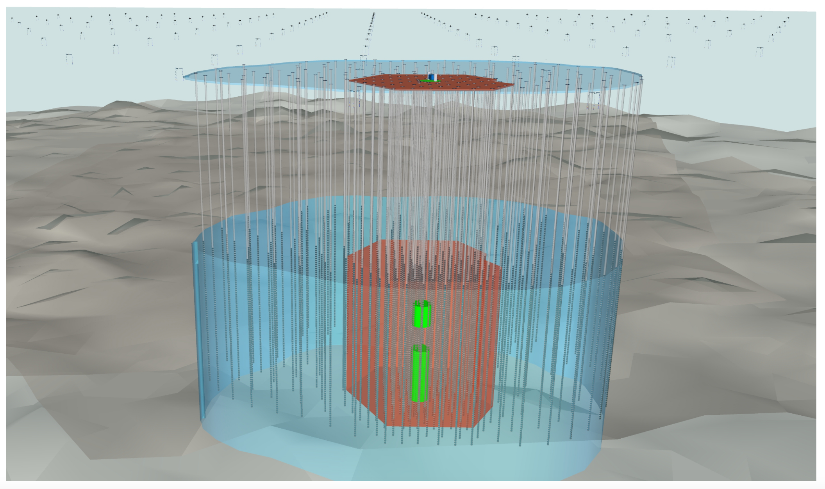
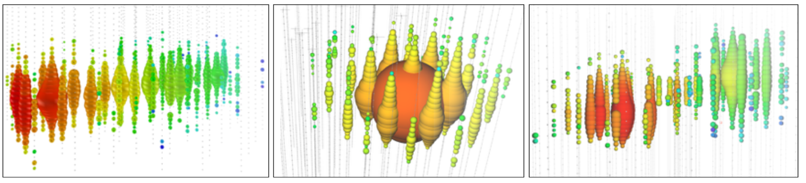
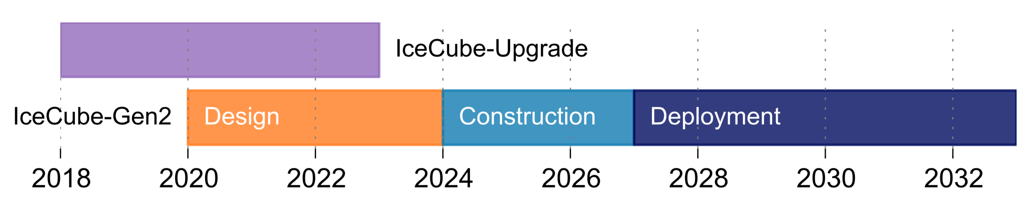
IceCube-Gen2
IceCube-Gen2 is designed to…
Resolve the high-energy neutrino sky from TeV to EeV energies
Investigate cosmic particle acceleration through multi-messenger observations
Reveal the sources and propagation of the highest energy particles in the universe
Probe fundamental physics with high-energy neutrinos
Projected timeline
https://arxiv.org/abs/2008.04323

Slide 18
Summary
The IceCube Neutrino Observatory has detected high energy cosmic neutrinos and published very sensitive neutrino oscillation studies, in addition to many other physics topics
The IceCube Upgrade is underway, and will greatly improve sensitivity to low energy neutrinos and improve our knowledge of the ice
Planning is underway for next generation neutrino telescope, IceCube-Gen2

