Slide 1
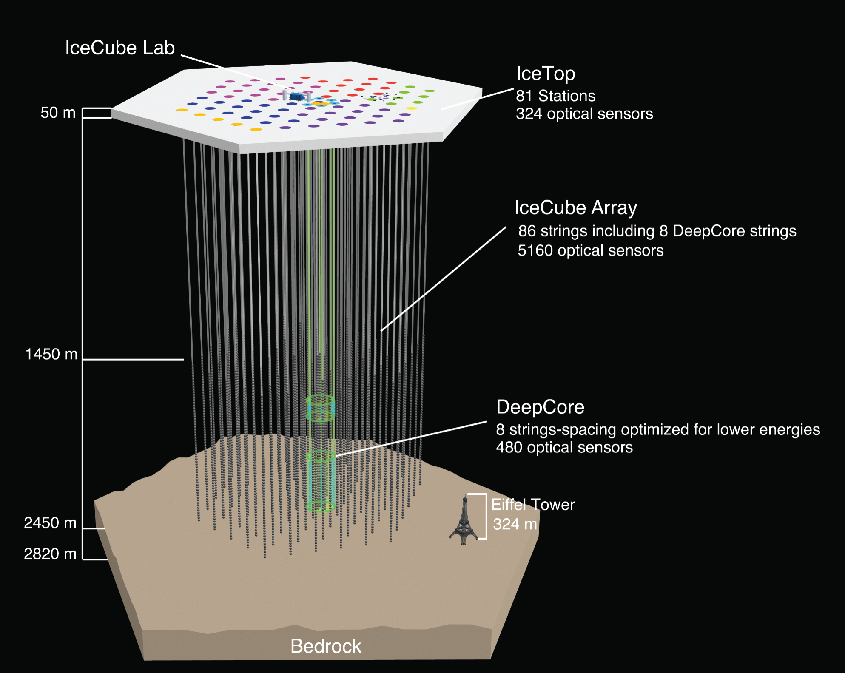
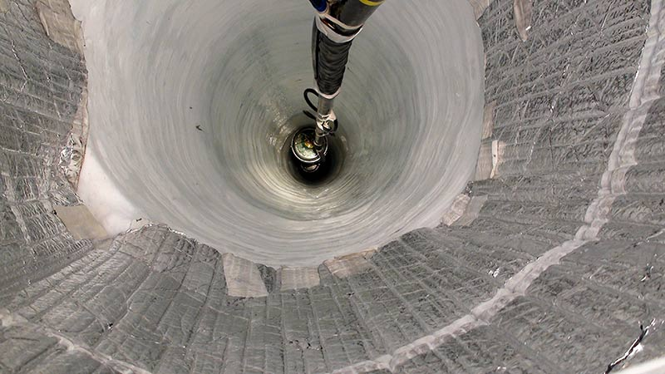
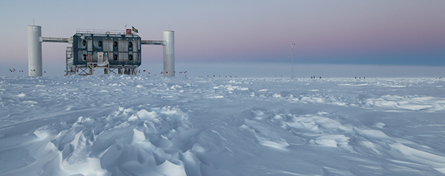
The IceCube optical ice model
AMANDA (turned off in 2009)
19 strings, 677 optical sensors
Dmitry Chirkin, UW Madison
Martin Rongen, U. Mainz

Slide 2
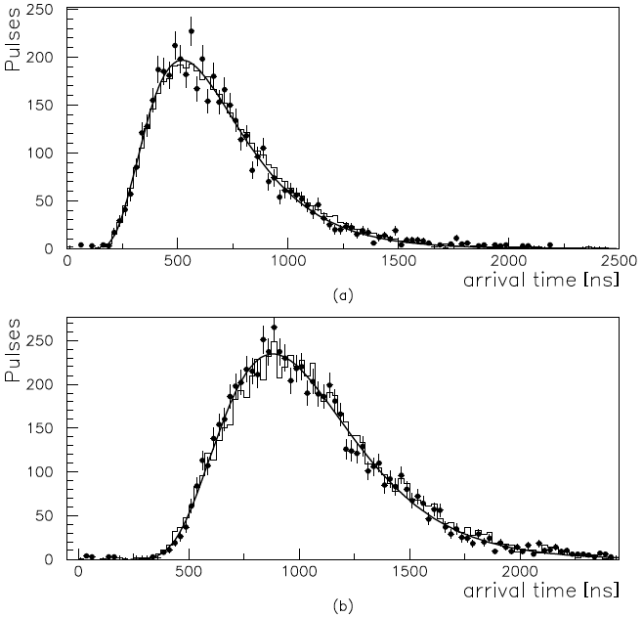
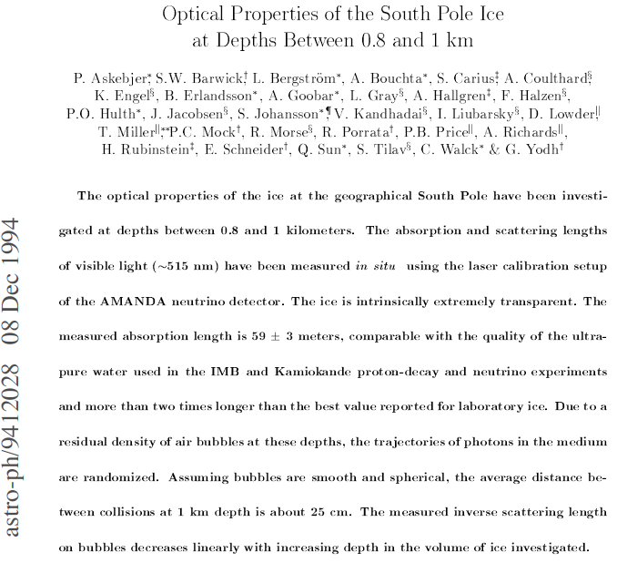
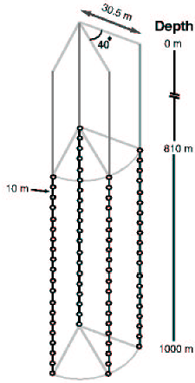
AMANDA-A: scattering on air bubbles!

Slide 3
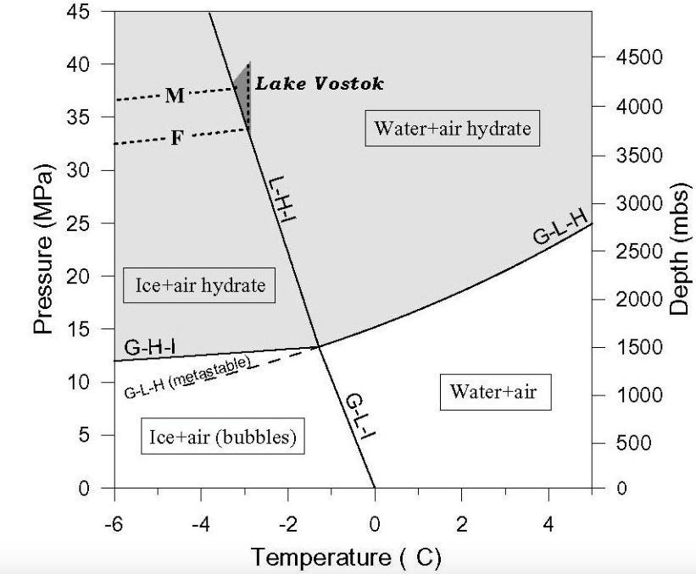
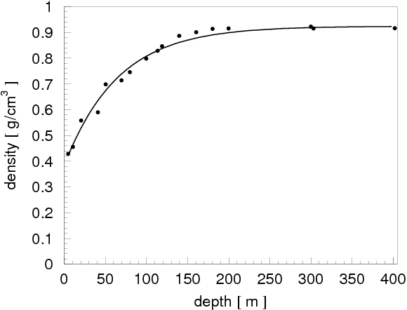
Trapped air bubbles
At some depth between 0 and 200 m air bubbles become trapped and are squeezed into the ice as ice packs under pressure.
-50…-20 C
are converted into air hydrates (at around 1350 m depth)

Slide 4
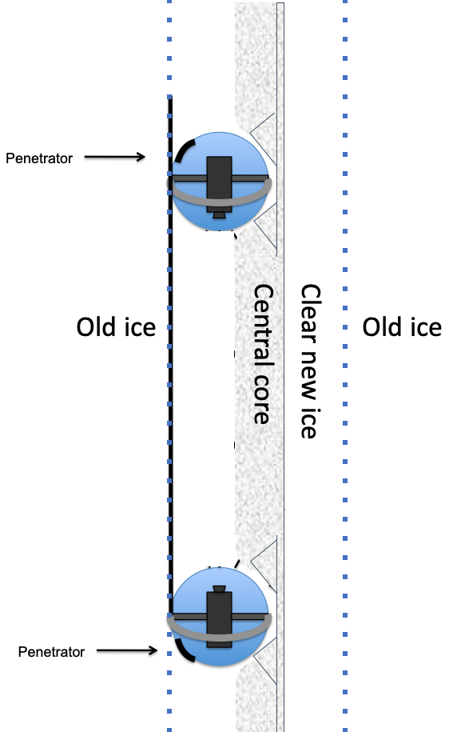
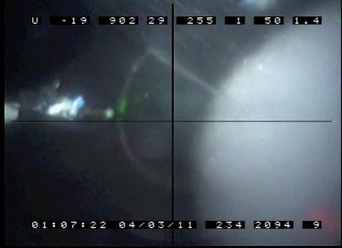
Refrozen hole ice is more complex than thought before the Swedish Camera took its pictures
We find:
DOM touches the hole wall, is 2/3 of the hole diameter
Most of the HI is transparent, except for the milky central column centered in the hole and 1/3 of hole diameter (referred to as HI in the following, starting with the next line)
HI diameter is ½ of DOM diameter

Slide 5
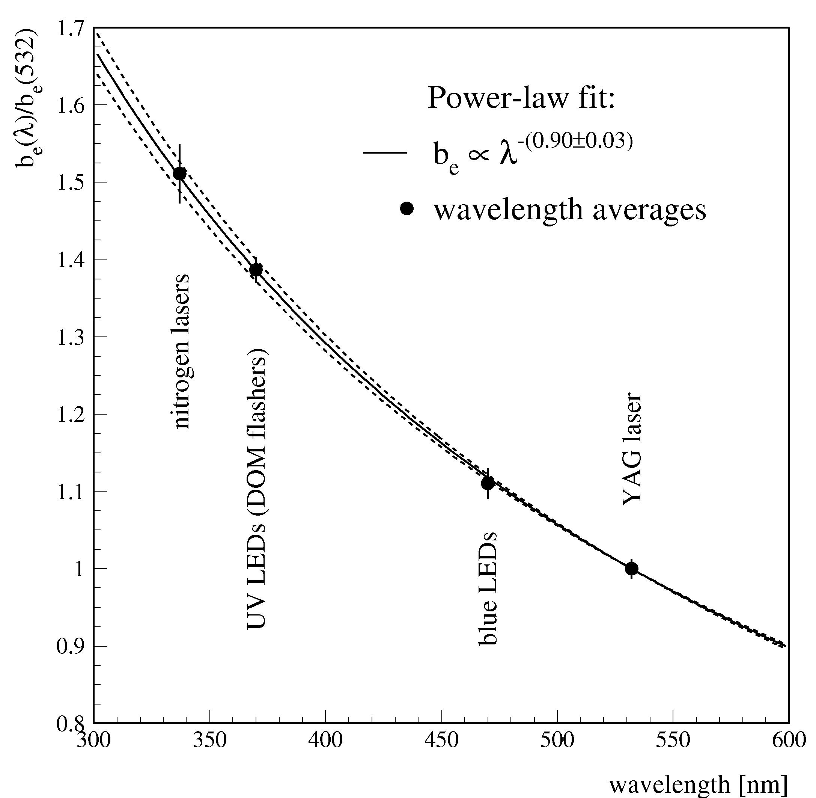
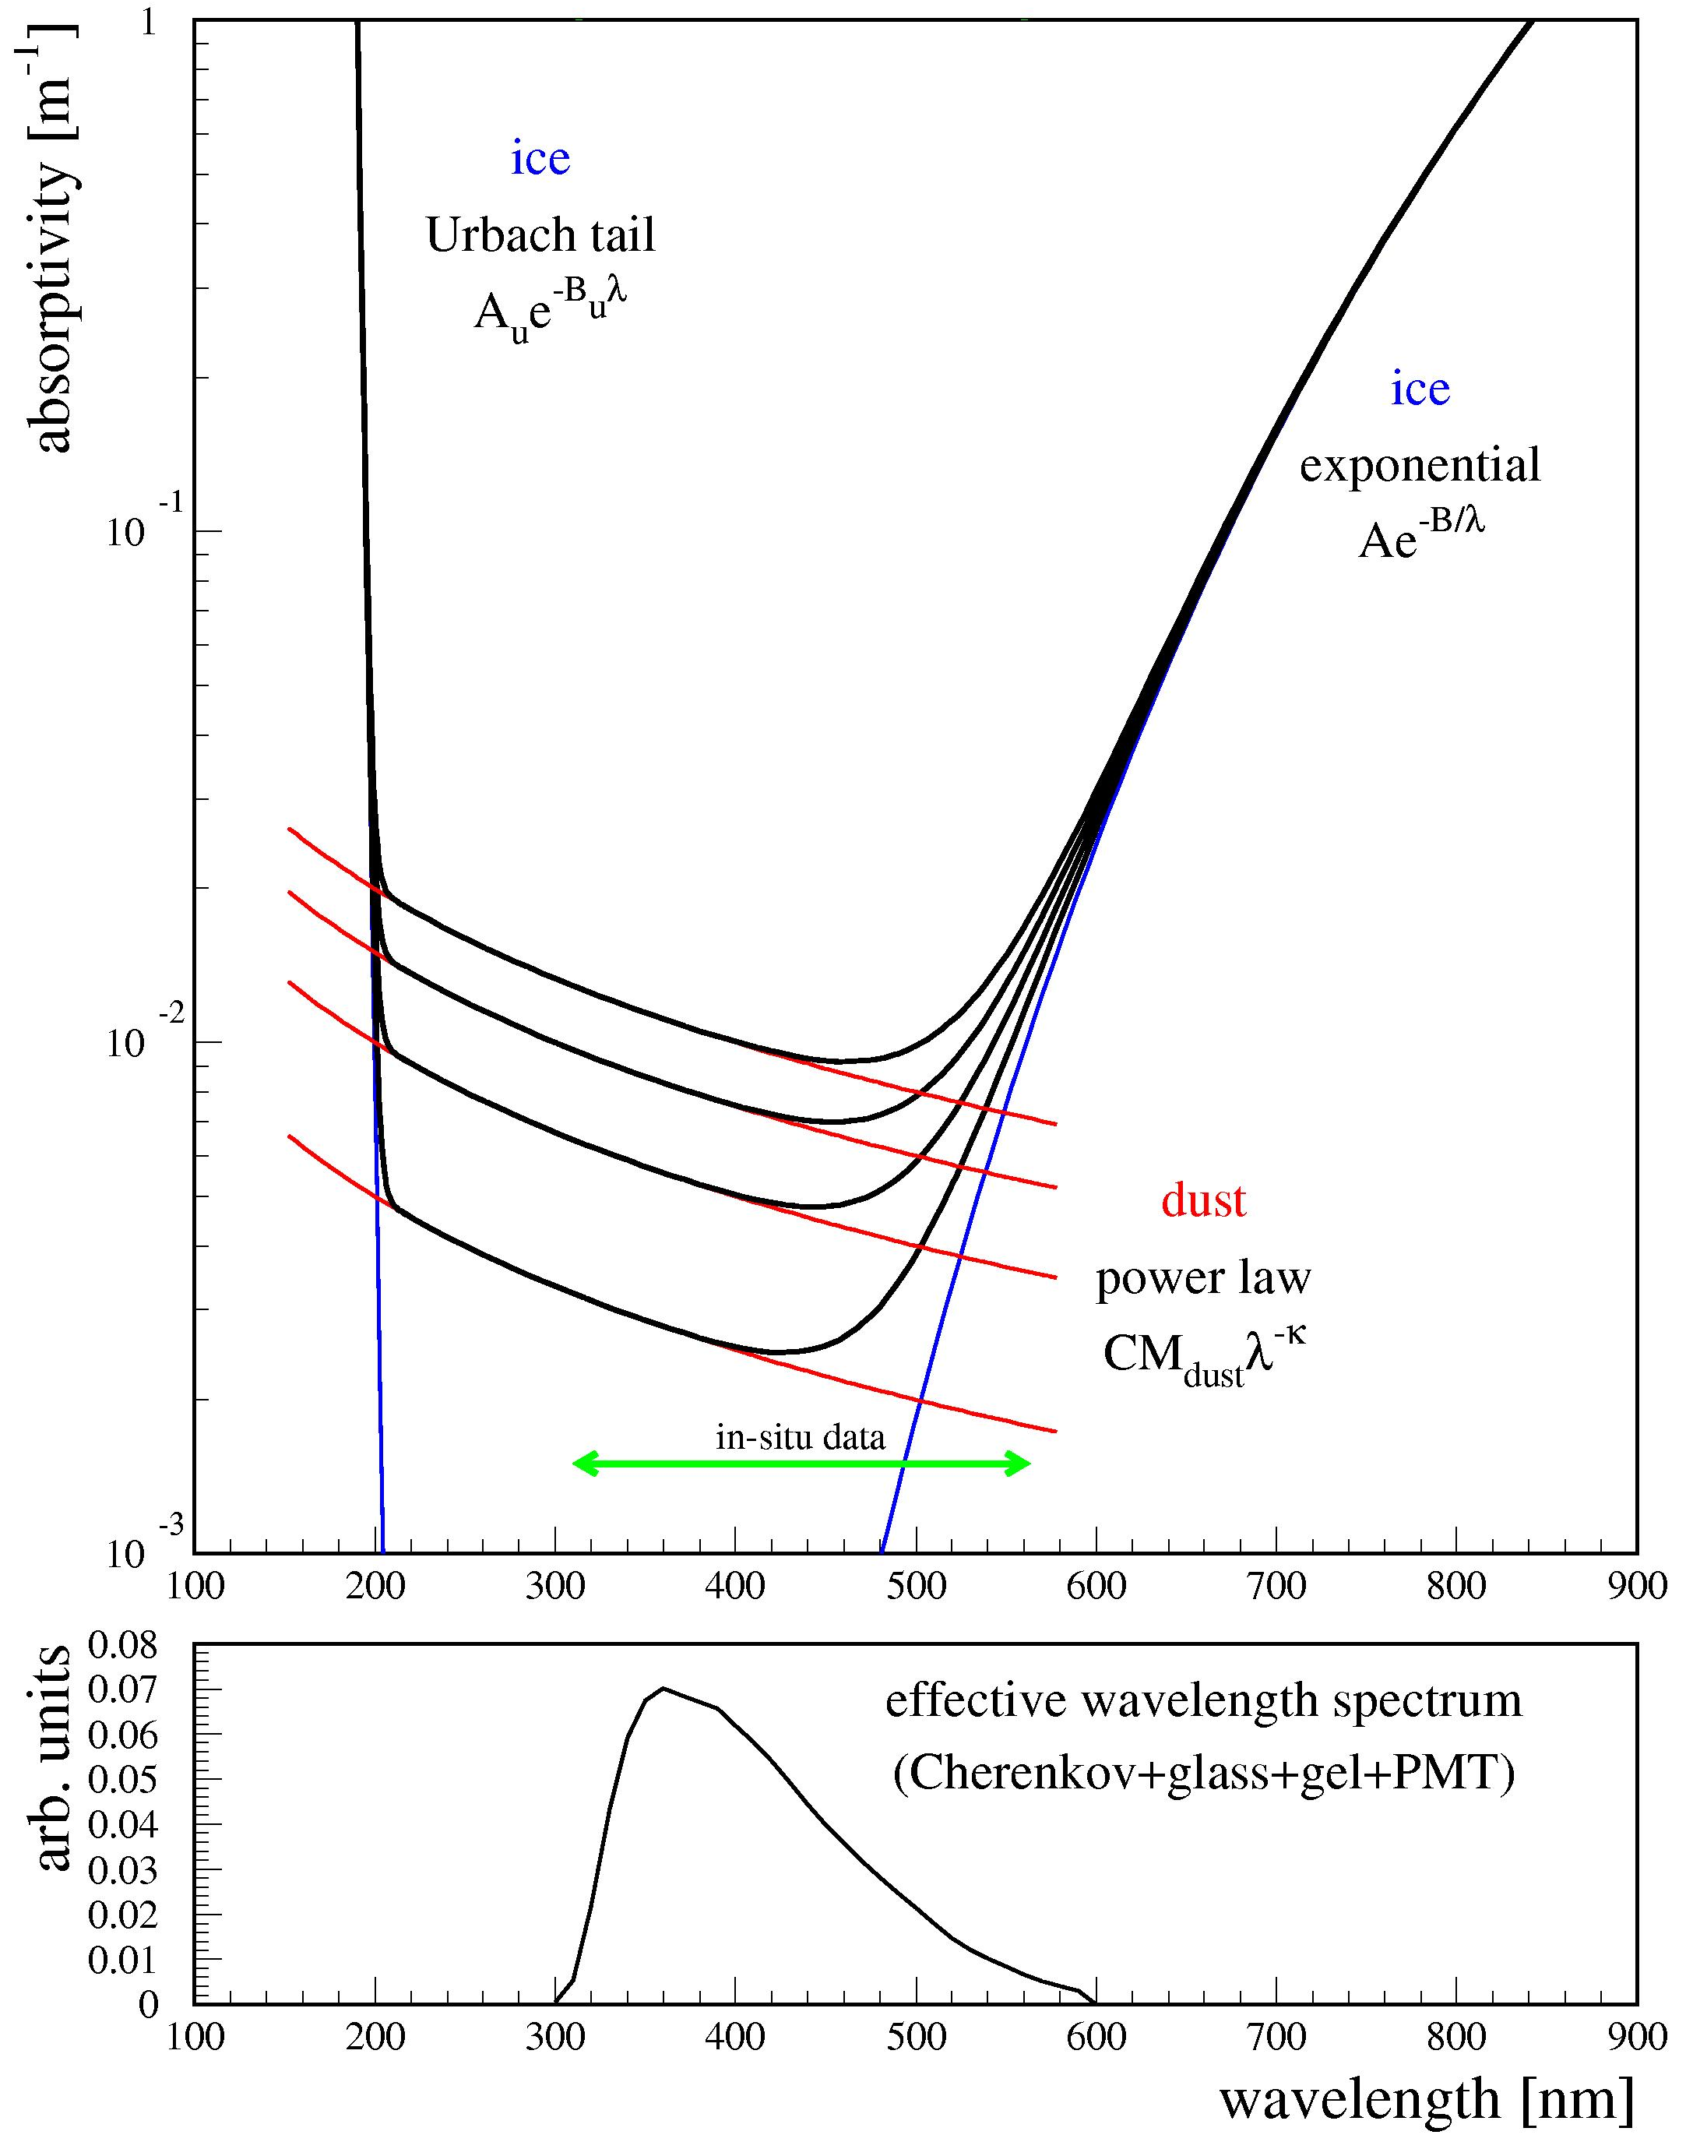
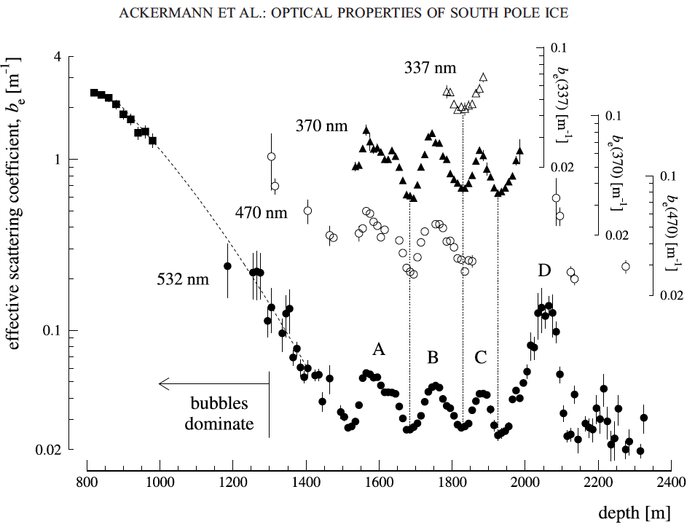
AMANDA-II: comprehensive layered ice model incl. wavelength dependence, identified dust contribution
Ice is extremely transparent between 200 nm and 500 nm
Scattering and absorption are determined by dust concentration
Wavelength dependence of dust scattering and absorption follow power law

Slide 6
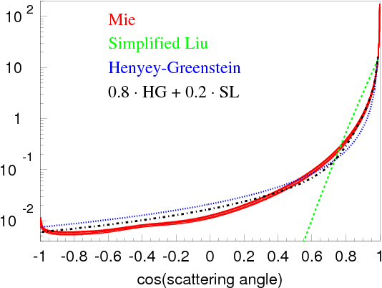


Mie scattering theory
Can be solved for spherically symmetric particles
Need to know:
refractive index
size distribution
Continuity in E, H: boundary conditions in Maxwell equations
We approximate and fit data with a mixture of:
e^{-ikr+iωt}
Simplified Liu:
e^{-i|k||r|}
r
Henyey-Greenstein:

Slide 7
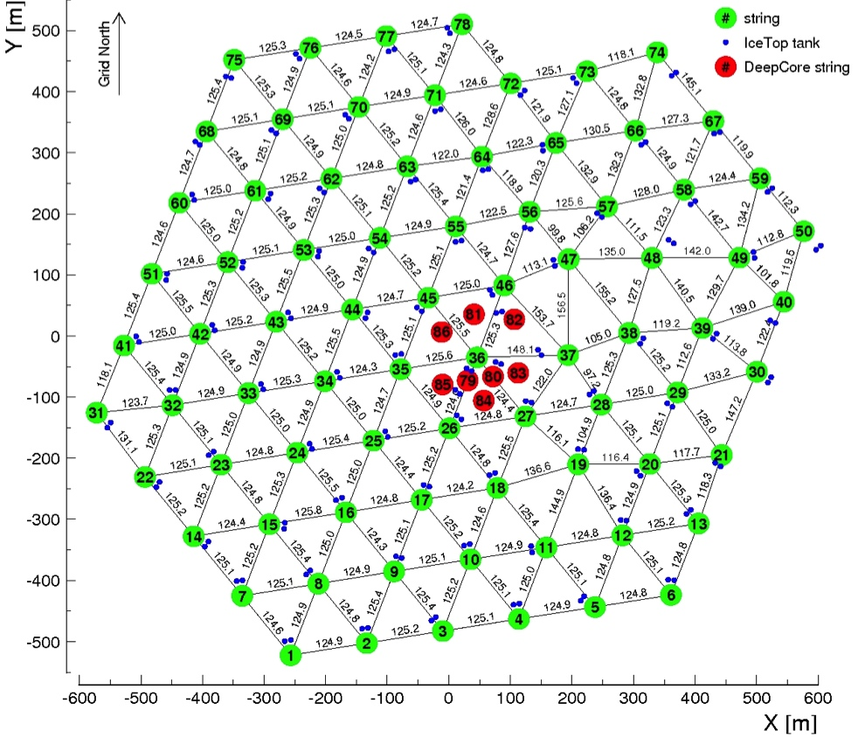
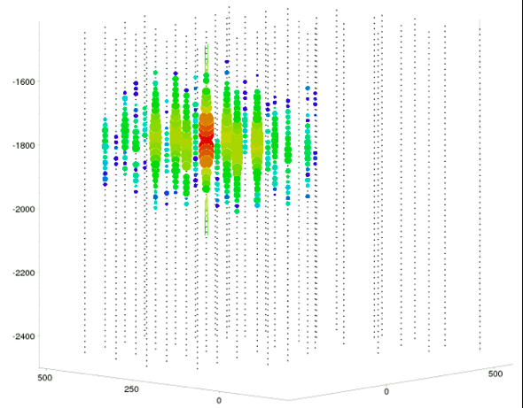
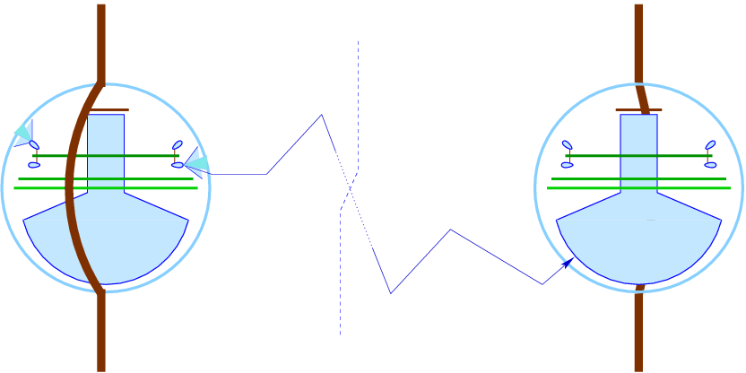
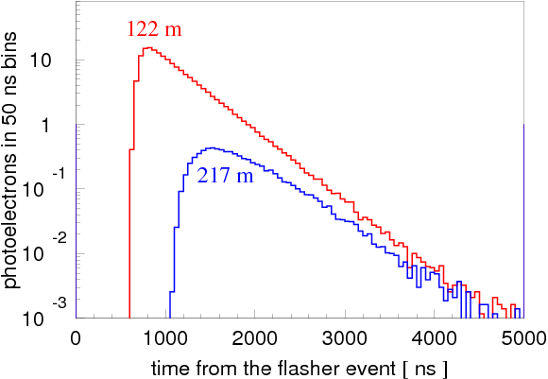
Fitting ice to in-situ data

Slide 8
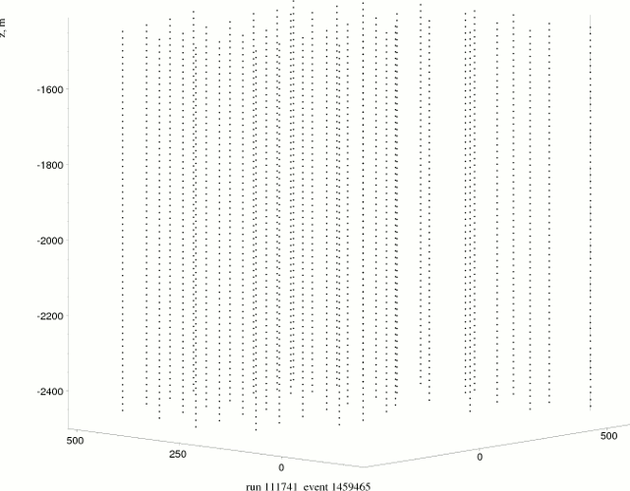
Fitting ice to in-situ data

Slide 9
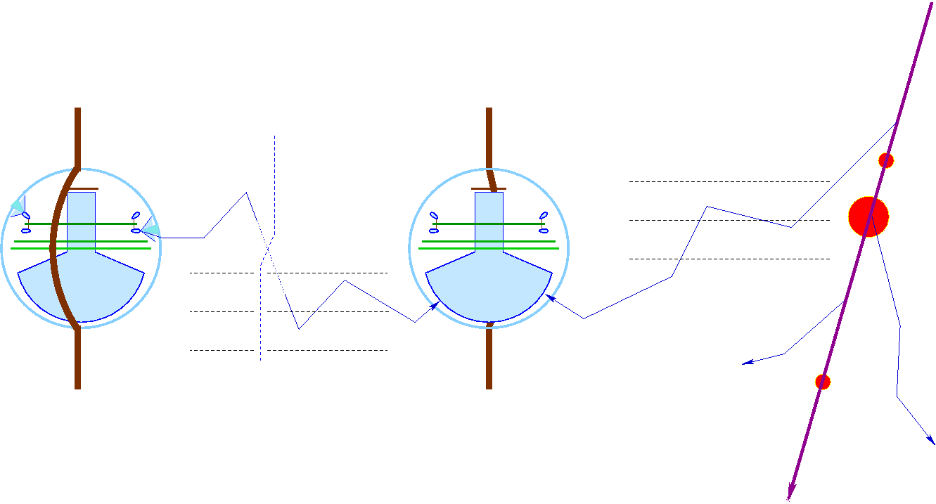
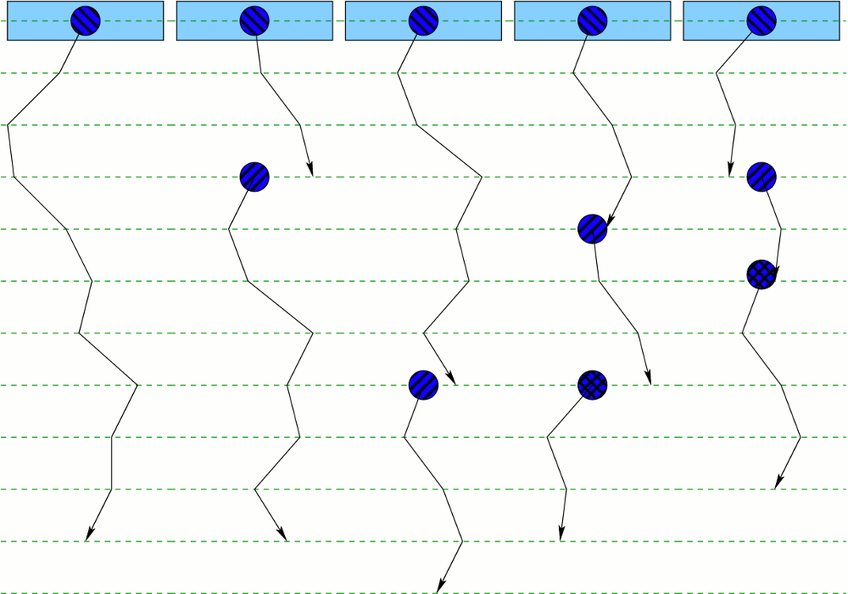
Simulation: Direct photon tracking
execution threads
propagation steps
scattering (rotation)
Same code used for both LED simulation/ice calibration and muon/physics data simulation
Because of the massively parallel nature of photon propagation, we use GPUs to accelerate simulation
photon absorbed
new photon created
(taken from the pool)
threads complete
their execution
(no more photons)

Slide 10
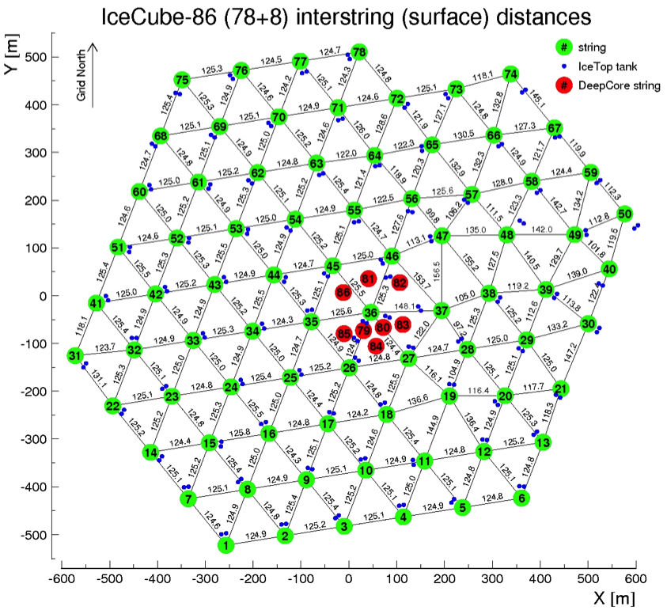
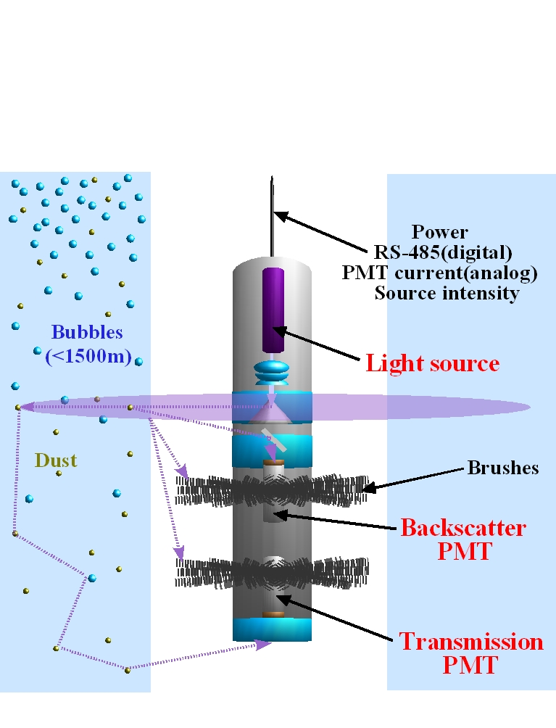
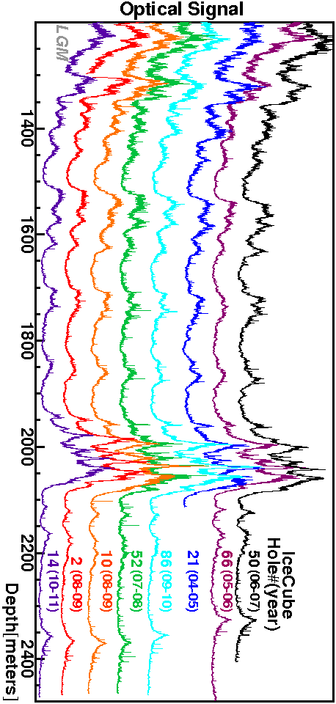
Dust logger discovers ice tilt
Dust logger
N
E
ice layer tilt direction: 225º SW
The ice layers (i.e. layers of ice with similar optical properties) change in depth by as much as 60 m when going from NE to SW corners of the detector

Slide 11
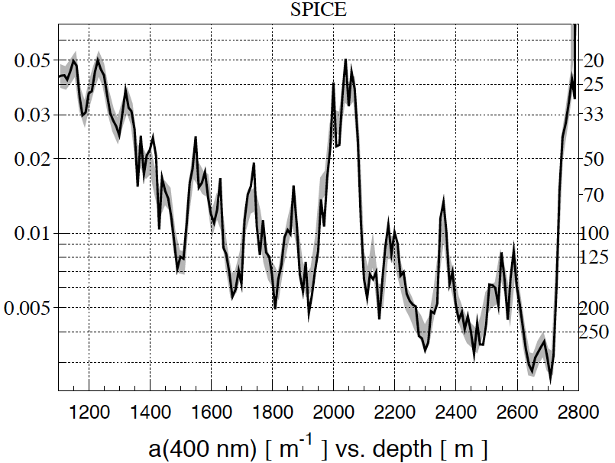
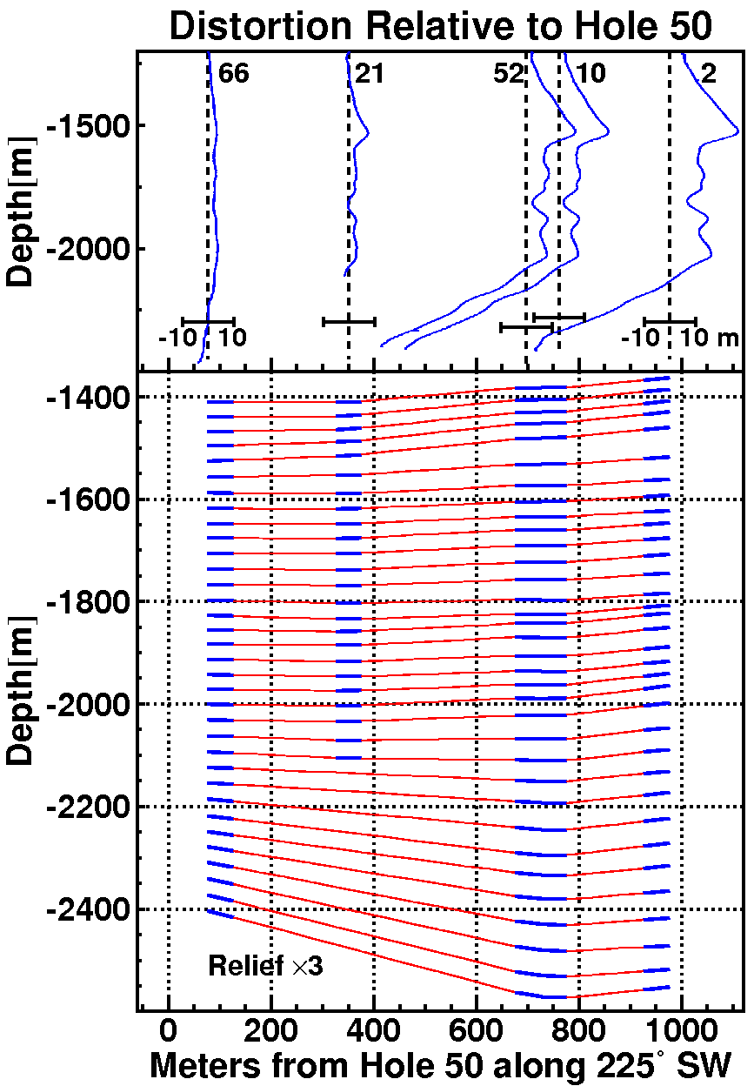
Correlation of fitted optical properties with dust logger data
black line: fit to flasher data
gray band: scaled merged dust log
(m⁻¹)
(m)
extrapolation region
fit region (inside detector)
(outside detector)

Slide 12
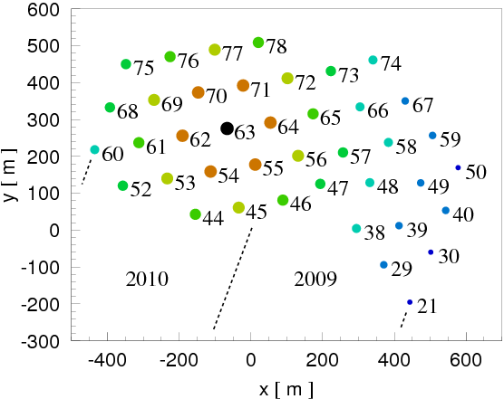
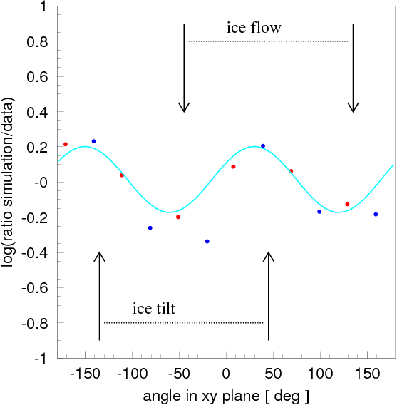
Ice anisotropy (ICRC 2013)
flashing string
+
-
62
53
72
54
64
71
70
-
45
55
56
77
69
+
10-20% per 100 m azimuth modulation in charge observed!

Slide 13
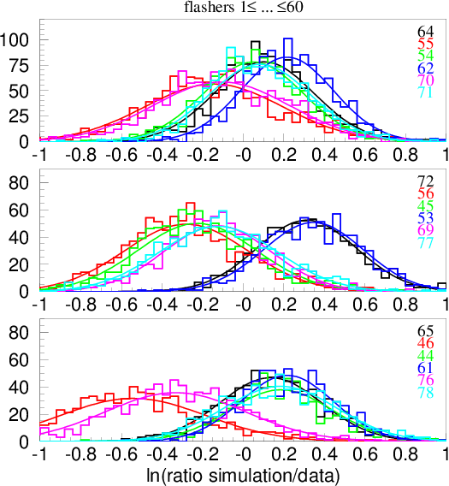
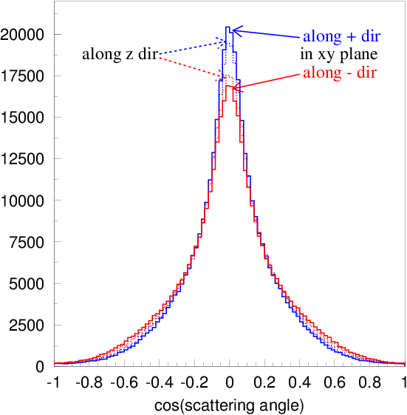
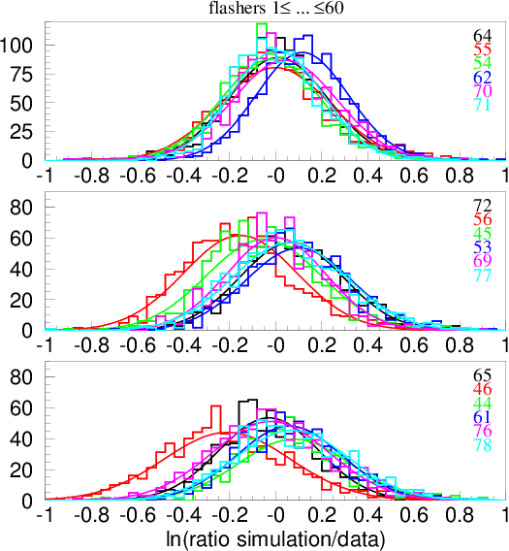

Charge variation vs. distance
SPICE Mie [SPICE Paper]
SPICE Lea
~ 125 m
~ 217 m
~ 250 m
Scattering function:

Slide 14
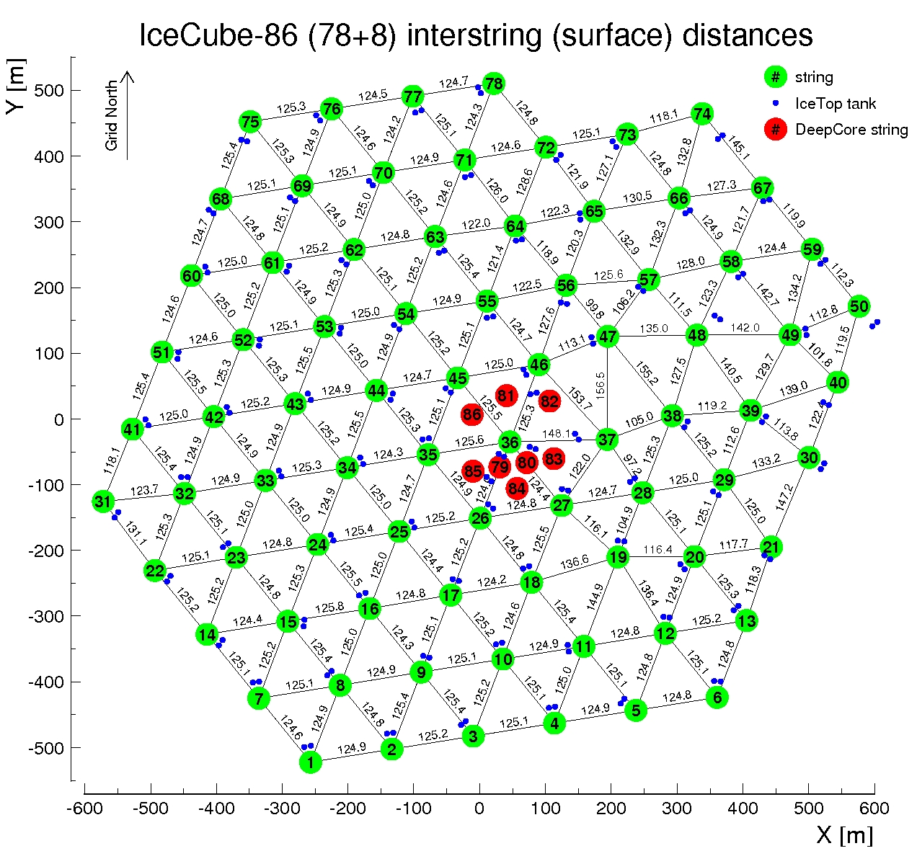
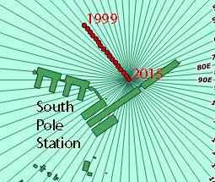
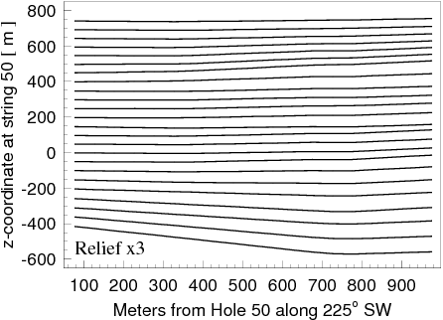
Glacial ice flow, ice layer tilt at the South Pole
N
Ice Layer tilt direction
225º SW
E
Ice flow direction
41º NW
Less attenuation
41º NW

Slide 15
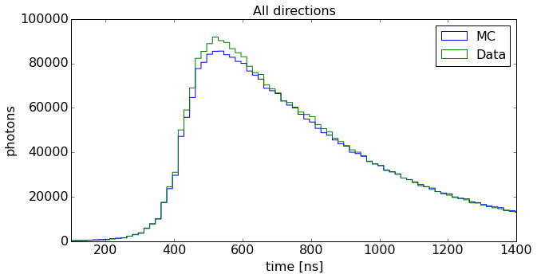
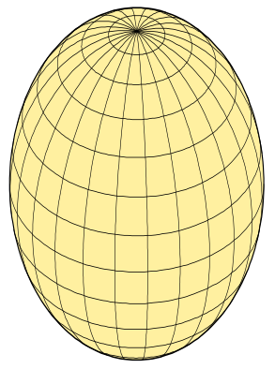
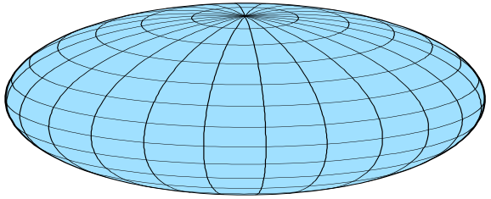
Models of optical ice anisotropy in IceCube
scattering-based
Scattering (mainly): direction dependent scattering function (ICRC 2013)
Absorption (mainly): direction dependent absorption (studied in 2018)
Introduced depth-dependence (2017)
Discrepancies between data and simulation remain
Cannot simultaneously fit total charge and
arrival time distribution to statistical precision
SPICE Lea, 3.2.x
Absorption driven
absorption-based
prolate
oblate
SPICE EMRM
Scattering driven

Slide 16
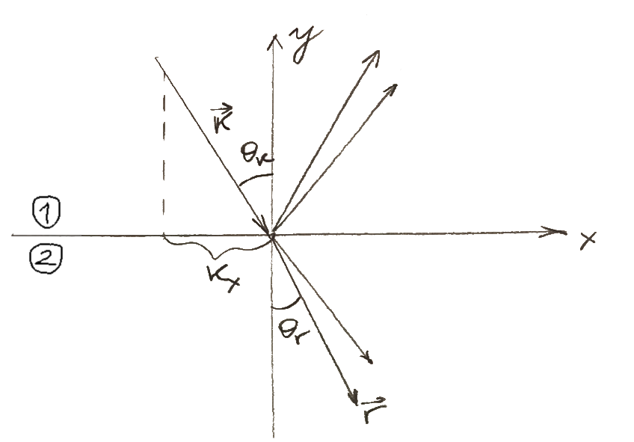
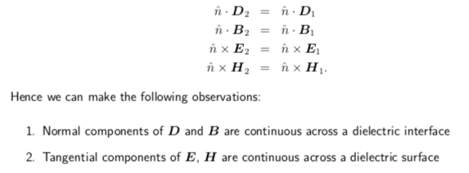
Birefringence
Ice is a birefringent material with n_{e}-n_{o}=0.0015. This tiny difference builds to a macroscopic effect due to 1000s of ice crystal boundaries crossed per meter of traveled distance
At each grain boundary every ray is split into two reflected and two refracted rays, one ordinary and one extraordinary ray each
Wave vector component parallel to surface is conserved,
norm is proportional to the refractive index
Poynting vectors are derived from wave vectors and boundary conditions
Outgoing ray is randomly sampled from Poynting vectors according to Poynting theorem (Poynting vector component through the plane is conserved)

Slide 17
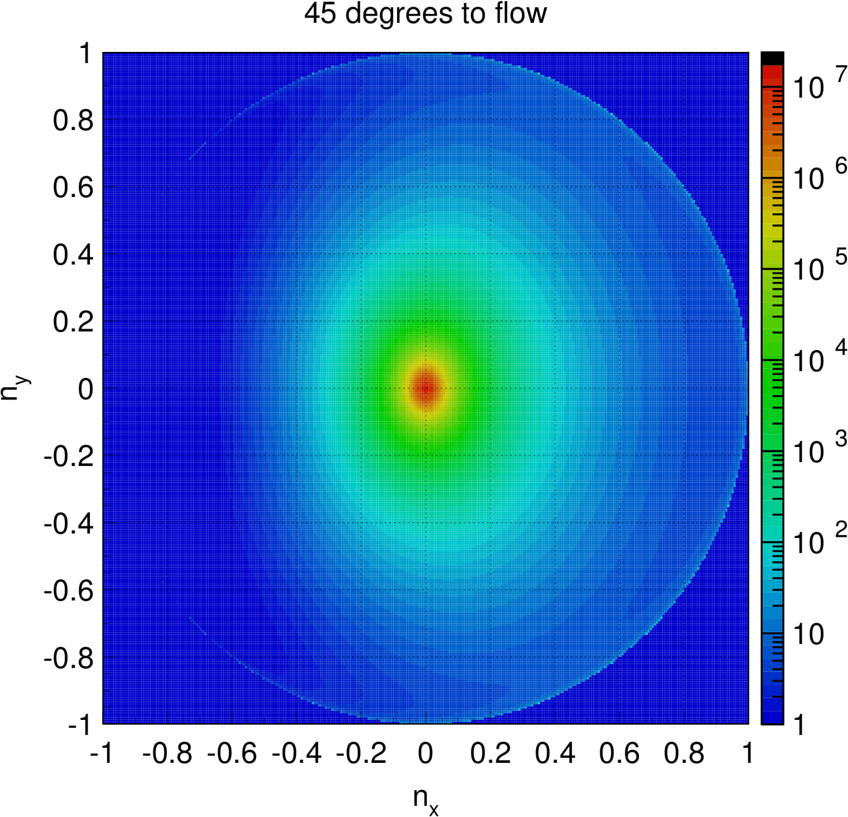
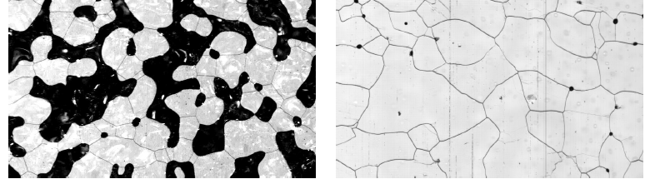
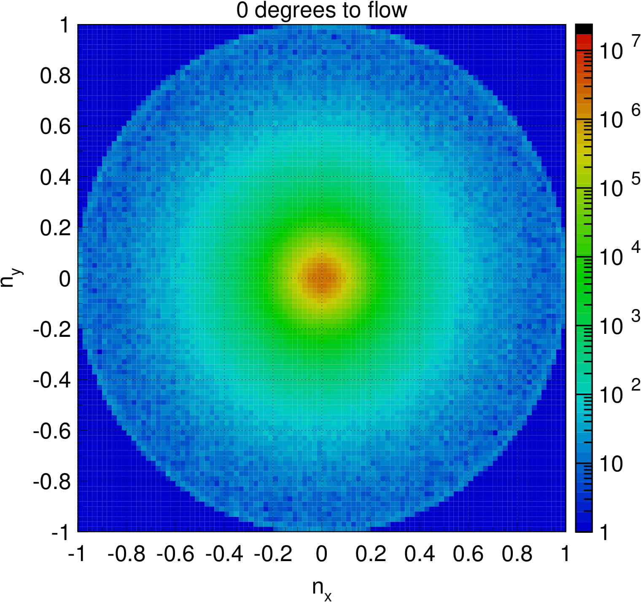
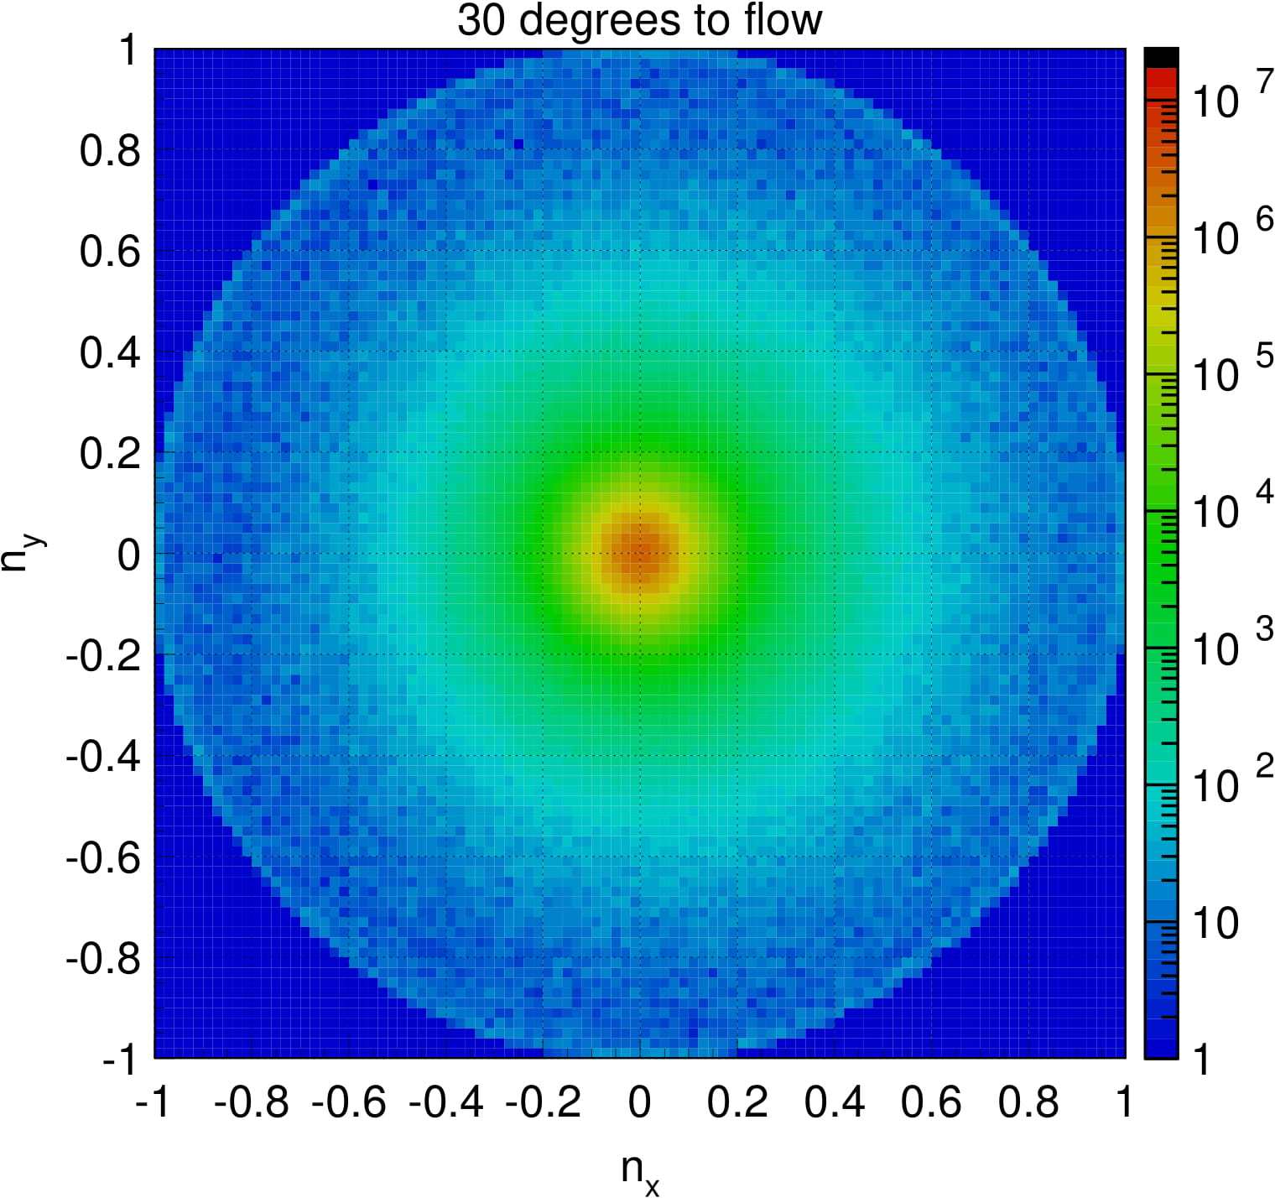
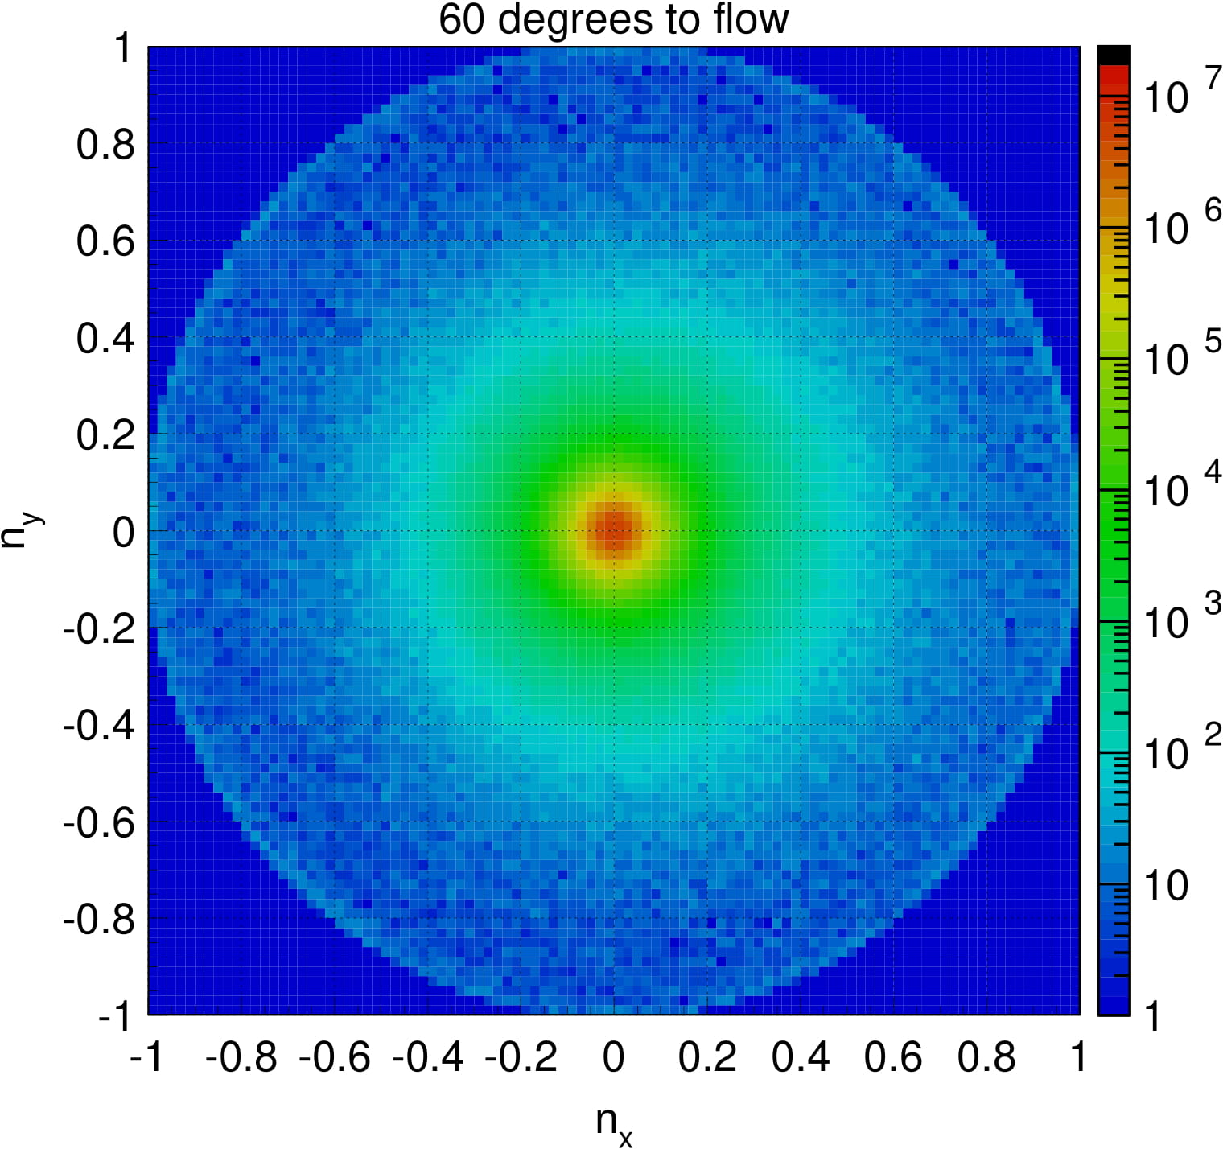
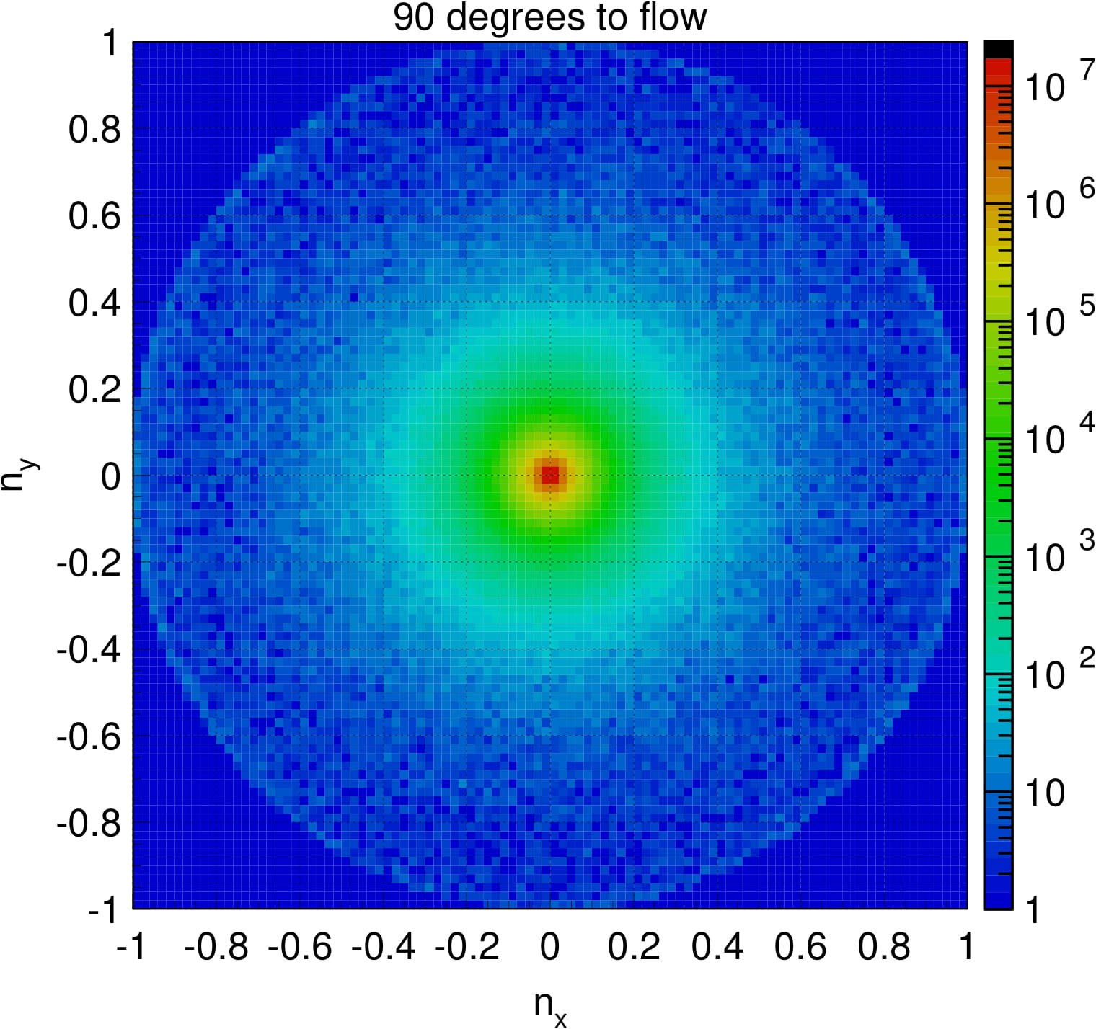
Scattering patterns birefringent ice
Running MC simulation with realistic crystal size, elongation, and orientation distributions (correlated to flow direction):
Diffusion is largest on flow axis and smallest orthogonal to it
Photons on average get deflected towards the flow axis
→ photons effectively fly a curve towards the flow axis
after ~ 1 m of propagation:
towards flow
along flow
orthogonal to flow

Slide 18
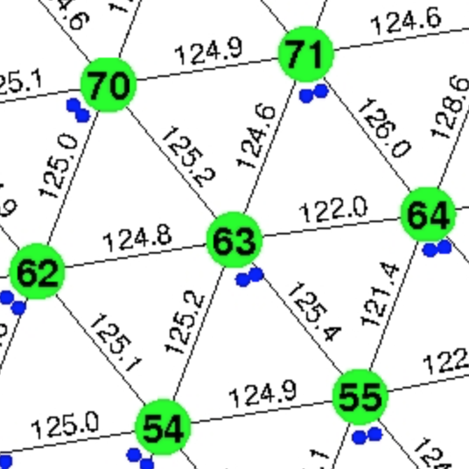
Our best tool to gauge the quality of our description of anisotropy
Next slide shows average waveform for nearby emitter-receiver DOM pairs aligned with the two directions (along and perpendicular to ice flow).
This might be the best tool to rank ice models on how well they describe the anisotropy
Here used string pairs one ~125 m spacing away (excludes DeepCore and far distances)
134 string pairs along flow
272 string pairs perpendicular to flow
Using DOM pairs at the same position (depth)
more attenuation
Less attenuation

Slide 19
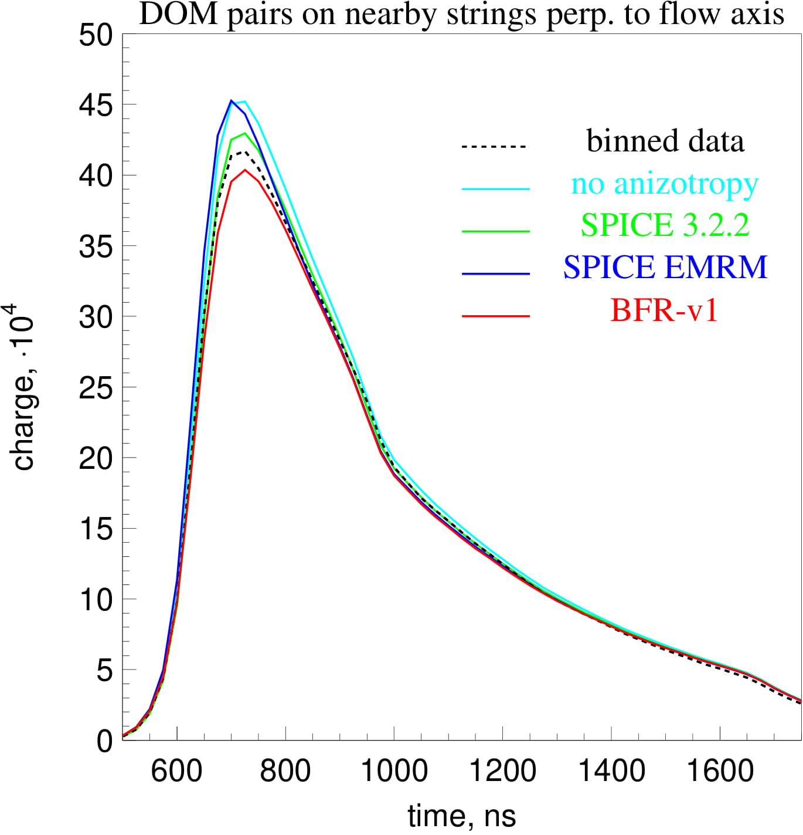
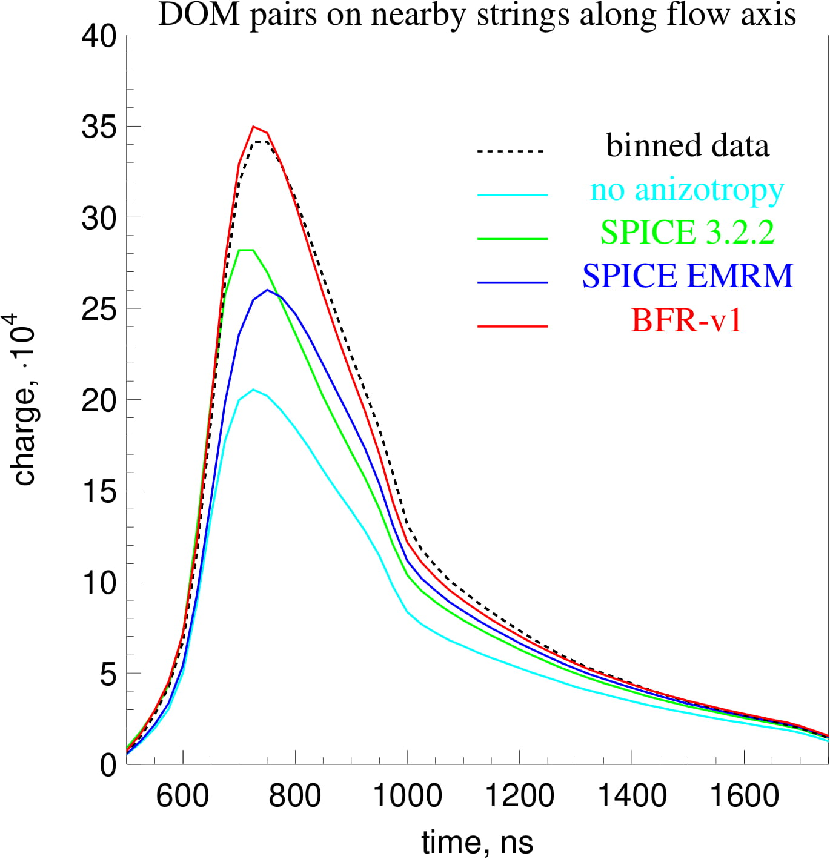
nominal

Slide 20
other metrics of ice model comparison
nominal
Ice model | No anisotropy | SPICE 3.2.2 | SPICE EMRM | Birefringence 1
Saturated llh (ndof=60848) | 73334 | 64006 | 59418 | 57546
Model error (10 … 500 p.e.) | 27.0% | 17.2% | 16.2% | 15.6%
All numbers shown here calculated with 10 simulated flasher events per configuration, 60848 configurations (5160 DOMs x 12 flasher LEDs minus dead DOMs/broken LEDs)
Used:
lab measured angular emission profile (no pattern unfolding)
single LED orientations previously fitted with SPICE 3.2.2
nominal cable shadow (between LEDs 11 and 12) and no DOM tilt
nominal RDEs (relative DOM efficiencies)
So, the numbers might be higher than shown elsewhere, but compare to each other

Slide 21
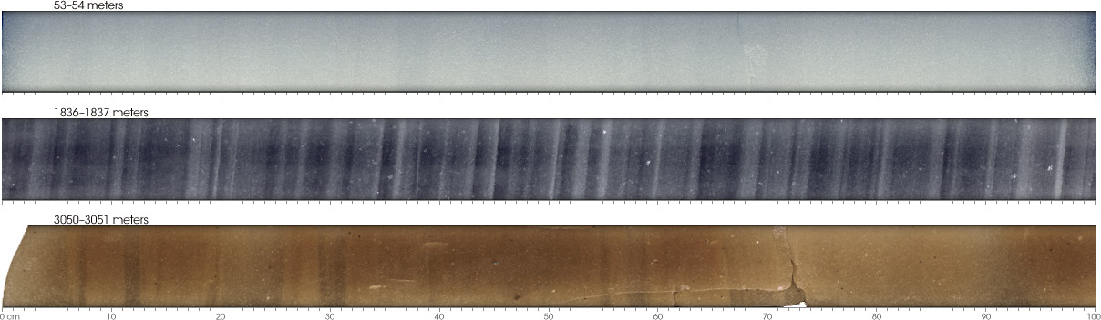
Timeline
AMANDA ice models: model error
bulk, f125, mam, mamint, stdkurt, sudkurt, kgm, …
millennium (published 2006) → AHA (2007) 55%
IceCube ice models:
WHAM (2011) 42%
SPICE 1 (2009) 29%
SPICE 2, 2+, 2x, 2y (2010) added ice layer tilt
SPICE Mie (2011) fit to scattering function 29%
SPICE Lea (2012) fit to scattering anisotropy 20%
SPICE (Munich) (2013) 7-string, LED unfolding 17%
SPICE³ (CUBE) (2014) llh fixes, DOM sensitivity fits 11%
SPICE 3.0 (2015) improved RDE, ang. sens. fits 10%
SPICE 3.1, 3.2 (2016) 85-string, correlated model fit <10%
SPICE HD, 3.2.2 (2017) direct HI and DOM sens., cable, DOM tilt
SPICE EMRM (2018) absorption-based anisotropy single
SPICE BFR (2020) birefringence-based anisotropy LEDs
Model error (precision in charge prediction): <10%
Extrapolation uncertainty: 13% (sca) / 15% (abs)
Linearity: < 2% in range 0.1 … 500 p.e.

Slide 22
Remarks
Our understanding of optical properties of the South Pole ice has come a long way in the last 30 years! Studied with fixed in-situ light-emitting devices and with special-purpose dust loggers in AMANDA-A, AMANDA-II, and IceCube detectors, and being an important part of the science plan for the future extensions. We were also allowed to lower several devices into the nearby SPICECORE hole to study anisotropy, UV-response, and fluorescence of ice.
Scattering and absorption of ice come from intrinsic ice and impurity contributions.
The entire ice is moving (flowing) downhill at 10 m/year sheet (at all depths relevant to IceCube). This likely is the source of interesting effects that we discovered over the years, in particular the tilt of the ice layers and anisotropy.
We have gone through several models that all describe the anisotropy effect, to various degrees of success. Scattering-based, and absorption-based, and now thought to be due to birefringence.
Birefringence-based model of anisotropy is well grounded on the known ice structure. Albeit individual photon direction changes are tiny, 1000s of crystal boundary crossings happen per every meter of photon path, resulting in a measurable macroscopic effect.

Slide 23
DOM orientations, hole ice, etc.
backup slides

Slide 24
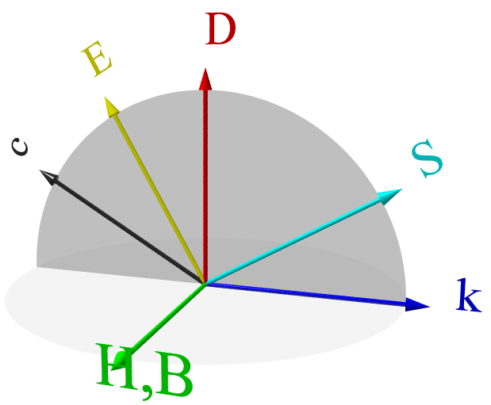


Birefringence
Ice is a birefringent material:
Light is split into an ordinary and an extraordinary rays with respect to the (optical) c-axis, these have orthogonal polarizations
The refractive index of the extraordinary ray is direction dependent
The extraordinary ray exhibits dispersion between the wave vector
and the Poynting vector
Physics of Ice, Victor F. Petrenko

Slide 25


Depth-dependent fit to the effective scattering length of the hole ice
deep
shallow
Very little depth dependence!

Slide 26


Identifying a problem region

Slide 27


Identifying a problem region: using unfolded profiles
cable
scan method
unfolding x10
unfolding x100

Slide 28


DOM orientations and hole ice positions
Direction to hole ice column

