Slide 1


IceCube Event Reconstruction
Bunheng Ty
16 June 2020
ty@wisc.edu

Slide 2
Acknowledgement
Many slides adapted from
Event Reconstruction, Bootcamp 2019
Thanks, Tianlu

Slide 3
IceCube
125 m string spacing
Digital Optical Module (DOM)
17 m DOM spacing
dense in-fill array
5160 DOMs
Fully operational in 2011

Slide 4
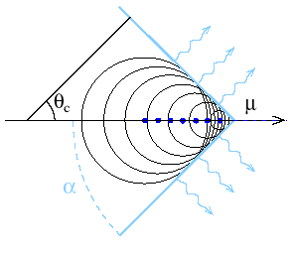
Detection Principles
High energy particles interact with the ice, producing Cherenkov photons
DOMs detect photons

Slide 5
Detection Principles
High energy particles interact with the ice, producing Cherenkov photons
DOMs detect photons
Reconstruction:
Piecing information from the DOMs for
energy
direction
topology

Slide 6
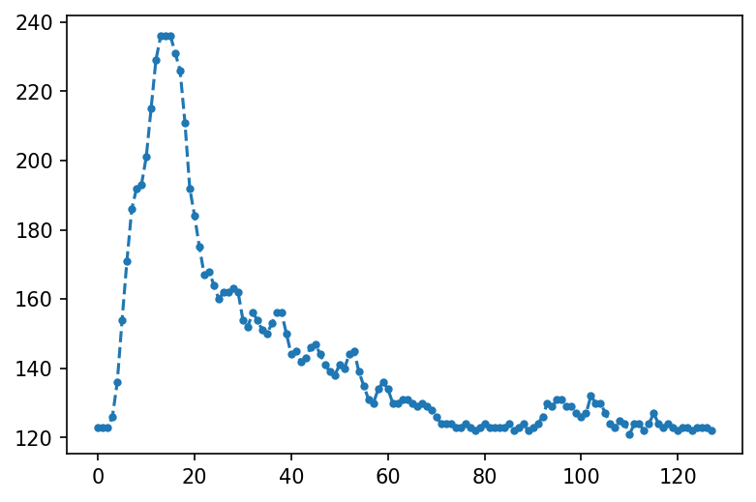
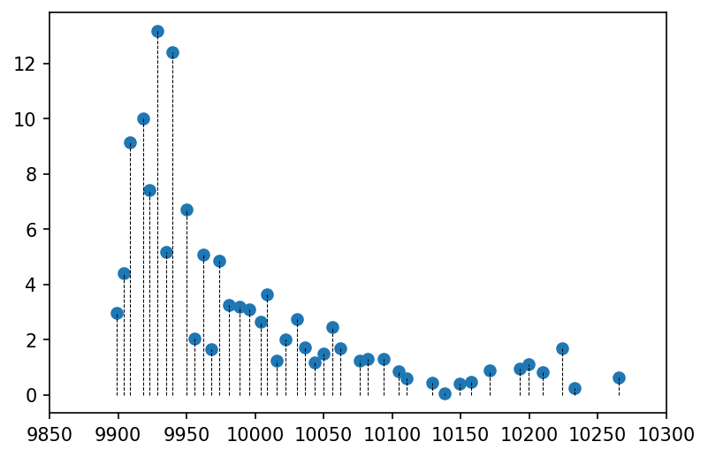
From voltage signal to photon counts
DOM raw data (PMT waveform)
“pulse series”
Wavedeform
photons
ADC counts
ADC time
time (ns)
PMT + wavedeform = photon counter

Slide 7
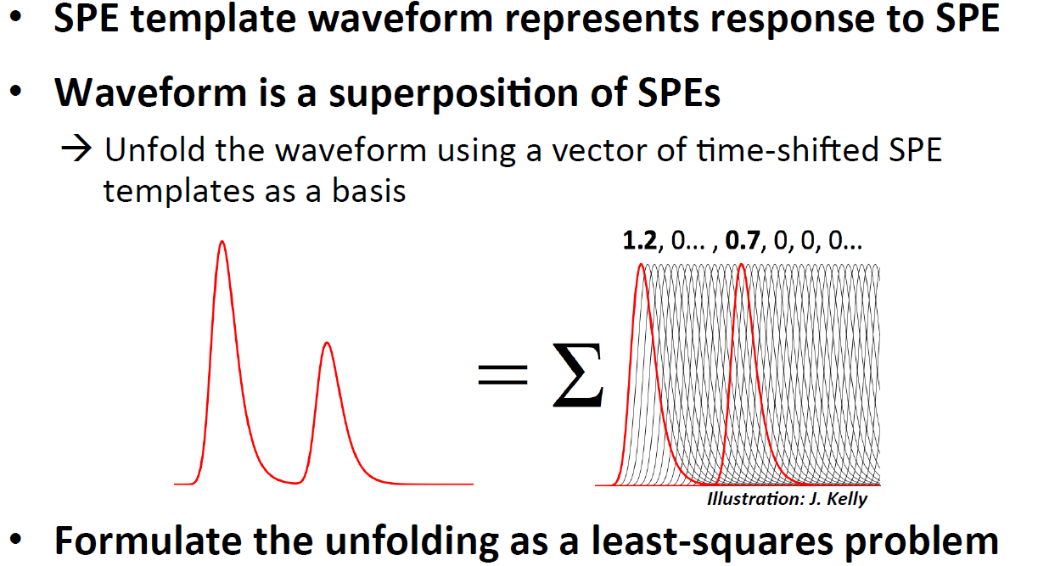
Wavedeform
Wavedeform Improvements, Jim Braun 2015

Slide 8
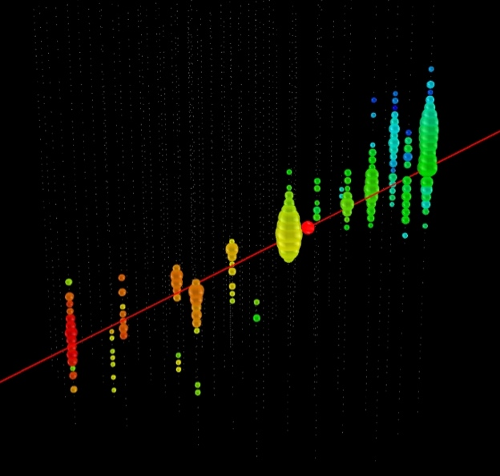
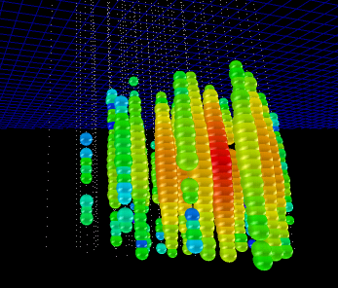
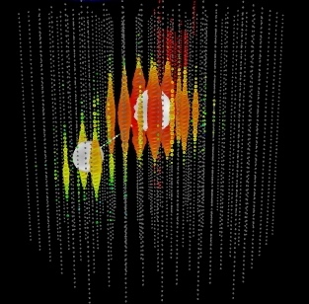
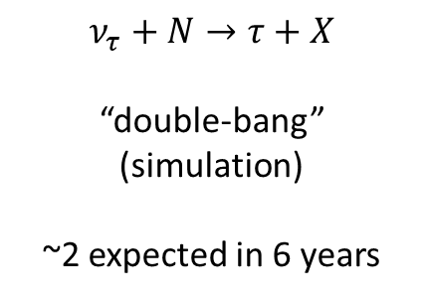
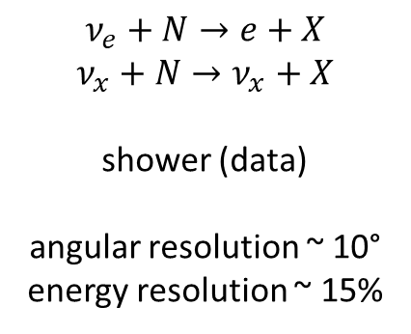
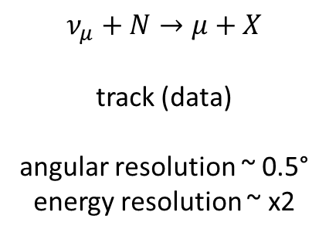
IceCube Event Topologies
CC muon neutrino
NC or CC electron neutrino
CC tau neutrino
$$ν_{e}+N→e+X$$
$$ν_{x}+N→ν_{x}+X$$
shower (data)
angular resolution ~ 10°
energy resolution ~ 15%
$$ν_{μ}+N→μ+X$$
track (data)
angular resolution ~ 0.5°
energy resolution ~ x2
$$ν_{τ}+N→τ+X$$
“double-bang” (simulation)
~2 expected in 6 years
Notes:
Expected taus

Slide 9
Track vs. Cascade
Line-like emission vs. point-like emission
A track is due to a muon(s).
A cascade can be due to anything:
  Neutrino DIS with a nucleus
  Muon stochastic loss
Only rarely that an IceCube event contains no track. So track reconstruction is important, even if only for the purpose of background rejection.

Slide 10
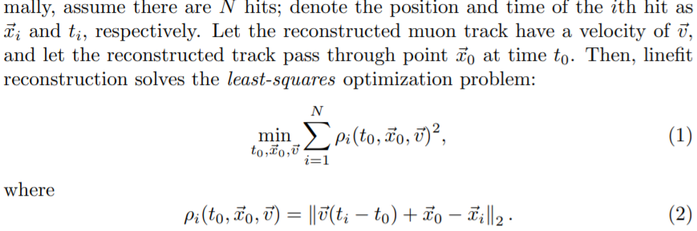
Linefit
A relatively simple but robust and fast track reconstruction algorithm
  Minimize sum of square distances, muon to DOMs
  Technically a least square problem, but analytically solvable.
    So just plug in numbers into the formulas

Slide 11
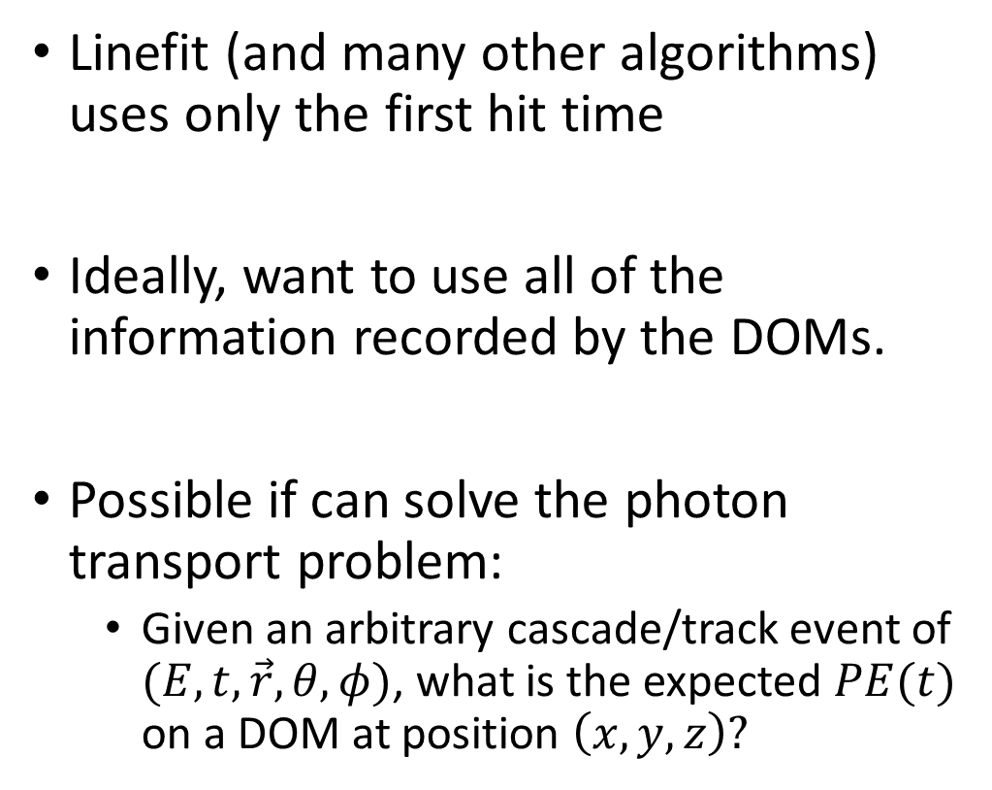
Challenge: use the whole pulse series
Linefit (and many other algorithms) uses only the first hit time
Ideally, want to use all of the information recorded by the DOMs.
Possible if can solve the photon transport problem:
  Given an arbitrary cascade/track event of $(E, t, \vec{r},θ,φ)$, what is the expected $PE(t)$ on a DOM at position $\left(x,y,z\right)?$
photons
time (ns)

Slide 12
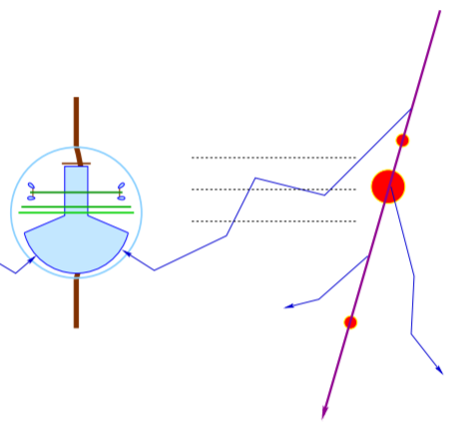
Expected photon flux at a DOM
Analytical approximation: Pandel functions
  Probably would work well in water
  Unfortunately, our medium is inhomogeneous ice
  SPEfit, CscdLlh, and some others…
Our modern solution
Monte Carlo simulation: ppc
  (There’s a Wikipedia page on MC photon transport)

Slide 13
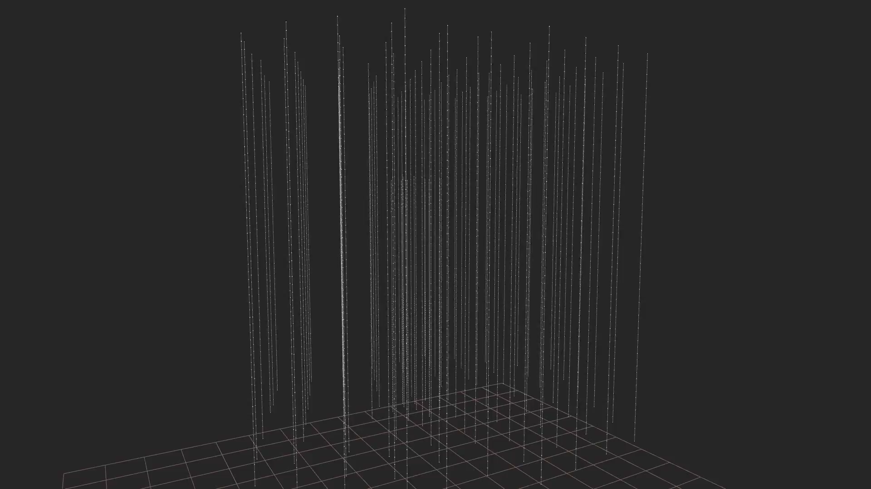

A Track simulation
muons: long paths in the detector → track

Slide 14
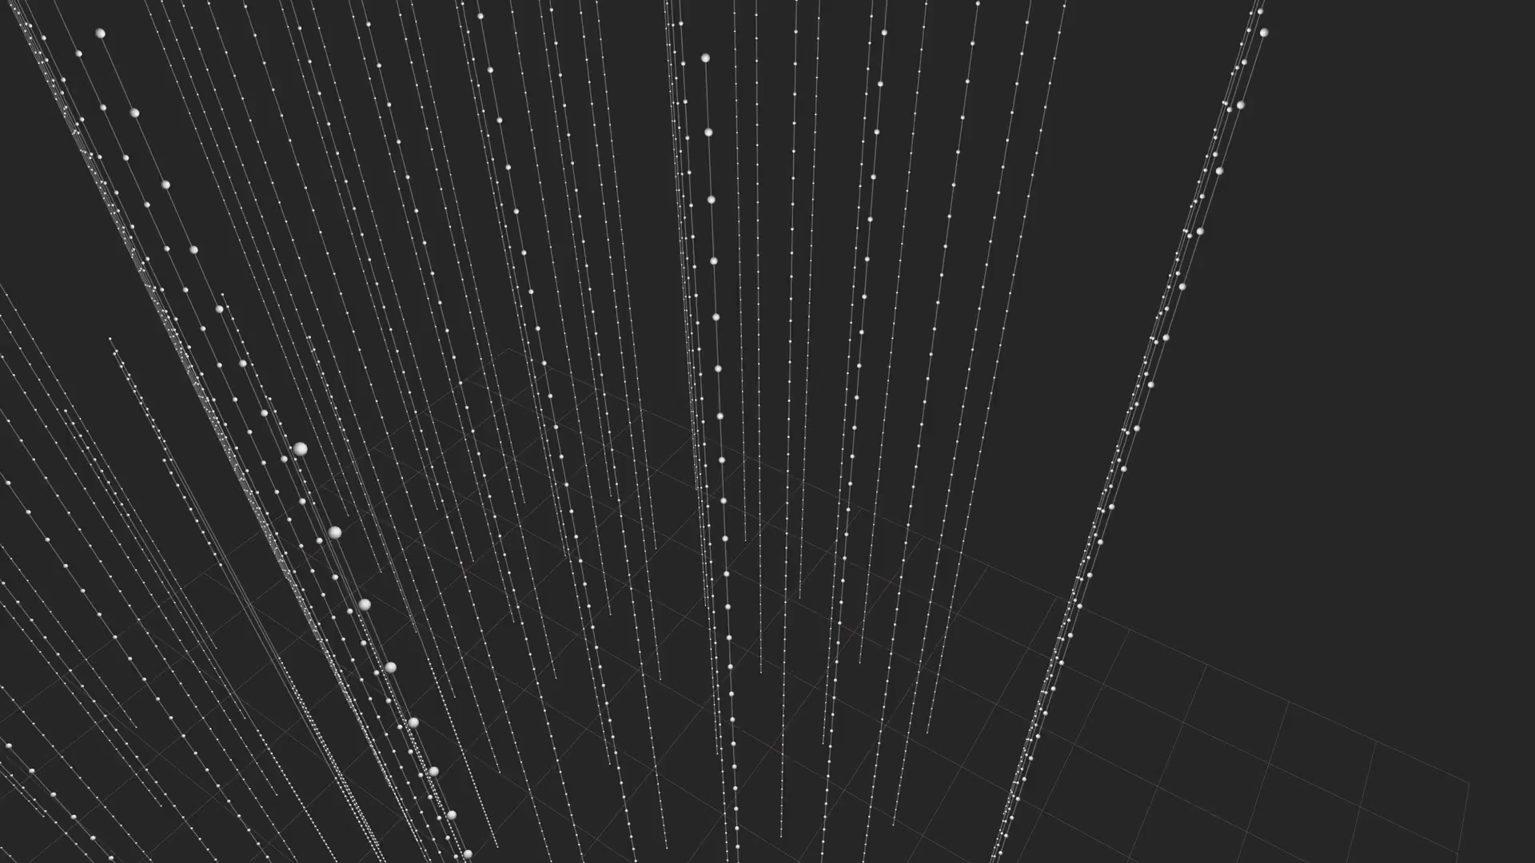
A Cascade Simulation
electrons/hadrons: shower of light → cascade

Slide 15
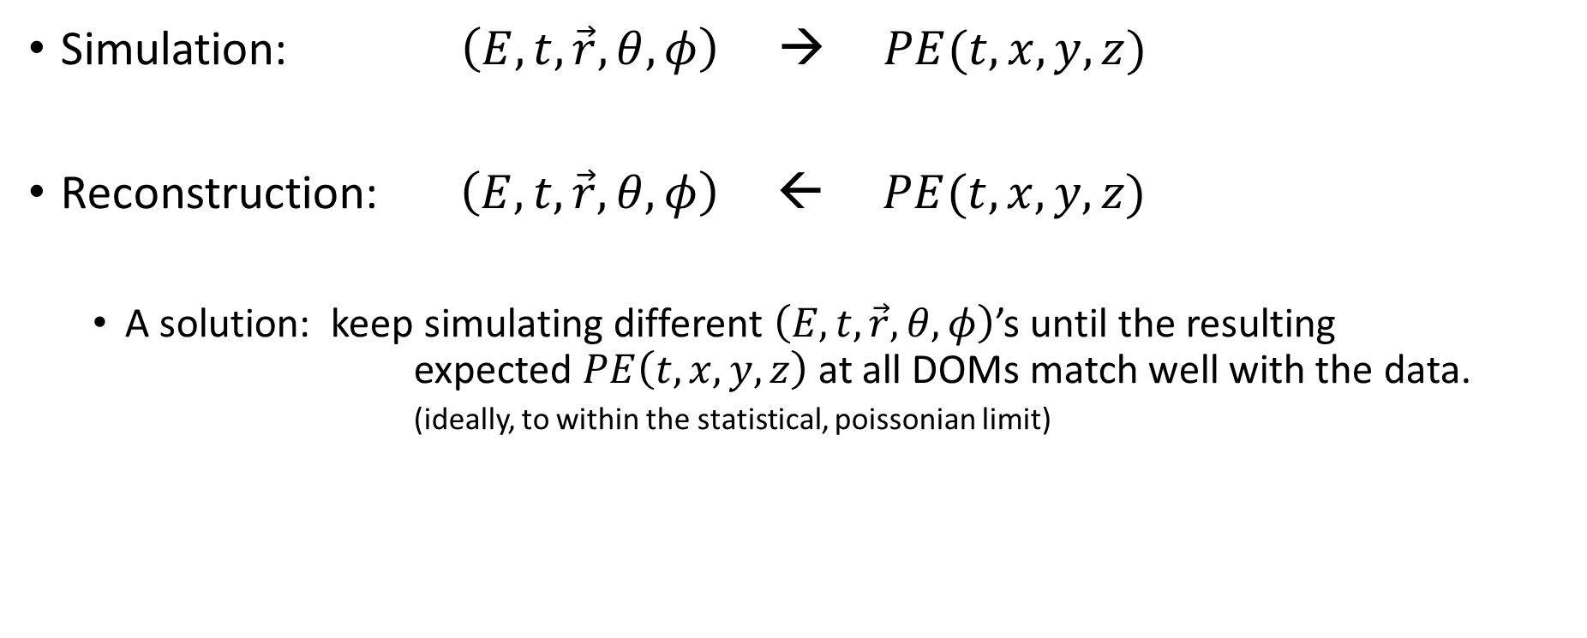
Reconstruction
Simulation: $\left(E, t, \vec{r},θ,φ\right)$ → $PE(t,x,y,z)$
Reconstruction: $\left(E, t, \vec{r},θ,φ\right)$ ← $PE(t,x,y,z)$
  A solution: keep simulating different $\left(E, t, \vec{r},θ,φ\right)$’s until the resulting expected $PE\left(t,x,y,z\right)$ at all DOMs match well with the data.
            (ideally, to within the statistical, poissonian limit)

Slide 16
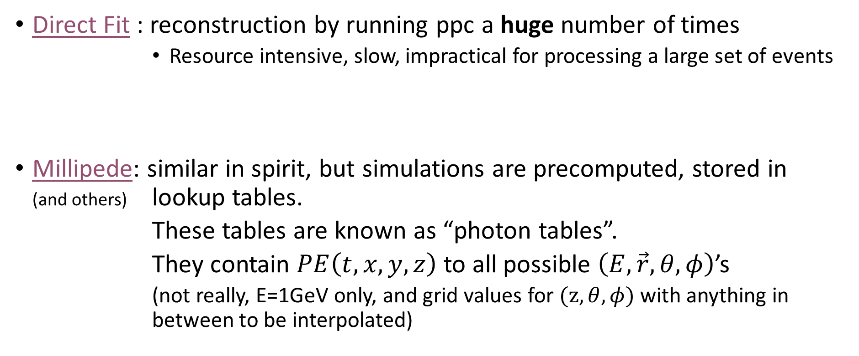
Reconstruction
Direct Fit : reconstruction by running ppc a huge number of times
        Resource intensive, slow, impractical for processing a large set of events
Millipede: similar in spirit, but simulations are precomputed, stored in (and others) lookup tables.
        These tables are known as “photon tables”.
        They contain $PE\left(t,x,y,z\right)$ to all possible $\left(E, \vec{r},θ,φ\right)$’s
        (not really, E=1GeV only, and grid values for $(z, θ,φ)$ with anything in between to be interpolated)

Slide 17
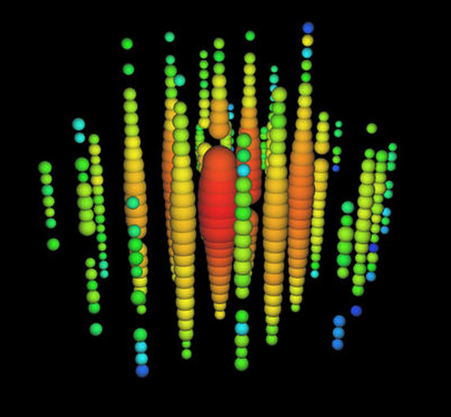
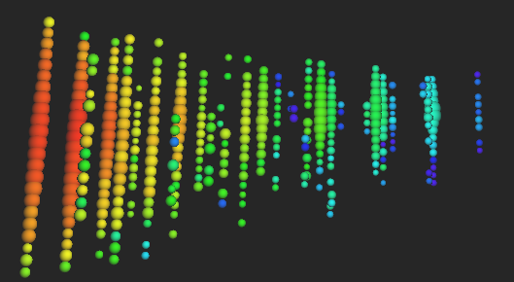
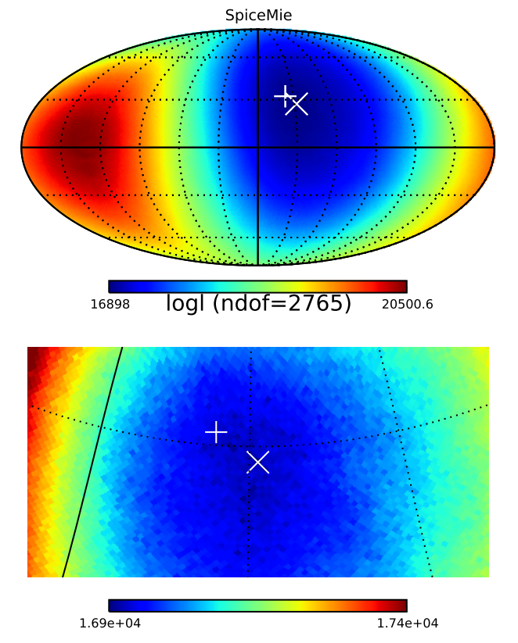
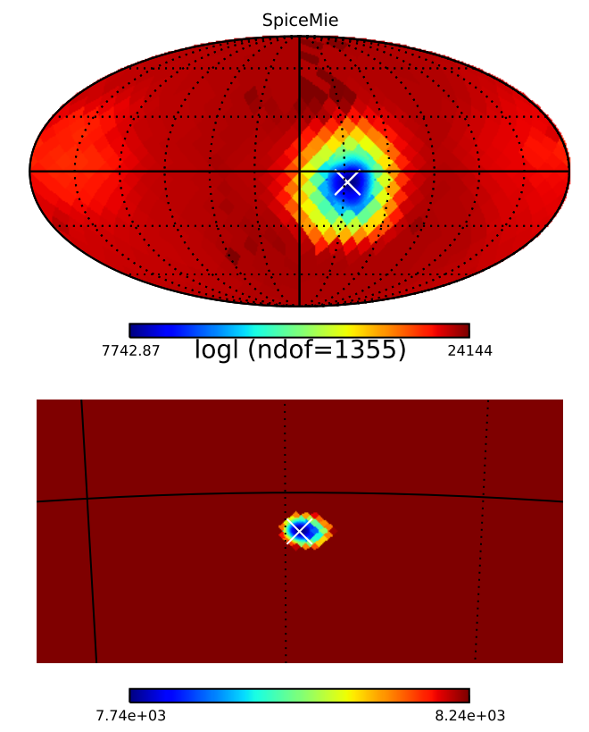
Cascade vs track skymap
Uses splines from tabulated distributions
Zenith
Azimuth
x Full scan
+ Fast reco
Much better resolution with tracks

Slide 18
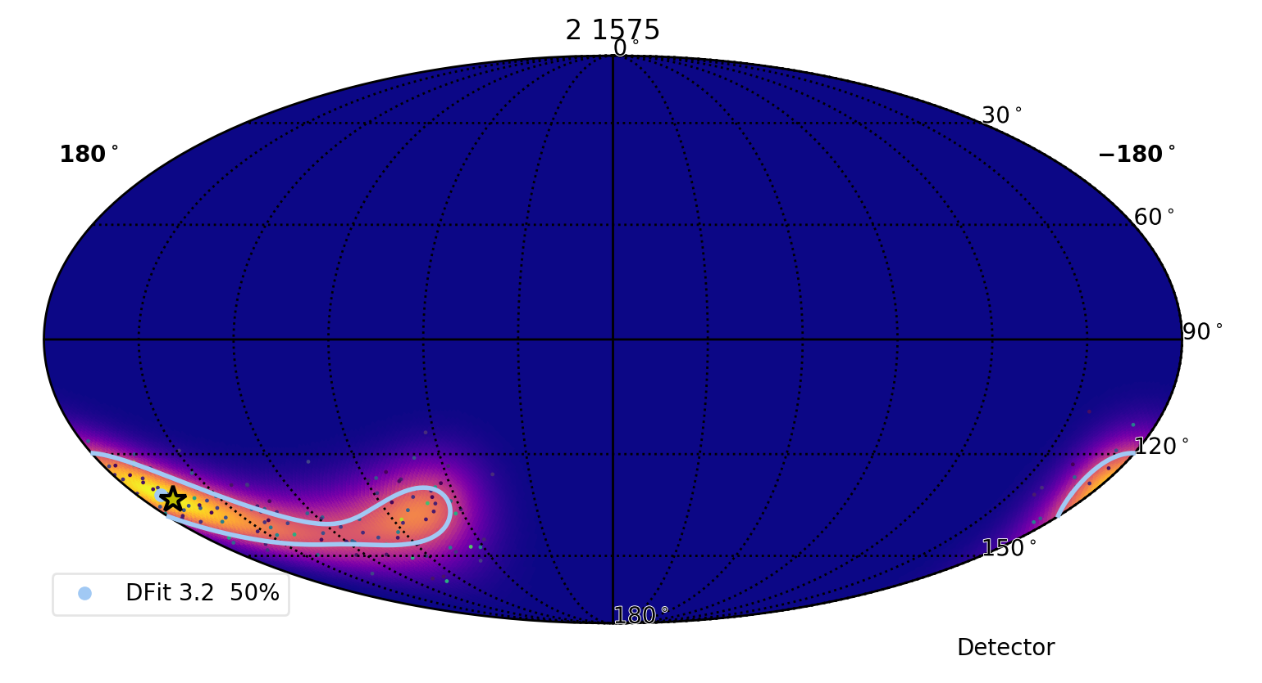
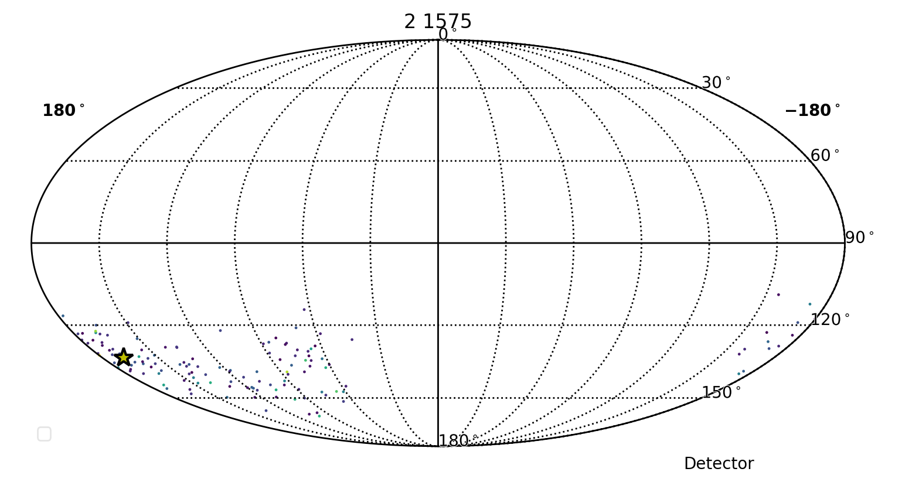
DirectFit with directional PDFs
(simulated event)

Slide 19
IceCube Event Topologies
CC muon neutrino
NC or CC electron neutrino
CC tau neutrino
$$ν_{e}+N→e+X$$
$$ν_{x}+N→ν_{x}+X$$
shower (data)
angular resolution ~ 10°
energy resolution ~ 15%
$$ν_{μ}+N→μ+X$$
track (data)
angular resolution ~ 0.5°
energy resolution ~ x2
$$ν_{τ}+N→τ+X$$
“double-bang” (simulation)
~2 expected in 6 years
Notes:
Expected taus

Slide 20
Ice Model Uncertainties
Our most sophisticated reconstructions rely directly on our simulations, which can vary greatly with the Ice model.
Our ice model is a work in progress, getting better with time.
→ Cascade directional reconstruction limited by our simulation model

Slide 21
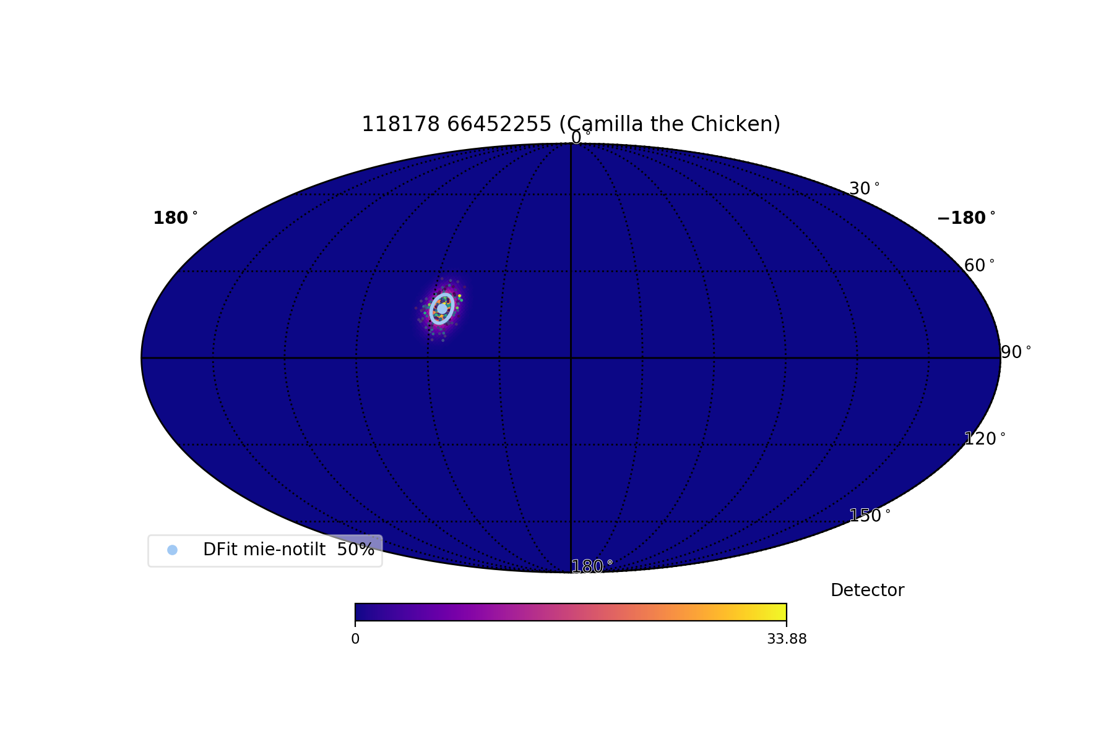
Notes:
Diameter of full moon is 0.5 degrees

Slide 22
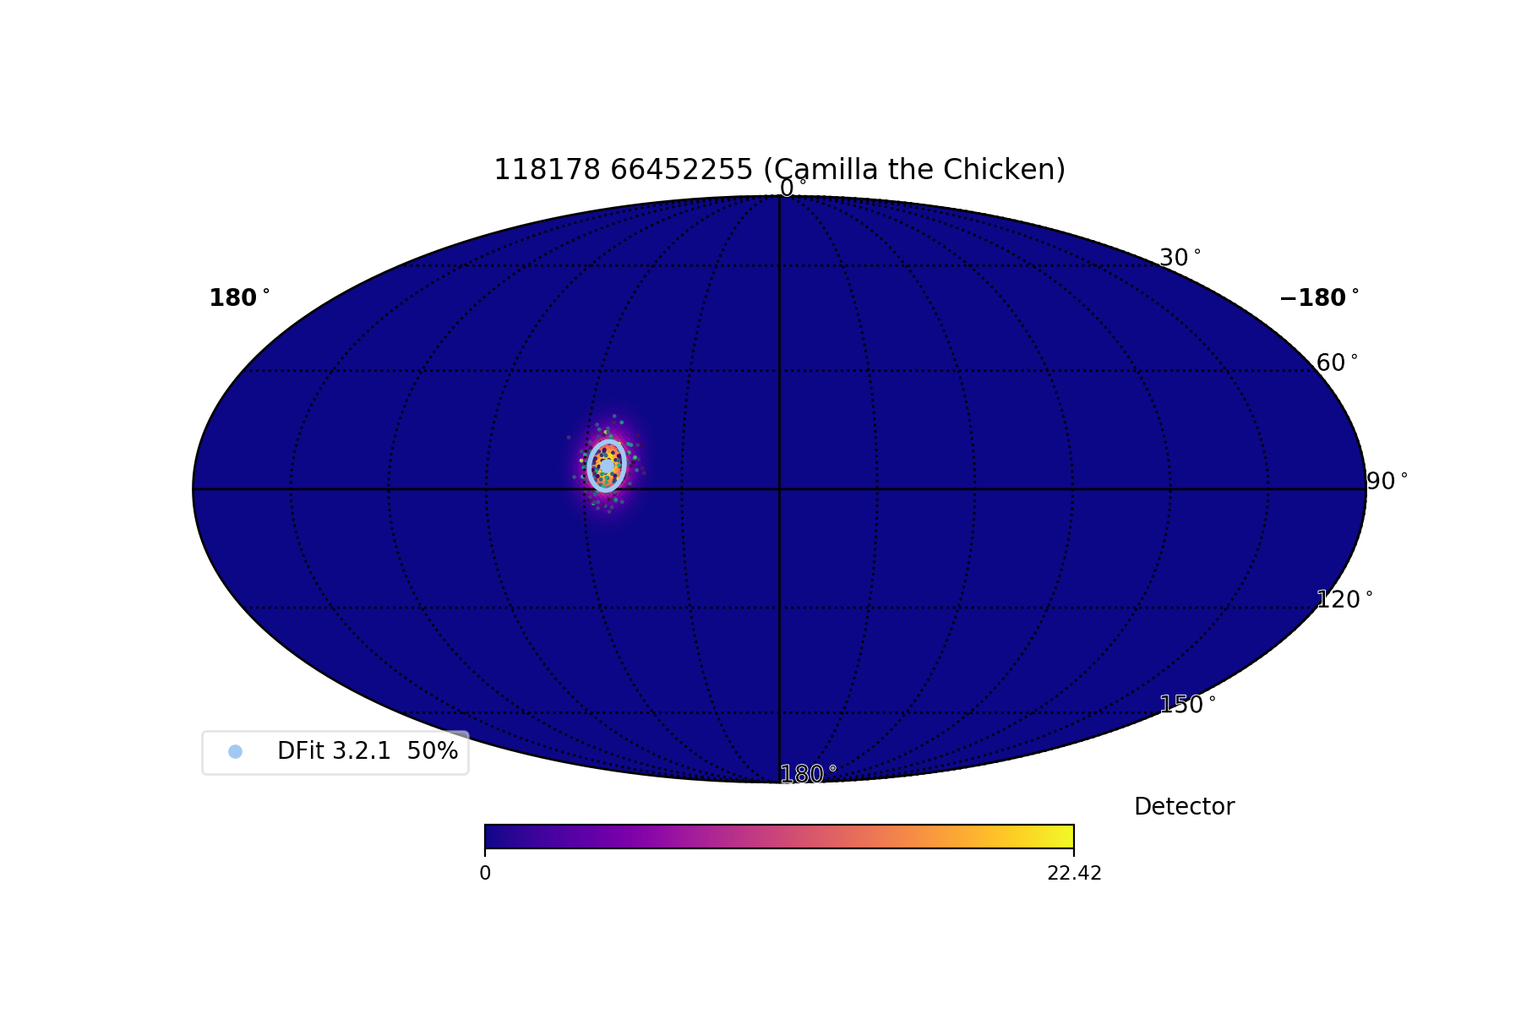
Ice affects cascade reconstruction
Updated ice
Notes:
Diameter of full moon is 0.5 degrees

Slide 23
Local effects
Hole-ice
DOM orientation
Refrozen central column with high scattering
Thick, support cable may impede direct photons if vertex is nearby
A few DOMs may not be perfectly horizontal
Looking up the string
Clear ice
Central region with bubbles

Slide 24
Summary and Future Outlook
IceCube reconstruction is determining event’s energy, direction, topology.
Simple to complicated, depending on how much of the pulse series we want to used.
Full cascade reconstruction is challenging, due to the ice medium.
  It is a miracle that the ice is that clear in the first place.
  Improve the ice model to improve reconstruction
Future (cascade reconstructions): deep neural network
  DNN offers potential direct fit performance, while fast enough to be practical for processing a large data set.

