Slide 1


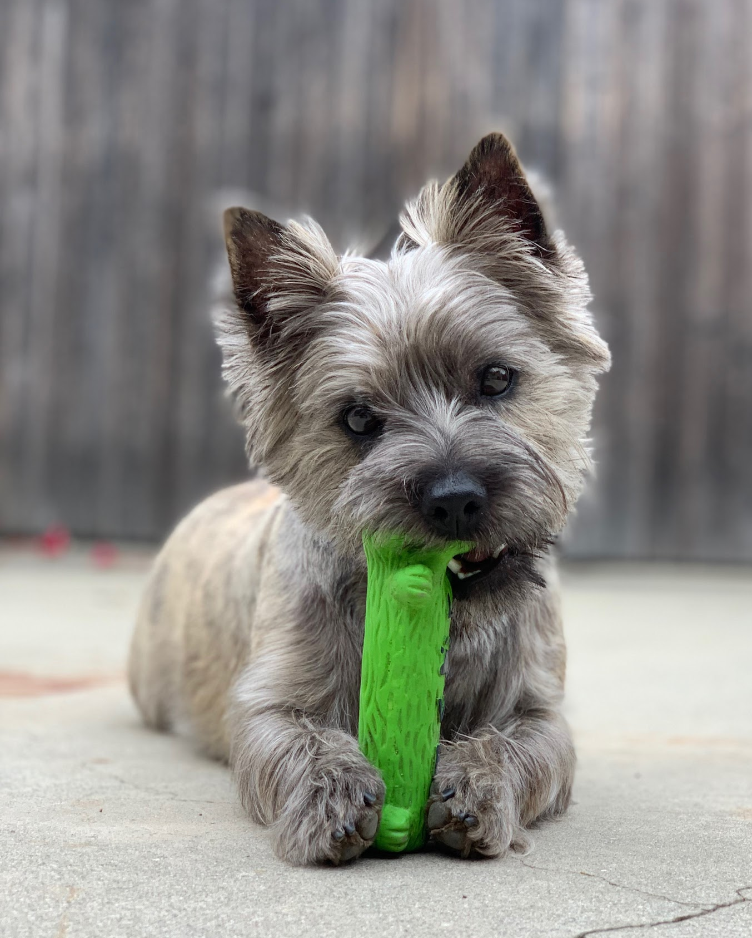
Kendall Alvarez
REU at University of Wisconsin River-Falls
Rio Hondo Community College
Whittier, California

Slide 2

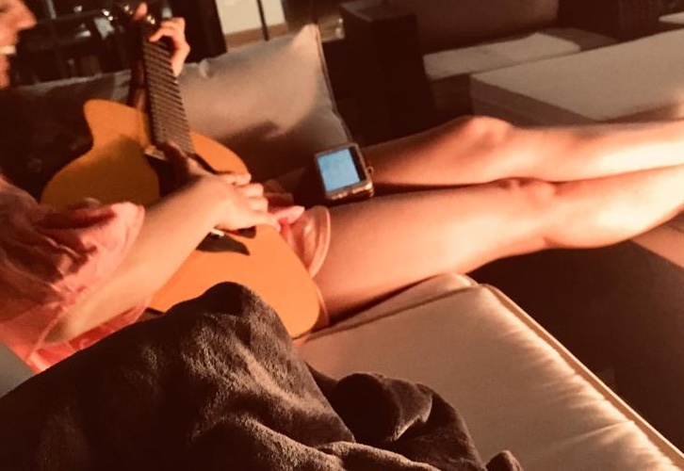

Harsha Jain
REU at University of Wisconsin River Falls
University of Connecticut
Riverside, Connecticut

Slide 3
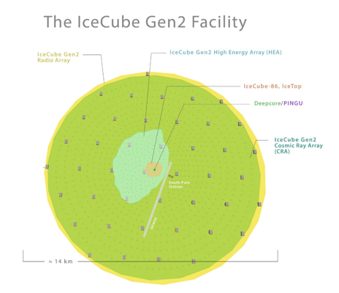
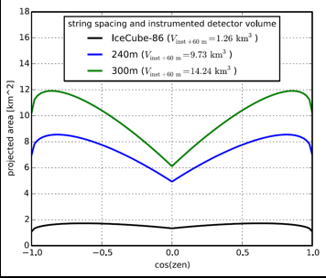
IceCube-Gen2
Notes:
10 cubic km detector (10x volume of icecube)
Spacing between strings is 250m instead of 125in IceCube
Idea is that with greater area (as shown in the graph)
120 strings
80 DOMs on each string
Each string being 1.3km long
Different types of DOMs that could be used for Gen 2: mDOM, D-Egg, POCAM
With such improvements, along with the expansion we are able to better detect high energy astrophysical neutrinos which can then tell us more about what’s happening in our universe. Region above 100TeV is sweet spot for neutrino astrophysics and this detector allows us to detect PeV levels of energy.
Instrumented area as a function of zenith of IceCube
So as the string spacing increases the ability to see astrophysical neutrinos also increases
So the dip that is shown here is due to at the horizon there being far more atmospheric neutrinos so in order to filter these out we have to face this tradeoff of missing out on detecting a lot of astrophysical neutrinos.

Slide 4
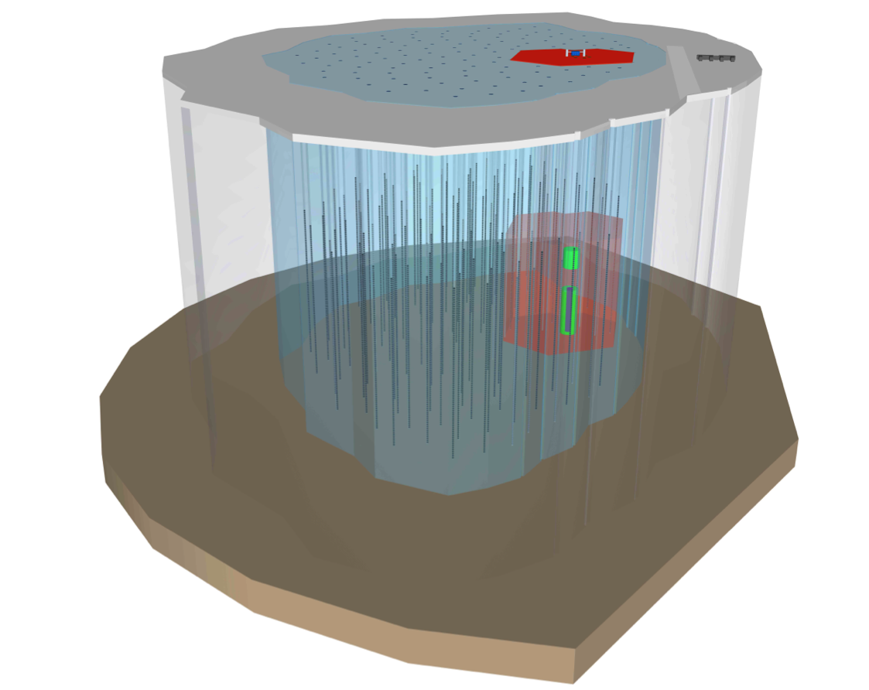
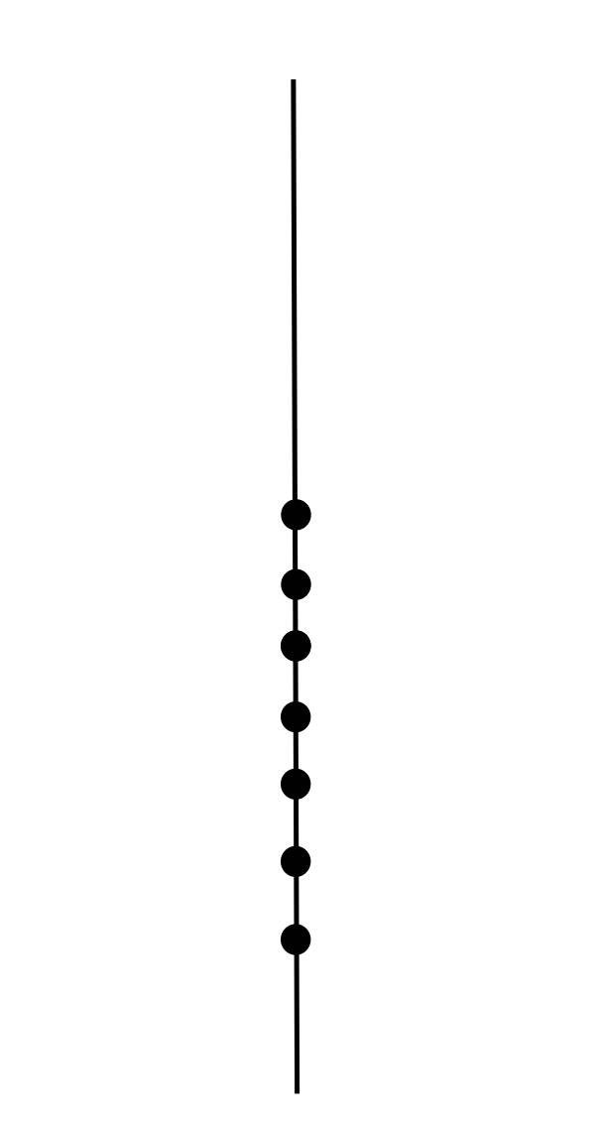
Gen-2 Triggers
A possible IceCube-Gen2 configuration. IceCube, in red, and the infill subdetector DeepCore, in green, show the current configuration. The blue volume shows the full instrumented next-generation detector, with PINGU displayed in grey as a denser infill extension within DeepCore.

Slide 5
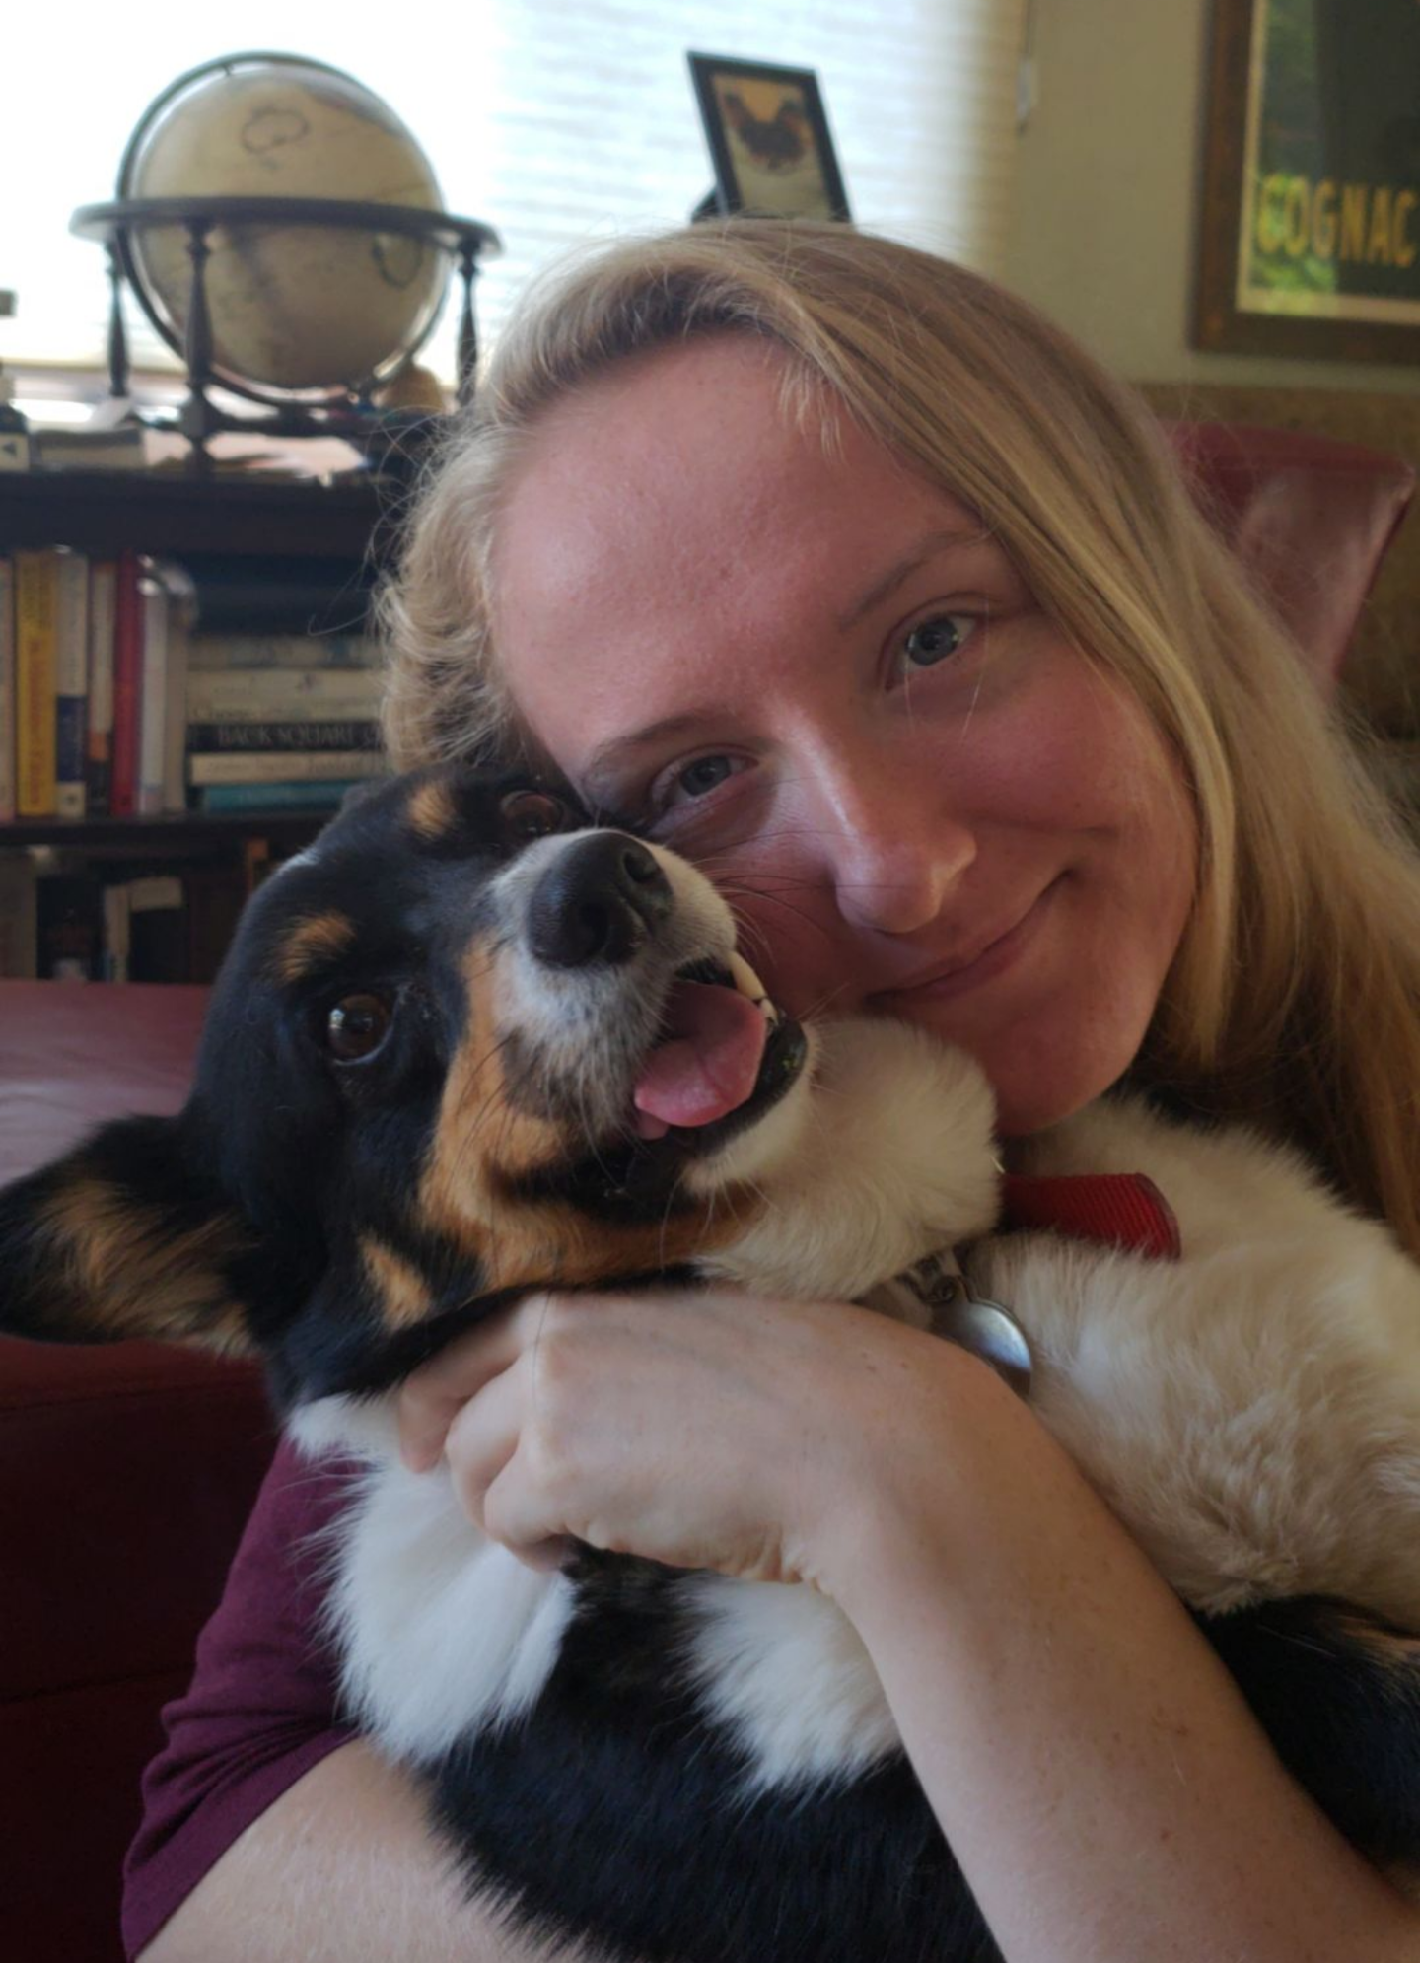
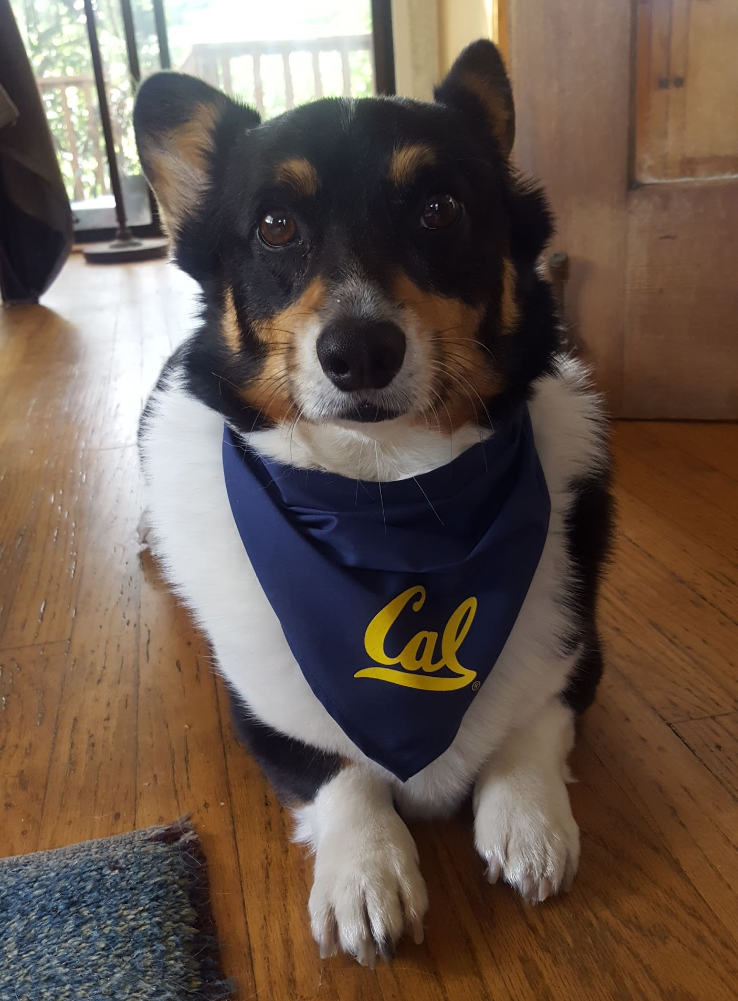
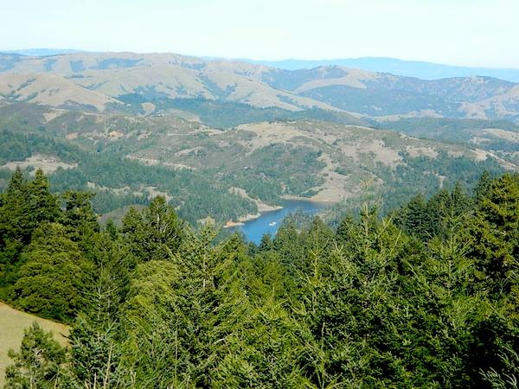
Natalie Jones
REU at University of Wisconsin - River Falls
UC Berkeley
Marin County, CA
Obvious fact: I love my dog (his name is Winston)

Slide 6
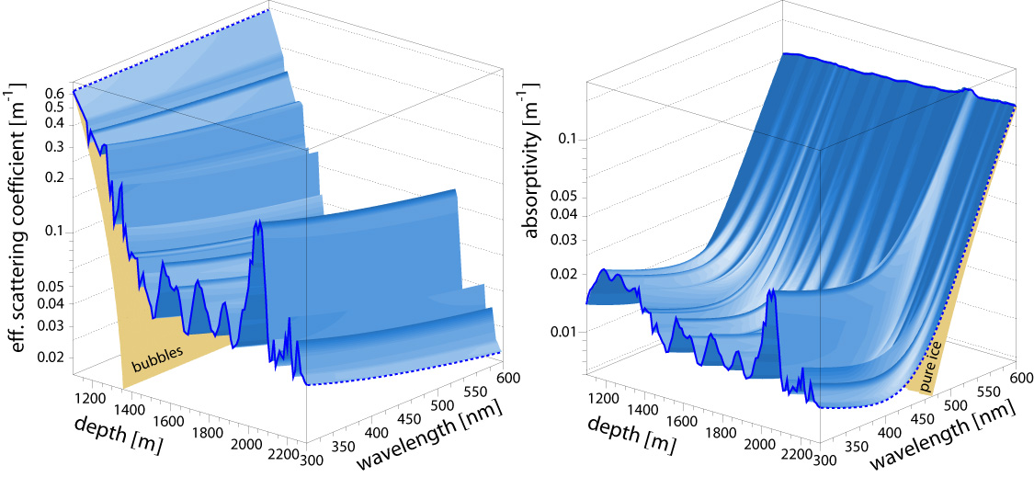
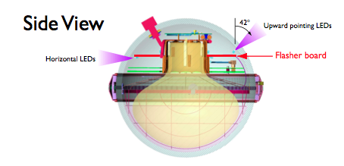
Measuring the Properties of the Ice in Gen 2
LED Flasher Board 🗸
Flashers fixed in place; DOM
orientation unknown.
Standard Candle 🗸 (🕱)
Laser (pencil beam) ⭐
Should be able to move in all directions
inside the DOM regardless of orientation.

Slide 7
Pencil Beam Simulation with CLsim
“An OpenCL-based photon-tracking simulation using a ray tracing algorithm modeling scattering and absorption of light in the deep glacial ice at the South Pole.” - Claudio Kopper
In order to better understand the absorption and scattering properties of the ice, I will use CLsim to simulate - and then test with different ice models - a pencil beam laser with the following parameters:
Azimuth and zenith to control the direction of the photon beam
Photon count (intensity) for calibration
Wavelength (energy) of photons emitted
Angular emission profile, changeable width of the photon beam

Slide 8
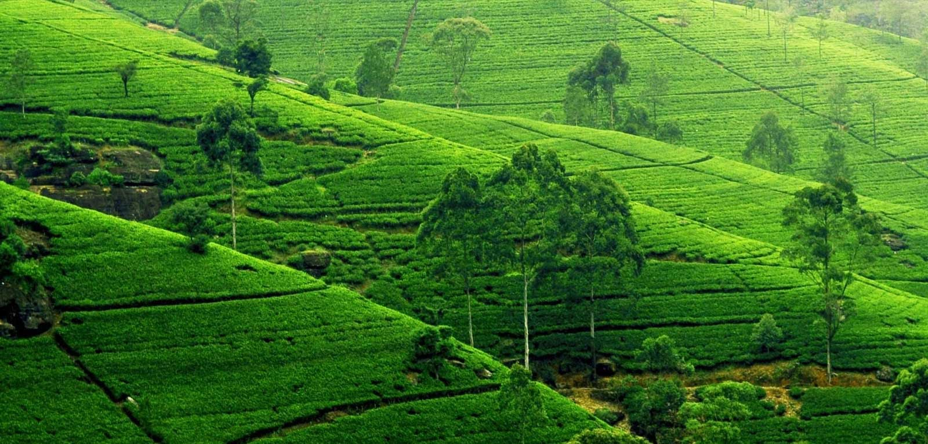
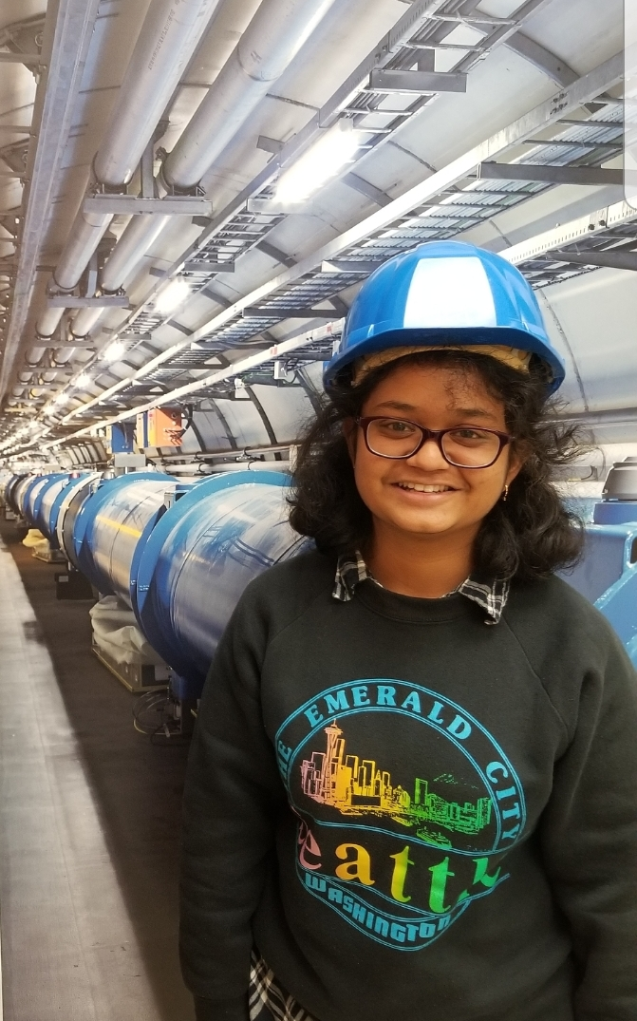
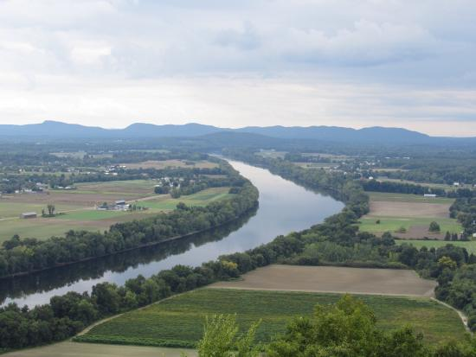



Faizah Siddique
University of Massachusetts,
Amherst
UWRF REU Participant

Slide 9
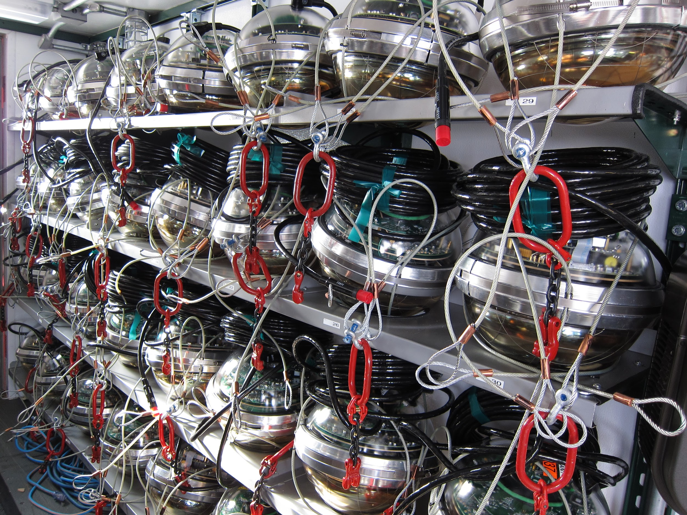
DOM Flasher Linearity
Study relationship between light intensity and DOM energy measurements.
Linearity between the sum of individual LEDs on horizontal plane of DOM compared to total signal observed.
Compare the data between low brightness LED data versus full brightness data.
Previous project analysis courtesy of Katherine UWRF REU 2018.
Image courtesy of https://icecube.wisc.edu/gallery/view/153
Notes:
6 LEDs horizontally, and 6 slanted on angle of 45 deg. Saturated data not good indicator. I will be focusing on low intensity data. REU student in the past focused on high intensity data.

Slide 10
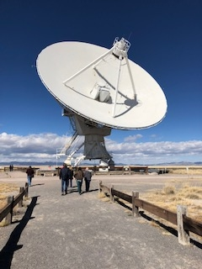

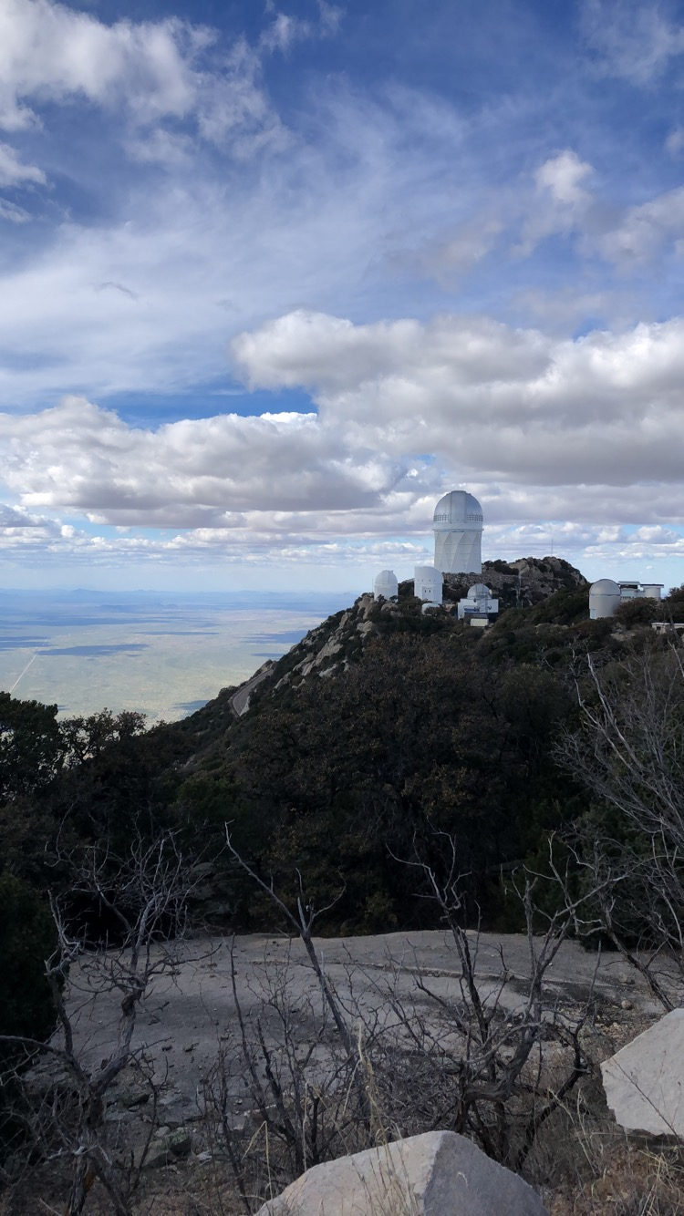
Madison Walder
UWRF REU
University of Arizona
Altamonte Springs, FL
Fun fact about me: I once had 8 cats in my house at the same time

Slide 11
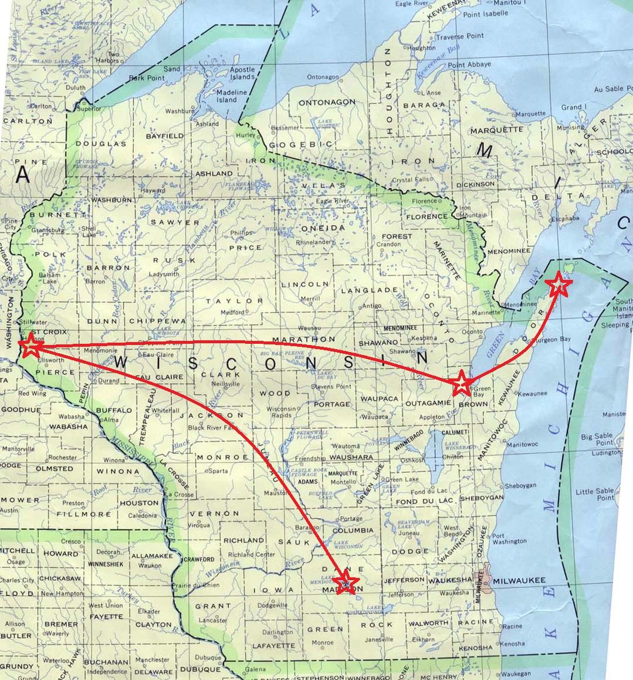
John Sawyer
University of Wisconsin-River Falls REU
Northeast Wisconsin Technical College
Gills Rock, WI
Not fun fact about me: my older sisters once broke my collarbone when I was five years old

Slide 12
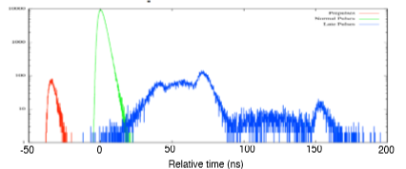
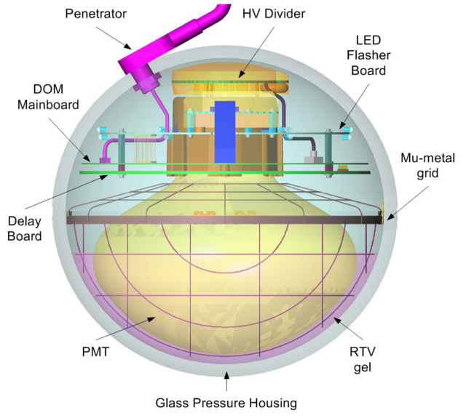
Investigating long delay after pulses
(Credit: Paolo Desiati et al)
Unsure of what causes these pulses
But we do know:
they occur ~100𝜇s after main pulse
Observed in some PMTs, but not others
Plan to build a pico-second pulser to test multiple PMTs

Slide 13
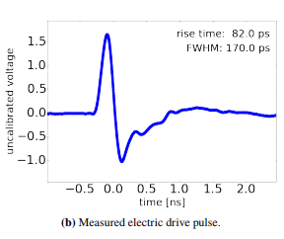
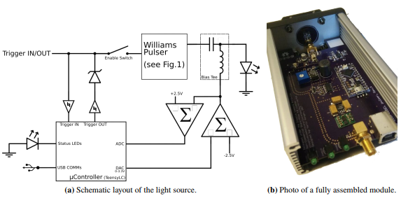
Assembly of a pico-second light pulser
But Why?
Illuminate the cause of the long delay after-pulses by testing various PMTs
Improve the calibration of the PMTs
For science!
Image credits and pulser design: M. Rongen and M. Schaufel 2018 JINST 13 P06002

