Slide 1

Deep Learning Reconstruction for IceCube
Hieu Le
Michigan State University

Slide 2
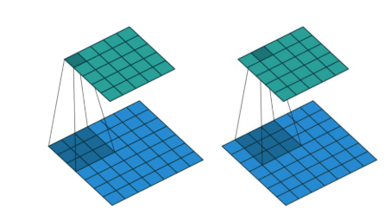
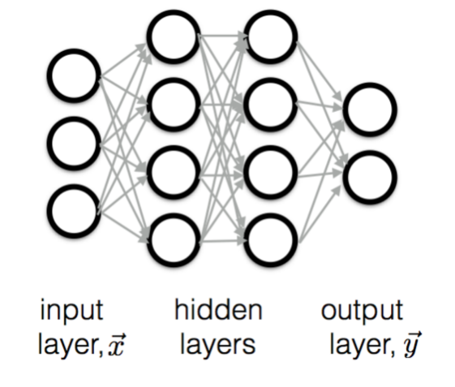
Convolutional Neural Network
Standard DL method for images
Previous applications in neutrino experiments (NOvA, MicroBooNE)
Convolving over images, recording simpler to more complex characteristics
Hyperparameters within hidden layers: type/number of layers

Slide 3
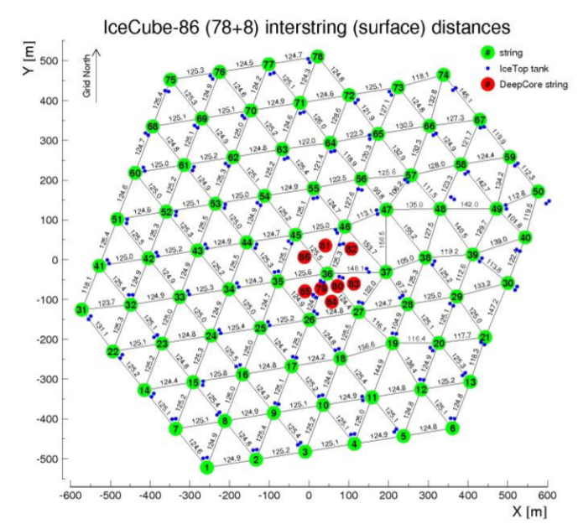
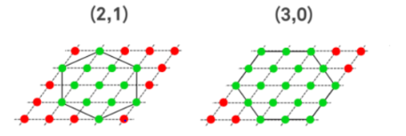
Limitations
Built to work on rectangular dataset
Shift invariance assumption
Does not account for other physical invariants, symmetries and simulation process

Slide 4
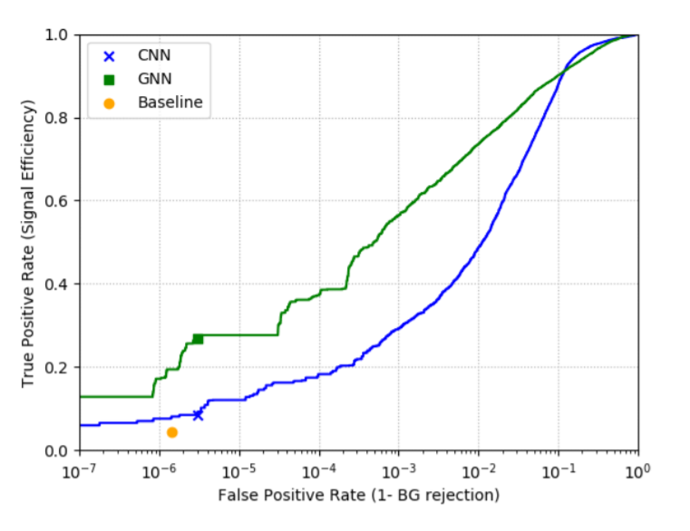
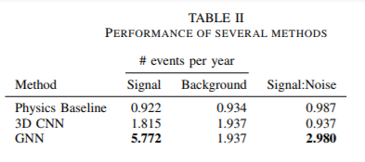
Graph Neural Network
GNN solves irregular geometry problem by treating distances as edges in a graph
Also works for DeepCore, and eventually IceCube-Gen2
Significant improvement compared to CNNs and conventional reconstruction methods (Millipede, Monopod, etc.)
Next step: combine with maximum likelihood methods

